Slide 1
Web Frameworks Comparison
Flask - Nimble
Bottle - Simple
Pyramid - Flexible
Django - Powerful

Slide 2
Response Times, Throughput and Technical Benchmarks
ms and req/s | Flask | Bottle | Pyramid | Django
Encode an object to JSON and return as response | 29.38 6831 | 13.39 18193 | 46.89 9178 | 46.61 4330
Load a response from remote server and return as response | 3713.45 13.25 | 3382.84 15.85 | 3443.16 14.1 | 3352.47 14.3
Load data from database with ORM and render to template | 865.54 259.45 | 725.3 316.8 | 880.64 265.3 | 2294.97 67.9

Slide 3
Features
 | Flask | Bottle | Pyramid | Django
Development Philosophy | Non Full Stack | Micro framework | Partially Full Stack | Full Stack
Community Support(Rank) | 2(Excessive documentation) | 2 | 2 | 1
Code Complexity(Rank) | 2 | 1 | 3 | 4
ORM | SQLAlchemy (via plugins) | SQLAlchemy (via plugins) | ORM-agnostic | Yes
MVC | No | No | Yes | Yes
Testing Framework | Via unittest | No | Yes | Yes
Security Framework | Yes | No | Yes | Yes
Template Framework | Pluggable | Builtin | Pluggable | Builtin
Ease of Use(Rank) | 3 | 4 | 2 | 1

Slide 4
Django

Slide 5
Characteristics
DRY (Don't Repeat Yourself)
MTV (Model Template View)
CBV (Class Based Views)
Batteries included

Slide 6
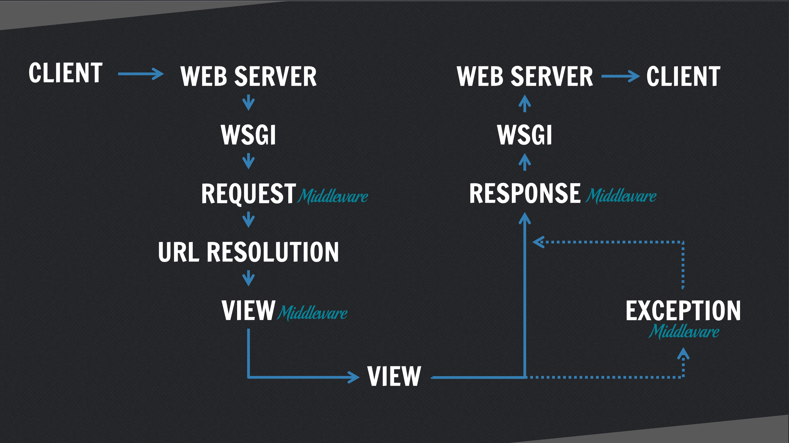
Request Response Cycle

Slide 7
Project Structure
mysite/
manage.py
mysite/
__init__.py
settings.py
urls.py
wsgi.py
polls/
__init__.py
admin.py
migrations/
__init__.py
0001_initial.py
models.py
static/
polls/
images/
background.gif
style.css
templates/
polls/
detail.html
index.html
results.html
tests.py
urls.py
views.py
templates/
admin/
base_site.html

Slide 8
Drawbacks
Django can feel bloated for small projects
Request routing uses regular expressions

Slide 9
REST Frameworks
 | Django-tastypie | Django-rest-framework
Coding style | Pure python | Django style CBVs
API browser | No | Yes
Documentation | Decent | Good
Community | Strong | Strong

