Slide 1
Java

Slide 2
MultiThreading
http://www.javatpoint.com/multithreading-in-java

Slide 3
Mutitasking
Process based (Multiprocessing)
  Heavyweight
  Costly communication between processes
  Own address space (memory)
  Slower Context switch
Thread based (Multithreading)
  Lighweight
  Communication cost less
  Shared address space
  Faster context switch
  Independent
  Own call stack
Note : At a time only one thread executes

Slide 4
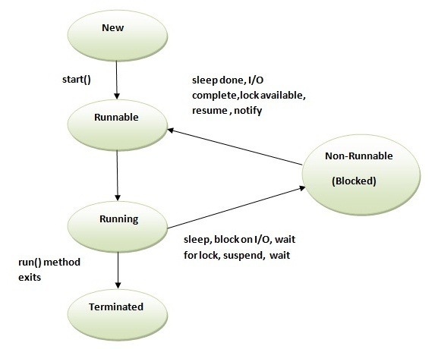
Thread Lifecycle

Slide 5
Setting a thread as daemon means making it background thread
Thread Scheduler part of JVM
  Uses preemptive (high priority always) and time slicing
Cannot start a thread again -> IllegalThreadStateExecution Exception
Invoking the run() method from main thread, the run() method goes onto the current call stack rather than at the beginning of a new call stack.
Thread.yield() method on a thread causes the currently executing thread object to temporarily pause and allow other threads to execute.
  A yielding thread tells the virtual machine that it’s willing to let other threads be scheduled in its place.
  It’s only a hint, though, and not guaranteed to have any effect at all
IsAlive() method on thread tests if the thread is alive.
If join() is called on a Thread instance, the currently running thread will block until the Thread instance has finished executing.

Slide 6
objectname.wait() v/s Thread.sleep()
Call on:
  wait(): Call on an object; current thread must synchronize on the lock object.
  sleep(): Call on a Thread; always currently executing thread.
Synchronized:
  wait(): when synchronized multiple threads access same Object one by one.
  sleep(): when synchronized multiple threads wait for sleep over of sleeping thread.
Hold lock:
  wait(): release the lock for other objects to have chance to execute.
  sleep(): keep lock for at least t times if timeout specified or somebody interrupt.
Wake-up condition:
  wait(): until call notify(), notifyAll() from object
  sleep(): until at least time expire or call interrupt().
Usage:
  sleep(): for time-synchronization and;
  wait(): for multi-thread-synchronization.

Slide 7
Daemon Thread (background thread) :
  Its sole role is to provide service to user threads
  All user threads die => JVM terminates daemon automatically
  Low priority thread
  If you want to make a user thread as Daemon, it must not be started otherwise it will throw IllegalThreadStateException.
  Difference between Daemon thread and user thread -> JVM does not wait for Daemon thread before exiting while it does not exit until unless all the user threads finish their execution.

Slide 8
Thread Pool :
  Group of fixed size threads are created
  A thread from the thread pool is pulled out and assigned a job by the service provider
  After completion of the job, thread is contained in the thread pool again.
  Adv : saves time of creating thread everytime
  Uses : By servlets and JSPs to process a request
Thread Group :
  To group multiple threads together to interrupt, suspend or resume them all together

Slide 9
The JVM shuts down when:
  user presses ctrl+c on the command prompt
  System.exit(int) method is invoked
  user logoff
  user shutdown etc.

Slide 10
Multitasking in Multithreading :
  Single task Multiple threads -> 1 run method, many threads
  Multiple tasks Multiple threads -> many run method, many threads
Factory Method -> The method that returns the instance of a class.
  eg., Runtime r = Runtime.getRuntime();

Slide 11
Garbage Collection :
  Memory efficient
  Automatically done by JVM's garbage collector
  Removes unreferenced objects which are formed by
    By nulling the reference
    By assigning a reference to another
    By annonymous object etc.
  Object class' finalize() method called before garbage collection of the object.
  System class' gc() method called to invoke garbage collector
  Garbage collects only objects created by new
  Daemon thread GC calls finalize
  Neither finalization nor garbage collection is guaranteed.

Slide 12
Runtime class :
  To interact with java runtime environment
  Singleton class : Only one instance per java application

Slide 13
Synchronization
http://www.javatpoint.com/synchronization-in-java

Slide 14
Uses :
  To prevent thread interference.
  To prevent consistency problem.
Types :
  Process Synchronization
  Thread Synchronization
    Mutual Exclusive
      Synchronized method.
      Synchronized block.
      Static synchronization.
    Cooperation (Inter-thread communication in java)
Locks
  Every object has an lock associated with it.
  A thread that needs consistent access to an object's fields has to acquire the object's lock before accessing them, and then release the lock when it's done with them.
  java.util.concurrent.locks

Slide 15
Synchronized method :
  When a thread invokes a synchronized method, it automatically acquires the lock for that object and releases it when the thread completes its task.
  eg., synchronized void printTable(int n)
Synchronized block :
  ynchronized block can be used to perform synchronization on any specific resource of the method
  eg., synchronized(this /*object reference*/){//synchronized block}
Static Synchronization :
  If you make any static method as synchronized, the lock will be on the class not on object.
  eg., synchronized static void printTable(int n){ }
  OR
  static void printTable(int n) {
  synchronized (Table.class) { // Synchronized block on class A
  // ...
  }
  }

Slide 16
Race Condition -> More formally, the situation where two threads compete for the same resource, where the sequence in which the resource is accessed is significant, is called race conditions. A code section that leads to race conditions is called a critical section.

Slide 17
Deadlock :
  Deadlock can occur in a situation when a thread is waiting for an object lock, that is acquired by another thread and second thread is waiting for an object lock that is acquired by first thread.
  Since, both threads are waiting for each other to release the lock, the condition is called deadlock.
  For example, Alphonse and Gaston are friends, and great believers in courtesy. A strict rule of courtesy is that when you bow to a friend, you must remain bowed until your friend has a chance to return the bow. Unfortunately, this rule does not account for the possibility that two friends might bow to each other at the same time. ... here there are two separate methods bow() and bowBack()

Slide 18
Starvation :
  Starvation describes a situation where a thread is unable to gain regular access to shared resources and is unable to make progress.
  This happens when shared resources are made unavailable for long periods by "greedy" threads.
  For example, suppose an object provides a synchronized method that often takes a long time to return. If one thread invokes this method frequently, other threads that also need frequent synchronized access to the same object will often be blocked.
Livelock :
  A thread often acts in response to the action of another thread. If the other thread's action is also a response to the action of another thread, then livelock may result.
  As with deadlock, livelocked threads are unable to make further progress. However, the threads are not blocked — they are simply too busy responding to each other to resume work.
  This is comparable to two people attempting to pass each other in a corridor: Alphonse moves to his left to let Gaston pass, while Gaston moves to his right to let Alphonse pass. Seeing that they are still blocking each other, Alphone moves to his right, while Gaston moves to his left. They're still blocking each other, so...

Slide 19
InterThread Communication :
  Inter-thread communication or Co-operation is all about allowing synchronized threads to communicate with each other.
  Cooperation (Inter-thread communication) is a mechanism in which a thread is paused running in its critical section and another thread is allowed to enter (or lock) in the same critical section to be executed.
  Methods of Object class :
    Wait() -> or wait(timeout) ... The current thread must own this object's monitor, so it must be called from the synchronized method only otherwise it will throw exception.
    Notify() -> Wakes up a single thread that is waiting on this object's monitor.
    NotifyAll() -> Wakes up all threads that are waiting on this object's monitor.

Slide 20
Interrupting thread :
  Thread is in sleeping or waiting state (i.e. sleep() or wait() is invoked) -> calling the interrupt() method on the thread -> breaks out the sleeping or waiting state throwing InterruptedException.
  Thread is not in the sleeping or waiting state -> calling the interrupt() method -> performs normal behaviour and doesn't interrupt the thread but sets the interrupt flag to true.
  Methods
    public void interrupt() -> to interrupt a thread
      eg., t1.interrupt();
    public static boolean interrupted() -> This static method returns the interrupted flag afterthat it sets the flag to false if it is true.
      eg., Thread.interrupted();
    public boolean isInterrupted() -> Returns the interrupted flag either true or false.
      eg., t1.isInterrupted();

Slide 21
Reentrant Monitor in java
  http://journals.ecs.soton.ac.uk/java/tutorial/java/threads/reentrant.html
  JRE allows a thread to re-acquire a monitor that it already holds because Java monitors are reentrant.
  To eliminate the possibility of a single thread deadlocking itself on a monitor that it already holds.
  Java thread can reuse the same monitor for different synchronized methods if method is called from the method.

Slide 22
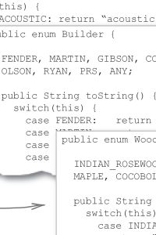
enum

Slide 23
Collection Framework
http://www.javatpoint.com/collections-in-java

Slide 24
Collection -> Collection represents a single unit of objects i.e. a group.
Framework
  provides readymade architecture.
  represents set of classes and interface.
  is optional
Collection Framework -> Collection framework represents a unified architecture for storing and manipulating group of objects. It has:
  Interfaces and its implementations i.e. classes
  Algorithm

Slide 25
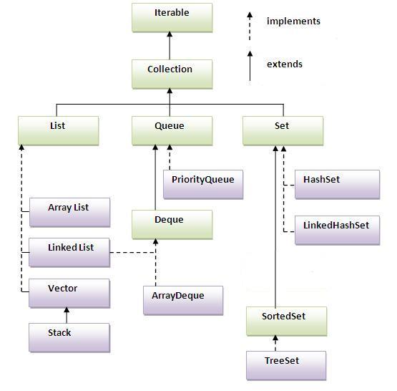
Hierarchy

Slide 26
Methods of collection interface
Add(Object), addAll(collection)
Remove(Object), removeAll(collection)
retainAll(collection)
Int size()
Clear()
contains(Object), containsAll(collection)
Iterator iterator()
Object[] toArray()
IsEmpty()
equals(Object)
Int hashCode()

Slide 27
When we override equals() method, we sholud usually also override hashCode() to ensure correct comparisons as according to Java specification, if two objects are equal they should have same hash code.

Slide 28
Iterator Interface
Provides the facility of iterating the elements in forward direction only.
Boolean hasNext()
Object next() -> returns then inc pointer
Remove() -> removes last elements returned by iterator

Slide 29
Non Generic v/s Generic Collection
  Non Generic -> allows any data type in single collection ... before JDK 1.5
  Generic -> allows only single data type in single collection ... using <>
Ways to iterate the elements of collection :
  By iterator interface
    Iterator itr = al.iterator();
    while(itr.hasNext()) {}
  By for-each loop
    for(String obj : al) {}
System.out.println("arraylist: "+al); prints
  arraylist: [Ravi,Vijay,Ravi,Ajay]

Slide 30
ArrayList
  Dynamic Array
  Implements List interface
  Extends AbstractList class
  Duplicate elements allowed
  Maintains insertion order
  Non synchronized
  Random access on index
  Manipulation slow as shifting
  Better for storage and accessing
LinkedList
  Doubly Linked List
  Used to implement list, queue, stack
  Implements List, Deque
  Extends AbstractList
  Duplicate elements allowed
  Maintains insertion order
  Non synchronized
  Manipulation is fast
  Better for manipulation

Slide 31
List Interface (subinterface of Collection)
Index starts from 0
add(int index,Object element); -> adds at index and shifts elements accordingly
boolean addAll(int index,Collection c);
object get(int index);
object set(int index,Object element); -> updates
object remove(int index);
ListIterator listIterator();
ListIterator listIterator(int i);
For example, if your list is [1,2,3,4,5]
  list.add(3, 10) will give [1,2,3,10,4,5,]
  list.set(3, 10) will give [1,2,3,10,5]

Slide 32
ListIterator
boolean hasNext();
Object next();
boolean hasPrevious();
Object previous();

Slide 33
List v/s Set
List -> duplicate allowed
Set -> only unique elements

Slide 34
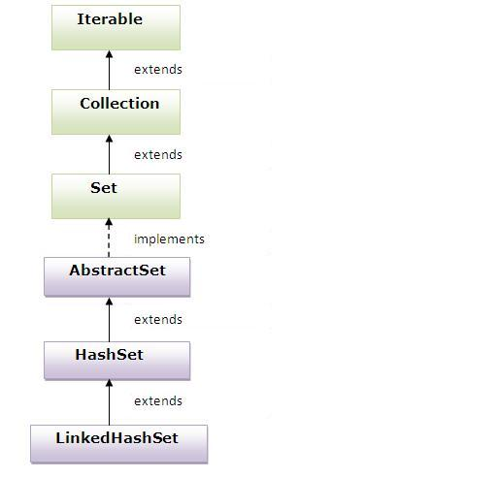
HashSet
  Uses hashtable to store elements
  Implements Set interface
  Extends AbstractSet class
  Unique elements
  No order
LinkedHashSet
  Implements Set
  Extends HashSet
  Unique elements
  Maintains insertion order

Slide 35
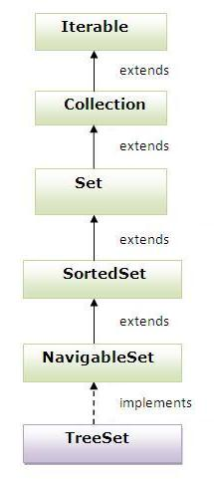
TreeSet
  Implements NavigableSet interface
  Extends SortedSet interface
  Unique elements
  Maintains ascending order

Slide 36
Queue Interface

Slide 37
Collections
Concurrent package -> blockingqueue, concurrenthashmap, copyonwrite

Slide 38
Unique Points
String is immutable and final in java.
Operator overloading is not supported.
Multiple inheritance is not allowed.
No pointers
No pass by reference
To access variables in anonymous class from the enclosing class, those variables must be final.

