Slide 1
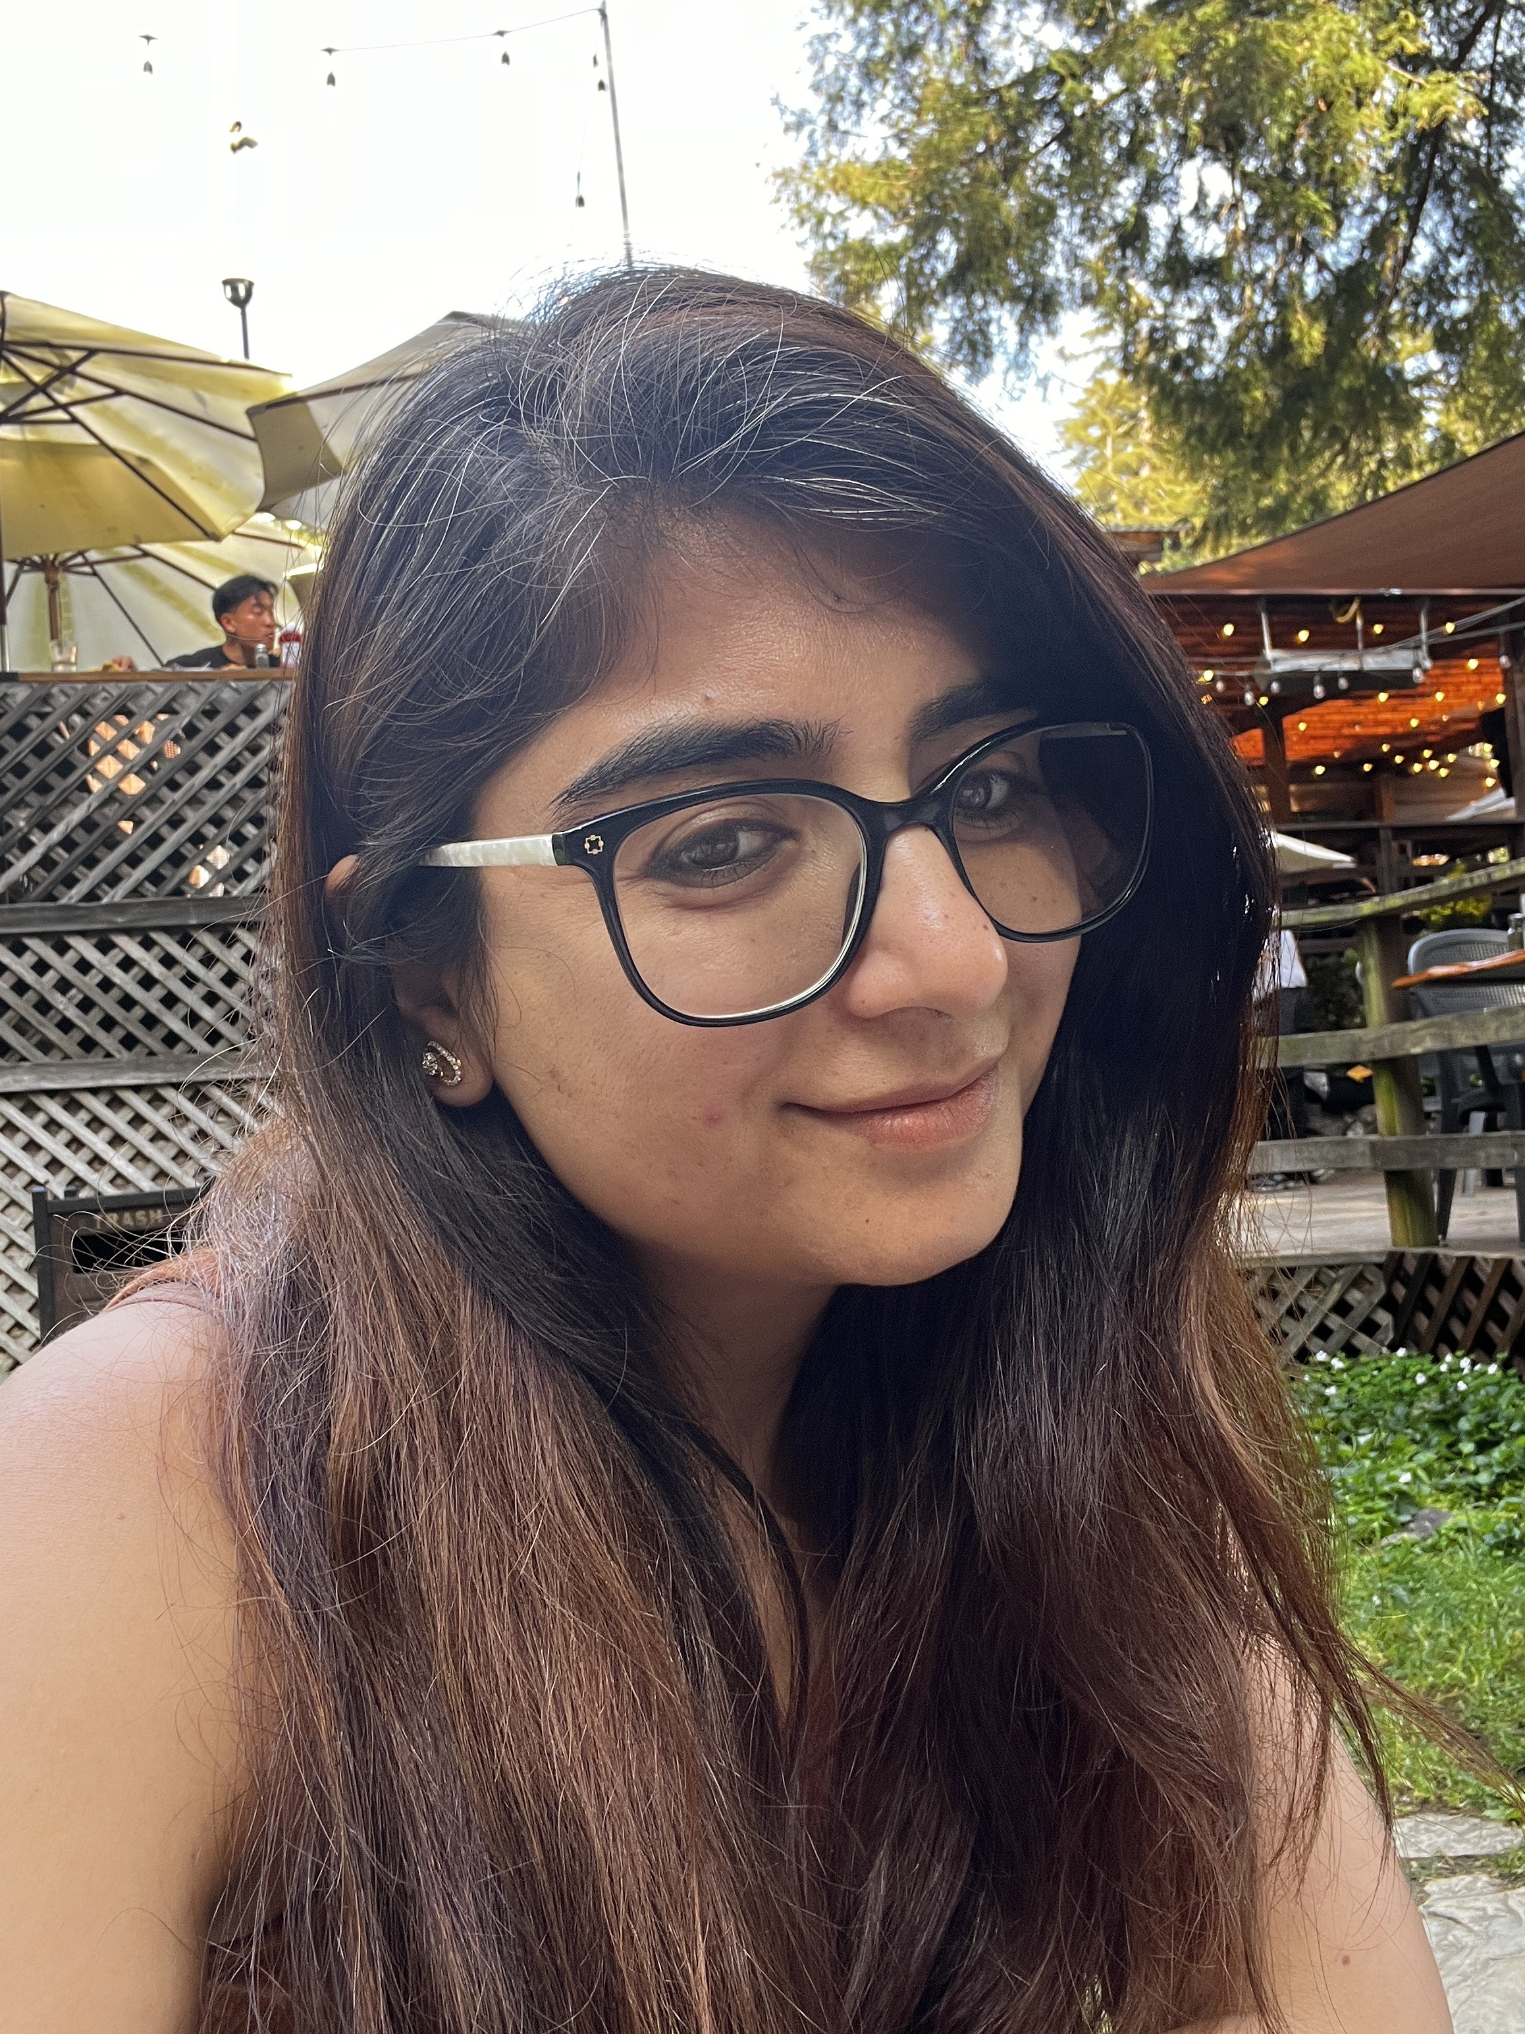

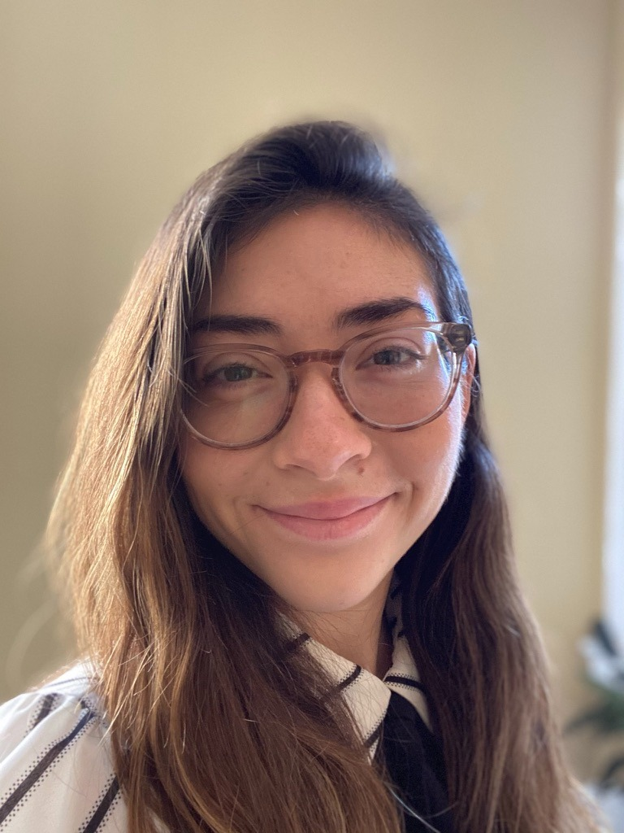

DELTA ANALYTICS FELLOWSHIP · 2026
Shikha Pamnani, Business Intelligence Lead, County of Santa Clara & Project Owner- Delta Fellowship
Emily Ward Economic Researcher, Economic Partners, Data Fellow
Rajesh Vayyala Principal Data Architect, PRA Group Inc.,Data Fellow
Husandeep Toor Financial Analyst, UC Davis Health, Data Fellow
Notes:
Welcome. I'm Shikha Pamnani, BI Strategy Lead for the Tazama Rule Trigger Discovery project — my final delivery for the Delta Analytics Fellowship.

Slide 2
DELTA ANALYTICS FELLOWSHIP · 2026
01
Tazama Alert Navigator &
Rule Trigger Discovery
Allowing investigators to decode the fraud alerts with ease reducing investigation time by eliminating manual transaction history search
Gates Foundation · Linux Foundation Project
Notes:
Welcome. I'm Shikha Pamnani, BI Strategy Lead for the Tazama Rule Trigger Discovery project — my final delivery for the Delta Analytics Fellowship.

Slide 3
What is TAZAMA Project?
02
It is a free, open-source real-time fraud detection platform fixing a critical TRUST gap in Digital Finance in Emerging Markets.
"Detect fraud before it happens — in real time. Designed to promote financial inclusion in emerging markets such as Africa and Asia where fraud runs rampant due to the lack of safe digital tools with primary focus to protect vulnerable victims from fraud such as women”
Real-Time Detection
Emerging Markets Focus
Evaluates every transaction real-time across 33 rules and 31 typologies -- flags fraud instantly
Deployed by dozen financial service providers in Beta program across South African markets and global ecosystems
Customizable and Integration-ready
Investigation Ready
Defines alerts based on institution’s needs
Seamlessly integrates with existing banking & payment systems
End-to-end case management and analytics on JupyterLab for investigations and reporting
Managed by Linux Foundation · Funded by Bill & Melinda Gates Foundation · Partners: Paysys Labs, Mojaloop, Sybrin and 10+ ecosystem partners
Notes:
Tazama is the first free open-source real-time transaction monitoring platform — built specifically for emerging markets where fraud runs rampant and expensive enterprise tools are inaccessible. Managed by the Linux Foundation, funded by the Bill and Melinda Gates Foundation, and already deployed across South African markets.

Slide 4
THE PROBLEM
Fraud Investigators were effectively left blind
03
Tazama evaluates transactions across 33 rules and 31 typologies but investigators receive only a binary "ALRT" signal. No context. No explanation. No data.
No Explainability
Slow Triage
No Transaction Context
Which of the typologies and rules got fired?
What was the typology score?
What band did the Independent variable fall into?
Every investigation starts from an ALRT but with no metadata context to guide the investigator
No transaction history/metadata behind each rule which means investigators cannot
validate or challenge the alert
KEY INSIGHT Without explainability and metadata, even powerful fraud detection loses its investigative value
Notes:
The gap was clear — Tazama is a world-class detection engine but investigators had no window into why an alert fired. Which rules? What data? Which band? None of that was visible.

Slide 5
THE SOLUTION
04
Alert Navigator + Rule Trigger Discovery
Allows investigators to immediately identify the specific behavior attributes and constituent transactions or metadata that triggered each rule, eliminating the need to manually search through a participant's entire transaction history.
01
02
03
Alert Navigator
Evaluation Explorer
Rule Trigger Discovery
Searchable dropdown across all tenants. Filter by ALRT or NALT, tenant, amount and timestamp. Select any alert to begin investigation.
Shows all 31 typologies evaluated for the alert, scores vs thresholds, and which ones breached - read from the evaluation result.
Replays rule queries against live transaction data. Displays the independent variable, band classification, thresholds and full transaction history.
IMPACT: The visualization takes the investigator from binary ALRT to a full investigative picture in one notebook
Notes:
We built two tools in one notebook. The Alert Navigator gives investigators a searchable, filterable view of all alerts. The Rule Trigger Discovery replays the rule query and shows exactly what the rule engine found.

Slide 6
THE LIVE DEMO
05
Alert Navigator + Rule Trigger Discovery
Link to the Notebook:
https://jupyter.beta.tazama.org/user/shikha.pamnani/lab/tree/DeltaAnalytics/Latest%20Notebook
Notes:
We built two tools in one notebook. The Alert Navigator gives investigators a searchable, filterable view of all alerts. The Rule Trigger Discovery replays the rule query and shows exactly what the rule engine found.

Slide 7
IMPACT
From detection to Investigation
VISUAL IMPACT — HOW ALERT INVESTIGATION CHANGED
BEFORE
Embedded in Tazama CMS
AFTER
✕ Investigator only sees Binary ALRT — no explanation
✕ Manually search entire transaction history
✕ No rule weights or context visible
✕ Every triage starts from scratch
✓ Instant typology and rule explainability with weights & IVs
✓ Specific behavior attributes surfaced automatically
✓ Full transaction history replayed
✓ Evidence-based triage in seconds
The Alert Navigator & Rule Trigger Discovery will be embedded inside the Case & Investigation Management System available to every operator who deploys Tazama 4.0 worldwide
→
COMMUNITY & SCALE — WHO WILL USE THESE VISUALS TO INVESTIGATE FRAUD
12+
4.0
50
∞
Low-cost open-source fraud monitoring system accessible to any Instant Payments System operator"
Participatory organizations as part of Beta program
Tazama watershed
release for broad adoption
countries targeted
by 2030
Already deployed protecting millions of digital payment users in emerging markets
Notes:
The impact is on two levels. For investigators — structured evidence-based triage instead of blind review. For the broader mission — Tazama is open source, free, and already deployed across South African markets.

Slide 8
TECHNICAL DEPTH
Behind the Scenes
05
DATA SOURCES
TOOLS & SKILLS
CHALLENGES OVERCOME
gold/evaluation
Alert dropdown + IDs + amount
DATA & PROCESSING
Uncertain Project Scope
PySpark 3.4.2
→ Aligned with Tazama and Delta Analytics leadership - defined 15-rule implementation in phase-1 as deliverable
bronze/alerts
Rule weights, IVs, typology scores
Apache Hudi Data LakeHouse
gold/pacs002
Transaction history for rule replay
PySpark SQL
Sandbox & data access
JSON parsing
→ Delayed Access – re-defined the project scope and timelines, worked with incomplete synthetic data, and bronze/alerts
gold/pacs008
Purpose code, transaction details
VISUALIZATION
bronze/pacs008
Date of birth — Rule-028
Plotly
ipywidgets
2 DLH migrations mid-project
gold/rule
Band thresholds, query ranges
→ Adapted architecture in real time — integrated new evaluation table
Python- Pandas
gold/account_holder
Account-identity relationships
JupyterLab
No ALRT test data
→ Validated on NALT + PAYSYSLABS ALRT data while awaiting TAZAMA ALRT
Stack PySpark · Apache Hudi · Plotly · ipywidgets · Voilà · JupyterLab | Domain Skills ISO 20022 · Data Lakehouse architecture · AML rule logic

Slide 9
THE JOURNEY
10 weeks. Sandbox Access. DLH Migration. 2 visuals. 15 rules.
Wk 1–2
Wk 3–4
Wk 5–6
Wk 7–8
Data Exploration
Phase 1 Rules
DLH Migration
Phase 2 Rules
Schema discovery
SparkSession setup
Hudi integration
6 core rules
implemented
and validated
2 schema changes
Evaluation table
integrated
9 additional rules
validated and
merged
Wk 9–12 · End to End testing · UI polish · Documentation · GitHub push · Fellowship wrap-up
"Fraud detection without explainability is a black box. We built the window."
Notes:
The journey wasn't linear. Two DLH migrations mid-project, synthetic data challenges, evolving architecture decisions — each challenge made the final product more robust. This fellowship has been one of the most meaningful technical experiences of my career.

