Slide 1


Slide 2


Disaster Allocation System
Second Year Project Synopsis Submitted by
ROLL | NAME
2401010056 | Ananya Sharma
2401010055 | Diksha Kumari
2401010113 | Krishika Sinha
2401010033 | Taniya
2401010063 | Shikha
Faculty Mentor: Mr. Nandan Kumar Mishra

Slide 3

Project Overview
The Disaster Management System is a comprehensive web-based application developed to support efficient planning, coordination, and management of disaster-related activities. Disasters such as floods, earthquakes, cyclones, fires, and pandemics cause severe damage to life and property, and managing such situations requires timely information, proper resource allocation, and coordinated communication.
This project aims to provide a centralized digital platform that enables authorities and organizations to manage disaster information, handle user requests, track available resources, and allocate them effectively to affected areas. The system ensures smooth communication between the frontend interface and the backend logic, with MongoDB serving as the database management system for secure and efficient data storage.
The application is developed using HTML, CSS, and JavaScript for the frontend, while backend functionalities handle user authentication, disaster management, resource handling, and database communication. The system focuses on accuracy, scalability, and ease of use to ensure better disaster response and management.

Slide 4
Specific Objectives
The specific objectives of the Disaster Management System are:
To design and develop a web-based platform for managing disaster-related information
To provide secure user authentication and role-based access control
To collect, store, update, and manage disaster data in a centralized database
To manage resources such as medical supplies, rescue teams, shelters, and equipment
To allocate resources efficiently based on disaster severity and location
To monitor and track disaster response activities in real time
To generate reports and logs for administrative analysis and future planning
To ensure smooth communication between frontend, backend, and database

Slide 5
Key Features
User Authentication and Authorization
Secure user registration and login system
Role-based access for administrators and authorized users
Protection of sensitive data using authentication mechanisms
Disaster Data Collection
Entry of disaster type, location, severity level, and status
Ability to update disaster information as the situation changes
Centralized storage of disaster data
Resource Management
Management of various resources such as food, medical aid, shelters, and rescue teams
Tracking of resource availability and usage
Updating resource status in real time

Slide 6
Key Features
Resource Allocation
Allocation of resources to disaster-affected regions
Priority-based resource distribution
Prevention of resource duplication and misuse

Slide 7
Project Usecases & Scope
Use Case 1: User Registration and Login
Users register with valid credentials and log into the system to access authorized features.
Use Case 2: Disaster Information Management
Authorized users can add, update, and manage disaster-related data such as location, type, and severity.
Use Case 3: Resource Management
Administrators manage resource inventory, including availability and status.
Use Case 4: Resource Allocation
Resources are allocated to affected areas based on priority and disaster severity.
Use Case 5: Monitoring and Tracking
Authorities monitor disaster response activities and track allocated resources.
Use Case 6: Report Generation
System generates reports related to disasters, resources, and response effectiveness.

Slide 8
Project Flow
System Flow:
User accesses the system through a web browser
User registers or logs into the system
Authentication module verifies credentials
User is redirected to the dashboard
User performs operations such as:
  Disaster data collection
  Resorce Management
  Resource allocation
  Monitoring and tracking
  Reporting and logging

Slide 9
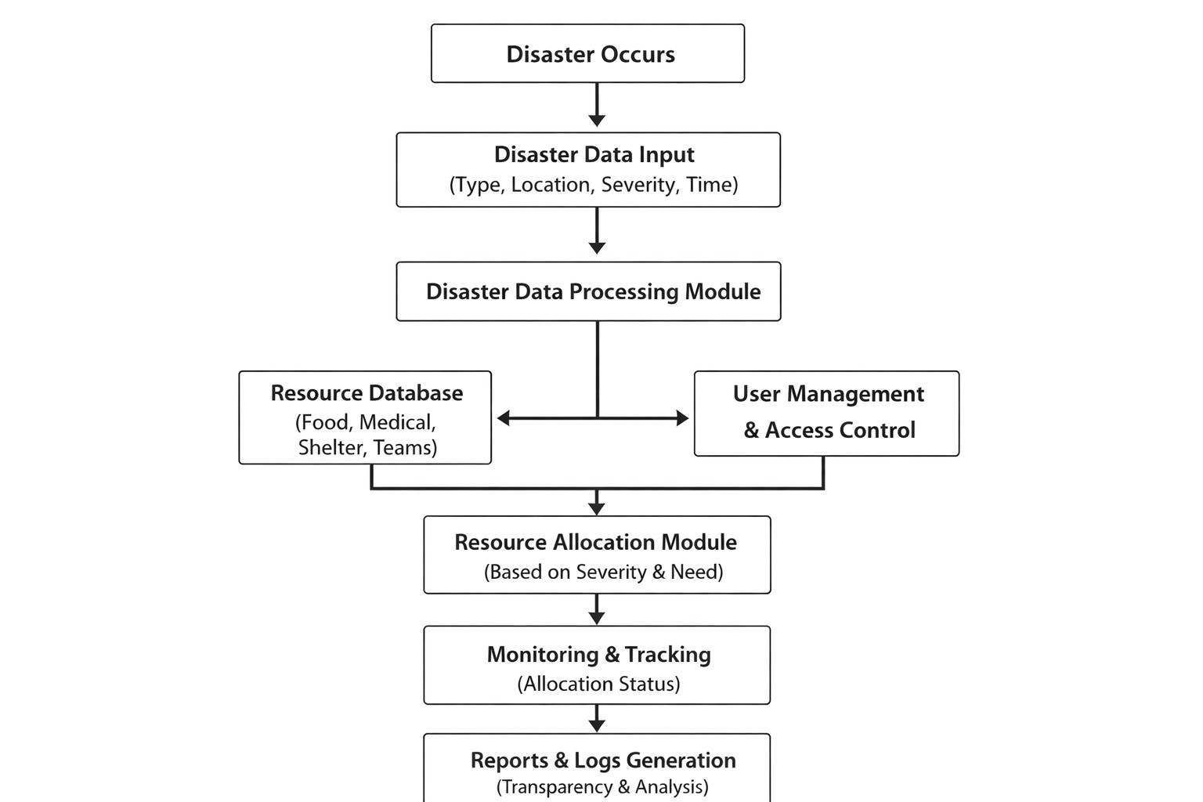
Project Flow
Backend processes requests and interacts with MongoDB.
Updated information is displayed on the frontend.

Slide 10
Data & Resources
Data Used
User details (User ID, name, role, login credentials)
Disaster data (type, location, severity, status)
Resource data (type, quantity, availability, location)
Allocation records
Logs and reports
Resources Required
Hardware: Computer system with internet connectivity
Software: VS Code, Web Browser, MongoDB
Technologies: HTML, CSS, JavaScript, MongoDB

Slide 11

Methodology
The project follows a modular development approach:
Requirement analysis and system design
Frontend design using HTML, CSS, and JavaScript
Backend development for data processing and authentication
Database design using MongoDB
Integration of frontend, backend, and database
Testing and debugging
Documentation and final deployment

Slide 12
Expected Results & Impact
Efficient management of disaster-related information.
Faster and more accurate resource allocation.
Improved coordination between disaster response teams.
Reduced manual effort and data redundancy.
Secure and reliable system for disaster management.

Slide 13
Project Timeline
Phase | Description | Duration
Phase 1 | Requirement Analysis | 1 Week
Phase 2 | System Design | 1 Week
Phase 3 | Frontend Development | 2 Weeks
Phase 4 | Backend Development | 2 Weeks
Phase 5 | Database Integration | 1 Week
Phase 6 | Testing & Debugging | 1 Week
Phase 7 | Documentation & Submission | 1 Week

Slide 14
THANK YOU

