Slide 1


Recipe Sharing
Subject Name: Web Development
Subject Code:ETVAWD009
Presented by:
Saieena(2401010081)
Shikha(2401010063)
Ananya(2401010056)
Diksha(2401010055)
Presented to:
Dr. Aarti

Slide 2
[Recipe Haven]
Discover, Cook, Enjoy!
Tagline: “Delicious recipes for everyday inspiration.”

Slide 3
Table of Contents
Introduction
Background Study
Mission & Vision
Website Overview
Homepage
Features & Functionality
Why is it unique?
Technology Used
Reference

Slide 4
Introduction
Welcome to Recipe Haven! Our platform is dedicated to helping food enthusiasts discover new recipes, share their passion for cooking, and connect with a vibrant food-loving community. Whether you're a home cook or a culinary pro, you'll find inspiration, tips, exchange cooking ideas, and a space to showcase your creations.

Slide 5
Background Study
This recipe-sharing platform was born from a simple idea: cooking should be personal, creative, and shared with others. It’s more than just a website—it’s like a digital kitchen journal where anyone can add their own recipes, share photos, and tell the stories behind their dishes. What makes it special is the community—people can leave tips, suggest new ways to make a recipe, and learn from each other. Whether you’re a student cooking in a hostel, a busy parent, or just someone who loves food, this platform brings everyone together to cook, experiment, and connect through their shared love of food.

Slide 6
Mission & Vision
Mission: Our mission is to bring home cooks together in a welcoming space to share recipes, stories, and tips. We foster creativity, learning, and support, turning every recipe into a shared cooking adventure.
Vision: Our vision is to build a fun and creative community where food lovers from all over can connect, share new ideas, and enjoy cooking together. We want this platform to be the go-to place for anyone who loves experimenting with recipes and learning from others.

Slide 7
Website Overview
Intuitive design for easy navigation
Searchable recipe database to explore new dishes
User profiles to save favorites and connect with others
Allows users to upload recipes
clean layout showcasing recipe photos and instructions.

Slide 8
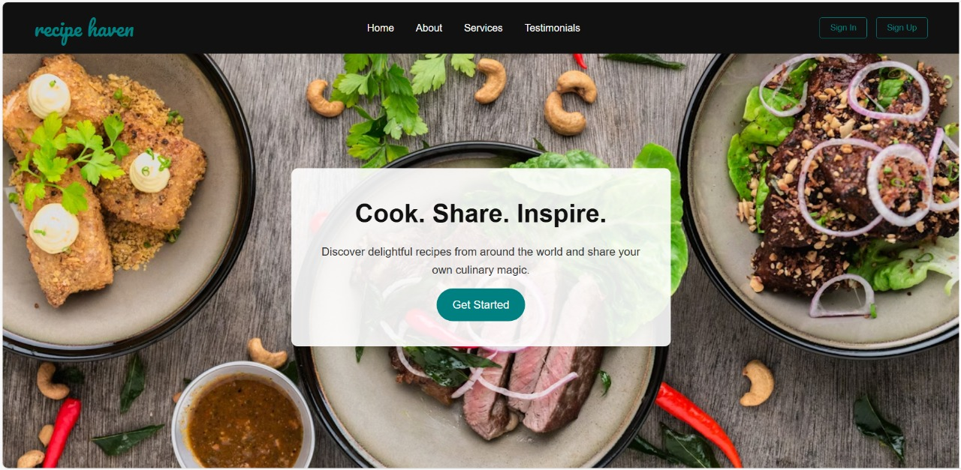
Homepage

Slide 9
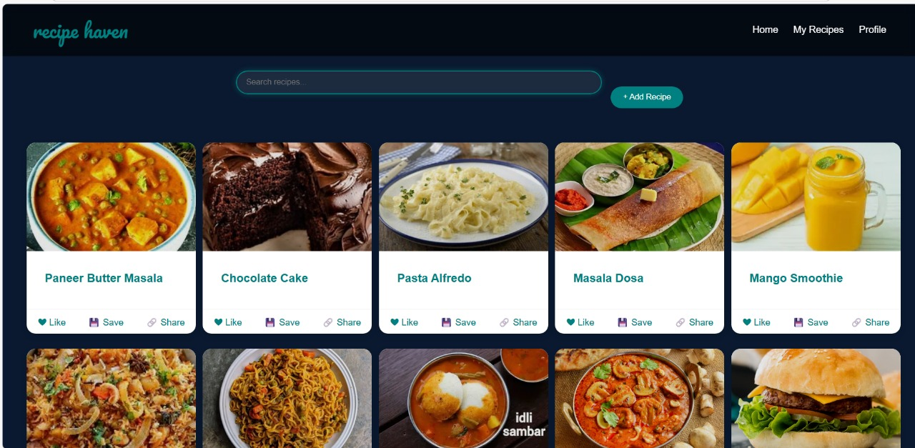
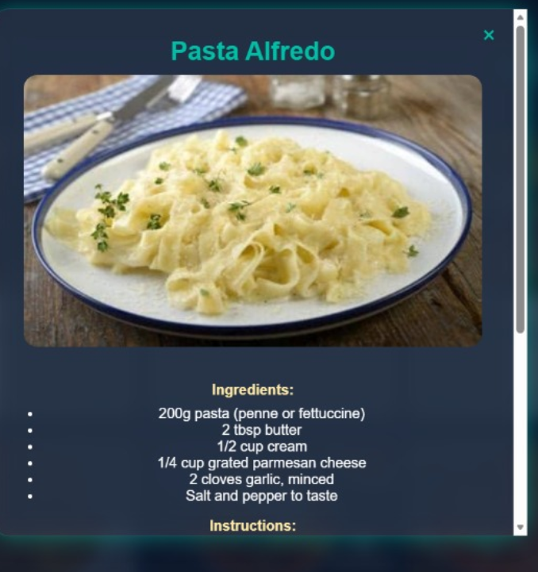

Slide 10
Features & Functionality
Users first create an account by signing up and then log in to access the platform easily in the future.
After logging in, clicking the "Get Started" icon takes users to the main page displaying a variety of recipes with photos.
Users can browse recipes, like their favorites, and share them with others.
Clicking on a recipe photo opens a detailed page showing the recipe description, including ingredients and step-by-step cooking instructions.

Slide 11
Why is it unique?
Our platform is all about community—users don’t just share recipes, they share ideas, tips, and suggestions to make cooking fun and creative.
It works like a personal recipe journal where users upload recipes along with their photos, making it feel warm and personal.
Whether you’re a beginner or an expert, the platform welcomes everyone to learn, share, and grow together, making cooking simple and enjoyable.

Slide 12
Technology Used
The website is built using Node.js for the backend, which allows us to create a fast and scalable server.
We use MongoDB as our database to store recipes, user information, and comments in a flexible, easy-to-manage way.
The frontend is designed with HTML, CSS, and JavaScript to make the site interactive and visually appealing.
Using these technologies helped create a responsive, user-friendly platform where users can share and interact with recipes easily.

Slide 13
References
W3Schools - HTML, CSS, and JavaScript Tutorials
MDN Web Docs - Node.js and Express.js Documentation
GeeksforGeeks - Web Development and SQL Tutorials
TutorialsPoint - Full Stack Development Guide

Slide 14
THANK YOU!!

