Slide 1

Global AI Tool Adoption Analysis
Analyzing and visualizing global adoption trends of AI tools across countries, industries, company sizes, and demographics — identifying where adoption is strongest and which segments are driving engagement.

Slide 2
Dataset Overview
The analysis uses 8 key variables to track AI adoption globally.
Country
Industry
Geographic location for country-wise comparisons
Sector type — healthcare, finance, education, etc.
AI Tool
Adoption Rate
Specific technology being adopted
% of organizations/users adopting (core metric) + YoY growth
Year
Age Group
Time dimension for trend tracking
Demographic segmentation of users
DAU
Company Size
Daily Active Users — engagement metric
Small, Medium, or Large organizations

Slide 3
Scope of Analysis
Four pillars drive this study.
Global Adoption Trends
Industry Adoption
Overall adoption rate and global DAU across all countries and tools
Average adoption per industry, ranked from highest to lowest
Company Size Segmentation
Demographic Insights
Adoption split across Small, Medium, and Large organizations
Adoption patterns and DAU segmented by age group

Slide 4

PYTHON EDA
Exploratory Data Analysis in Python
We began with data preparation and cleaning in Python to ensure data quality before deeper analysis.
01
02
Data Loading
Initial Exploration
Imported the dataset using pandas for initial processing
Used df.info() to check structure and .describe() for summary statistics
03
Data Handling
Checked for null values and duplicate records to ensure data integrity

Slide 5
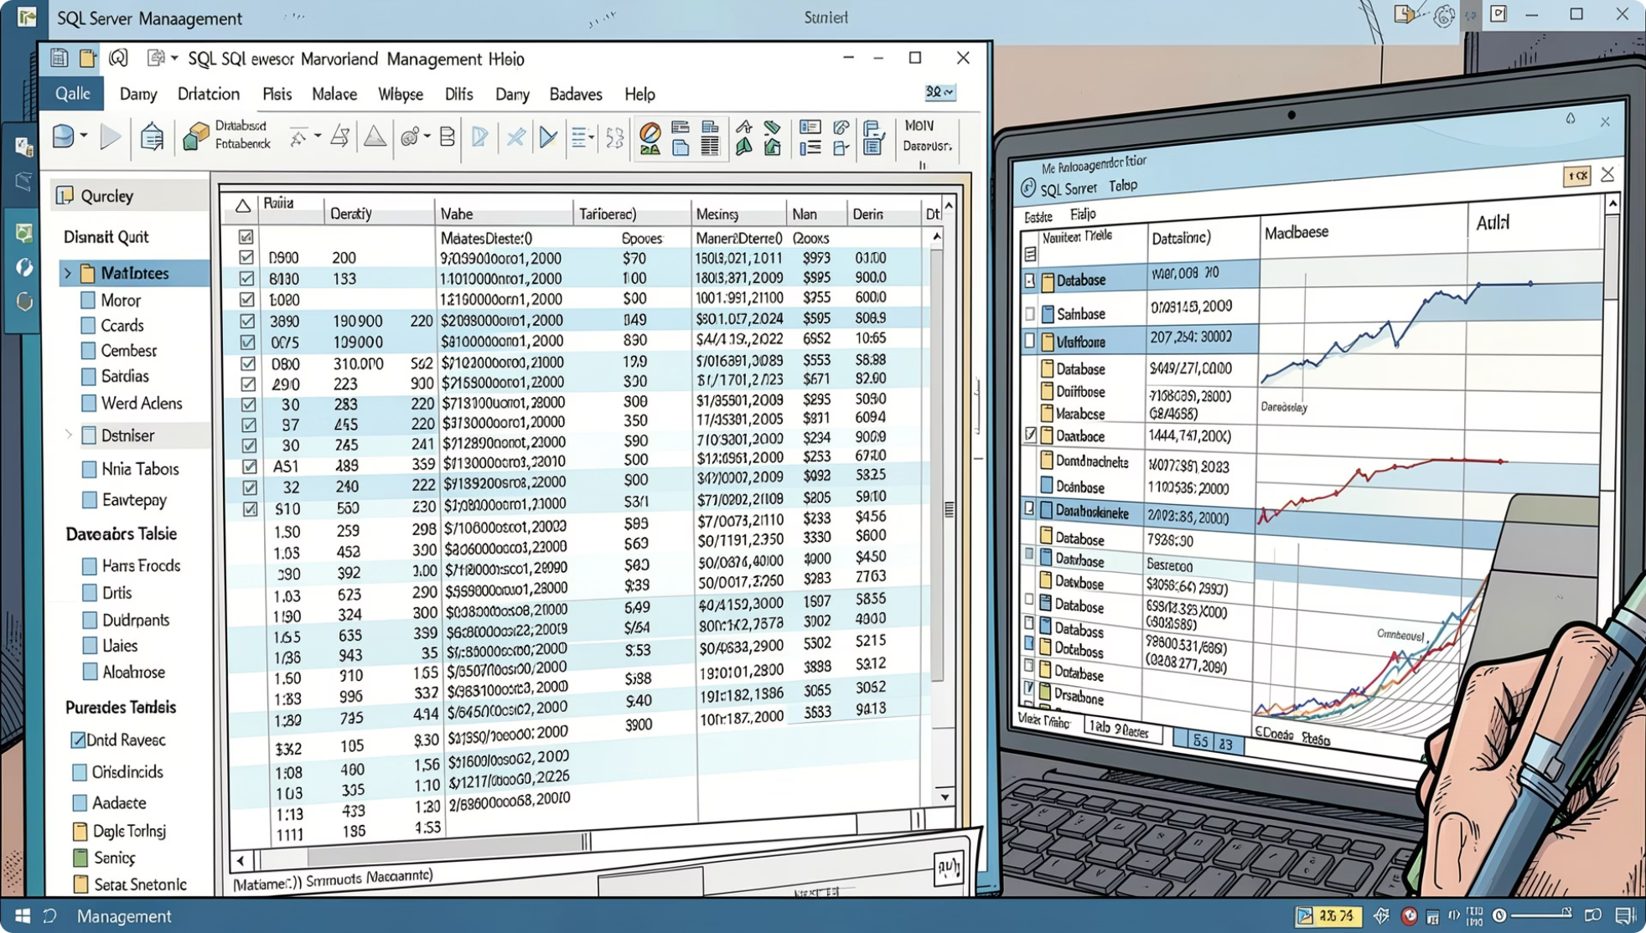
SQL SERVER
Data Analysis Using SQL
Structured analysis performed in SQL Server — from database creation to querying key adoption metrics.
Data Loading
Created a database in SQL Server and loaded CSV data via the task import option
Initial Exploration
Queried total number of records available for analysis
Overall Adoption Rate
Calculated the overall adoption rate of AI tools across the dataset
Global Daily Active Users
Aggregated daily active users across the world using AI tools

Slide 6
SQL INSIGHTS
Industry & Company Size Adoption
Industry Adoption Rate
Calculated adoption rates across different industries and ranked the top 5 sectors by adoption to identify which industries are leading AI tool uptake.
Company Size by Adoption Rate
Analyzed how AI tool adoption varies across different organization sizes — Small, Medium, and Large — to understand which segments are driving adoption.

Slide 7

SQL INSIGHTS
Age Group & Daily Active Users
Age Group Adoption Rate
Examined how AI tool adoption varies across different age groups to reveal demographic patterns in uptake.
Total Daily Active Users by AI Tool
Aggregated total active users per AI tool on a daily basis to measure engagement at scale.
Average Daily Active Users by AI Tool
Calculated average DAU per tool to compare relative engagement levels across tools.

Slide 8

POWER BI
Interactive Dashboard in Power BI
Finally, we built an interactive dashboard in Power BI to present all insights visually — consolidating adoption rates, industry comparisons, company size segmentation, demographic patterns, and daily active user metrics into a single, cohesive view.

Slide 9
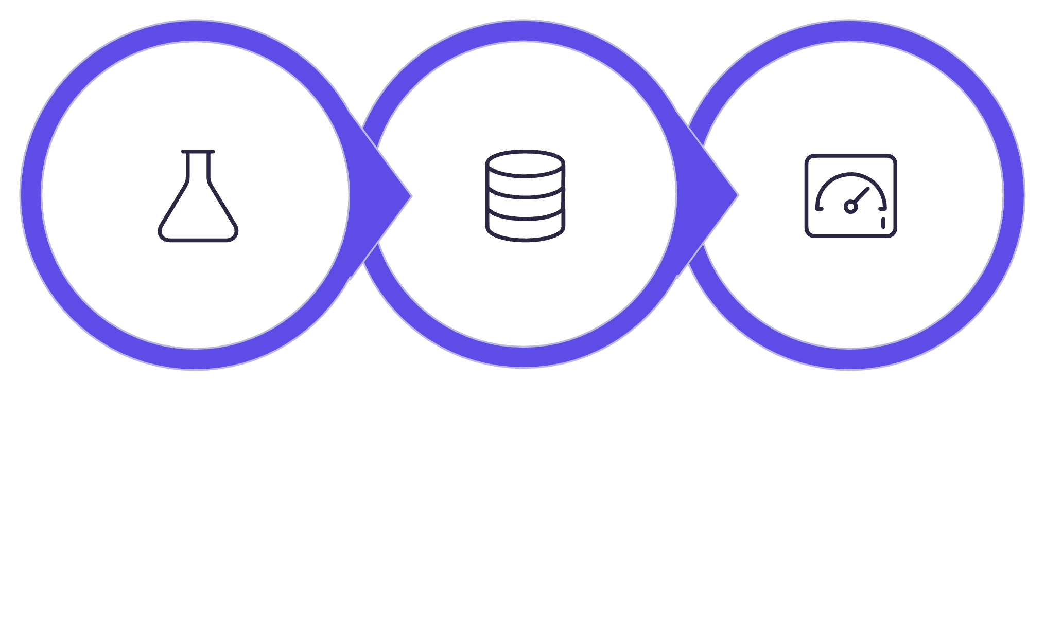
Analysis Workflow Summary
A three-stage pipeline transformed raw data into actionable insights.
Python EDA
SQL Analysis
Power BI
Each stage built on the previous — Python ensured data quality, SQL enabled structured metric calculation, and Power BI delivered the final interactive visualization layer.

Slide 10
Key Takeaways
Global Coverage
Python EDA
Adoption analyzed across countries, industries, company sizes, and age demographics
Data loaded, explored with df.info() and .describe(), and cleaned for nulls/duplicates
SQL Metrics
Power BI Dashboard
Adoption rates, DAU, industry rankings, company size splits, and age group patterns queried in SQL Server
All insights consolidated into an interactive dashboard for visual exploration

