Slide 1
Programming in Python

Slide 2
Copyright Guideline
2
© 2016 Infosys Limited, Bangalore, India. All Rights Reserved.
Infosys believes the information in this document is accurate as of its publication date; such information is subject to change without notice. Infosys acknowledges the proprietary rights of other companies to the trademarks, product names and such other intellectual property rights mentioned in this document. Except as expressly permitted, neither this documentation nor any part of it may be reproduced, stored in a retrieval system, or transmitted in any form or by any means, electronic, mechanical, printing, photocopying, recording or otherwise, without the prior permission of Infosys Limited and/ or any named intellectual property rights holders under this document.

Slide 3
Confidential Information
3
This Document is confidential to Infosys Limited. This document contains information and data that Infosys considers confidential and proprietary (“Confidential Information”).
Confidential Information includes, but is not limited to, the following:
Corporate and Infrastructure information about Infosys
Infosys’ project management and quality processes
Project experiences provided included as illustrative case studies
Any disclosure of Confidential Information to, or use of it by a third party, will be damaging to Infosys.
Ownership of all Infosys Confidential Information, no matter in what media it resides, remains with Infosys.
Confidential information in this document shall not be disclosed, duplicated or used – in whole or in part – for any purpose other than reading without specific written permission of an authorized representative of Infosys.
This document also contains third party confidential and proprietary information. Such third party information has been included by Infosys after receiving due written permissions and authorizations from the party/ies. Such third party confidential and proprietary information shall not be disclosed, duplicated or used – in whole or in part – for any purpose other than reading without specific written permission of an authorized representative of Infosys.

Slide 4
Course Information
4
Course Code: PY-BASIC
Course Name: Programming in Python Document Number: 001
Version Number: 1.0

Slide 5
Topics covered in “Programming in Python” course
5
Introduction
Python Basics
Python Data Variables & Operators
Data Variables and its types
Operators
id() and type() functions
Coding Standards
Control Structures
If else
elif, Nested if
Iteration Control Structures
Break, Continue & Pass

Slide 6
Topics covered in “Programming in Python” course
6
Data Structures
Strings
Tuples
Lists
Sets
Dictionary
Functions
Defining & Calling a function
Passing Arguments to functions – Mutable & Immutable Data types
Different types of arguments
Recursion
Scope of variables
Introduction to Python Tutor

Slide 7
Topics covered in “Programming in Python” course
7
Standard Library and Regular Expression
Math Module
String Module
List Module
Date & Time Module
Regular Expression: match, search, replace
Modules and Package
Modules
Packages

Slide 8
Topics covered in “Programming in Python” course
8
File Operations
Open
Close
Write
Read
Errors and Exception Handling
Errors
Try….except….else
Try….except
Try….finally

Slide 9
Introduction

Slide 10
Why Python for beginners?
10
Easy – to - learn
Code is 3-5 times shorter than Java
5-10 times shorter than C++
Stepping Stone to Programming universe
Python’s methodologies can be used in a broad range of applications
Bridging the Gap between abstract computing and real world applications
Python is used as main programming language to do projects using Raspberry Pi
Rising Demand for Python Programmers
Google, Nokia, Disney, Yahoo, IBM use Python
Open- Source, Object – Oriented, procedural and functional
Not only a Scripting language, also supports Web Development and Database Connectivity

Slide 11
Python v/s Java
11
A simple Program to print “Hello World”
Java Code | Python Code
public class HelloWorld { public static void main(String args [] ) { System.out.println (“Hello World!”) } } | print (“Hello World!”)

Slide 12
Worldwide Python Users
12
Web Development
Yahoo Groups, Google, Shopzilla
Games
Battelefield2, The Temple of Elemental Evil, Vampire
Graphics
Walt Disney feature Animation, Blender 3D
Science
National Weather Service
NASA
Environmental Systems Research Institute

Slide 13
Evolution of Python
13
Guido Van Rossum developed Python in early 1990s at National Research
Institute for Mathematics and Computer Science, Netherlands.
Named after a circus show Monty Python show.
Derives its features from many languages like Java, C++, ABC, C, Modula-3, Smalltalk, Algol-68, Unix shell and other scripting languages.
Available under the GNU General Public License (GPL) – Free and open-source software.

Slide 14
Python Versions
14
Python v0.9.0 - February, 1991
Features: Exception Handling, Functions and core data types like List, Dictionary, String and others. It was object oriented and had module system
Python v1.0 - January 1994
Features: Functional Programming tools lambda, map, filter and reduce
Python v2.0 - October 2000
Features: List comprehensions, Garbage Collector and support for Unicode.
Python v3.0 - 2008
Known as “Python 3000” and “Py3k”. It is not backward compatible with v2.0 and its other variants. Emphasizes more on removal of duplicate programming constructs and modules

Slide 15
Python Features
15
Python is a High - Level, Interpreted, Interactive and Object - Oriented Programming Language
Features include:
Beginners Language
Extensive Standard Library
Cross Platform Compatibility
Interactive Mode
Portable and Extendable
Databases and GUI Programming
Scalable and Dynamic Semantics
Automatic Garbage Collection

Slide 16
Configuration
16
Download and Install Python 3.5: https://www.python.org/downloads/
Download PyDev_3.8.0 or higher version: http://www.pydev.org/download.html
Download Eclipse Juno or higher version: https://www.eclipse.org/downloads/index.php
Install Python on your machine
Note: You need eclipse locally installed in your machine Procedure:
Copy paste the contents of the plugin folder of PyDev into plugin folder of Eclipse
In Eclipse open PyDev perspective (Window -> Open Perspective -> Other -> Pydev)
Create a PyDev Project
Select Grammar as 3.0
Configure interpreter by choosing the .exe file of Python installed in your machine

Slide 17
Python Basics

Slide 18
Commenting Style in Python!
18
Types of Comments:
A single line comment starts with hash symbol ‘#’ and end as the line ends.
These lines are never executed and are ignored by the interpreter.
Single € # This is a single line comment
Multi-line comments starts and ends with triple single quotes ‘’’ or triple “””
double quotes
Used for documentation
Triple € ‘’’ or “””
“””
Contents here can be used for documentation
“””
‘’’
An example for multi-line comments with single quotes ‘’’

Slide 19
Multiline statements
19
Python statements always end up with a new line, but it also allows multiline statement using “\” character at the end of line as shown below:
result = (8+5)*\
2+\
9/5
Statements which have (), [], {} brackets and comma, do not need any multiline character to go to next line.
customer_details = [101, ‘kevin’,
‘165’, 498.24]

Slide 20
Print Statement
20
Displays the output on the screen of user
Python has its own String Format Operator as %
print('The value of PI is %5.3f' % 3.1417)
print('The value of PI is approximately %5.2f.' % 3.1417) print( "Latest Python Version is: %d" % 3.5)
print ("%20s : %d" % ('Python', 3000.34 ))
Output:
The value of PI is 3.142
The value of PI is approximately 3.14. Latest Python Version is: 3
Python : 3000
User Input in Python
name = input("Enter your name")
print("Welcome to session on Programming in Python,", name)
Guided Activity: Assignment 1: Using Eclipse IDE to create and execute Python Program

Slide 21

Execute a Python Script
21
Execution of python program means execution of the byte code on Python Virtual Machine
print(“Hello World!”)
print("My first sample python script")
#prints Hello World!
#prints My first sample python script
Virtual Machine
Source Code
Byte Code
PVM

Slide 22
Python Data Variables

Slide 23
Programming Constructs in Python
23
Guided Activity: Programming constructs in Python - Assignment 2
Given a real world problem, to solve the problem using a program, we need:
Logic
High level programming language
Programming Fundamentals
Identifiers
Variables
Data types
Operators etc

Slide 24

Identifiers
24
Are names given to anything that you want to identify in a program
Helps to refer to that item from any place in the program
Can start with an underscore (_) or a upper or lower case alphabet
Can have digits
Identifiers cannot match any of Python's reserved words
Are case-sensitive
Identify the identifiers needed to solve the
problem discussed as part of previous guided activity?
bill_id customer_id bill_amount

Slide 25
Variables
25
An identifier for the data and it holds data in your program
Is a location (or set of locations) in memory where a value can be stored
A quantity that can change during program execution
No declaration of variables
Data type of a variable can change during program execution compared to other strongly typed languages such as Java, C++, C
customer_id = 101 customer_name = "John" bill_amount = 675.45
x = 5.3 + 0.9j
print(customer_id, customer_name, bill_amount) print(x.real)
print(x.imag + 3)
# Integer
# String
# Floating-point
# complex number
#prints 101 John 675.45
#prints 5.3
#prints 3.9

Slide 26
Data Types in Python
26
Category | Data Type | Example
Integer Type | int | 675
 | long | 9669737712
 | complex | 2 + 5i
Floating Type | float | 642.43
Textual | char | C
 | String | Infosys
Logical | boolean | True, False
We will now understand different types of operators and how to write a simple program
Guided Activity: Programming constructs in Python - Assignment 3, 4

Slide 27
Python Operators

Slide 28








Operators (1 of 7)
28
Used to perform specific operations on one or more operands (or variables) and provide a result
Arithmetic Operators Relational Operators
Assignment Operators Bitwise Operators
Logical Operators Membership Operators
Identity Operators
Copyright © 2015 - 2016, Infosys Limited

Slide 29
Operators (2 of 7)
29
Arithmetic Operators
– Used for performing arithmetic operations
Operators | Description | Example
+ | Additive operator (also used for String concatenation) | 2 + 3 = 5
- | Subtraction operator | 5 – 3 = 2
* | Multiplication operator | 5 * 3 = 15
/ | Division operator | 6 / 2 = 3
% | Modulus operator | 7 % 2 = 1
// | Truncation division (also known as floor division) | 10 // 3 = 3 10.0 // 3 = 3.0
** | Exponentiation | 10 ** 3 = 1000
Copyright © 2015 - 2016, Infosys Limited

Slide 30
Operators (3 of 7)
30
Relational Operators
Also known as Comparison operators
Used in conditional statements to compare values and take action depending on the result
Operators | Description
== | Equal to
< | Less than
> | Greater than
<= | Lesser than or equal to
>= | Greater than or equal to
!= | Not equal to
<> | Similar to Not equal to
Copyright © 2015 - 2016, Infosys Limited

Slide 31
Operators (4 of 7)
31
Assignment Operators
Operators | Description | Example | Equivalent
= | Assignment from right side operand to left side | c = 50; c = a;
+= | Add & assigns result to left operand | c += a | c = c + a
-= | Subtract & assigns result to left operand | c -= a | c = c – a
*= | Multiply & assigns result to left operand | c *= a | c = c * a
/= | Divide & assigns result to left operand | c /= a | c = c / a
%= | Calculates remainder & assigns result to left operand | c %= a | c = c % a
//= | Performs floor division & assigns result to left operand | c //= a | c = c // a
**= | Performs exponential calculation & assigns result to left operand | c **= a | c = c ** a
Multiple Assignments – Same value can be assigned to more than one variable
Ex.1: Students Ram, Sham, John belong to semester 6 Ram = Sham = John = 6
Ex.2: a, b, c = 10, 20, 30 is same as a = 10, b = 20, c = 30
Copyright © 2015 - 2016, Infosys Limited

Slide 32
Operators (5 of 7)
32
Bitwise Operators
– performs bit by bit operation on bits
Operators | Description
& | Binary AND
| | Binary OR
^ | Binary XOR
~ | Binary Ones Complement
<< | Binary Left Shift
>> | Binary Right Shift
Copyright © 2015 - 2016, Infosys Limited

Slide 33
Operators (6 of 7)
33
Logical Operators
Are based on Boolean Algebra
Returns result as either True or False
Operator | Meaning
and | Short Circuit-AND
or | Short Circuit-OR
not | Unary NOT
Demo: Assignment 5: Programming constructs in Python
Guided Activity: Assignment 6, 7, 8: Programming constructs in Python
Copyright © 2015 - 2016, Infosys Limited

Slide 34
Operators (7 of 7)
34
Membership Operators
– Checks for membership in a sequence of Strings, Lists, Dictionaries or Tuples
Operators | Description
in | Returns to true if it finds a variable in given sequence else false
not in | Returns to true if it does not find a variable in given sequence else false
Identity Operators
– Are used to compare memory locations of 2 objects
Operators | Description
is | Returns to true if variables on either side of operator are referring to same object else false
is not | Returns to false if variables on either side of operator are referring to same object else true
Copyright © 2015 - 2016, Infosys Limited

Slide 35
Built-in function: id()
35
Id(object)
Returns identity of an object. It is the address of object in memory
It will be unique and constant throughout the lifetime of an object
Example:
Output
a = 10
b = a
print("Value of a and b before increment") print("id of a: ",id(a))
print("id of b: ",id(b)) b = a + 1
print("Value of a and b after increment") print("id of a: ",id(a))
print("id of b: ",id(b))
Value of a and b before increment
id of a: 1815592664
id of b: 1815592664
Value of a and b after increment
id of a: 1815592664
id of b: 1815592680
Note the change in address of variable ‘b’ after increment
Copyright © 2015 - 2016, Infosys Limited

Slide 36
Built-in function: type()
36
Used to identify the type of object
Example:
int_a = 10
print("Type of 'int_a':", type(int_a))
str_b = "Hello"
print("Type of 'str_b':", type(str_b))
list_c = []
print("Type of 'list_c':", type(list_c))
Output:
Type of 'int_a': <class 'int'>
Type of 'str_b': <class 'str'> Type of 'list_c': <class 'list'>
Note: Every variable in Python is a object
Guided Activity: Assignment 9: id() and type() functions - Quiz
Copyright © 2015 - 2016, Infosys Limited

Slide 37
Coding Standards in Python
37
Set of guidelines
To Enhance the readability and Clarity of the program
Make it easy to debug and maintain the program
All the letters in a variable name should be in lowercase
When there are more than two words in variable name, underscore can be used between internal words
Use meaningful names for variables
Limit all lines to a maximum of 79 characters
A function and class should be separated by 2 blank lines
Methods within classes should be separated by single blank line
Always surround binary operators with a space on either side:
Ex: a = a + 1;
Copyright © 2015 - 2016, Infosys Limited

Slide 38
Coding Standards in Python
38
Bad Code | Good Code
a = 10 b = 23 C = 24 ^{sum = a + b + c} Usage of keyw ‘sum’ as varia ^{avg = sum/3} name will lea warning print(“Average: “, avg) | marks1 = 10 marks2 = 23 marks3 = 24 _{o}s_{r}u_{d}m_of_marks = marks1 + marks2 + marks3 ble _{d t}a_{o}vg_of_marks = sum_of_marks / 3 print (“Average: “, avg_of_marks)
Guided Activity: Assignment 10: Coding Standards
Copyright © 2015 - 2016, Infosys Limited

Slide 39
Control Structures

Slide 40

Indentation in Python
40
Python uses offside rule notation for coding
Uses indentation for blocks, instead of curly brackets
The delimiter followed in Python is a colon (:) and indented spaces or tabs.
Example:
x = 3
if x > 5:
print("true") print(x)
else:
print ("false") print ("Out of if block")
Block 1
Block 2
Block 3
Block 2, Continuation
Block 3, Continuation
1st level indent € if block
2nd level indent €statements within if or else block

Slide 41
Control Structures
41
Guided Activity: Assignment 11: Control Structures
Decision making statements
– if statement:
if statement checks for a condition and if that is found true a particular set of instructions gets executed
Syntax:
Example:
x = 8
if x < 10:
print("Value of x is %d" %x) var = 10
if var > 5:
print ("Hi") # line belongs to if block print("I'm out of if")
if condition1:
statement(s)
else:
statement(s)
Output:
Predict the output of this code snippet when value of x = 15?
Value of x is 8 Hi
I'm out of if

Slide 42
Control Structures…
42
Demo: Assignment 12: Control Structures
elif statement:
– elif statement is used when there is more than one condition to be checked separately
Example:
Syntax:
if condition1:
statement(s)
elif condition2:
statement(s)
else:
statement(s)
var=10
if var > 10 : print("Hello") print(var)
elif var < 10:
print("Hola in Spanish for Hello") print(var)
else:
print("Hi") print(var)
print("End of Program")
Output:
Hi 10
End of Program
Note: There is no switch case statement in Python unlike C/C++ language
Guided Activity: Assignment 13, 14, 15, 16: Control Structures

Slide 43
Iterative Statements
43
Loop statements:
Allows us to execute a statement or group of statements multiple times.
While Loop
For Loop
Range
Loop Control Statements:
Are used to change flow of execution from its normal sequence.
Break
Continue
Pass

Slide 44
Iterative Statements
44
while loop:
Repeats a statement or group of statements while a given condition is TRUE.
Tests the condition before executing the loop body.
Syntax:
while condition:
statement(s)
Example:
n = 5
result = 0
counter = 1
while counter <= n:
result = result + counter counter += 1
print("Sum of 1 until %d: %d" % (n, result))
Output:
Sum of 1 until 5: 15

Slide 45
Iterative Statements
45
for loop:
Executes a sequence of statements multiple times and abbreviates the code that manages the loop variable.
Syntax:
for iterating_var in sequence: statement(s)
Output:
1
2
Sita 7
Ram 5
Example:
for counter in 1,2,'Sita', 7,'Ram',5: print(counter)

Slide 46
Iterative Statements
46
range function in loops
Used in case the need is to iterate over a specific number of times within a given range in steps/intervals mentioned
Syntax:
range(lower limit, upper limit, Increment/decrement by)
Loop | Output | Remarks
for value in range(1,6): print(value) | 1 2 3 4 5 | Prints all the values in given range exclusive of upper limit
for value in range(0,6,2): print(value) | 0 2 4 | Prints values in given range in increments of 2
for value in range(6,1,-2): print(value) | 6 4 2 | Prints values in given range in decrements of 2
for ch in "Hello World": print(ch.upper()) | H E L L O W O R L D | Prints all the characters in the string converting them to upper case
Guided Activity: Assignment 17: Control Structures

Slide 47
Iterative Statements- break
47
Loop Control Statements - break and continue
When an external condition is triggered, Exits a loop immediately.
Break Statement:
– Terminates the loop statement and transfers execution to the statement immediately following the loop.
Example:
var = 3
while var > 0:
print ("I'm in iteration ",var) var -= 1
if var == 2: break
print ("I'm still in while") print ("I'm out of while loop")
Output:
I'm in iteration 3 I'm out of while loop
Observe the output of this code snippet when value of var = 5?
Demo: Assignment 18: break statement

Slide 48
Iterative Statements - continue
48
continue statement:
Causes the loop to skip the remainder of its body and immediately retest its condition prior to reiterating.
Example:
var = 3
while var > 0:
print ("I'm in iteration ", var) var -= 1
if var == 2: continue
print ("I'm still in if block") print ("I'm still in while")
print ("I'm out of while loop")
Output:
I'm in iteration 3 I'm in iteration 2 I'm still in while I'm in iteration 1 I'm still in while
I'm out of while loop
Demo: Assignment 19: continue statement
Guided Activity: Assignment 20: Iteration Control Structure - Debugging

Slide 49
Iterative Statements- pass
49
pass statement:
pass statement is never executed.
Used when a statement is required syntactically but do not want any command or code to execute or if the code need to be implemented in future.
Behaves like a placeholder for future code
Example:
x = "Joy"
if x == "John":
print ("Name:",x) elif x == "Joy":
pass else:
print ("in else")
Output:
No Output

Slide 50
Data Structures

Slide 51
Data Structure in Python
51
Dynamic way of organizing data in memory
Some of the Data Structures available in Python are:
Strings
List
Tuples
Sets
Dictionaries
Copyright © 2015 - 2016, Infosys Limited

Slide 52
Strings

Slide 53
Strings
53
Guided Activity: Assignment 21: Strings
Accepts 3 types of quotes to assign a string to a variable.
single ('), double (") and triple (''' or """)
String starts and ends with same type of quote
Triple quotes are used to span string across multiple lines.
Index starts from zero.
Can be accessed using negative indices. Last character will start with -1 and traverses from right to left.
word = ‘Programming’
sentence = “Object Oriented Programming."
paragraph = ""“ Python is a Object Oriented Programming Language. It is a Beginner’s language."""
Syntax:
Demo: Assignment 22: Strings

Slide 54
String Operators and Functions
54
Concatenation
Strings can be concatenated with ‘+’ operator
“Hello” + “World” will result in HelloWorld
Repetition
Repeated concatenation of string can be done using asterisk operator “*”
“Hello” * 3 will result in *HelloHelloHello*
Indexing
“Python”[0] will result in “P”
Slicing
Substrings are created using two indices in a square bracket separated by a ‘:’
“Python”[2:4] will result in “th”
Size
prints length of string
len(“Python”) will result in 6
Guided Activity: Assignment 23, 24, 25, 26, 27 : Strings

Slide 55
Tuples

Slide 56
Tuples
56
An ordered group of sequences separated by symbol , and enclosed inside the parenthesis
Tuples are immutable.
Syntax:
tuple1 = () #Creation of empty tuple tuple2 = (Sequence1,)
tuple3 = (Sequence1, Sequence2)
, symbol is mandatory without which it becomes just a string assignment operation
Examples:
customer = (“John”,)
customers = (‘John’, ’Joe’, ’Jack’, ’Jill’, ’Harry’)
Demo: Assignment 28: Operations on Tuples Guided Activity: Assignment 29: Tuples
Copyright © 2015 - 2016, Infosys Limited

Slide 57
Lists

Slide 58
Lists
58
An ordered group of sequences enclosed inside square brackets and separated by symbol ,
Lists are mutable.
Syntax:
In this case symbol , is NOT mandatory
list1 = [] #Creation of empty List list2 = [Sequence1,]
list3 = [Sequence1, Sequence2]
Examples:
language = [‘Python’]
languages = [‘Python’,’C’,’C++’,’Java’,’Perl’]

Slide 59
List Notation and Examples
59
List Example | Description
[] | An empty list
[1, 3, 7, 8, 9, 9] | A list of integers
[7575, “Shyam”, 25067.56] | A list of mixed data types
[“Bangalore”, “Bhubaneshwar”, “Chandigarh”, “Chennai”, “Hyderabad”, “Mangalore”, “Mysore”, “Pune”, “Trivandrum”] | A list of Strings
[[7575, “John”, 25067.56], [7531, “Joe”, 56023.2], [7821, “Jill”, 43565.23]] | A nested list
[“India”, [“Karnataka”, [“Mysore”, [GEC1, GEC2]]]] | A deeply nested list
Demo: Assignment 30: Accessing Elements from Lists

Slide 60
Basic List Operations
60
Python Expression | Result | Operation
len([4, 5, 6]) | 3 | Length
[1, 3, 7] + [8, 9, 9] | [1, 3, 7, 8, 9, 9] | Concatenation
[ ‘Hello’ ] * 4 | [‘Hello’ , ‘Hello’ , ‘Hello’ , ‘Hello’ ] | Repetition
7 in [1, 3, 7] | True | Membership
for n in [1, 3, 7] : print(n) | 1 3 7 | Iteration
n = [1, 3, 7] print(n[2]) | 7 | Indexing: Offset starts at 0
n = [1, 3, 7] print(n[-2]) | 3 | Negative slicing: Count from right
n = [1, 3, 7] print(n[1:]) | [3, 7] | Slicing
Guided Activity: Assignment 31, 32, 33 : Lists

Slide 61
Sets

Slide 62
Sets
62
An un-ordered collection of unique elements
Are lists with no index value and no duplicate entries
Can be used to identify unique words used in a paragraph
set1 = {} #Creation of empty set set2 = {“John”} #Set with an element
Syntax:
Example:
s1 = set("my name is John and John is my name".split()) s1 = {'is', 'and', 'my', 'name', 'John'}
Operations like intersection, difference, union, etc can be performed on sets
Demo: Assignment 34: Sets

Slide 63
Operations on Sets
63
Operation | Equivalent | Operation
len (s) |  | Length of set ‘s’
x in s |  | Membership of ‘x’ in ‘s’
x not in s |  | Membership of ‘x’ not in ‘s’
s.issubset(t) | s <= t | Check whether ‘s’ is subset ‘t’
s.issuperset(t) | s >= t | Check whether ‘t’ is superset of ‘s’
s.union(t) | s | t | Union of sets ‘s’ and ‘t’
s.intersection(t) | s & t | Intersection of sets ‘s’ and ‘t’
s.difference(t) | s - t | Returns elements in ‘s’ but not in ‘t’
s.symmetric_difference(t) | s ^ t | Returns elements in either ‘s’ or ‘t’ but not both
s.copy(_) |  | A new copy of ‘s’
Guided Activity: Assignment 35: Sets

Slide 64
Dictionary

Slide 65
Dictionary
65
A list of elements with key and value pairs(separated by symbol :) inside curly braces.
Keys are used instead of indexes
Keys are used to access elements in dictionary and keys can be of type – strings, number, list, etc
Dictionaries are mutable, i.e it is possible to add, modify and delete key-value pairs
Syntax:
phonebook = {} #Creation of empty Dictionary phonebook={“John”:938477565} #Dictionary with one key-value pair phonebook={“John”:938477565, “Jill”:938547565} #2 key-value pairs
Demo: Assignment 36: Dictionary
Guided Activity: Assignment 37: Dictionary

Slide 66
Mutable v/s Immutable Data Types
66
Mutable Data Type | Immutable Data Type
Sequences can be modified after creation | Sequences cannot be modified after creation
Ex: Lists, Sets, Dictionary | Ex: Strings, Tuples
Operations like add, delete and update can be performed | Operations like add, delete and update cannot be performed
Example
int_list = [12, 14, 9]
int_tuple = (12, 14, 19)
int_list[0] = 7
#prints [7, 14, 9]
print("List: ", int_list)
int_tuple[0] = 7
#Prints TypeError: 'tuple' object does not support
#item assignment
print("Tuple: ", int_tuple)
Output
List: [7, 14, 9]
int_tuple[0] = 7
TypeError: 'tuple' object does not support item assignment

Slide 67
Functions

Slide 68
Functions
68
Are blocks of organized, reusable code used to perform single or related set of actions
Provide better modularity and high degree of reusability
Python supports:
Built-in functions like print() and
User - defined functions

Slide 69
Functions (Cont…)
69
Defining a function:
Function blocks starts with a keyword ‘def’ followed by function_name, parenthesis (()) and a colon :
Arguments are placed inside these parenthesis
Function block can have optional statement/comment for documentation as its first line
Every line inside code block is indented
return [expression] statement exits the function by returning an expression to the caller function.
return statement with no expression is same as return None.
Syntax:
def function_name( parameters ):
“—optional: Any print statement for documentation" function_suite
return [expression]
Parameters exhibit positional behavior, hence should be passed in the same order as in function definition

Slide 70
Functions (Cont…)
70
Calling a Function
Defining a function gives it a name, specifies function parameters and structures the blocks of code.
Functions are invoked by a function call statement/code which may be part of another function
Example:
# Defining function print_str(str1)
def print_str(str1):
print("This function prints string passed as an argument") print(str1)
Observe the
return
usage of optional
print statement for
# Calling user-defined function print_str(str1)
documentation
print_str("Calling the user defined function print_str(str1)")
Function Call
Output:
This function prints string passed as an argument Calling the user defined function print_str(str1)

Slide 71
Functions (Cont…)
71
Pass arguments to functions:
Arguments are passed by reference in Python
Any change made to parameter passed by reference in the called function will reflect in the calling function based on whether data type of argument passed is mutable or immutable
In Python
Mutable Data types include Lists, Sets, Dictionary
Immutable Data types include Number, Strings, Tuples

Slide 72
Functions (Cont…)
72
Pass arguments to functions: Immutable Data Type - Number
Example:
#Function Definition
def change(cust_id): cust_id += 1
print("Customer Id in function definition: ", cust_id) return
# Function Invocation with arguments of immutable data type
cust_id = 100
print("Customer Id before function invocation: ", cust_id) change(cust_id)
print("Customer Id after function invocation: ", cust_id)
Observe that customer id remains unchanged even after function invocation
Output:
Customer Id before function invocation: 100 Customer Id in function definition: 101 Customer Id after function invocation: 100

Slide 73
Functions (Cont…)
73
Pass arguments to functions: Mutable Data Type - List
Example:
#Function Definition
def change(list_cust_id):
#Assign new values inside the function
list_cust_id.append([10, 20, 30])
print("Customer Id in function definition: ", list_cust_id) return
# Function Invocation with arguments of immutable data type
list_cust_id = [100, 101, 102]
print("List of Customer Id before function invocation: ", list_cust_id) change(list_cust_id)
print("Customer Id after function invocation: ", list_cust_id)
Output:
List of Customer Id before function invocation: [100, 101, 102]
List of Customer Id in function definition: [100, 101, 102, [10, 20, 30]]
List of Customer Id after function invocation: [100, 101, 102, [10, 20, 30]]

Slide 74
Functions (Cont…)
74
Different types of formal arguments:
Required arguments
Keyword arguments
Default arguments
Variable – length arguments
Demo: Assignment 38: Functions – Pass by Reference
Guided Activity: Assignment 39: Functions – Pass by Reference

Slide 75
Functions (Cont…)
75
Required arguments
Arguments follow positional order
No. of arguments and the order of arguments in the function call should be exactly same as that in function definition
Example:
# Function Definition
def print_str(str1):
print("This function prints the string passed as an argument") print(str1)
return
# Function Invocation without required arguments
print_str()
Output:
TypeError: print_str() missing 1 required positional argument: 'str1'

Slide 76
Functions (Cont…)
76
Keyword arguments
when used in function call, the calling function identifies the argument by parameter name
Allows you to skip arguments or place them out of order
Python Interpreter uses the keyword provided to match the values with parameters
Example:
# Function Definition
def customer_details (cust_id, cust_name): print("This function prints Customer details") print("Customer Id: ",cust_id) print("Customer Name: ",cust_name)
return
# Function Invocation with Keyword arguments
customer_details(cust_name = "John", cust_id = 101)
Output:
This function prints Customer details Customer Id: 101
Customer Name: John
Observe the change in
positional order of
arguments

Slide 77
Functions (Cont…)
77
Default Arguments:
– Assumes a default value if the value is not specified for that argument in the function call
Example:
# Function Definition
def customer_details (cust_name, cust_age = 30): print("This function prints Customer details") print("Customer Name: ",cust_name) print("Customer Age: ",cust_age)
return
# Function Invocation with Default arguments customer_details(cust_age = 25, cust_name = "John") customer_details(cust_name = "John")
Output:
This function prints Customer details Customer Name: John
Customer Age: 25
This function prints Customer details Customer Name: John
Customer Age: 30
Observe the usage of
default value for cust_age
argument

Slide 78
Functions (Cont…)
78
Variable-length arguments
Used to execute functions with more arguments than specified during function definition
unlike required and default arguments, variable arguments are not named while defining a function
Syntax:
def functionname([formal_args,] *var_args_tuple ): “—optional: Any print statement for documentation" function_suite
return [expression]
An asterisk ‘*’ is placed before variable name to hold all non-keyword variable arguments
*var_args_tuple is empty if no additional arguments are specified during function call

Slide 79
Functions (Cont…)
79
Variable-length arguments
Example:
# Function Definition
def customer_details (cust_name, *var_tuple): print("This function prints Customer Names") print("Customer Name: ",cust_name)
for var in var_tuple: print(var)
return
# Function Invocation with Variable length arguments customer_details("John", "Joy", "Jim", "Harry") customer_details("Mary")
Invocate this
Output:
This function prints Customer Names Customer Name: John
Joy Jim Harry
This function prints Customer Names Customer Name: Mary
function without
arguments and
observe the
output

Slide 80
Functions (Cont…)
80
Scope of variables
– Determines accessibility of a variable at various portions of the program
Example:
total = 0
# Function Definition
def add( arg1, arg2 ):
# Add both the parameters and return total total = arg1 + arg2; # total is local variable print ("Value of Total(Local Variable): ", total) return total;
# Function Invocation
add( 25, 12 );
print("Value of Total(Global Variable): ", total)
Different types of variables
– Local variables
Variables defined inside the function have local scope
Can be accessed only inside the function in which it is defined
– Global variables
Variables defined outside the function have global scope
Output:
Variables can be accessed throughout the program by all other functions as well
Value of Total(Local Variable): 37 Value of Total(Global Variable): 0

Slide 81
Usage of keyword ‘Global’
81
Used to access the variable outside the function
Example:
total = 0
# Function Definition
def add( arg1, arg2 ):
# Add both the parameters and return total
global total
total = arg1 + arg2; # Here total is made global variable
print ("Value of Total(inside the function): ", total) return total;
Observe the usage
of keyword ‘global’
# Function Invocation
add( 25, 12 );
print("Value of Total(outside the function): ", total)
Output:
Variable total is accessible outside the function
Value of Total(inside the function): 37 Value of Total(outside the function): 37

Slide 82
Recursion
82
A method invoking itself is referred to as Recursion
Typically, when a program employs recursion the function invokes itself with a smaller argument
Computing factorial(5) involves computing factorial(4), computing factorial(4) involves computing factorial(3) and so on
Often results in compact representation of certain types of logic and is used as substitute for iteration
Demo: Assignment 40a: Recursion
Guided Activity: Assignment 40b, 41, 42: Recursion

Slide 83
Towers of Hanoi problem
83
Problem was discovered by the French mathematician Edouard Lucas in 1883.
Used to learn recursion
Rules:
Move only one disk at a time. Rings must be in decreasing size
No move should result in a larger disk on top of a smaller disk
For temporarily holding a disk, the third tower can be used
A B C
A B
C
Transfer the 3 disks from tower A to tower B

Slide 84


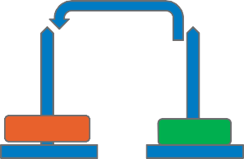
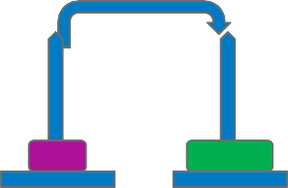
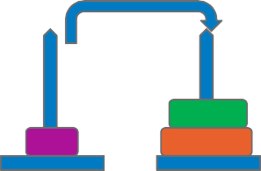

Towers of Hanoi - 3 discs
84
Solution:
A
B
C
A
B
C
1
5
2
6
3
7
4
8

Slide 85
Introduction to Python Tutor
85
A visualization tool Created by Philip Guo
Helps in understanding step-by-step execution of each line of a program’s source code.
It can be used to write and visualize programs in Python, Java, JavaScript, Ruby, C and C++
Click on the link below to visualize your code using Python Tutor and follow the steps in following 3 slides
http://www.pythontutor.com/
Suggested Sections of examples on Python Tutor:
Basic
Intro – a 10min introduction to Python Programming Fundamentals
Math
Objects
Linked Lists

Slide 86
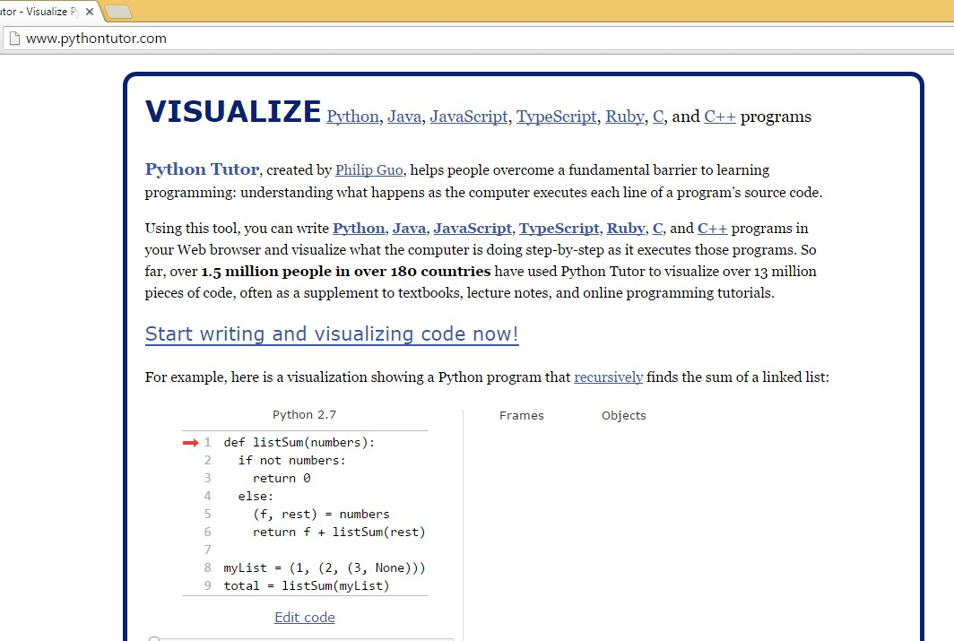
Introduction to Python Tutor…
86
Click here to start coding and visualizing

Slide 87
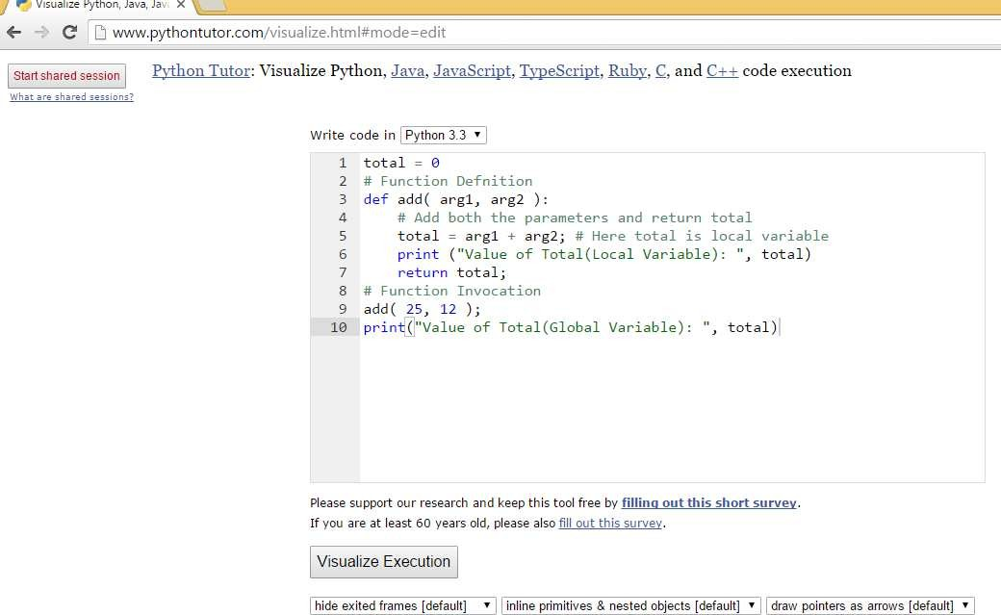
Introduction to Python Tutor…
87
Select programming language Python 3.3 from drop-down menu
Write your code here
Click on Visualize execution to visualize your code

Slide 88
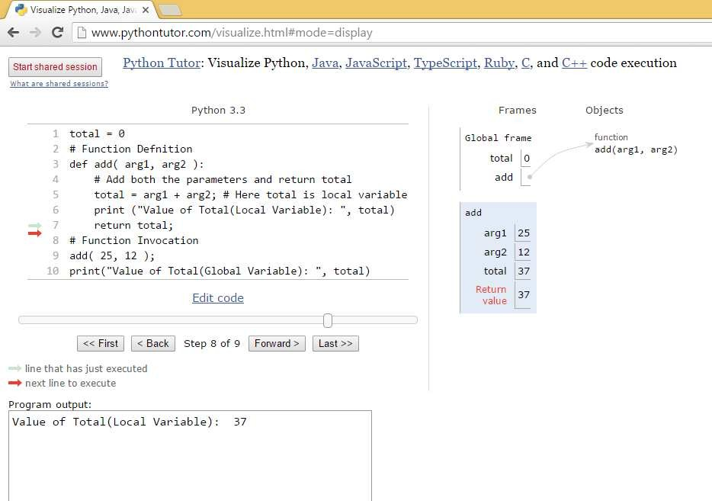
Introduction to Python Tutor…
88
Observe the change in values of variables during execution and contents of frames and objects
Click here to visualize the step-by-step execution of your code

Slide 89
Standard Library

Slide 90
Math Module
90
Provides access to mathematical functions like power, logarithmic, trigonometric, hyperbolic, angular conversion, constants etc;
Few functions are described below:
Function | Description
abs(x) | Absolute value of x: the (positive) distance between x and zero
ceil(x) | Ceiling of x: smallest integer not less than x
cmp(x, y) | -1 if x < y, 0 if x == y, or 1 if x > y
exp(x) | Exponential of x: e^{x}
floor(x) | Floor of x: the largest integer not greater than x
max(x1, x2,...) | Largest of its arguments: the value closest to positive infinity
min(x1, x2,...) | Smallest of its arguments: the value closest to negative infinity
pow(x, y) | Value of x**y
round(x [,n]) | x rounded to n digits from the decimal point.
sqrt(x) | Square root of x for x > 0

Slide 91
String Module
91
Includes built-in methods to manipulate strings. Consider the string, str = Infosys
Method | Result | Description
str.count(“s”) | Returns count of occurrence of character “s” in string str | 2
str.startswith(“s”) | Returns true if string str starts with character “s” | false
str.endswith(“s”) | Returns true if string str ends with character “s” | true
str.find(“s”) | Returns index position of character “s” in string str if found else -1 | 4
str.replace(“s”, “S”) | Replaces all occurrences of character “s” with character “S” in string str | InfoSyS
str.isdigit() | Checks if all the characters in string str are digits and returns true or false accordingly | false
str.upper() | Converts all the characters in string str to uppercase | INFOSYS
str.lower() | Converts all the characters in string str to lowercase | infosys
Guided Activity: Assignment 43: Strings built-in functions

Slide 92
List module
92
Built-in functions and methods in lists
Function | Description
cmp(list1, list2) | Compares elements of both lists
len(list) | Gives total length of list
max(list) | Returns item from the list with maximum value
min(list) | Returns item from the list with minimum value
list(seq) | Converts a tuple to list
list.append(obj) | Appends object obj to list
list.count(obj) | Returns count of how many times obj occurs in list
list.insert(index, obj) | Inserts object obj into list at offset index
obj = list.pop() | Removes the item at position -1 from list and assigns it to obj
list.remove(obj) | Removes object obj from list
list.reverse() | Reverses the order of items in list
sorted(list) | Sorts items in list
Guided Activity: Assignment 44, 45, 46, 47, 48: Lists

Slide 93
Date and Time Module
93
Supplies classes for manipulating dates and times in both simple and complex ways.
Import time module. Ex: Print(time.localtime())
Function | Description
time.clock() | Returns current time in seconds, given as a floating point number
time.gmtime() | Returns current UTC date and time (not affected by timezone)
time.localtime() | Returns time based on the current locality (is affected by timezone)
time.timezone() | Returns the number of hours difference between your tomezone and the UTC time zone (London)
time.time() | Returns the number of seconds since January 1st 1970.
time.sleep(secs) | Suspends execution of the current thread for the given number of seconds
time.daylight() | Returns 0 if you are not currently in Daylight Savings Time

Slide 94
Regular Expressions in Python

Slide 95
Regular Expression
95
Special sequence of characters to match or find other strings or set of strings, using a specialized syntax held in a pattern.
Widely used in languages like UNIX, PHP, Perl.
Module re provides support for regular expressions in Python.
re module raises re.error exception if an error occurs while compiling or using a regular expression

Slide 96
Functions in re module
96
Import re module to access methods in re module
Some important functions in re module:
match function
– attempts to match re pattern to string with optional flags
Syntax:
re.match(pattern, string, flags=0)
findall function
– Returns all non – overlapping matches of re pattern in a given string
Syntax:
re.findall(pattern, string, flags=0)
Guided Activity: Assignment 49, 50: Regular Expression

Slide 97
Functions in re module
97
search function
– Searches for first occurrence of re pattern within string with optional flags.
Syntax:
re.search(pattern, string, flags=0)
match checks for a match only at the beginning of string, while search checks for a match anywhere in the string.
sub function
– Substitutes all occurrences of the re pattern in string with repl, replacing all occurrences unless max provided. Returns modified string.
Syntax:
re.sub(pattern, repl, string, max=0)
Guided Activity: Assignment 51, 52: Regular Expression

Slide 98
Module

Slide 99
Module
99
Allows logical organization of code.
Grouping related code into module makes it easier to understand and use.
Can be used to define functions, classes and variables.
It is a file and may have runnable code.
import Statement
– Any Python source file can be used as a module by executing an import statement in any other Python source file
Syntax:
import module1[, module2[,... moduleN]
When the interpreter encounters the import statement, it imports the module if it is present
Module is loaded only once regardless of the number of times it is imported
Copyright © 2015 - 2016, Infosys Limited

Slide 100
Packages and its elements

Slide 101
Packages
101
Packages are namespaces which contain multiple packages and modules
Collection of modules in directory
Must have init .py file
May contain subpackages
_init_.py can be empty or it contains valid python code
_init_.py indicates that the directory it contains is a package and it can be imported the same way as a module
Ex: foo.abc
Module abc belongs to package named foo
Users of the package can import individual modules from the package
Ex: import sound.effects.echo
This loads the submodule sound.effects.echo. It must be referenced with its full name.
Copyright © 2015 - 2016, Infosys Limited

Slide 102
File Operations

Slide 103
File operations
103
A file is a chunk of logically related data or information which can be used by computer programs.
Python provides some basic functions to manipulate files
open Function
Syntax:
file object = open(file_name [, access_mode][, buffering])
close Function
Syntax:
fileObject.close()
write Function
Syntax:
fileObject.write(string)
read Function
Syntax:
fileObject.read([count])

Slide 104
open Function
104
Used to open or create a file
Syntax:
file object = open(file_name [, access_mode][, buffering])
file_name: Name of the file that you want to access
access_mode: determines the mode in which the file is to be opened, like read, write, append, etc
buffering: If the buffering value is set to 0, no buffering takes place. If the buffering value is 1, line buffering is performed while accessing a file.
Once a file is opened following list of attributes can get information related to file
Attribute | Returns (Description)
file.close | true if file is closed, false otherwise.
file.mode | access mode with which file was opened
file.name | name of the file.

Slide 105
open Function…
105
Example:
# Open a file
result = open("foo.txt", "w") print("Name of the file: ", result.name) print("Closed or not : ", result.closed) print("Opening mode : ", result.mode)
Output:
Name of the file: foo.txt Closed or not : False Opening mode : w

Slide 106
close() Function
106
flushes any unwritten information and closes the file object, after which no more writing can be done.
Syntax:
fileObject.close()
Example:
# Open a file
result = open("foo.txt", "w") print("Name of the file: ", result.name)
# Close opened file
result.close()
Output:
Name of the file: foo.txt

Slide 107
write Function
107
Writes any string to an open file.
Strings can have binary data or text data.
Does not add a newline character ('\n') to the end of the string
Syntax:
fileObject.write(string)
Example:
# Open a file
result = open("foo.txt", "w")
result.write( "Python is a great language.\nYeah its great!!\n");
# Close opened file
result.close()
Output:
Contents of file foo.txt: Python is a great language. Yeah its great!!

Slide 108
read Function
108
Reads a string from an open file.
Syntax:
fileObject.read([count])
Parameter ‘count’ is the number of bytes to be read from the opened file.
It starts reading from the beginning of the file and if count is missing, then it tries to read as much as possible, maybe until the end of file.
Example:
# Open a file
result = open("foo.txt", "r+") sentence = result.read(10);
print ("Read String is : ", sentence)
# Close opened file
result.close()
Output:
Read String is : Python is

Slide 109
Errors and Exception Handling

Slide 110
Errors and Exception handling
110
Used to handle any unexpected error in Python programs
Few Standard Exceptions:
Exception Name | Description
Exception | Base class for all exceptions
Arithmetic Error | Base class for all errors that occur for numeric calculation
Floating Point Error | Raised when a floating point calculation fails.
Zero Division Error | Raised when division or modulo by zero takes place for all numeric types.
IO Error | Raised when an input / output operation fails, such as print() or open() functions when trying to open a file that does not exist.
Syntax error | Raised when there is a error on Python syntax
Indentation error | Raised when indentation is not specified properly
Value Error | Raised when built-in-function for a data type has a valid type of arguments, but the arguments have invalid values specified
Runtime Error | Raised when a generated error does not fall into any category

Slide 111
Handling an Exception
111
Exception is an event, which occurs during the execution of program and disrupts the normal flow of program’s instructions.
When a Python script raises an exception, it must either handle the exception immediately otherwise it terminates and quits.
If you have some suspicious code that may raise an exception, you can defend your program by placing the suspicious code in a try: block.
After the try: block, include an except: statement, followed by a block of code which handles the problem as elegantly as possible.
Different ways of Exception Handling in Python are:
try….except…else
try…except
try…finally

Slide 112
Handling an Exception…
112
Try to open the same file when you do not have write permission, it raises an exception
try…except…else
A single try statement can have multiple except statements
Useful when we have a try block that may throw different types of exceptions
Code in else-block executes if the code in the try: block does not raise an exception
Syntax:
try:
You do your operations here;
......................
except ExceptionA:
If there is ExceptionA, then execute this block.
except ExceptionB:
If there is ExceptionB, then execute this block.
......................
else:
If there is no exception then execute this block
Example:
try:
fh = open("testfile", "w") fh.write("This is my test file")
except IOError:
print ("Error: can\'t find file or read data") else:
print ("Written content to file successfully") fh.close()
Output:
Written content to file successfully

Slide 113
Handling an Exception…
113
try…except..
Catches all exceptions that occur
It is not considered as good programming practice though it catches all exceptions as it does help the programmer in identifying the root cause of the problem that may occur.
Try to write to the file when you do not have write permission, it
Syntax:
try:
You do your operations here;
......................
except ExceptionA:
If there is ExceptionA, then execute this block.
except ExceptionB:
If there is ExceptionB, then execute this block.
......................
Example:
try:
raises an exception
fh = open("testfile", "w")
fh.write("This is my test file for exception handling!!")
except IOError:
print ("Error: can\'t find file or write data")
Output:
Error: can't find file or write data

Slide 114
Handling an Exception…
114
try…finally..
finally block is a place to put any code that must execute irrespective of try-block raised an exception or not.
else block can be used with finally block
Try to write to the file when you do not have write permission
Syntax:
try:
You do your operations here;
......................
Due to any exception, this may be skipped.
finally:
This would always be executed.
......................
Example:
try:
fh = open("testfile", "w")
fh.write("This is my test file for exception handling!!")
finally:
print("Error: can\'t find file or write data")
Output:
Error: can't find file or write data

Slide 115
References
115
Books:
Head First Programming, Apress Publications
Head First Python, Apress Publications
Beginning Python, Apress Publications
E-Books:
http://www.diveintopython3.net/
Tutorials:
http://www.pythontutor.com/
http://www.learnpython.org/
https://docs.python.org/2/tutorial/index.html
http://en.wikibooks.org/wiki/Non-Programmer%27s_Tutorial_for_Python_3/Intro https://developers.google.com/edu/python/introduction

Slide 116

Thank You
© 2013 Infosys Limited, Bangalore, India. All Rights Reserved. Infosys believes the information in this document is accurate as of its publication date; such information is subject to change without notice. Infosys acknowledges the proprietary rights of other companies to the trademarks, product names and such other intellectual property rights mentioned in this document. Except as expressly permitted, neither this documentation nor any part of it may be reproduced, stored in a retrieval system, or transmitted in any form or by any means, electronic, mechanical, printing, photocopying, recording or otherwise, without the prior permission of Infosys Limited and/ or any named intellectual property rights holders under this document.

Slide 117
Appendix

Slide 118
Python v/s Java
118
Python | Java
Dynamic Typing and weak typing | Static Typing and strong typing
Does not require declaration of variables before usage | Requires declaration of variables before usage
Allows change of data type of a variable during run-time | Does not allow change of data type of a variable after declaration
Uses indentation to separate code into blocks | Uses brackets to separate code into blocks
Easy to learn | Needs more time compared to Python
Simple and consistent syntax | Complex syntax
Helps beginners to concentrate on problem decomposition and data type design | Beginners spend their initial days on learning to declare and use data variables
Concise, compact and clean looking syntax | Not compact
Print statement automatically inserts spaces and newline | ‘\n’ or a space should be used to insert a space or newline

Slide 119
Type Conversion
119
Conversion of data type of a variable from one to other
Following are few built-in types available to convert between types
Function | Description
int(a) | Converts ‘a’ to an integer
long(a) | Converts ‘a’ to a long integer
float(a) | Converts ‘a’ to a floating – point number
complex (real [,imag]) | Creates a complex number
str(a) | Converts object ‘a’ to a string representation
eval(a) | Evaluates a string and returns an object
tuple(a) | Converts ‘a’ to a tuple
list(a) | Converts ‘a’ to a list.
set(a) | Converts ‘a’ to a set.
dict(a) | Creates a dictionary. ‘a’ must be a sequence of (key, value) tuples.

Slide 120
Lambda or Anonymous Functions
120
‘lambda’ keyword is used to define anonymous functions
Anonymous functions are not defined in the standard manner using ‘def’ keyword
Can take any number of arguments but, return only one value in the form of an expression
Cannot be direct call to print as lambda requires an expression
They have their own namespace and cannot access variables in either in local or global namespaces
Note: They are not equivalent to inline statements in C and C++
Syntax contains only a single statement
Syntax:
lambda [arg1, [ ,arg2,……..argn ] ] : expression

Slide 121
Lambda or Anonymous Functions
121
Example :
# Function definition
total = lambda num1, num2: num1 + num2
# Function Invocation
print ("Value of total : ", total( 8, 25 )) print ("Value of total : ", total( 56, 15 ))
Output:
Value of total : 33 Value of total : 71

Slide 122
Multithreading
122
Is running several threads concurrently similar to running different programs concurrently
Thread
Benefits:
Threads within a process can share same data space
Can share information or communicate more easily than if they were in separate processes
Called light-weight process and are cheaper than processes with less memory over-head
Has a beginning, an execution sequence and conclusion
Has an instruction pointer to keep track of the context it is currently running
Python provides built-in functions to perform operations on threads
Threads can be interrupted or temporarily put on hold (known as sleeping) while others are running – called yielding

