Slide 1
Software engineering Doctor Appointment Booking System
By
2110030110 – J. Laasya Kruthi
2110030100 – E. Srivardhan Reddy
2110030019 – I. N. Chiranjeevi
2110030041 – K. Shikha
Under the guidance of
Dr. shadab siddiqui

Slide 2
Problem statement and domain
In the healthcare service, we propose appointment scheduling problems and various applications and solution approaches in healthcare systems.
The problems are based on the flow of patients, patient preferences, and random arrival time and service.
What we plan to do is to provide the user with a solution to the problem they are facing. It has always fascinated me to imagine that we can get almost everything online then why can’t we get some trusted medical help using the same technology?

Slide 3
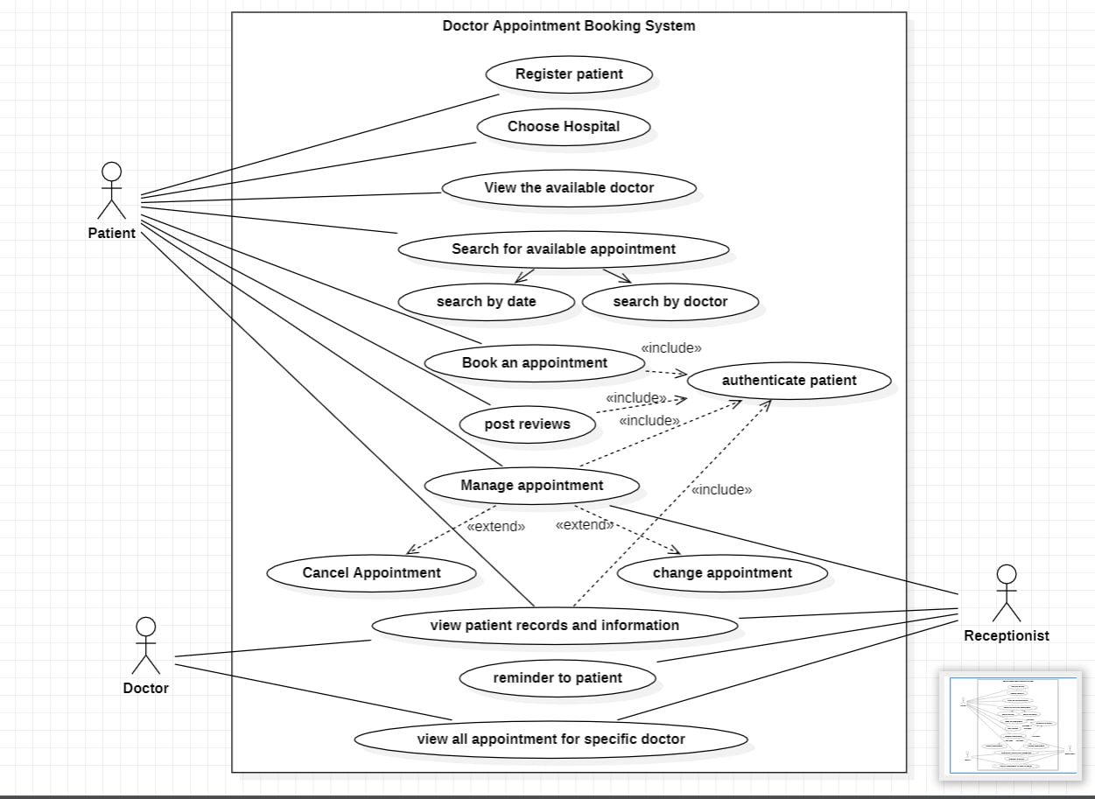
USE CASE DIAGRAM

Slide 4
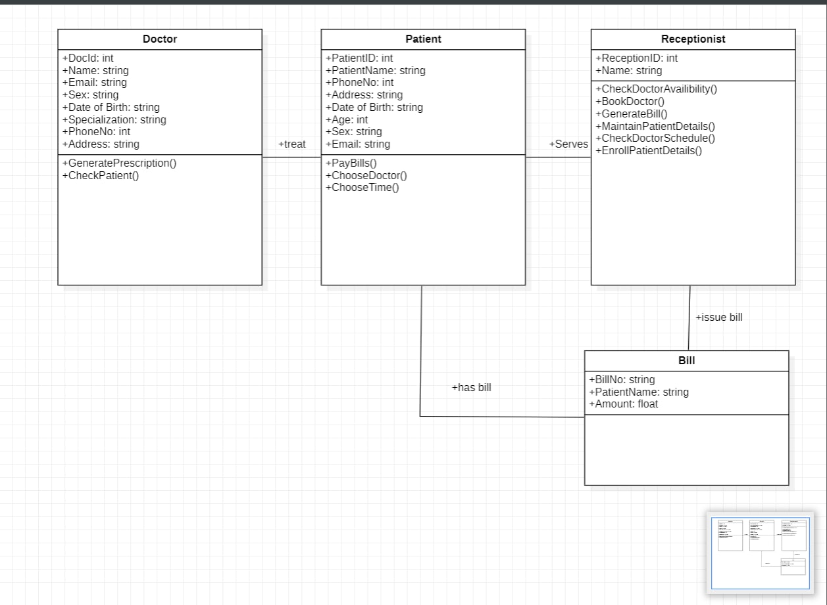
CLASS DIAGRAM

Slide 5
Literature review
Doctor appointment system is one of those medical technologies that make the lives of patients, doctors, and administration easier.
Making an appointment with a doctor in a few clicks online is one of the solutions that, in our opinion, can make a difference in the interaction between a doctor and a patient.
Benefits of doctor appointment system are
Reducing Patient Wait Times
Simplifying the Process of Finding a Doctor
Increasing Patient Satisfaction
24*7 booking: Anytime Anywhere
Multiple locations and multiple doctors

Slide 6
Proposed Algorithm Design Technique
One of the techniques for doctor appointment booking systems is E-marketing
Patient details such as contact numbers and emails are used for booking through the system. The database of patient information can be used for sending newsletters and the clinic can generate additional revenue.
They are 6 steps to design any pattern for E-marketing
1 Market and Customer Research
2 Selection of the Essential MVP (minimum viable product) Features
3 Design Creation
4 Ensuring Adherence to all the Legal Security Requirements
5 Software Development
6 Testing

Slide 7
FEATURES PROVIDED IN THIS BOOKING SYSTEM
Admin Login: The system is under supervision of admin who manages the bookings made.
User login/registration: Users have to first register themselves to login into the system.
Clinic areas: The system will provide users with three clinic areas of different locations.
Appointment availability check: User can click on spaces to view the availability.
Appointment booking online for date and time: Users can book appointment for their required date and time.
Automatic cost calculation: The system calculates the total cost incurred for parking based on the time that user has asked for booking.
Booking cancellation: User may even cancel their bookings by login into the system anytime.
Email on appointment booking: When user is successful in appointment confirmation and 'thank you' email regarding the a lot booked.
Feedback: The system has a feedback form, where user can provide feedback into the system.

Slide 8
functionality
User side functionality:
Book appointment
Cancellation
Receipt
Feedback
Recharge Account
Admin side functionality:
Administers booked
Cancellation
View User Data
Feedback view and reply

Slide 9
Dataset collection
A data set is a structured collection of data points related to a particular subject. A collection of related data sets is called as a database.
Items of related data are:
Patient Details
Contact No.
Name
Gender
Age
2. Doctor Details
Contact No.
Name
Specialization

Slide 10
Tools required
Software Requirements:
JDK 18
SQL 2019
Visual studio 2022
Service Requirements:
Heroku
Discord
Telegram
Gmail
GitHub

Slide 11
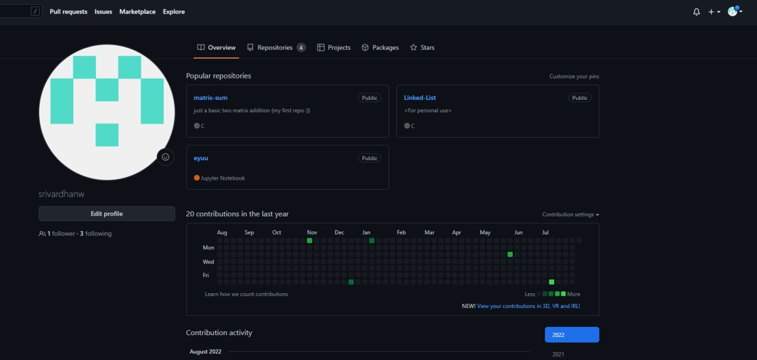
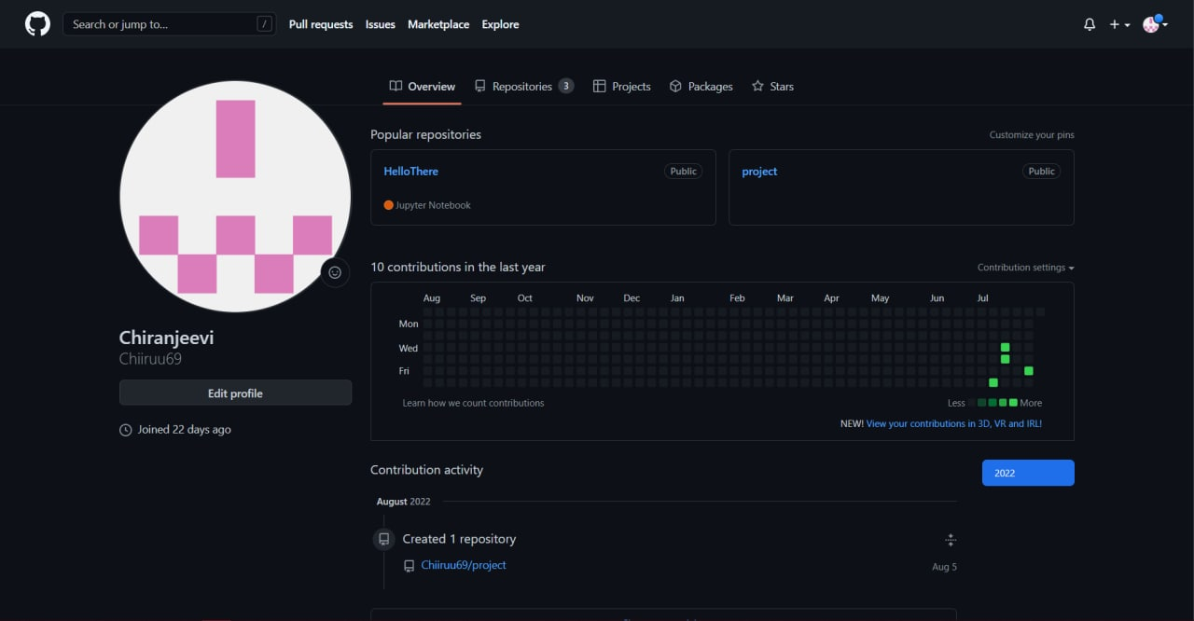
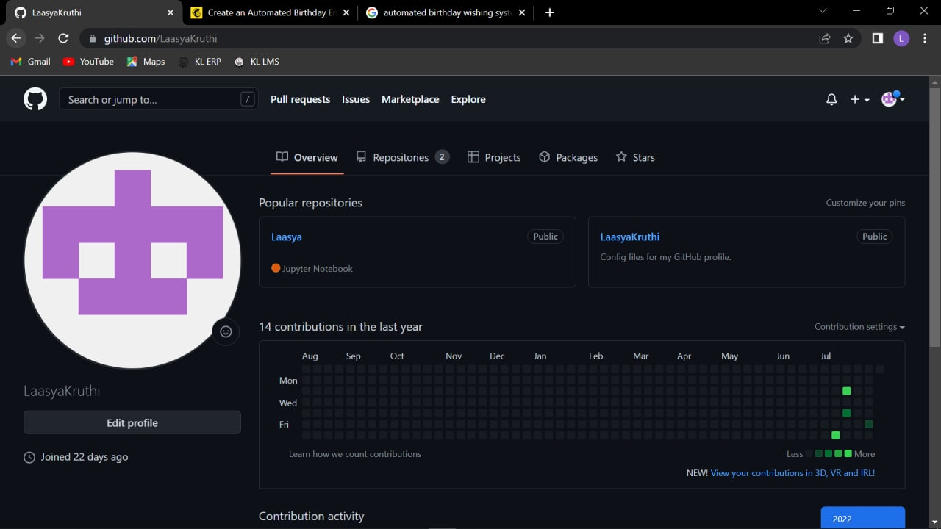
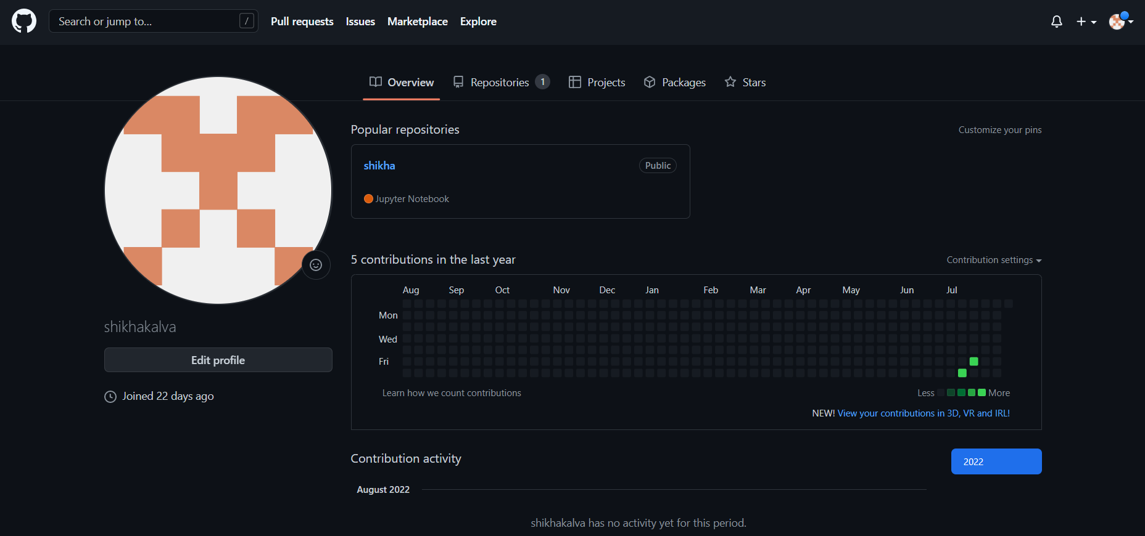
GitHub Setup
GIT HUB SETUP

Slide 12
Individual roles of group members
Modelling figures : 2110030041, 2110030110
Data collection : 2110030019, 2110030100
Design : 2110030041, 2110030110

Slide 13


