Slide 1
Plant Leaf Disease Detection and Classification Using AI
Major Project Presentation
Mentor: Ms Rati Goyal
SHIKHAR SHARMA PIYUSH PANDEY UJJWAL SINGH YASH SRIVASTAVA

Slide 2
Introduction
Overview of the project
Detecting plant diseases early helps prevent crop losses and ensures food security
AI enables faster, more accurate diagnosis compared to traditional methods
Computer vision and deep learning techniques improve disease classification efficiency

Slide 3
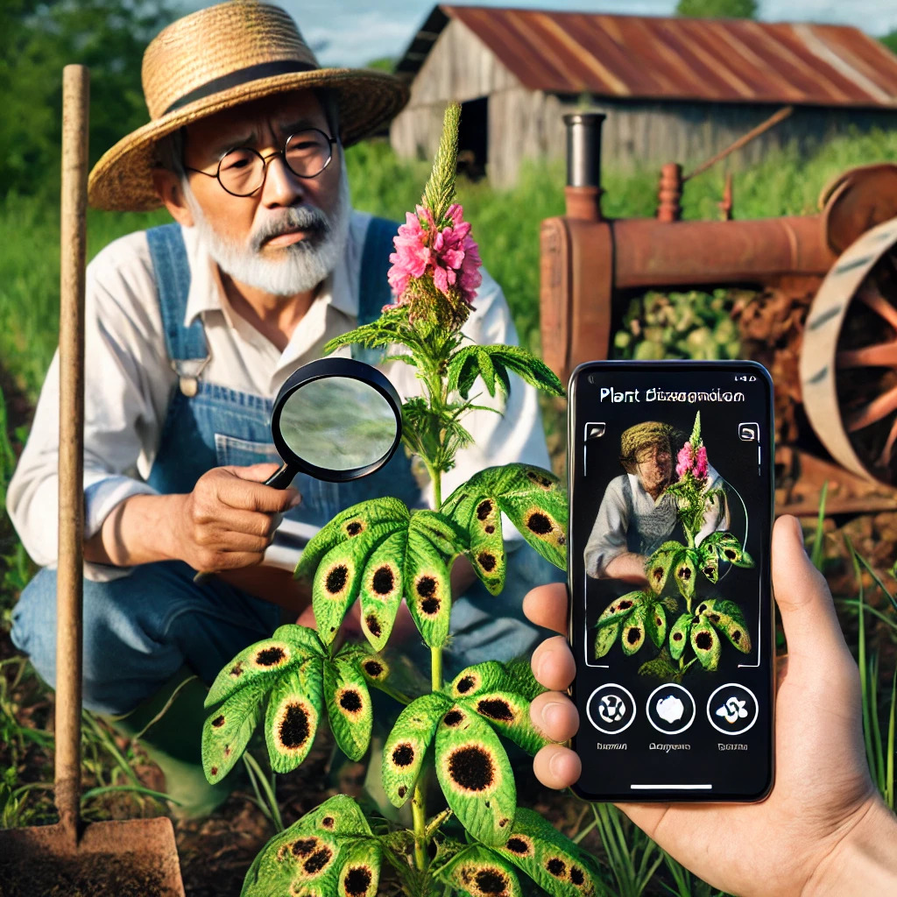
Problem Statement
Farmers struggle with identifying plant diseases early also traditional methods are time-consuming and inaccurate. Hence there is a need for an automated, AI-driven solution.

Slide 4
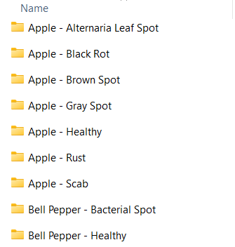
Dataset Description
Dataset: 'plant_data' containing 72 folders (each representing a different disease)
Each folder contains images of leaves affected by that disease
There are also sample images to test the model

Slide 5
Data Preprocessing
Transformations applied:
- Resize to (128x128)
- Convert to Tensor
- Normalize Images
Splitting dataset: 80% Training, 20% Testing
Data Augmentation for better generalization

Slide 6
CNN Model Architecture
Convolutional Neural Network (CNN) Model:
-2 Convolutional Layers (ReLU + MaxPooling)
-Fully Connected Layers
-Output Layer (Softmax for classification)
Activation Functions: ReLU, Softmax

Slide 7
Model Training
Loss Function: CrossEntropyLoss
Optimizer: Adam (Learning Rate = 0.001)
Epochs: 10
Training process with loss updates

Slide 8
Model Evaluation
Performance Metrics: Accuracy, Confusion Matrix
Accuracy Achieved: XX% (mention obtained accuracy)
Confusion Matrix visualization

Slide 9
Deployment Using Flask
Model saved as 'plant_disease_cnn.pth'
Web application built using Flask
User uploads an image -> Model predicts the disease -> Displays result on webpage

Slide 10
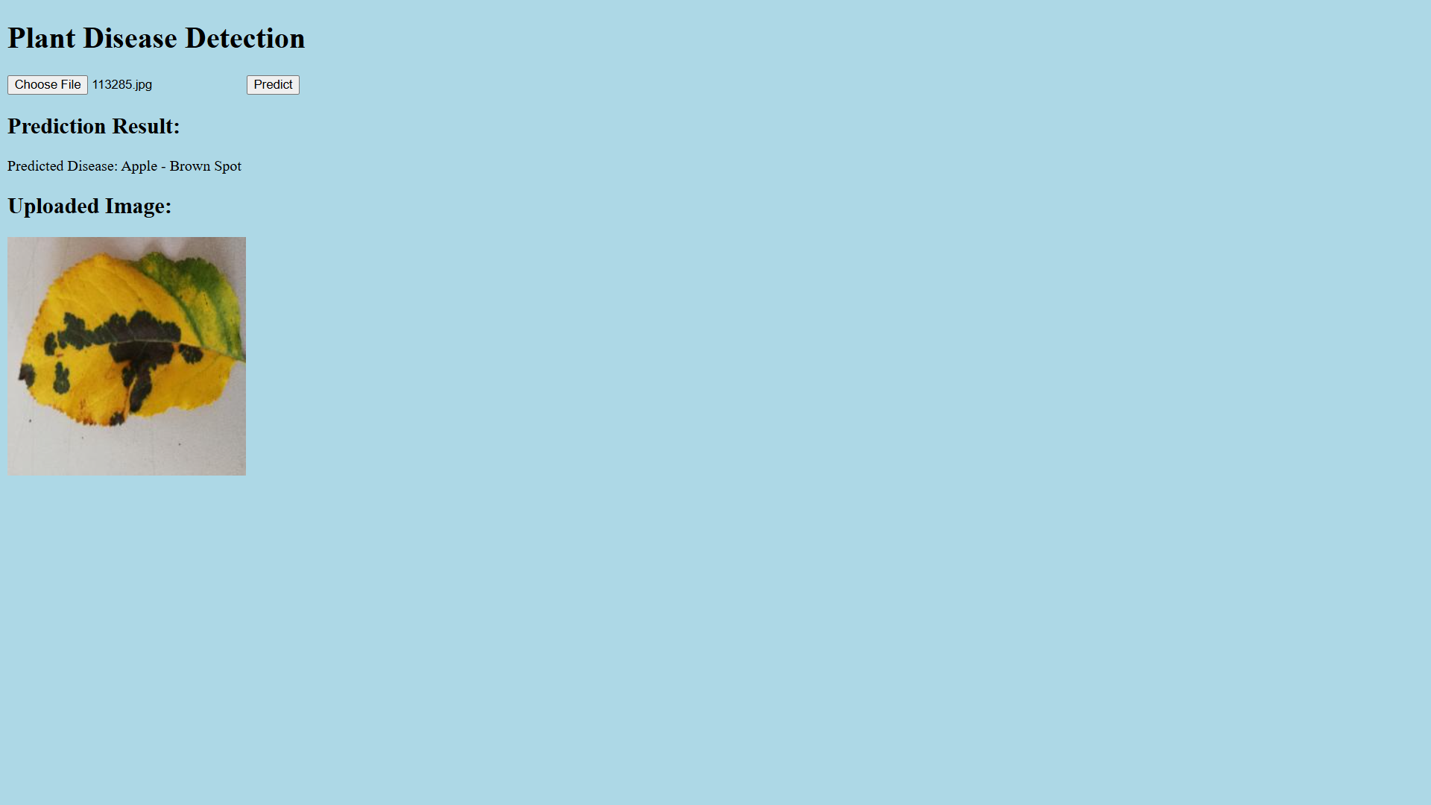
Web Interface

Slide 11
Challenges & Solutions
Issue: Wrong predictions for external images
Solution: Improved preprocessing & retraining with external data
Issue: Model accuracy improvement
Solution: Data augmentation and fine-tuning

Slide 12
Future Improvements
Increase dataset size with more real-world images
Optimize model for mobile applications
Extend classification to suggest treatment solutions
Implementation of other models like Yolov8

Slide 13
Conclusion
Summary of the project – Recaps the goal of detecting and classifying plant leaf diseases using AI. It emphasizes the importance of early detection in agriculture and how deep learning techniques were leveraged for accurate classification.
How AI helps in plant disease detection – Explains how AI-based models, particularly CNNs, process leaf images to classify diseases quickly and accurately compared to traditional manual methods.
Future scope and improvements – Suggests potential advancements like increasing dataset diversity, optimizing the model for mobile deployment, and integrating a treatment recommendation system for real-world use.

Slide 14
Thank You

