Slide 1
Lead Score Case Study
By
Mr. Dron Amrit
Ms. Mridusmita Goswami
Mr. Shikhar Saxena

Slide 2
Table of Contents
Problem statement
Business Goal
Solution methodology
Data manipulation
EDA
Data conversion
Model building
ROC curve
Conclusion

Slide 3
Problem statement of the Case Study
X Education sells online courses to industry professionals. On any given day, many professionals who are interested in the courses land on their website and browse for courses.
X Education gets a lot of leads, its lead conversion rate is very poor. If they acquire 100 leads in a day, only about 30 of them are converted.
To make this process more efficient, the company wishes to identify the most potential leads, also known as ‘Hot Leads’
If they successfully identify this set of leads, the lead conversion rate should go up as the sales team will now be focusing more on communicating with the potential leads rather than making calls to everyone

Slide 4
Business Goal of the Case Study
X Education wants to know the most promising leads.
To achieve the business goal a model needs to be built which will give Hot Leads.
The CEO, in particular, has given a ballpark of the target lead conversion rate to be around 80%.

Slide 5
Solution methodology:
Steps followed
Analysis of the data first by Data Loading and Data Understanding
Data Quality Check and Missing Values
  Removing the columns where missing values is very high.
  Identify and remove columns with high missing percentage (>45%)
  Get the column with null values more than 45%
  Dropped all columns from Data frame for which missing value percentage are more than 45%.
  Imputation of the missing values for less than 15% of total values.

Slide 6
Steps followed
  Performing the Univariate Analysis.
  Performing the Bi-variate Analysis.
  Finding the correlation among the dataset.
  Feature Scaling

Slide 7
Steps followed
  Model building
  Feature Selection Using RFE
  Checking VIFs
  Plotting the ROC Curve
  Evaluating the model by Precision and Recall

Slide 8
DATA MANIPULATION
Insights :
There are 9240 rows and 37 columns in the data set.
Many of the columns have null values.
Prospect ID and Lead Number both are unique values. Thus, they are redundant and one of them may be dropped. As Prospect ID is alphanumeric and also a larger sequence, hence it was dropped.
40% as a cutoff for missing values is considered

Slide 9
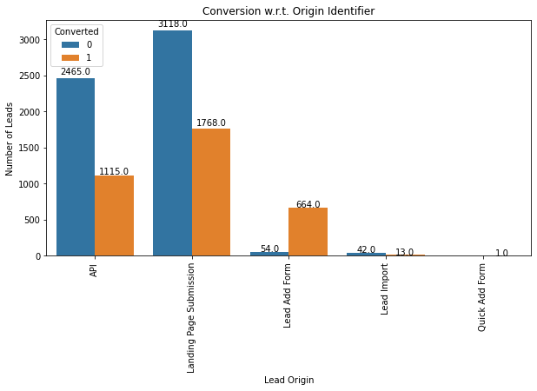
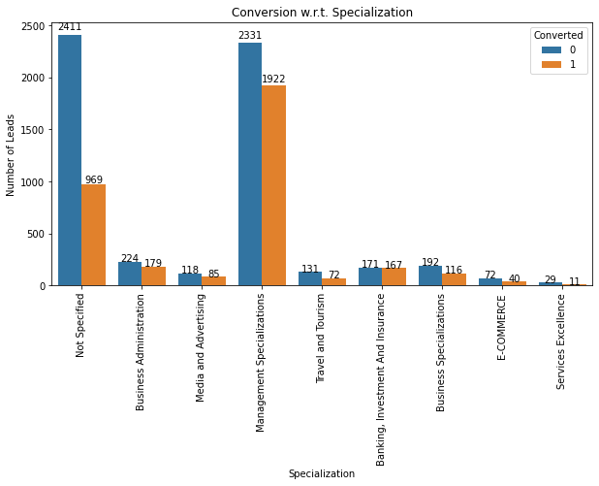
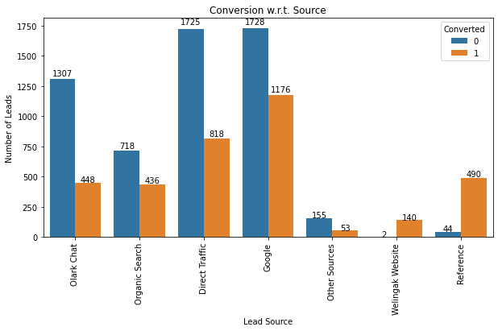
EDA

Slide 10
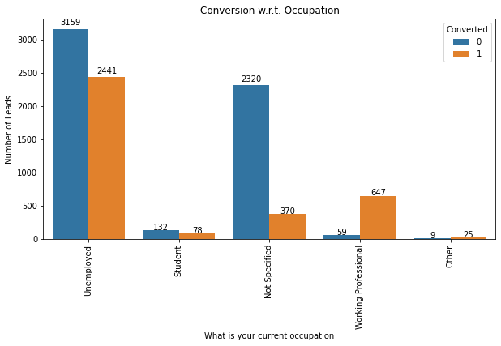
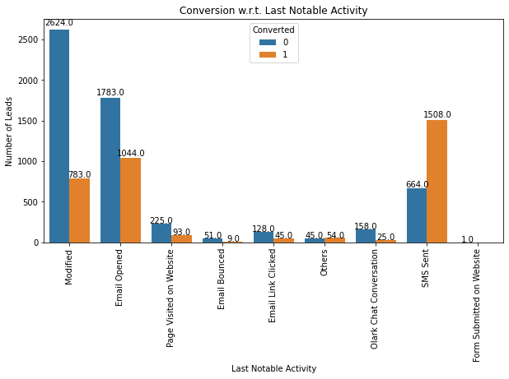
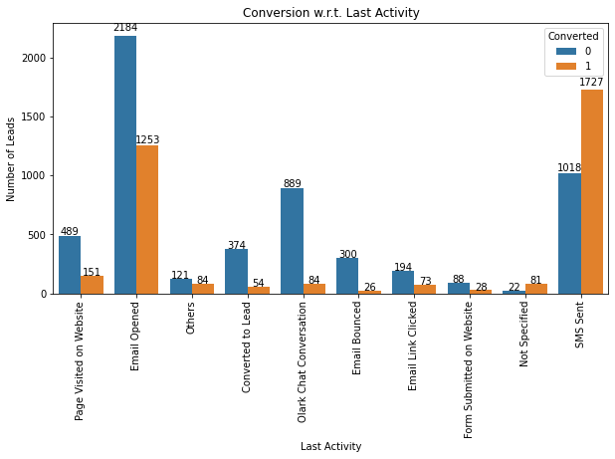
EDA

Slide 11
Variables impacting the conversion
It can be clearly seen that customers identified through the 'Lead add form' have higher conversion rate than rest of the identifiers
Leads received through references and Wellingkak Website have a greater chance to get converted
When the last activity performed by the customer is 'SMS Sent', then the chances of conversion are much higher (1727 converted out of 2745 which is more than 60% conversion)Overall accuracy on test dataset is 88%
Leads with management specialisation have the highest number of conversions while leads working in services have the lowest conversion in all specializations
When the Last Notable activity was 'SMS Sent', 1508 out of 2172 (close to 70%) of the leads were converted

Slide 12
Model building
Splitting our data into a training set and a test set.
Feature Selection Using RFE running RFE with 20 variables.
Dropping the variables having p-values greater than 0.05 and a value of VIF greater than 5
Overall accuracy on test dataset is 88%.

Slide 13
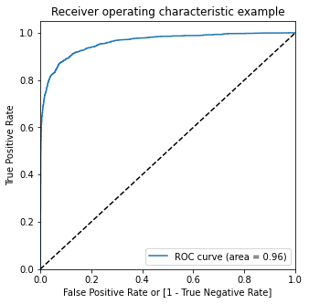
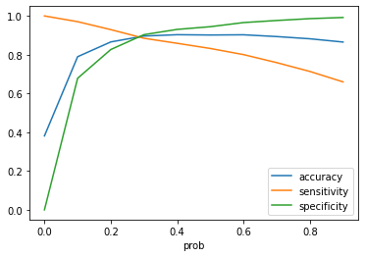
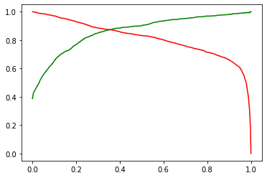
ROC Curve
Finding final optimal cutoff
  Optimal cut off probability is when we get balanced sensitivity and specificality
  Thus as per above, the cutoff can be considered as 0.38

Slide 14
Final Insights
Final Observation:
the values obtained for Train & Test:
A) Train Data:
Accuracy:89.6%
sensitivity:87.5%
specificity: 90.3%
B) Test Data:
Accuracy: 90.4%
Sensitivity: 88.5%
Specificity: 92.7%

Slide 15
Final Insights
The model seems to predict the conversion rate quite well
The top variables as per heatmap and residual coeffients:
Total Time Spent on the Website
Lead Origin_Lead Add Form
Last Activity_SMS Sent
Overall the model seems to be good one for Hot Leads.

Slide 16
Thank You

