Slide 1
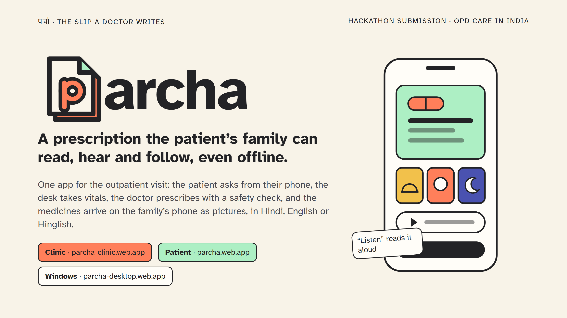
Notes:
Parcha means the slip a doctor writes. The promise is the whole job of that slip: the family can read it, hear it and follow it, with or without the internet. All three apps are live at these addresses with sample data; nothing on them is a real patient.

Slide 2
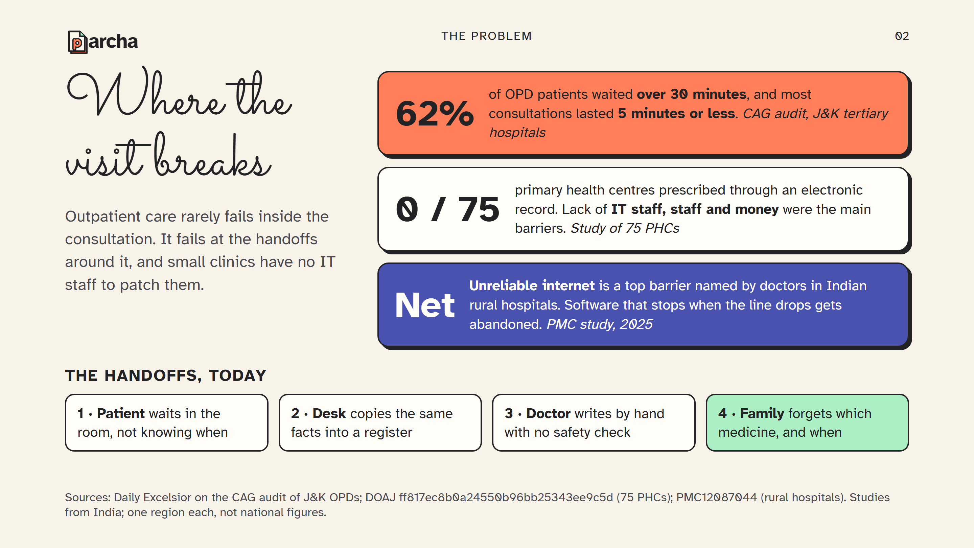
Notes:
Three numbers, each from a named source. 62 percent waited over half an hour for a consultation of five minutes or less. None of 75 primary health centres prescribed electronically, and the barrier was people and money, not interest. And the internet drops. Parcha is built around those three facts. These are single studies, so treat them as the shape of the problem, not national statistics.

Slide 3
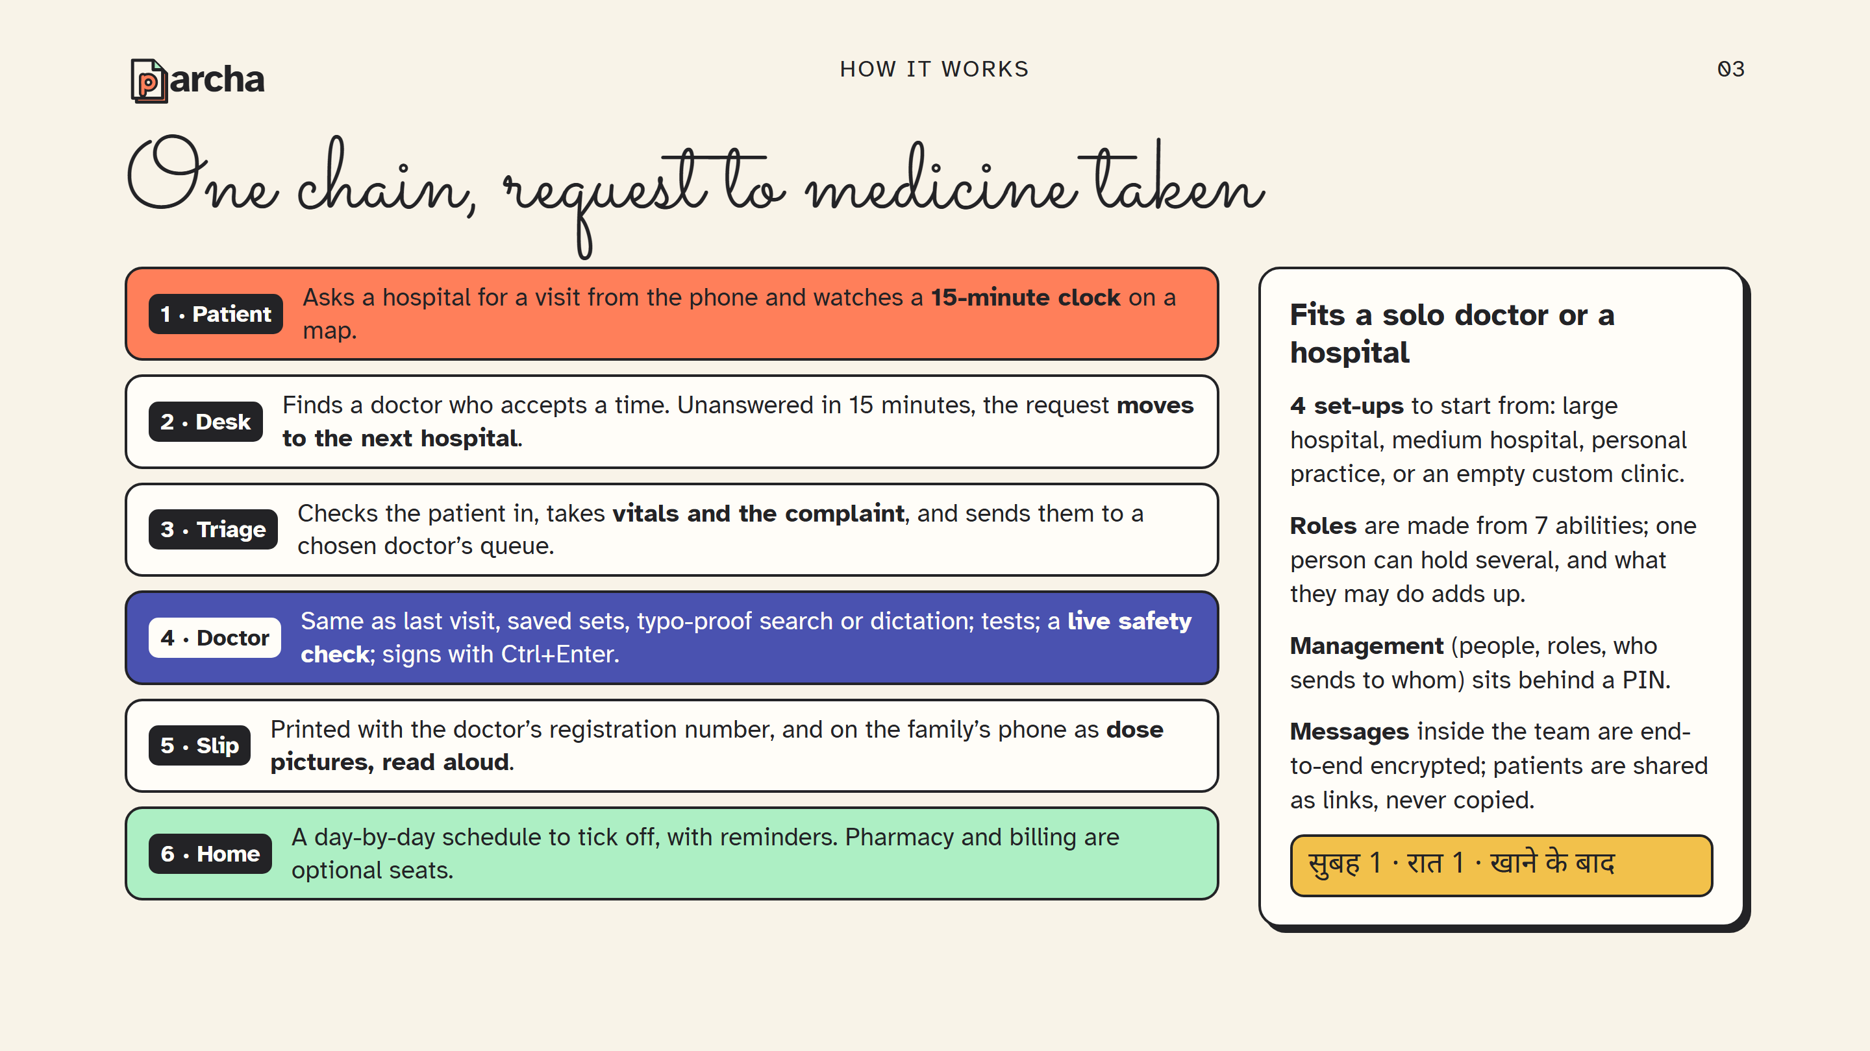
Notes:
Walk the six steps left to right in the room's order. The fast ways in for the doctor are the point of step four: the last visit's medicines, a saved set or a usual medicine are one tap each. Nothing is timed yet, so do not quote a number of seconds. The yellow line is how a dose reads on the patient's phone in Hindi: morning one, night one, after food.

Slide 4
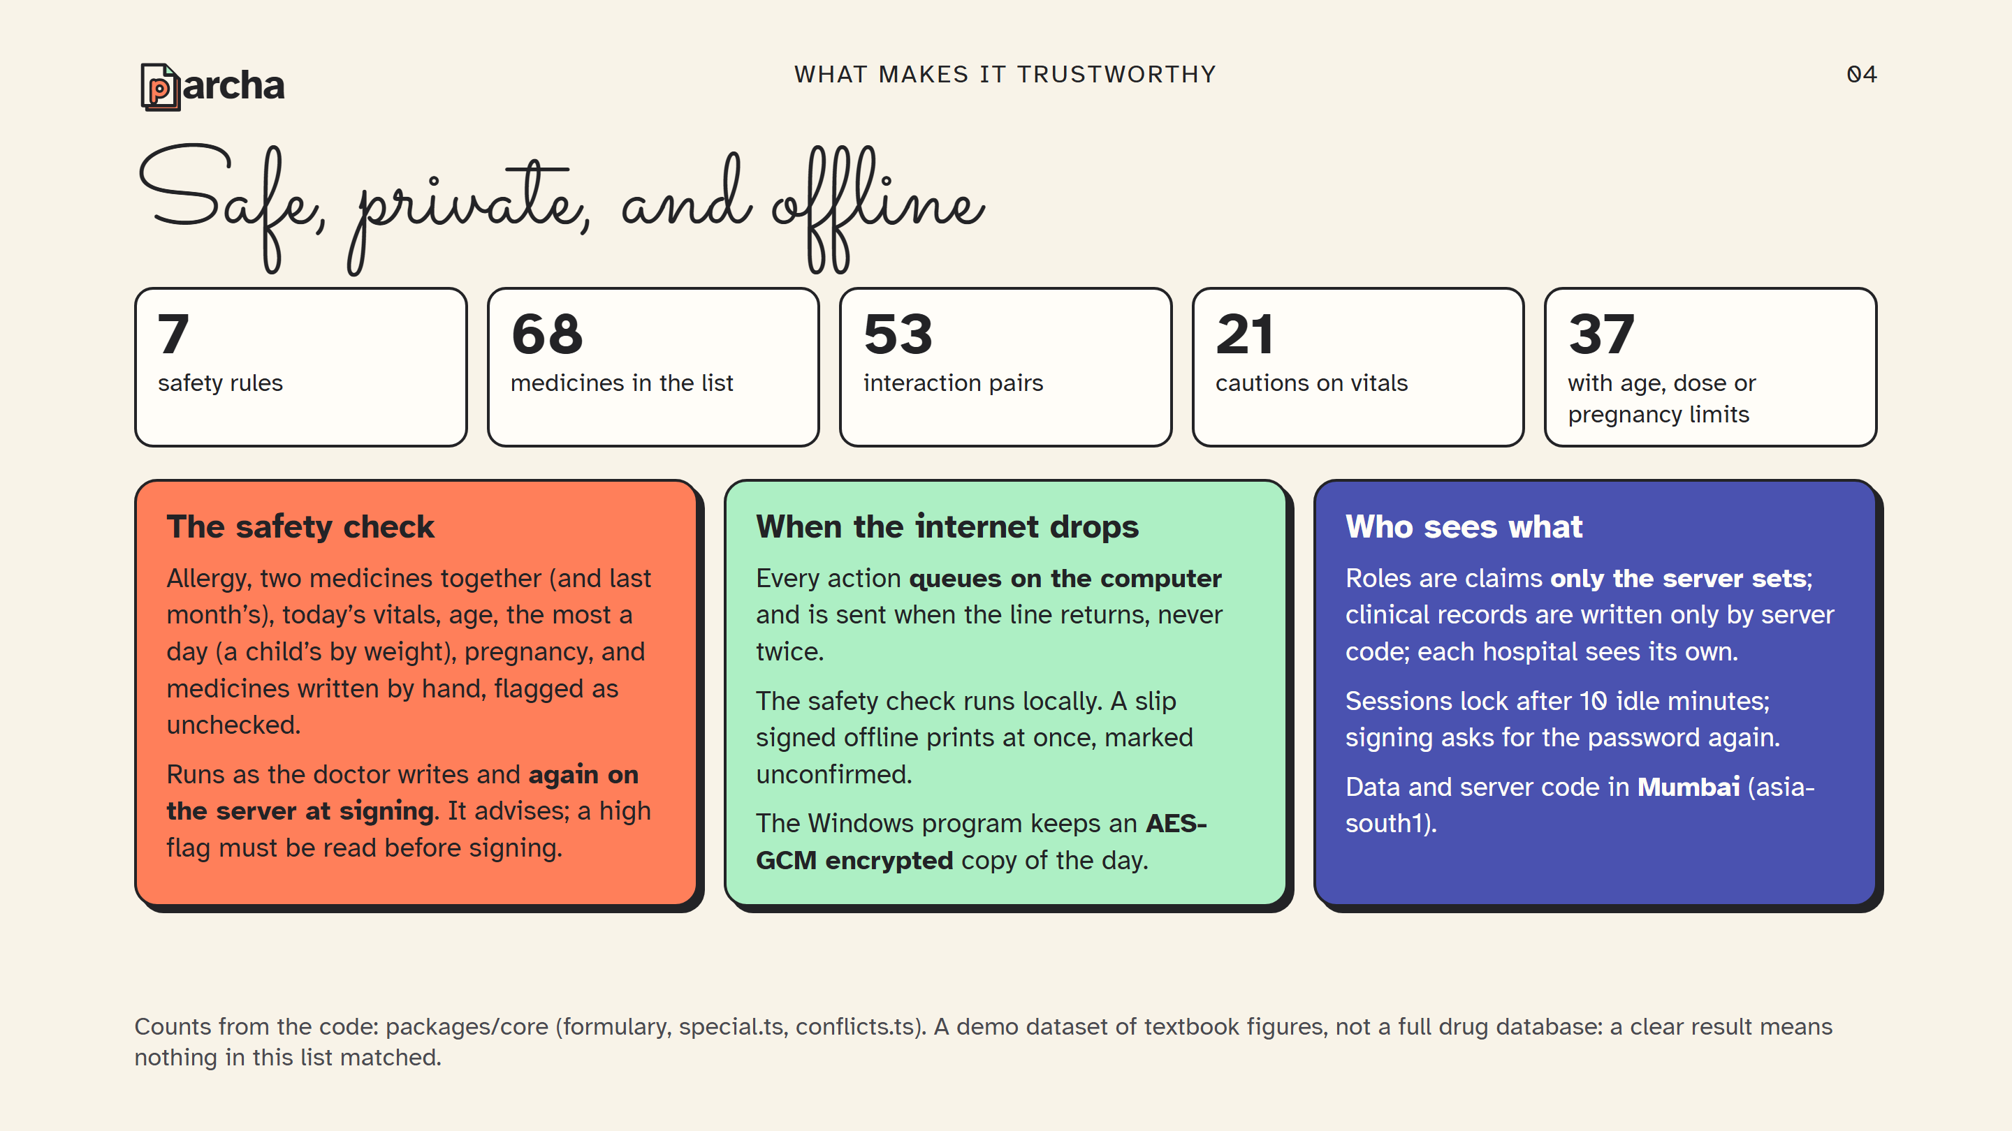
Notes:
The five numbers are counted from the repository, not estimated. Be precise about what the check is: deterministic rules over a hand-written list, the same code on the doctor's screen and on the server. It does not know every drug, and the screen says so. Medicines outside the list can still be written, and are marked as not checked.

Slide 5
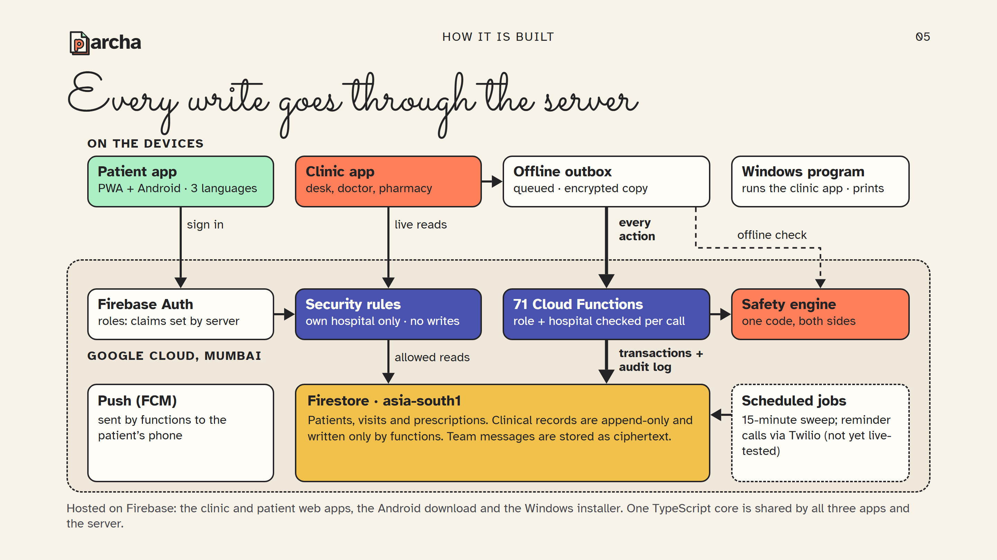
Notes:
Read it top to bottom. Every screen reads live, and the security rules decide what each person may see: staff only their own hospital, and a patient only the records on their own phone number. Every change goes the other way, as a call to a server function that checks the role and the hospital before it writes, inside a transaction, with an audit entry. When the internet is down, the actions wait in the outbox on the computer and the same safety code runs locally.

Slide 6
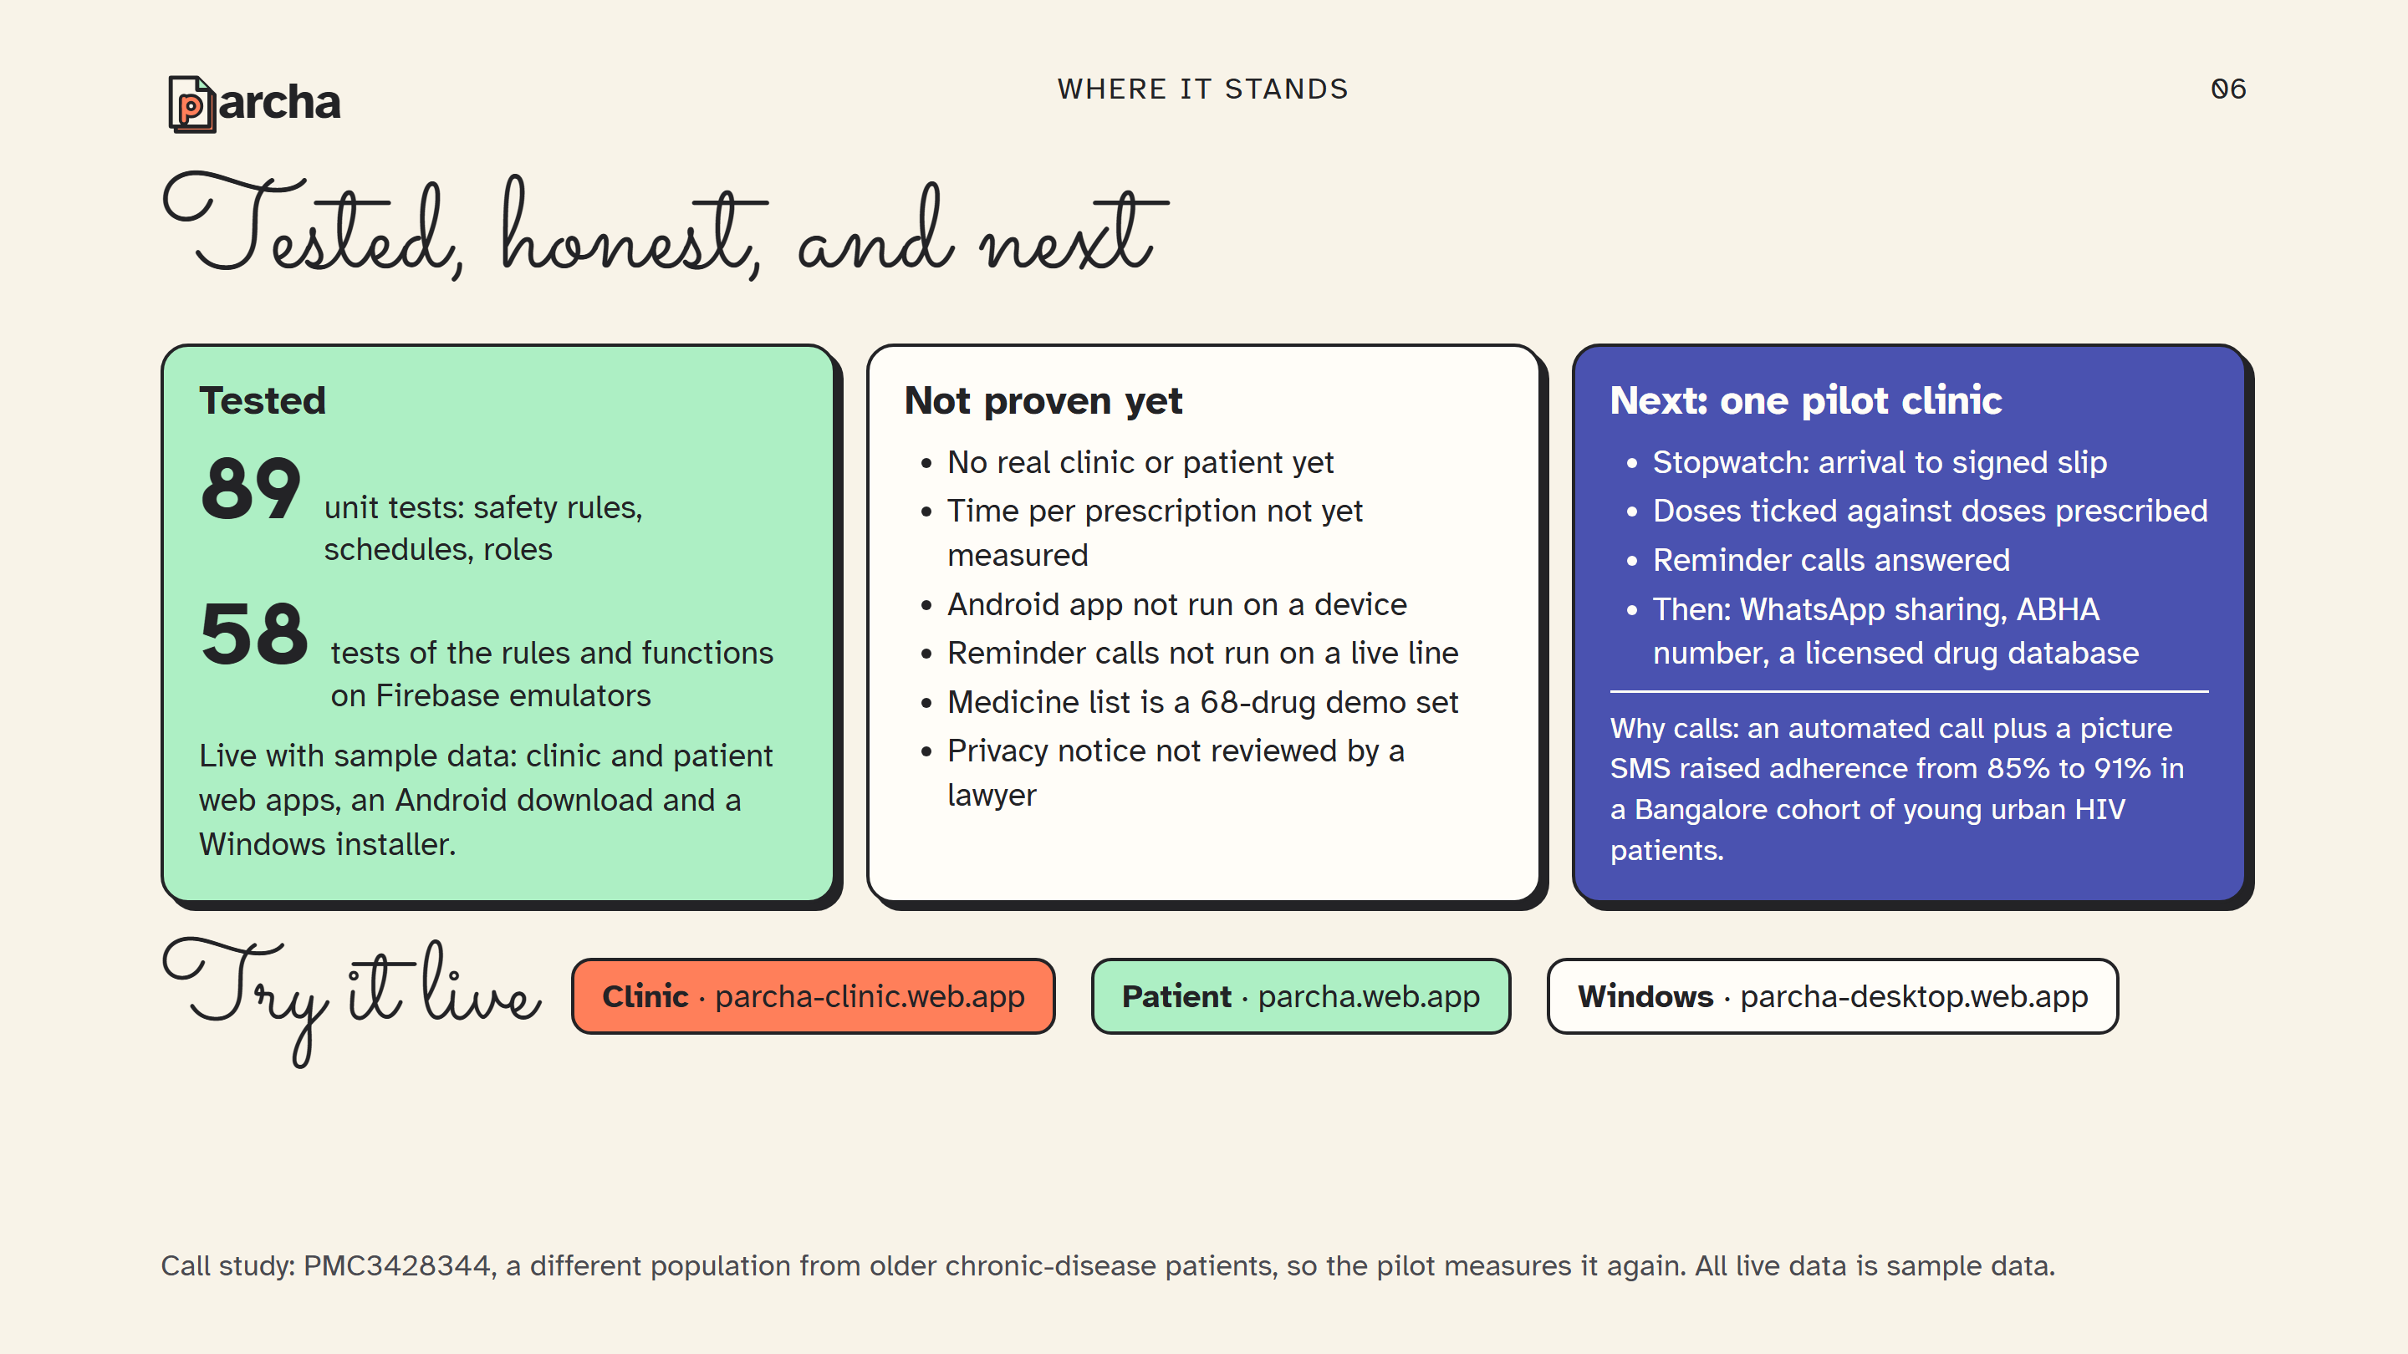
Notes:
Close on what is true. The software is tested, 89 unit tests and 58 tests against the Firebase emulators, and it is live with sample data. It has not met a real clinic yet, and every unproven part is listed. The next step is a pilot with one clinic, measuring three things with a stopwatch and the app's own records. The call study is the reason reminders are phone calls, but it was a different population, so the pilot has to prove it again.

