Slide 1
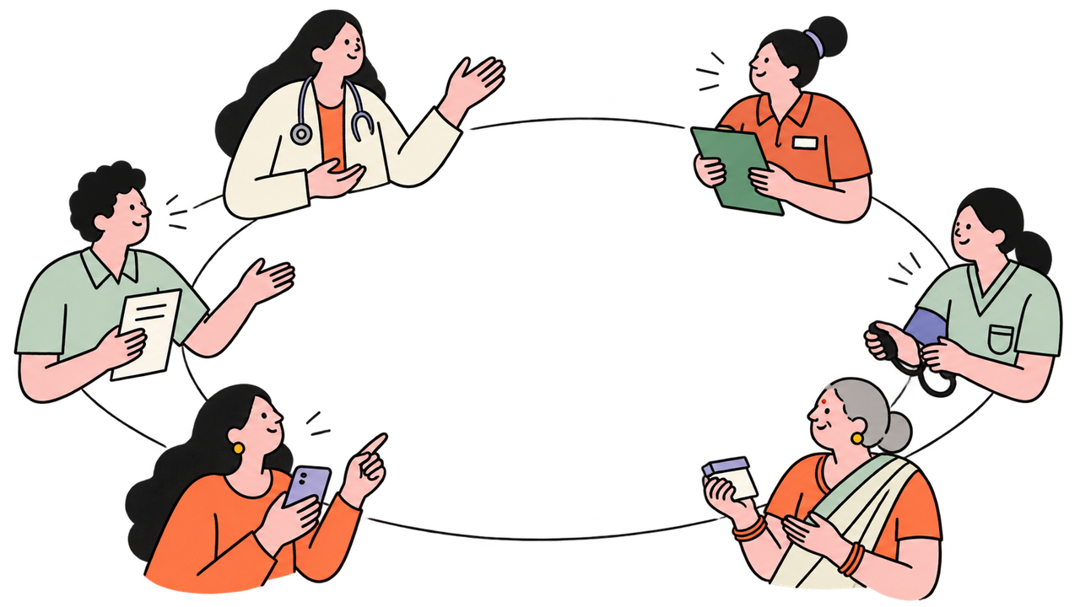

THEME: MEDTECH
01
Team Afterburners
Shikhar Shahi
Priyam Srivastava
Bhanu Pratap Singh
Parcha
One visit. Care that follows.
1 in 20
patients experience preventable
medication-related harm globally
WHO, 2024: 100 studies / 487,162 patients
Notes:
Parcha connects the clinic visit to the medicine routine at home. The problem figure is a pooled global estimate, not an India-specific rate, not a prevalence of unclear labels, and not an app result. WHO 2024 reviewed 100 studies involving 487,162 patients. The pooled prevalence of preventable medication-related harm was 5% (one in twenty). Most evidence was hospital-based, and the review calls for more primary-care research. No pilot outcome or reduction in harm is claimed.
Sources:
C:/Users/royal/Desktop/Parcha/README.md
https://www.who.int/publications/i/item/9789240088887
https://iris.who.int/bitstream/handle/10665/376203/9789240088887-eng.pdf
User photographs are examples of information separation, not a diagnosis, safety assessment of a pictured product, or evidence of its efficacy. Illustrated assets were generated using the two user-supplied style references.
Team: Afterburners. Theme: Medtech. Members: Priyam Srivastava, Bhanu Pratap Singh, Shikhar Shahi. Team and theme supplied by the user.

Slide 2
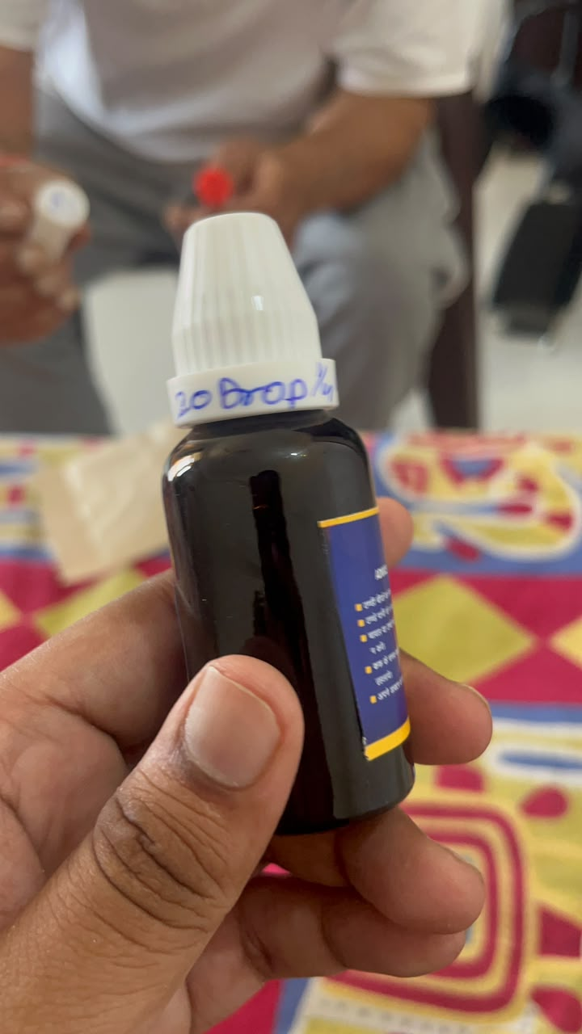
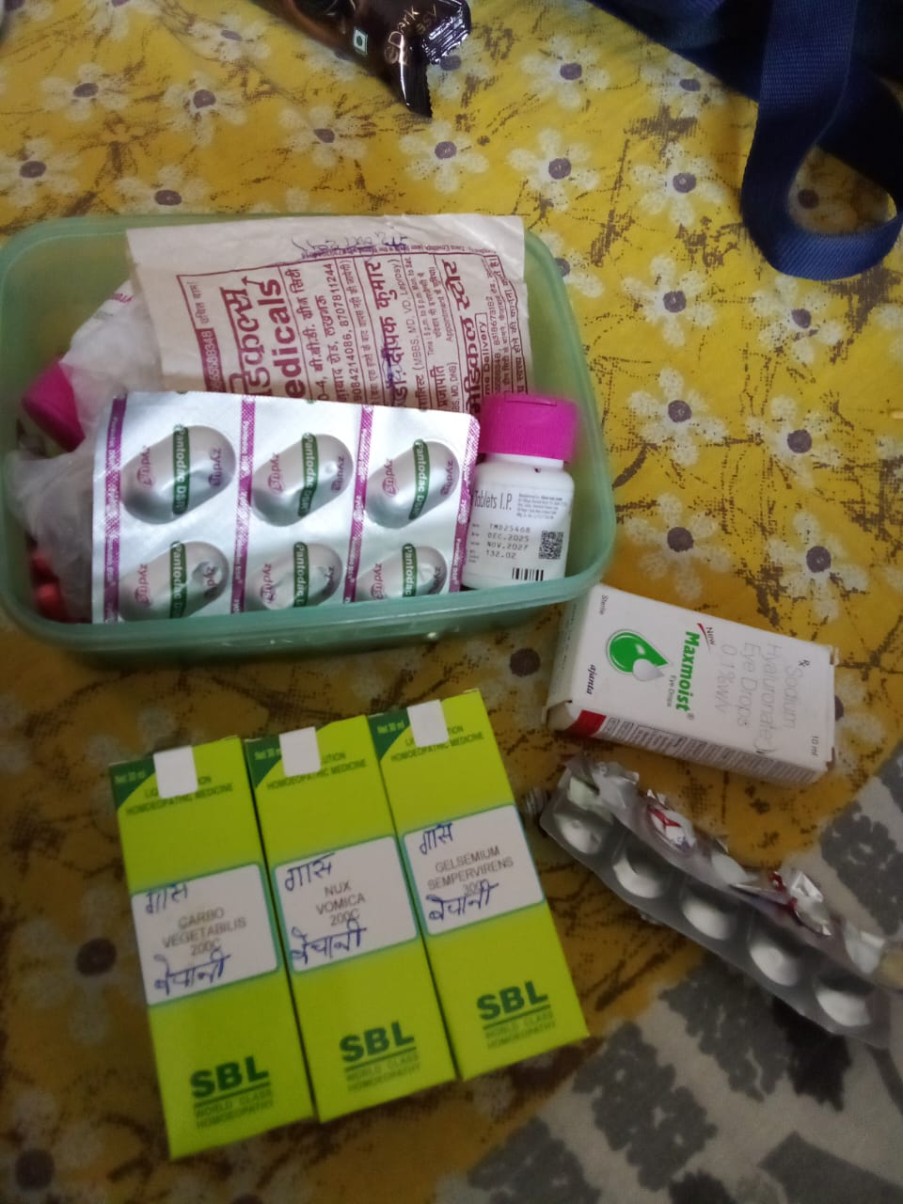
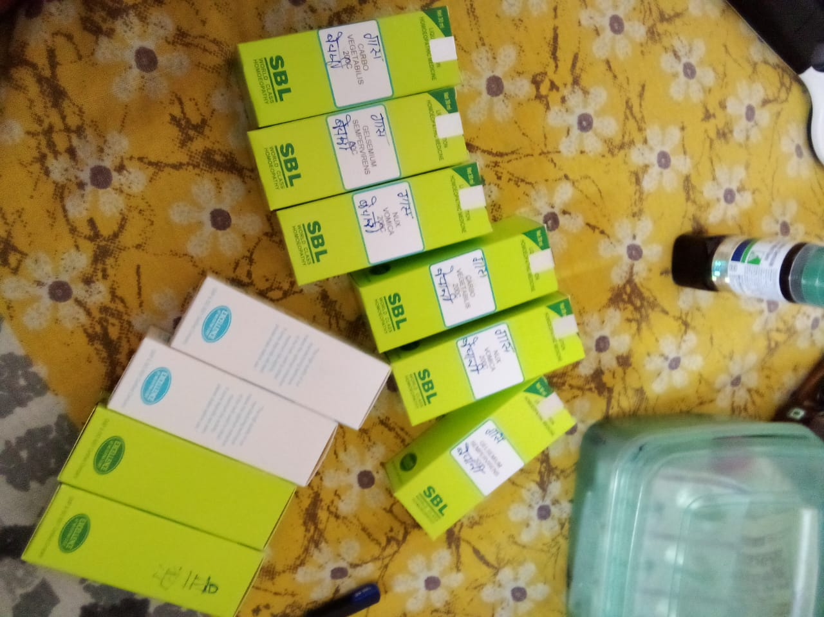
A prescription alone doesn’t complete care
02
Parcha connects the visit to the patient’s daily medicine routine.
REAL MEDICINES. MISSING CONTEXT.
THE GAP
PARCHA’S RESPONSE
Medicines without patient,
prescriber or purpose
Signed QR: patient, prescriber,
dose + recorded diagnosis*
A visit split across
queues and counters
One connected visit,
from booking to signed Rx
A team handoff without
the patient record
Patient-linked encrypted chat
with role-checked access
“20 drops.”
For whom? For what?
Instructions become hard
to follow at home
Photo reminders + simple Dadi view
Hindi / English / Hinglish
1 in 4
preventable medication
harm is severe or potentially
life-threatening globally¹
*Diagnosis, when recorded. Outside prescriptions use bill OCR + review.
¹ WHO global review, 2024
Notes:
The problem is a break in care context across medicine identification, clinic workflow, staff handoff and the patient’s routine at home. The supplied real medicine photos illustrate why a bottle or strip by itself does not tell the family which person it belongs to, who prescribed it or what recorded visit context it came from. The slide maps each gap directly to the relevant implemented Parcha workflow.
1. A signed Parcha QR links the patient, prescriber, doses and a diagnosis only where one was recorded. A package photo alone cannot reconstruct an unknown prescriber, diagnosis or medicine indication. Outside prescriptions use printed-bill OCR and reviewed instructions. The diagnosis is visit context, not a guaranteed per-drug indication.
2. Hospital matching, confirmation, queue/check-in, clinic voice draft, doctor review and sign-off form a connected visit.
3. Staff can mention a patient, visit or prescription in encrypted chat, and the linked resource remains subject to access checks.
4. Confirmed timings and medicine photos support reminders, read-aloud and the simple Dadi view in Hindi, English and Hinglish. Permissions and platform capabilities affect notifications.
WHO 2024 global review: one in four preventable medication harms is severe or potentially life-threatening. This is global problem evidence, not evidence that all harm is caused by lost prescriptions or a measured effect of Parcha. https://www.who.int/publications/i/item/9789240088887
Original photos: three WhatsApp images supplied by the user, retained without content alteration.
Product evidence: apps/patient/src/screens/ScanParcha.tsx; Schedule.tsx; EasyHome.tsx; Book.tsx; Upcoming.tsx; apps/clinic/src/comms/Comms.tsx; packages/client/src/rx.ts; firestore.rules.

Slide 3
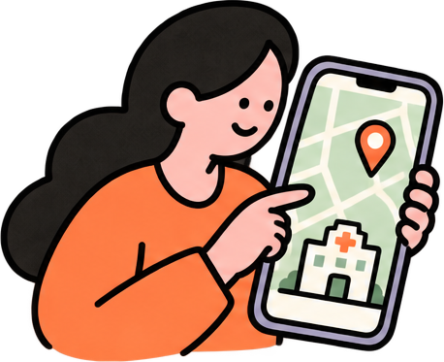

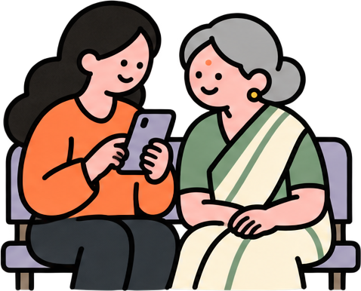
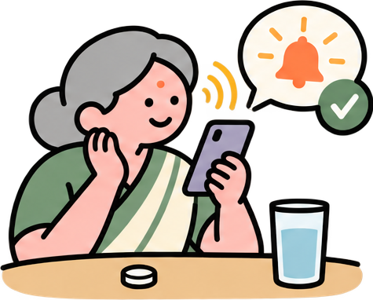
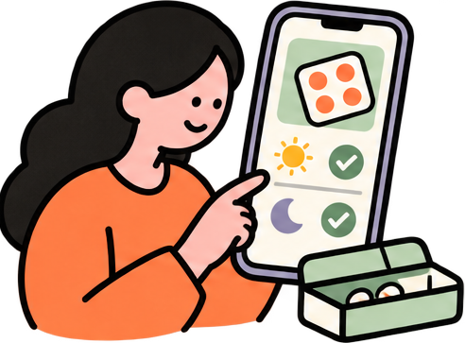

The patient’s complete care journey
03
A clinic visit becomes a daily medicine routine
1 Match a hospital
2 Confirm the visit
3 Wait for your turn
Family profile, distance + fee
15-min default hospital reply
Check-in + live visit status
6 Get dose alerts
5 Add medicine schedule
4 Receive Parcha
Listen / Taken / Later
Confirm timings + strip photos
Scan its QR and verify
Outside prescriptions use bill OCR + review. Notifications need permission. Calls are opt-in.
Notes:
The client-side workflow follows one family from finding care to a daily medicine routine. The selected family profile starts a request; hospital options include distance, fee and availability. The hospital finds a doctor, and a doctor confirms a visit time. Fifteen minutes is the default hospital response deadline, not a guaranteed wait or appointment time. Overdue requests can move to another candidate. After arrival/check-in, the patient sees live visit status while waiting. The doctor reviews and signs the Parcha. Scanning the signed QR verifies the prescription and presents patient, prescriber and dosing details; the family confirms the person, associates medicine/strip photos, and sets reminders. At home, the schedule drives due-dose alerts and read-aloud, with Taken/Later controls. Outside-prescription routes use printed-bill OCR and reviewed doctor/chemist instructions. Notifications require platform permissions, while in-app alerts may remain available. Native Android notifications can run through scheduled OS alarms; web behavior differs. Reminder calls require opt-in and configured service, and the local call UI includes a demo. No improved adherence or patient outcomes have been measured.
Original conceptual illustration generated with the built-in image generation tool, matched to the existing doctor/grandmother art. Editable labels and connectors explain the sequence.
Code sources:
C:/Users/royal/Desktop/Parcha/apps/patient/src/screens/Book.tsx
C:/Users/royal/Desktop/Parcha/apps/patient/src/screens/Upcoming.tsx
C:/Users/royal/Desktop/Parcha/apps/patient/src/screens/Home.tsx
C:/Users/royal/Desktop/Parcha/apps/patient/src/screens/ScanParcha.tsx
C:/Users/royal/Desktop/Parcha/apps/patient/src/screens/CheckMedicines.tsx
C:/Users/royal/Desktop/Parcha/apps/patient/src/screens/Schedule.tsx
C:/Users/royal/Desktop/Parcha/apps/patient/src/screens/EasyHome.tsx
C:/Users/royal/Desktop/Parcha/apps/patient/src/components/alerts.tsx
C:/Users/royal/Desktop/Parcha/apps/patient/src/components/native.tsx
C:/Users/royal/Desktop/Parcha/packages/core/src/hospitals.ts

Slide 4
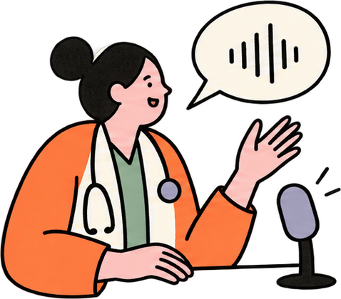


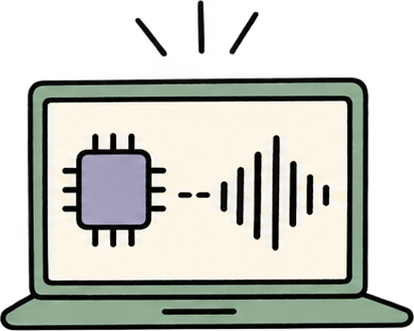
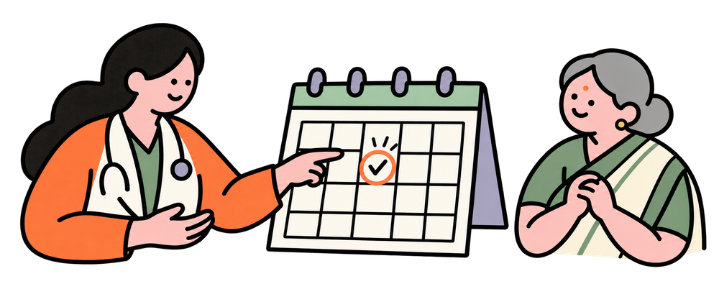
At the clinic, context becomes a signed Parcha
04
Speak
Process on device
Doctor reviews
Sign Parcha
0 cloud audio uploads
53%
of preventable medication harm occurs
at ordering / prescribing globally
WHO, 2024. Parcha supports doctor review; clinical impact has not been measured.
Follow-up, if needed
Notes:
The arrival flow leads into a voice-first consultation and a doctor-reviewed signed prescription. The default hospital response deadline is fifteen minutes; overdue requests can move to another candidate. This is not a fifteen-minute wait or appointment guarantee. Local Whisper runs on the device after model setup, so recorded speech is not uploaded to a cloud transcription API. Doctor verification and limited deterministic safety checks remain essential. WHO 2024 reports that 53% of preventable medication-related harm occurred at ordering/prescribing; this does not mean paperwork causes all that harm, or that Parcha has demonstrated a reduction. Published problem burden and product architecture are distinct.
Sources:
C:/Users/royal/Desktop/Parcha/packages/core/src/hospitals.ts
C:/Users/royal/Desktop/Parcha/firebase/functions/src/previsit.ts
C:/Users/royal/Desktop/Parcha/apps/clinic/src/screens/consultation/whisper.ts
C:/Users/royal/Desktop/Parcha/apps/clinic/src/screens/consultation/Pad.tsx
C:/Users/royal/Desktop/Parcha/packages/core/src/conflicts.ts
https://www.who.int/publications/i/item/9789240088887
User photographs are examples of information separation, not a diagnosis, safety assessment of a pictured product, or evidence of its efficacy. Illustrated assets were generated using the two user-supplied style references.
Optional follow-up: the clinician records a return interval in the Parcha; this does not imply an automatically booked appointment slot. Sources: apps/clinic/src/screens/consultation/Pad.tsx; apps/patient/src/screens/VisitScreen.tsx.
Follow-up artwork was generated with the built-in image generation tool, matched to the existing clinic illustration style. It is a conceptual return-visit scene, not a real booked appointment. Prompt and saved image: presentation/followup-art/ART-PROMPT.md and followup-calendar.png.
The complete patient-side arrival and medication journey now appears on display slide 3. This clinic detail page is display slide 4 and concentrates on voice input, local processing, clinician review, signing and optional follow-up. Repeated arrival boxes were removed and the existing four illustrations enlarged. The original follow-up art and the user-added connector remain.

Slide 5

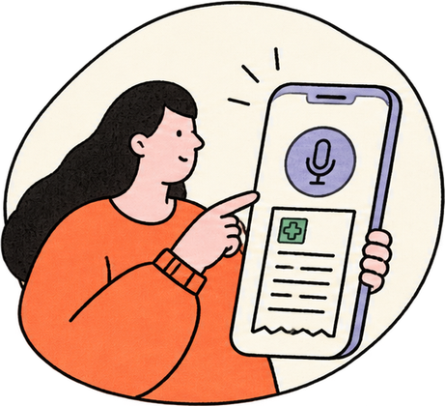
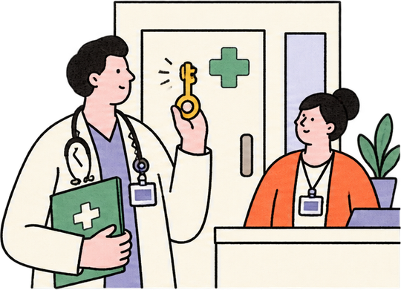
The context moves. Access stays controlled.
05
36%
of preventable medication harm occurs
at monitoring / reporting globally
Team conversations
WHO global review, 2024
# general
Personal papers
Role-based access
End-to-end encrypted
R
Rekha (management)
9:43 am
Please give out
Active prescription #6
Ramesh Chand
Personal papers stay outside
clinic staff access
Each seat defines
its permissions
Linked visit / Rx, with access checks
Message / @ a patient
A patient mention carries the right context
into an encrypted team conversation.
Illustrative layout using real demo content
Notes:
The messaging interface is an editable portrait illustration adapted from the actual local demo chat, not a literal screenshot of the running application. It preserves the real demo message: Rekha (management), 9:43 am, Please give out, Active prescription #6, Ramesh Chand. No additional exchange or clinical event is invented. Demo data, not a real patient. The portrait messaging section measures 465 by 547 pixels, approximately 27.6% of the 1280 by 720 slide. Original sources: pitch-build/assets/messages.png, message-focus.png and message-composer.png. Original Parcha mark: apps/clinic/public/favicon.svg.
Patient mentions link visits or prescriptions and remain subject to access checks. Staff chat uses device-side ECDH/HKDF/AES-GCM with ciphertext transport. Routing metadata remains visible, and new device keys do not decrypt older messages. Private personal papers are separate from the clinical records shared under the relevant permissions.
WHO global review, 2024: 36% of preventable medication harm occurs in monitoring/reporting. This is global problem evidence, not measured Parcha impact. Source: https://www.who.int/publications/i/item/9789240088887

Slide 6
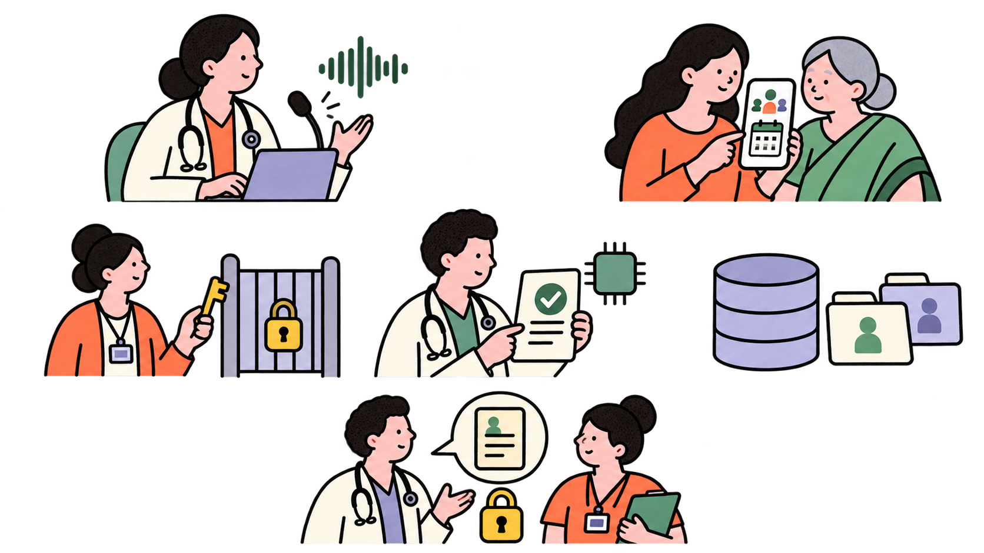
Parcha architecture & access boundaries
06
Separate Clinic and Patient apps. Access checks guard shared services.
1 Parcha Clinic
1
2
2 Parcha Patient
React / Vite / Electron
Local Whisper + draft outbox
Staff roles + hospital scope
React / Vite / Capacitor
Local OCR + signed QR
Family profiles + Dadi mode
Hindi / English / Hinglish
3
4
Rules
5
5 Shared records
Firestore + access rules
Phone / hospital scope
Visits, Rx + live queues
3 Auth & sessions
Staff only
Phone OTP / staff claims
Active staff sessions
Hospital-scoped access
6
4 Clinical commands
6 Staff chat
Cloud Functions + seat checks
Sign-off + stage guards
Clinical writes + safety
Device-side encryption
Ciphertext through Firestore
Keys stay on staff devices
Clinical writes use Functions. Live reads use Rules. Patient logins cannot open clinic counters.
Notes:
Conceptual flat 2D architecture diagram in the established hand-drawn character style. Original Parcha logo inserts, six station markers, callouts and logical connectors are native editable objects. Human characters represent app users and review steps; Cloud Functions and Firestore remain the actual backend services. The diagram is conceptual, not an exhaustive network trace.
Clinic app: React/Vite/Electron, local Whisper WASM, drafts/outbox, staff claims and hospital scope. Patient app: React/Vite/Capacitor, Tesseract OCR, signed QR checks, household profiles, simple Dadi view, Hindi/English/Hinglish. These are separate app deployments and sign-in flows, with shared Firebase infrastructure and enforced permissions rather than physically isolated databases. Patient logins do not grant clinic counter or staff chat access.
Auth: phone ownership, staff custom claims, active staff sessions and hospital scope. Clinical callables: the relevant role/seat/hospital or phone-ownership checks, stage guards, clinical writes and sign-off/safety logic. Doctor review is human review before signing. Firestore: authorized live reads are Rules-scoped by phone ownership, visit links or staff hospital scope and can go directly to Firestore. Clinical writes go through callable Functions. The patient-to-record connector represents authorized live reads, not direct clinical writes.
Staff chat is a separate device-encrypted path, shown as staff only: ECDH P-256 / HKDF-SHA-256 / AES-256-GCM, ciphertext in Firestore, metadata visible, non-extractable keys remain on devices. New devices cannot decrypt messages predating their keys. This does not claim universal E2E encryption of clinical records or isolation of adult household profiles.
Sources: firebase.json; apps/clinic/src/auth.tsx; apps/patient/src/auth.tsx; firebase/functions/src/guards.ts; firestore.rules; packages/client/src/firebase.ts; packages/client/src/comms.ts; packages/client/src/vault.ts. Original mark: apps/clinic/public/favicon.svg.
Artwork generated in built-in image generation mode using the existing approved 2D role-access scene as the style reference. Saved asset and full prompt: presentation/architecture-2d/people.png and ART-PROMPT.md.

Slide 7
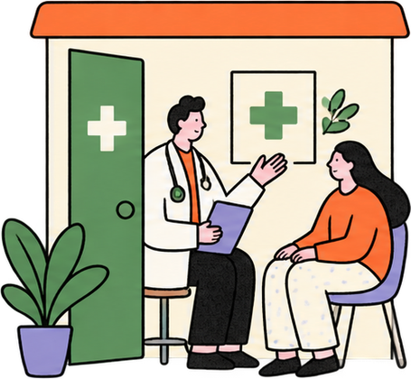
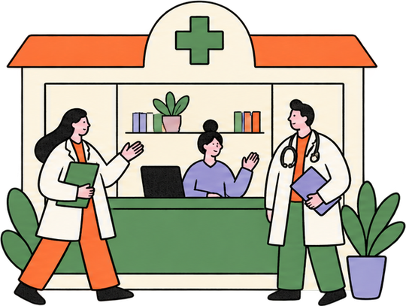
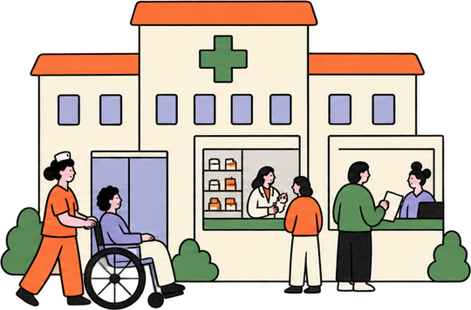
Go-to-market: small clinics first
07
Target: 1–3 doctor clinics. Expand through referrals and modules.
5-clinic monthly model
₹4,995 revenue
5 solo clinics × ₹999 / month
Solo clinic
Desk + doctors
Hospital modules
Cloud + hosting reserve
₹600
₹999 / mo
₹2,499 / mo
Custom quote
Phone OTP (200 paid SMS)
₹1,260
90 days: founder visits + pharmacy referrals
Support, outreach & fees
₹1,420
Total running cost
₹3,280
30 visits
10 pilots
5 paying
PROJECTED OPERATING PROFIT
A 14-day pilot. Review signed visits + repeat staff use.
Convert to paid use, then ask for a clinic referral.
₹1,715 / mo
34.3% before founder pay & tax
Outside prescriptions grow patient reach
Bill OCR + review brings families in.
Visit analytics + team modules support higher plans.
OTP: 200 paid SMS × ₹6.30
₹90/USD planning rate. Usage changes costs.
Illustrative estimates and test prices. Excludes founder salaries, setup and taxes. Optional calls billed separately.
Notes:
PROPOSED GO-TO-MARKET, NOT TRACTION OR ACTUAL PROFIT. Target 1–3 doctor neighbourhood clinics, where the founder can reach the decision maker, demonstrate the current workflow and learn with a small implementation. The 90-day target is 30 founder clinic visits or qualified pharmacy referrals, 10 short pilots and 5 paying clinics. These imply 33.3% outreach-to-pilot and 50% pilot-to-paid conversions and are hypotheses. Use a 14-day pilot and a week-two review of signed visit use, repeat staff use and willingness to pay. Do not claim time savings or clinical impact before measuring them. Ask satisfied clinics for peer referrals. Scale to more desks/doctors and hospital modules after retention and support effort are understood.
Patients can enter beyond partner clinics via printed-bill OCR plus review and confirmed medication information. The proposed patient entry is free, while clinics pay for workflow/team modules and visit analytics. Solo ₹999/month and team ₹2,499/month are test prices; hospital modules need a scope-based quote. Billing/module entitlements would need commercial implementation and validation. No purchase intent has been measured.
ILLUSTRATIVE MONTHLY OPERATING MODEL: 5 solo clinics x ₹999 = ₹4,995 revenue. Cloud/hosting/storage reserve ₹600. Phone verification budget 200 billable India SMS x $0.07 x assumed ₹90/USD = ₹1,260. Support budget ₹800, outreach amortisation ₹500 and collection/payment reserve ₹120 = ₹1,420 operations. Total cash operating costs shown = ₹600+₹1,260+₹1,420 = ₹3,280. Modelled operating surplus = ₹4,995-₹3,280 = ₹1,715, or 34.3343% of revenue, rounded to 34.3%. This is a partial founder-operated pilot operating model before founder salaries, initial setup/development, GST/taxes and optional call usage. It is not earned profit, an audited P&L or a promise of profitability.
The ₹600 cloud reserve is a proposed budget, not a quoted provider bill or measured load-test result. It assumes low pilot usage, eligible free usage still available and no always-warm capacity; it must be validated against deployed logs, listeners, traffic, scheduler reads, storage and actual billing. The 200 SMS count is billable usage after any applicable allowance, not total sends. More SMS or compute/traffic reduces surplus. With all other shown costs fixed, around 472 paid SMS/month would consume the shown surplus; this is a sensitivity, not a volume forecast. The exchange rate is a planning assumption, not a current FX quote.
Pricing checked 30 October 2026. Official sources: https://firebase.google.com/pricing (Firestore standard allowances 50K document reads/day, 20K writes/day, 1 GiB storage; hosting and Functions have separate limits); https://cloud.google.com/identity-platform/pricing (India phone authentication $0.07 per SMS, first 10 SMS/day not billed); https://cloud.google.com/run/pricing (compute, region and request-based free-tier conditions). Budget allowances are assumptions.
Market context retained for reference: MoHFW/PIB 27 March 2026 reports 1,388,185 registered allopathic doctors, about 13.88 lakh. This is not a count of private clinics or an addressable-customer calculation. https://www.pib.gov.in/PressReleasePage.aspx?PRID=2245966&lang=1&reg=1

Slide 8




08
Try Parcha. Pick your device.
Scan to explore the live apps
Clinic web
Patient app
Android
Desktop
parcha-clinic.web.app
parcha.web.app
parcha-android.web.app
parcha-desktop.web.app
One visit. Care that follows.
Team Afterburners / Medtech
Notes:
The four destinations are the sites supplied by the user. The QR codes encode these exact HTTPS URLs, use error correction M, and retain a four-module quiet zone. Source QR images were decoded to verify their destinations. All four URLs returned HTTP 200 to a read-only HEAD request during preparation.
https://parcha-clinic.web.app/
https://parcha.web.app/
https://parcha-android.web.app/
https://parcha-desktop.web.app/

