Slide 1
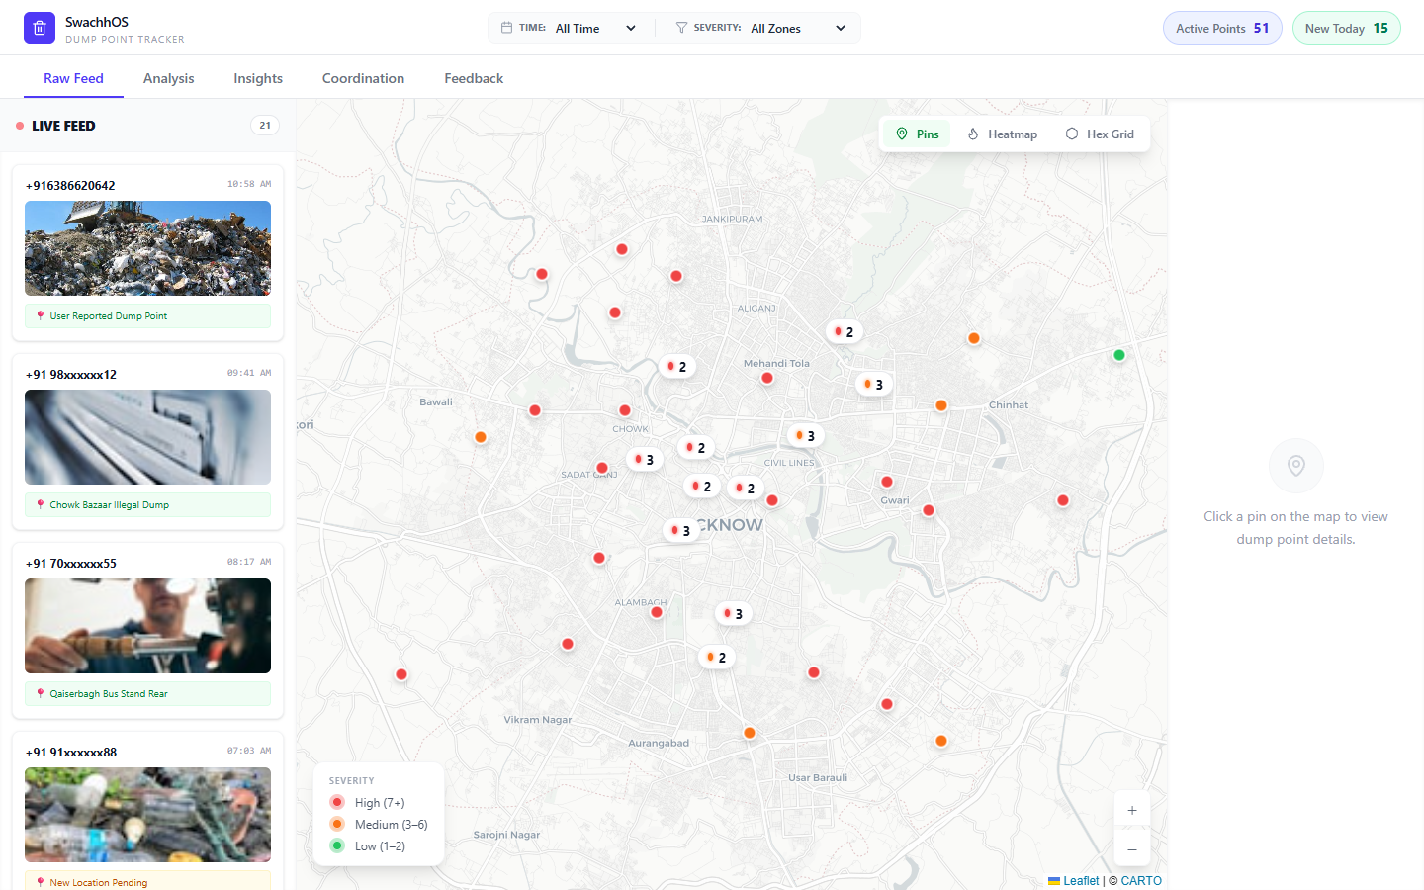
SwachhOS
1 / Problem & Solution
Waste reports need one operating system
SwachhOS turns WhatsApp complaints, map clustering, cleanup assignment, and citizen feedback into one visible workflow.
51
526
57%
active points
reports logged
match rate
Reports arrive with photos and location signals.
Repeat dump sites are grouped by severity instead of treated as isolated complaints.
Live feed + severity map + cleanup details
Teams get a shared map for cleanup and follow-up.

Slide 2
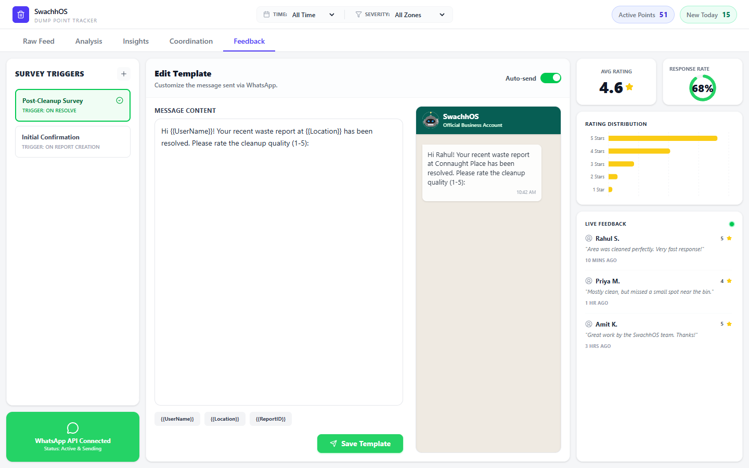
SwachhOS
2 / Target Users
Three user groups share the same source of truth
The product connects people who report waste, supervisors who prioritize it, and field teams who resolve it.
1
Citizens
2
Municipal staff
3
Cleanup teams
Report a dump point quickly through WhatsApp, without learning a new app.
See recurring sites, severity, and weekly activity in one dashboard.
Receive zone-based assignments and close the loop with feedback.

Slide 3
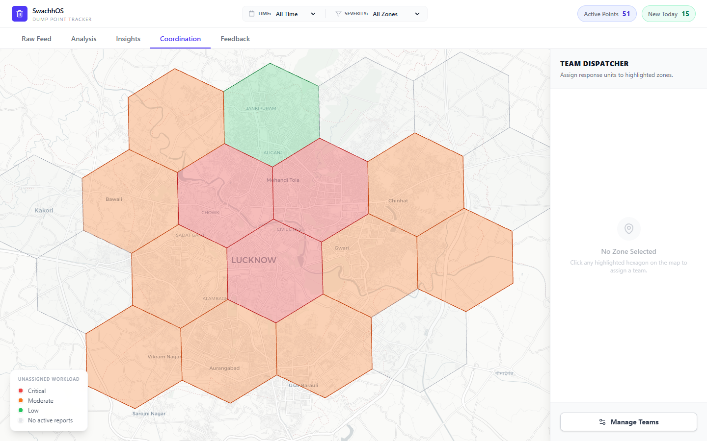
SwachhOS
3 / Scaling Strategy
Scale by adding zones, not by adding complexity
The same model can expand from one city pilot to ward-level operations and then to multiple municipalities.
1
Pilot one city
2
Standardize zones
3
Replicate playbook
Start with Lucknow-style dump points, WhatsApp intake, and supervisor dashboards.
Use hex-grid zones so team assignment and reporting stay comparable across wards.
Package templates, thresholds, and reports for new colleges or municipal partners.
Scaling lever: a familiar channel plus repeatable geospatial zoning.

Slide 4
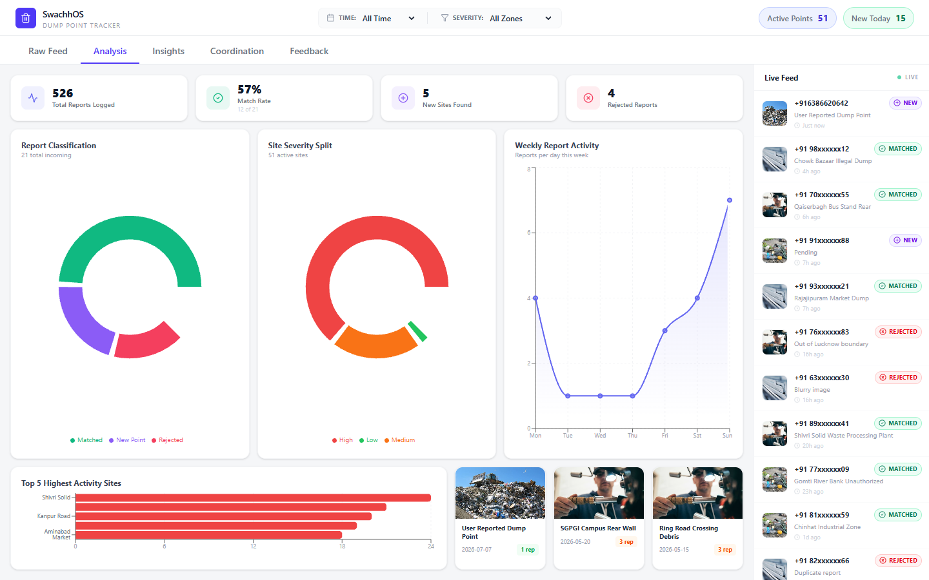
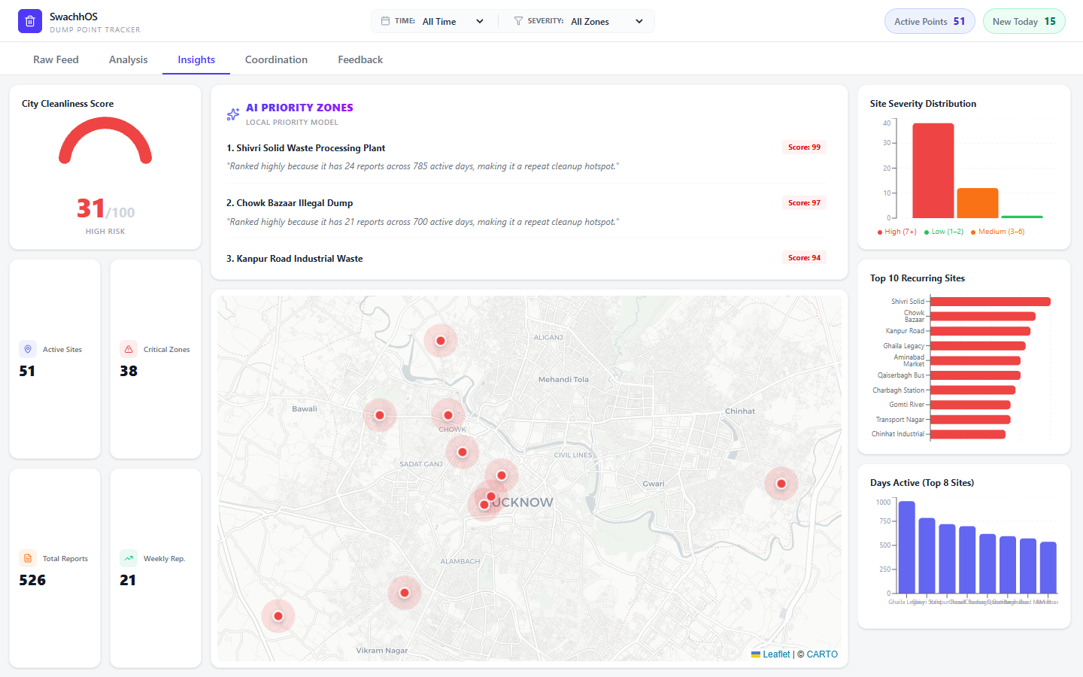
SwachhOS
4 / Implementation Plan
Build the cleanup loop in four releases
Each release produces something evaluators can test: intake, dashboarding, dispatch, then automated feedback.
1
Data intake
2
Detection
3
Operations
4
Closure
WhatsApp report capture, Firestore sync, photo and GPS fields.
Map clustering, severity filters, duplicate and rejected report states.
AI/local priority ranking and team-zone assignment workflow.
Feedback templates, rating dashboard, and response-rate tracking.

Slide 5
SwachhOS
5 / Risks & Mitigation
The plan is strongest when weak points are visible early
SwachhOS should be judged as a practical prototype: it already has fallback states, mock data, and operational controls for demo reliability.
Risk
Mitigation
Low-quality reports
Use rejected states, duplicate checks, and photo/GPS validation.
AI/API downtime
Keep local priority scoring so the dashboard never goes blank.
Visible fallback behavior keeps the demo credible even when external services slow down.
Team adoption
Use ward-style zones and simple assignment controls.
Data privacy
Mask phone numbers and store only needed report metadata.

