Slide 1



urbanOS
People's Priority
An AI layer between citizen voice and MP development decisions.
Team
Afterburners
Team leader: Shikhar Shahi , Btech DS
Team member : Jigyasa Tiwari , Btech DS
UrbanOS
01

Slide 2
PROBLEM STATEMENT
Citizen priorities reach the office as noise, not a ranked planning queue
MP offices hear real demand every week, but the inputs arrive in formats that cannot be compared fairly.
Requests arrive through public meetings, letters, WhatsApp, social posts, grievance portals, photos and calls.
There is no objective way to consolidate repeat asks, spot recurring needs, and weigh them against real infrastructure gaps.
The decision problem
The result is an unfair choice between projects that sound urgent and projects that are measurably high priority.
School, road, drainage, or health centre. Which moves first?
UrbanOS
02

Slide 3
CHALLENGE
The product must listen in many formats and still recommend action
The evaluation asks for a multilingual AI platform that converts citizen suggestions into ranked works an MP can act on.
01
02
03
04
Intake
Sensemaking
Evidence
Action
Voice, text, photos, location pins and messaging apps.
Surface recurring themes and map demand hotspots.
Combine feedback with demographic, infrastructure and public datasets.
Recommend and rank high-priority works.
UrbanOS
03

Slide 4
SOLUTION
UrbanOS turns messy public input into a defensible priority list
It meets citizens where they already communicate, then gives the MP office a planning workflow.
Citizen input
AI triage
Cluster
Rank
Close loop
WhatsApp or SMS
->
category, priority, zone, budget
->
same issue, same area
->
demand x urgency x gap
->
sanction and notify
The MP does not get another inbox. They get a ranked queue with evidence and a feedback loop.
UrbanOS
04

Slide 5
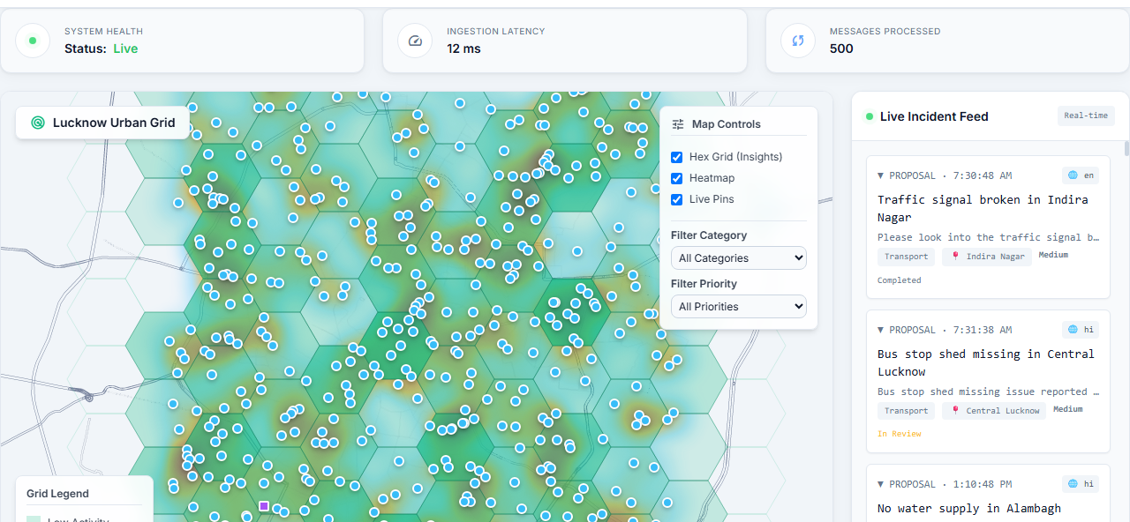
PRODUCT PROOF
The raw feed is now a live constituency command surface
The current build shows incoming proposals, map hotspots, filters and telemetry in one operational view.
500
proposals loaded into the live feed
map
hotspots, pins and raw intake side by side
real-time
webhook incident stream for aides
UrbanOS
05

Slide 6
AI EXECUTION
The AI is doing civic work, not decoration
Gemini is used where judgment and structure are needed, while the backend keeps every output reviewable.
Structured triage
Multimodal evidence
Grounded agent
Schema-constrained JSON for category, priority, feasibility, location, budget, language, zone and semantic tag.
Photo and voice pathways turn unstructured field reports into visible evidence and searchable civic records.
The RAG assistant answers from connected proposals, sanctions, surveys and uploaded datasets, with graceful fallback.
UrbanOS
06

Slide 7




TECHNICAL SNAPSHOT
07 / 11
The stack, end to end
Frontend
Backend
AI Engine
Data & Integrations
Vanilla JS
Python 3.11
Gemini 2.5 Flash
Firestore
Lightweight admin UI logic
Core runtime
Multimodal triage
Realtime NoSQL store
Tailwind CSS
FastAPI
GCP Speech-to-Text
Firebase Hosting
Utility-first styling
Async API framework
Voice transcription
Dashboard delivery
Chart.js
Firebase Fns Gen 2
RAG Agent
Twilio
Analytics visualizations
Serverless compute
Natural-language insights
WhatsApp Business API
Leaflet.js
Pydantic
Semantic Tagging
WhatsApp API
Interactive grievance map
Schema validation
Complaint clustering
Citizen channel
UrbanOS · Afterburners

Slide 8
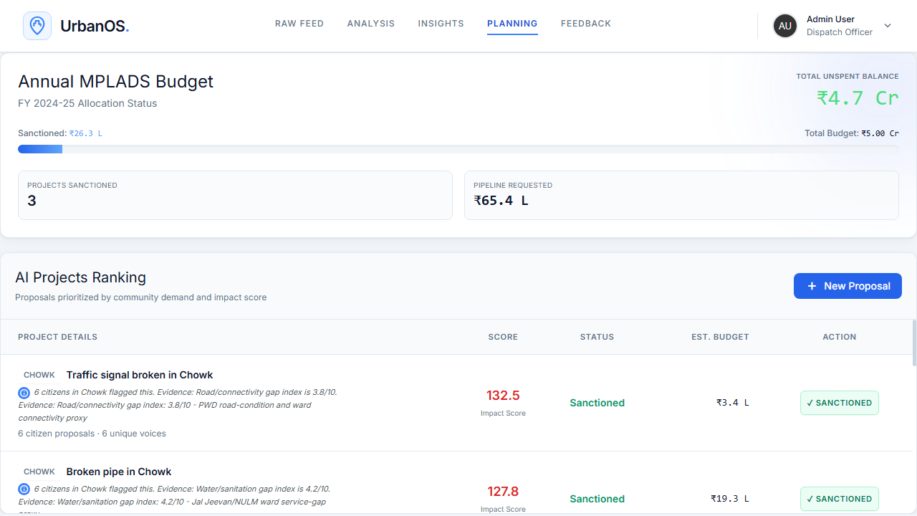
PRIORITIZATION
Ranking combines public demand with measurable need
UrbanOS clusters repeated requests, scores urgency, then applies a project-specific infrastructure gap signal.
Impact Score
demand count x priority score x (1 + category gap / 10)
UrbanOS
07

Slide 9
DEPLOYMENT
The prototype can run in an MP office without a new citizen app
It uses familiar channels for citizens and simple hosted infrastructure for the office.
Citizen channels
WhatsApp, SMS, voice notes, photos and location pins.
Backend
FastAPI, Firestore, Firebase Hosting and Cloud Functions.
Inclusion by design
AI layer
multilingual
low bandwidth
Gemini triage, semantic clustering and grounded insights.
voice first
SMS fallback
UrbanOS
08

Slide 10

Testing
DEPLOYED LINK
urbanOS.web.app
STEPS TO TEST WHATSAPP AGENT
1.Send Join molecular-join To +14155238886
2.Send Hey and follow along
3.See Messages Go in Live Incident Feed
1 MINUTE EXPLAINER
UrbanOS
10

