Slide 1

E-Commerce Sales Analysis Report
Sales Performance · Revenue Insights · Product Analysis
1,000 PRODUCTS
7 CATEGORIES
12 MONTHS OF DATA
Tools: Python · PostgreSQL · Power BI

Slide 2
Executive Summary
Comprehensive analysis of transactional product-level data to identify revenue drivers, seasonal patterns, and customer review impacts on business outcomes.
1,000
6M
₹1.49B
Total Products
Units Sold
Total Revenue
7
₹1.49M
Categories
Avg. Revenue/Product

Slide 3
Business Objectives
Revenue Analysis
1
Which categories and products drive the most revenue? How concentrated is it?
Sales Trends
2
Which months peak? Are there identifiable seasonal patterns?
Product Performance
3
Which products outperform? Which require intervention or discontinuation?
Customer Reviews
4
Do higher ratings drive higher sales? Which categories get the best feedback?
Strategic Planning
5
How to optimize inventory and prioritize category investment?

Slide 4


Dataset & Methodology
Dataset Variables
Product ID
Integer — Unique identifier
Category
Text — Product category
Price
Decimal — Selling price
Review Score
Float — Customer rating
Sales Month 1–12
Integer — Monthly units sold
Feature Engineering: Annual Sales = Sum(Month 1–12) · Annual Revenue = Annual Sales × Price

Slide 5
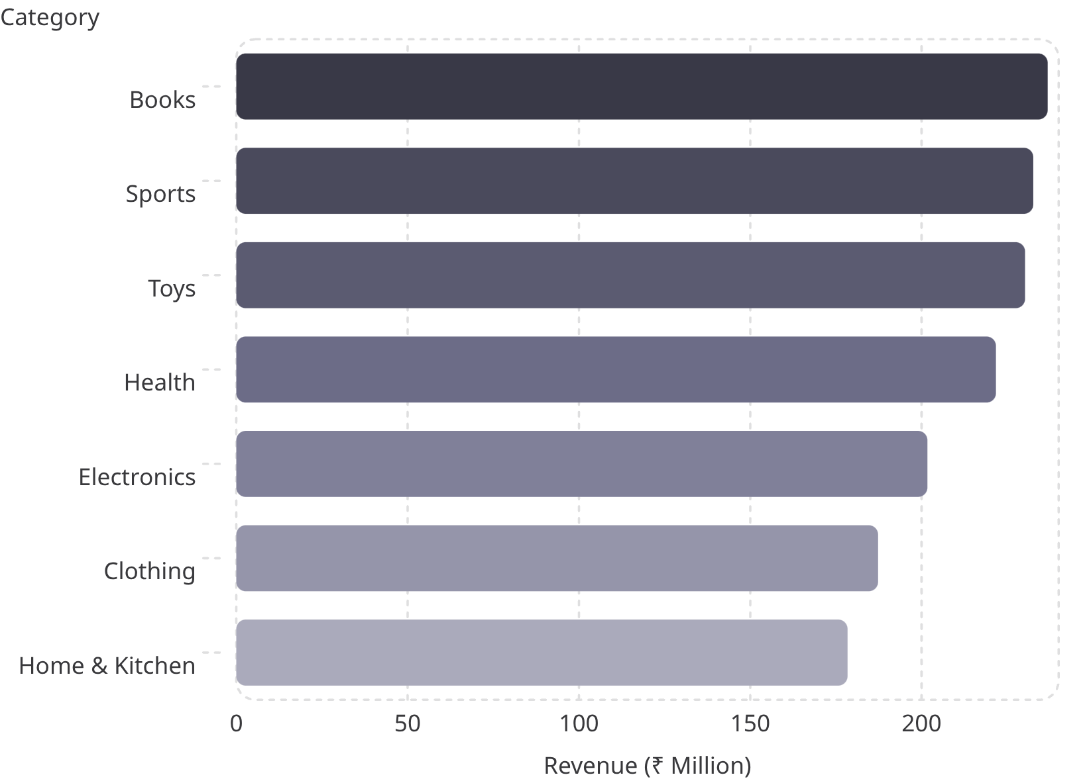

Revenue Analysis
Key Insights
Books leads revenue despite not being the highest-priced category. Sports and Toys also perform strongly, indicating high consumer demand.
Top 3 categories contribute over 45% of total revenue — a clear concentration among specific consumer interests.
Prioritize inventory investment, marketing campaigns, and product expansion in Books, Sports, and Toys.

Slide 6
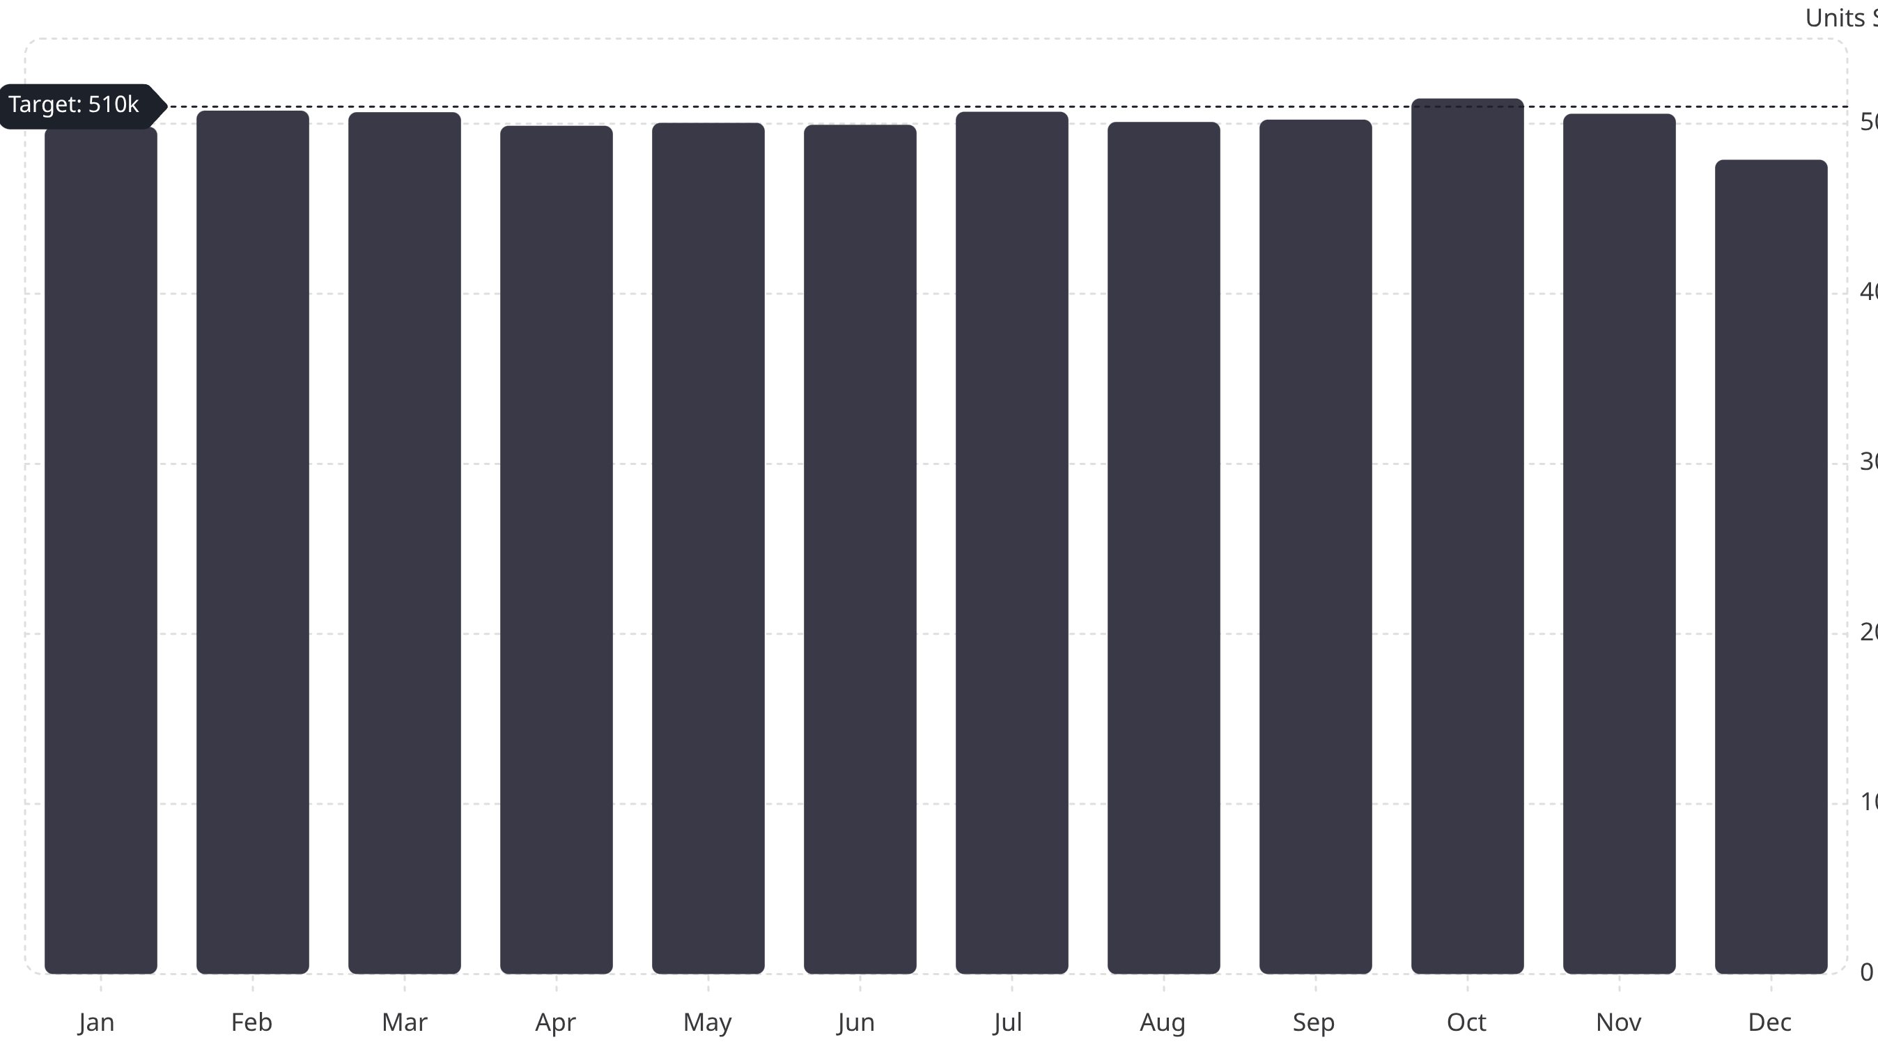
Monthly Sales Trends
October peaked at 514,798 units — likely driven by festive season demand and promotional campaigns. December was the weakest month (478,800 units). Targeted end-of-year promotions are recommended to close the gap.

Slide 7

Product Performance
Top Revenue Products
Pareto Principle in Action
Product
Revenue
A small number of products contribute disproportionately to total revenue — a classic retail pattern.
Product 306
₹3.81M
Product 532
₹3.76M
Product 53
₹3.72M
Product 229
₹3.70M
Product 391
₹3.65M
Prioritize Stock
Review Low Performers
Ensure availability of top performers year-round.
Evaluate pricing, relevance, and potential discontinuation.

Slide 8




Category Deep Dive
Books — #1
Sports — #2
Toys — #3
Home & Kitchen — #7
Highest revenue, consistent demand. Expand catalog and bundle recommendations.
Strong demand and engagement. Run seasonal campaigns and cross-sell accessories.
High-volume category. Leverage holiday promotions and gift bundles.
Lowest revenue category. Reevaluate assortment and improve visibility.

Slide 9

Reviews & Pricing Analysis
Customer Review Correlation
Pricing Observations
Sales are driven by category demand, pricing, and product visibility — not customer ratings.
Mid-priced products
Dominate sales volume
Premium products
Contribute significantly to revenue
Balanced pricing
Most effective overall strategy
Review Score vs Sales
Review Count vs Sales
Correlation: −0.018 — virtually no relationship
Correlation: −0.069 — very weak relationship

Slide 10





Key Findings & Recommendations
Books Lead Revenue
October Peaks
Revenue Concentration
Increase investment in Books, Sports, and Toys.
Stock up ahead of October and November to avoid shortages.
Expand top-selling product lines; review low performers for discontinuation.
Ratings Don't Drive Sales
Data Strategy
Focus on visibility, pricing, and category campaigns over review management.
Collect customer demographics, repeat purchase behavior, and marketing attribution for predictive analytics.

