Slide 1
DATABASE DESIGN AND MAINTENANCE
Professor/Instructor
Prof. Dr. Angelina Ziesemer
Group members
Keval Patel
Miten Patel
Shikhar Shah

Slide 2
Agenda
Introduction
ER Diagram
Queries
Demonstration
Challenges

Slide 3
Introduction
Design the database for the Music Streaming scenario.
In the database there are total 14 tables.
Define the realistic constraints for all the tables.
Defining the relationships between tables.
Design basic ER model and then go through normalization process to make 3rd normal form.
Populate the database.
Solve the queries including Stored Procedure.

Slide 4
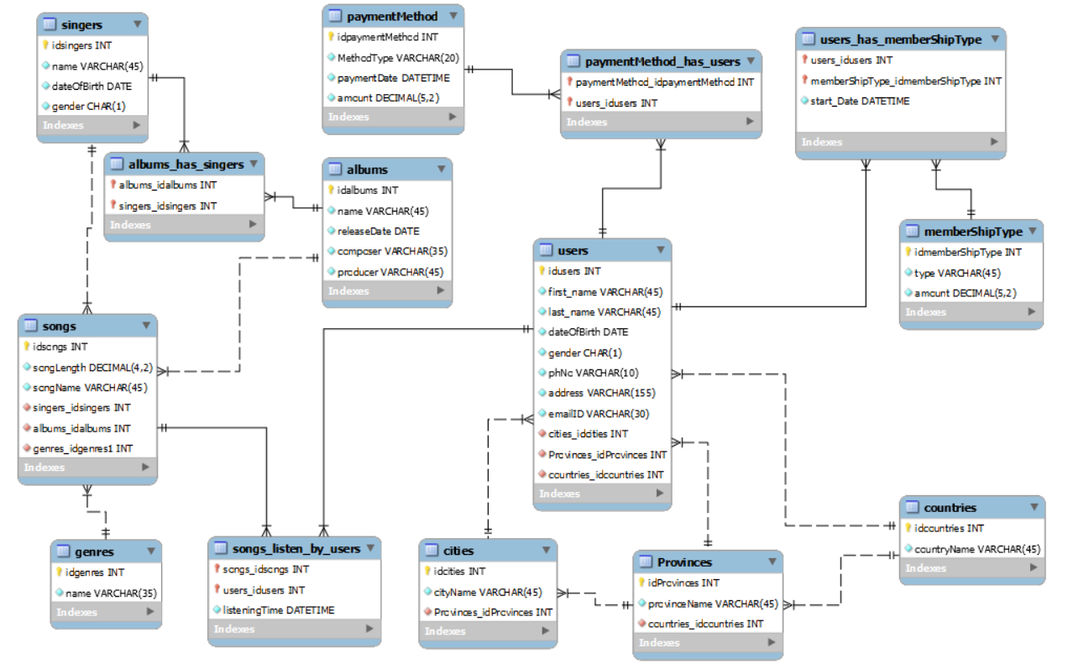
ER
Diagram

Slide 5
Queries
Showing all genres and how many songs by each genre.
Most album released by singer in a year.
Most popular membership.
Country with most subscriber.
Which gender has purchase most number of membership?
List how many users the system has by location (Country, Province, and City), and then sort them.
List how many distinct albums each singer has.
Which Membership is most popular by age?
Top 5 most listened songs.
Most and less popular payment method and how many times they were used?
Top 3 singers with least number of songs.

Slide 6
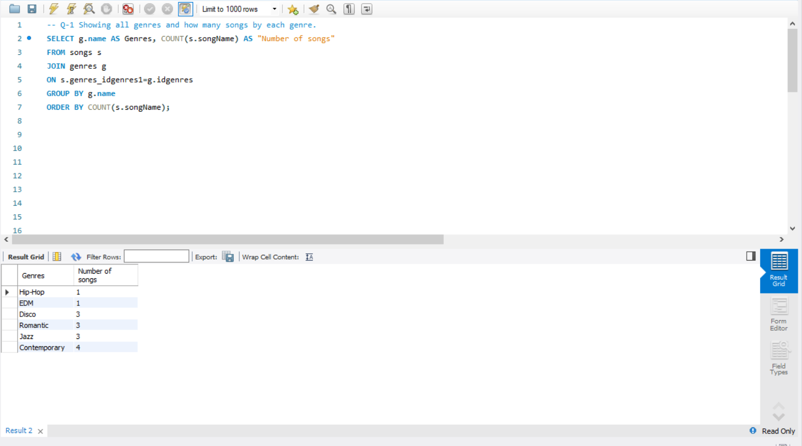
Showing all genres and how many songs by each genre.

Slide 7
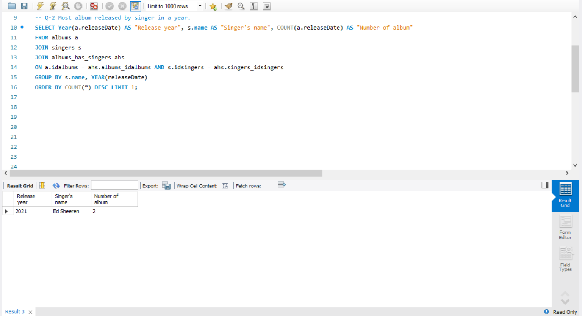
Most album released by singer in a year.

Slide 8
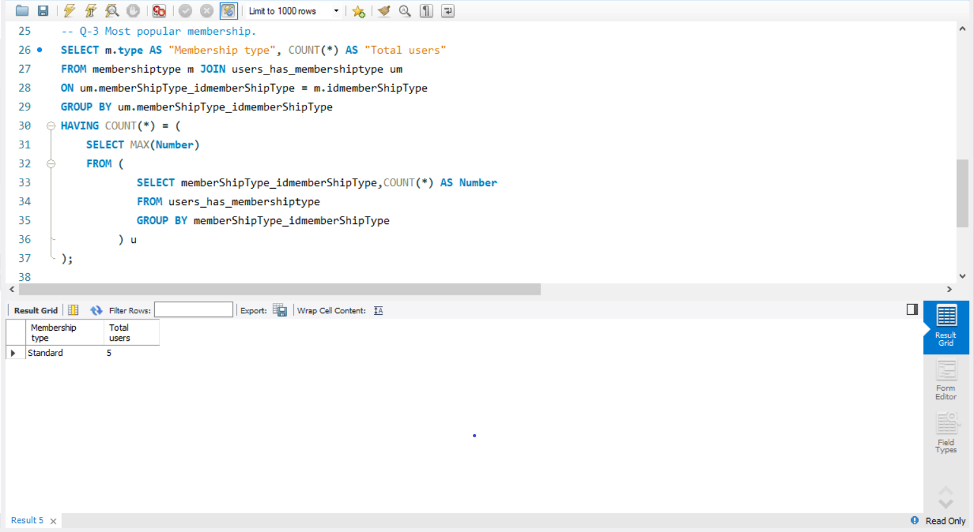
Most popular membership.

Slide 9
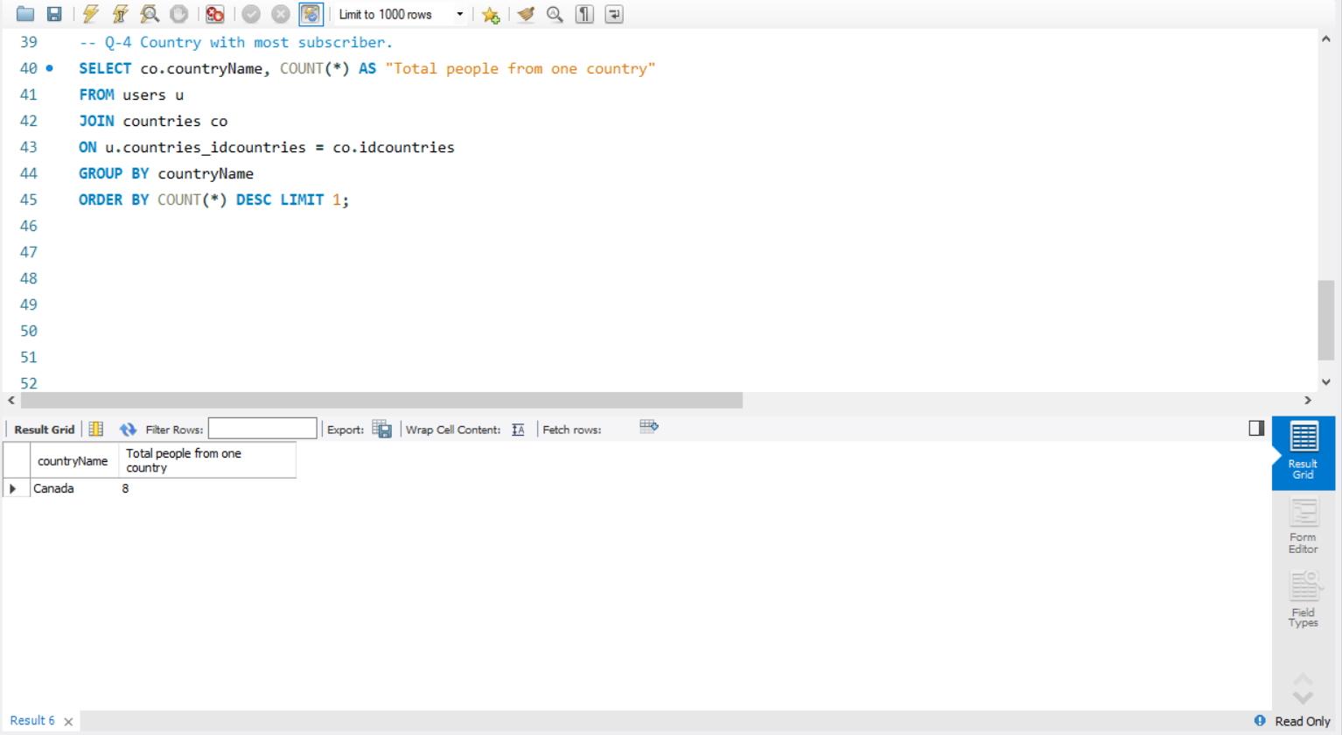
Country with most subscriber.

Slide 10
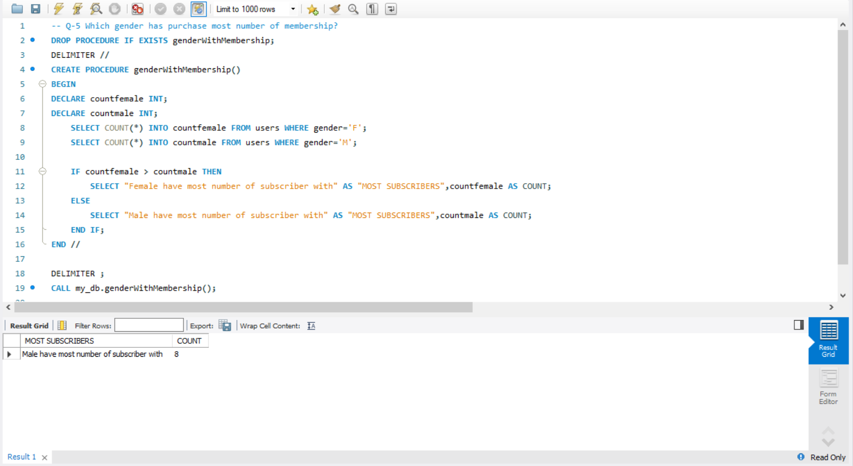
Which gender has purchase the most number of membership ?

Slide 11
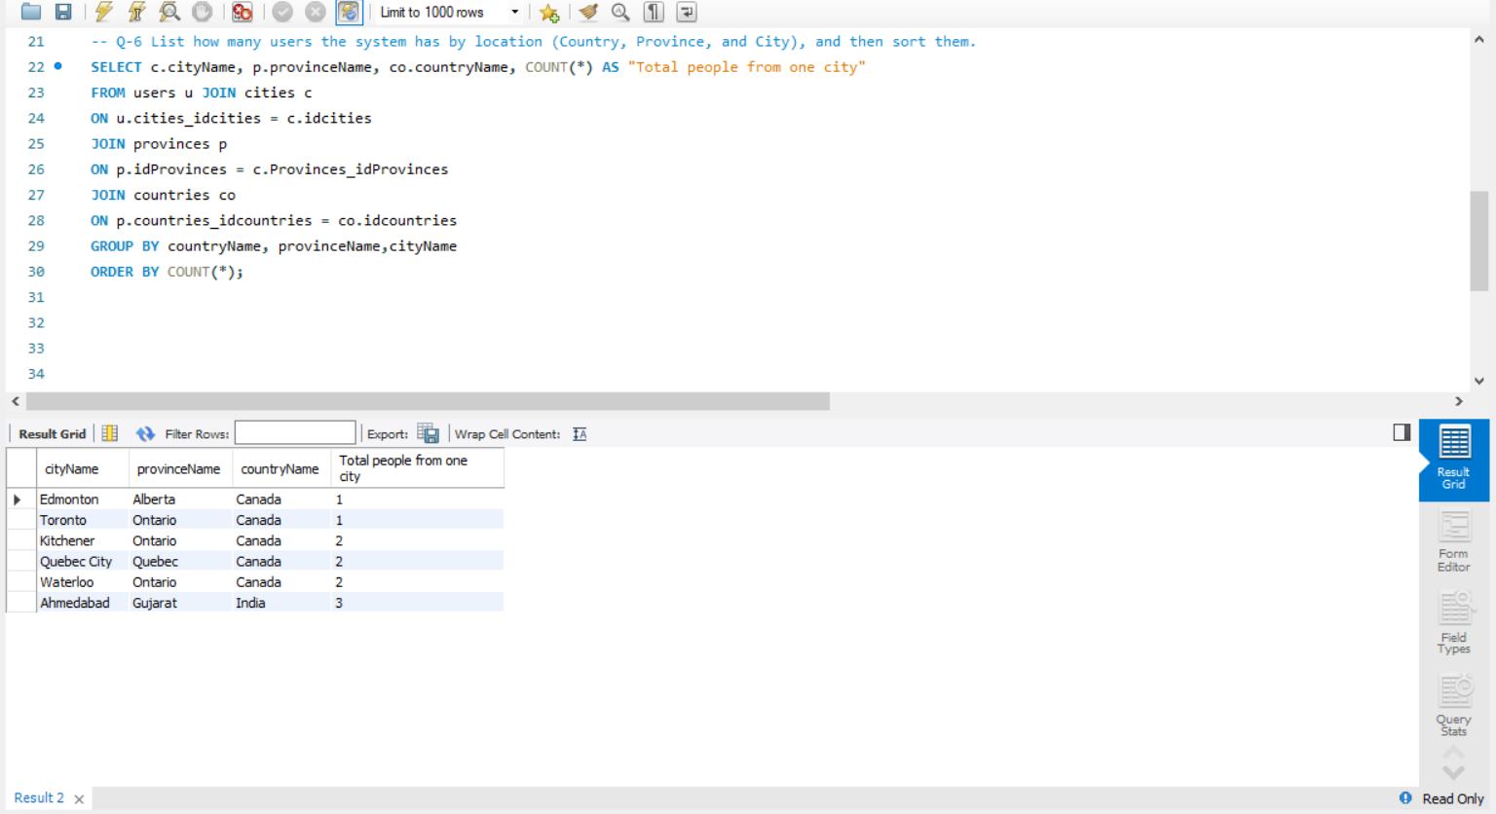
List how many users the system has by location (Country, Province, and City), and then sort them.

Slide 12
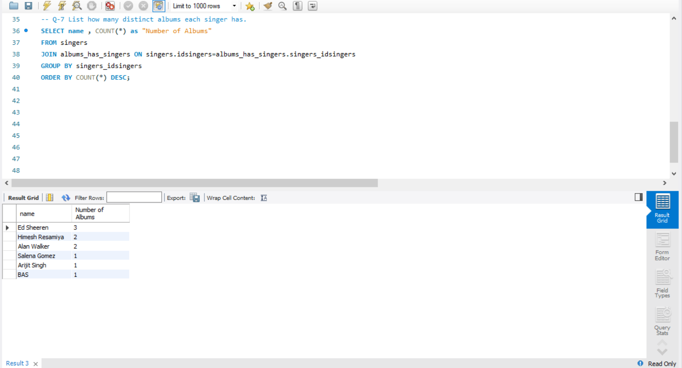
List how many distinct albums each singer has.

Slide 13
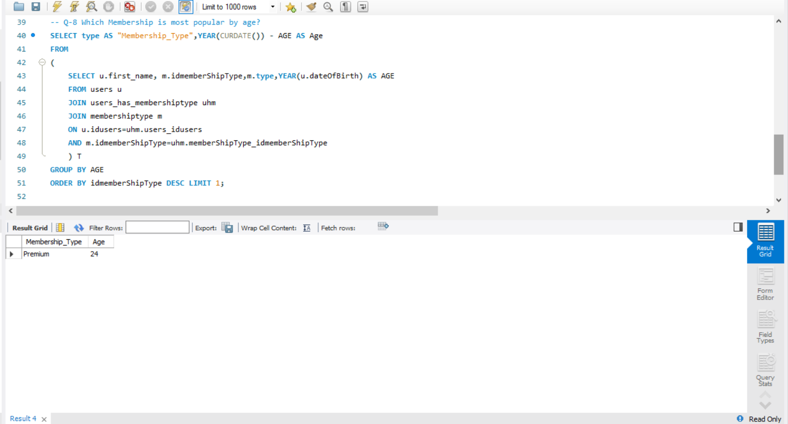
Which Membership is most popular by age?

Slide 14
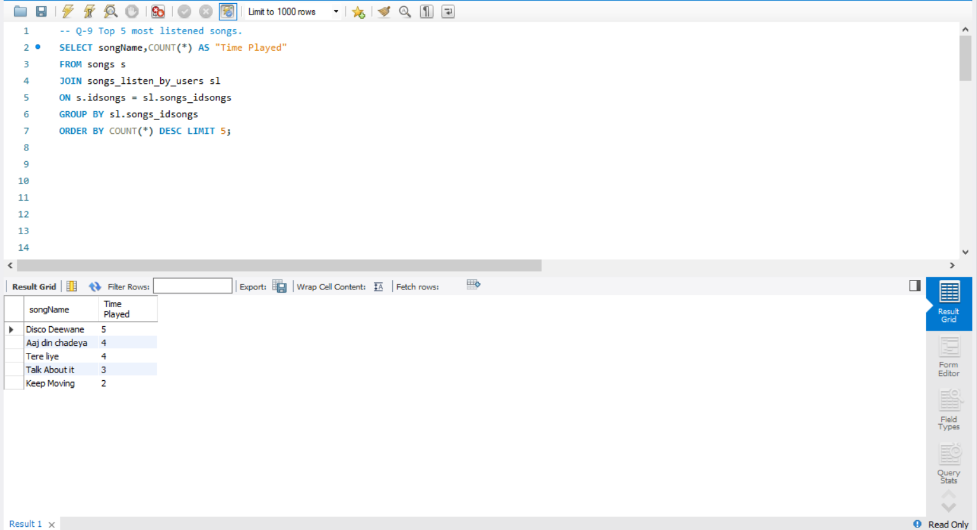
Top 5 most listened songs.

Slide 15
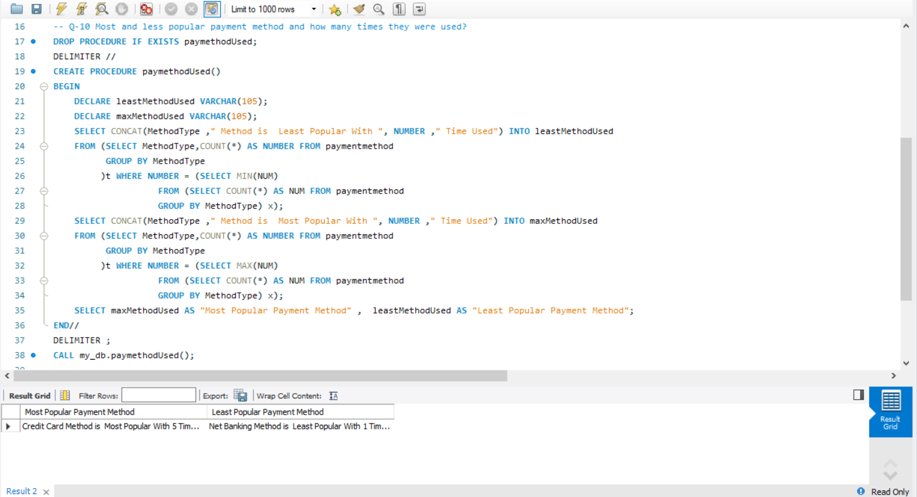
Most and less popular payment method and how many times they were used?

Slide 16
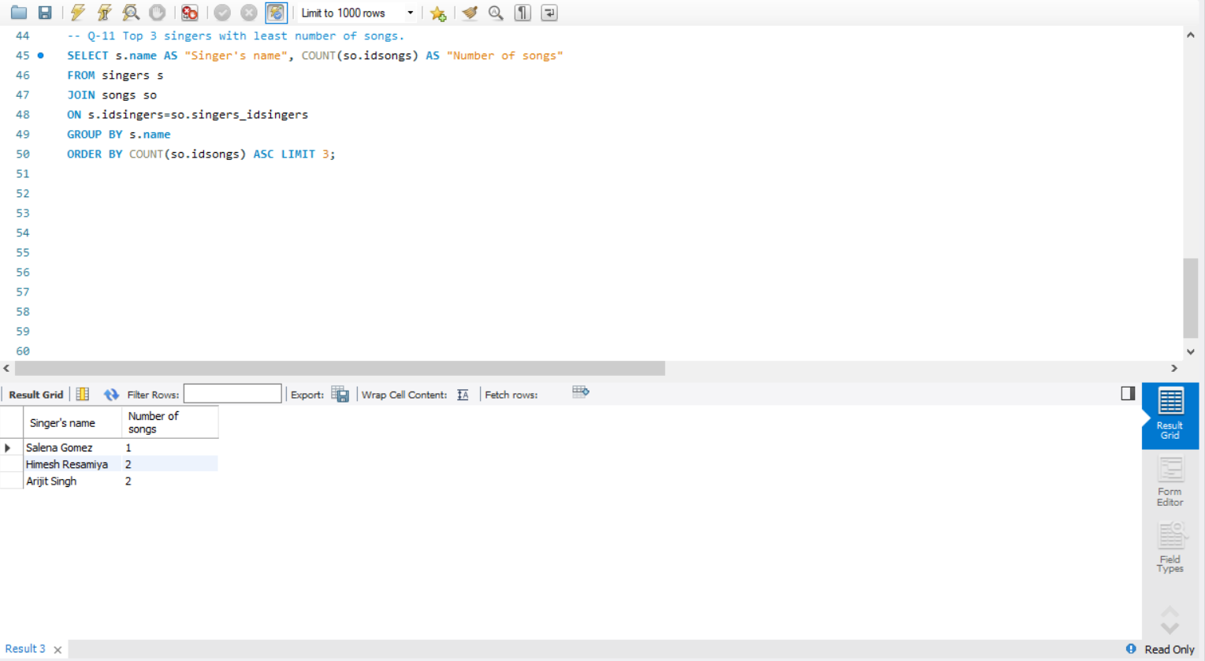
Top 3 singers with least number of songs.

Slide 17
Challenges
To decide how many tables are going to be their in database.
Deciding relationships between tables.
While generating database script some errors occur due to different version of software.
Solving question 6th was hard but we managed to it with the help of course materials.

Slide 18
Thank you

