Slide 1
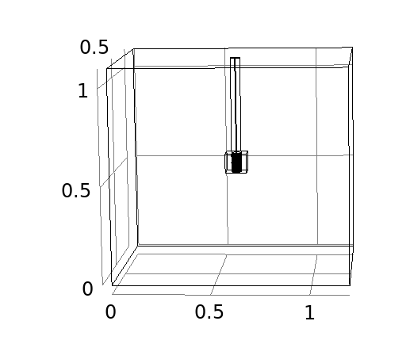
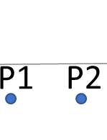
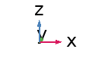
m
m
(a)
(b)
(c)

Slide 2
m
m
(a)
(b)
(c)

Slide 3
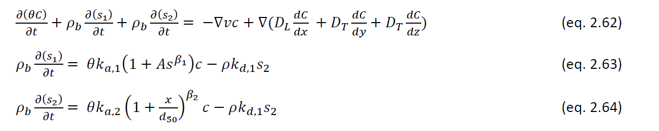

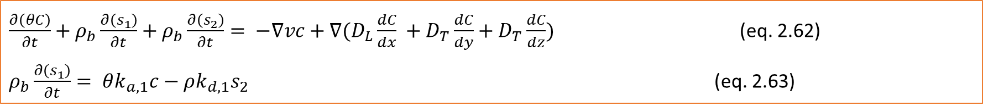
$\frac{∂\left(θC\right)}{∂t}+ρ_{b}\frac{∂\left(s_{1}\right)}{∂t}+ρ_{b}\frac{∂\left(s_{2}\right)}{∂t}= −∇vc+{∇(D}_{L}\frac{dC}{dx} +D_{T}\frac{dC}{dy}+D_{T}\frac{dC}{dz})$ (eq. 2.62)
$ρ_{b}\frac{∂\left(s_{1}\right)}{∂t}= θk_{a,1}c−ρk_{d,1}s_{2}$ (eq. 2.63)

Slide 6
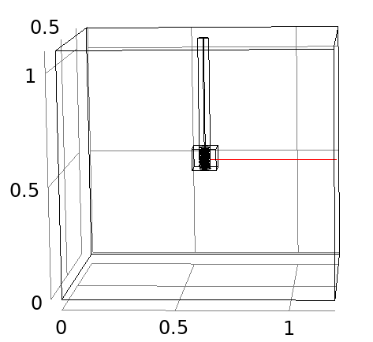
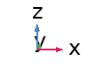
(a)
(b)

Slide 7
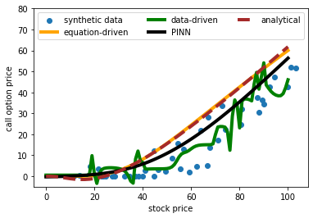
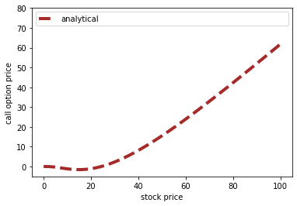
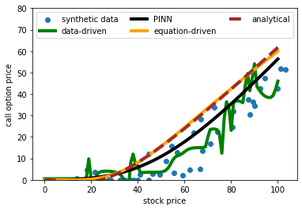
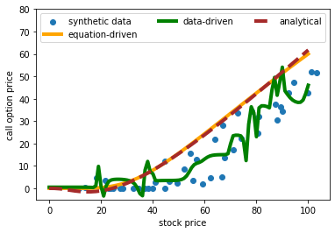
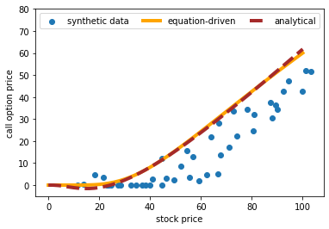
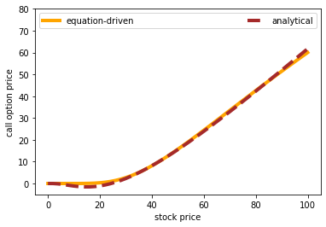
Analytical failed, convetional neural failed, finally it worked out

