Slide 1
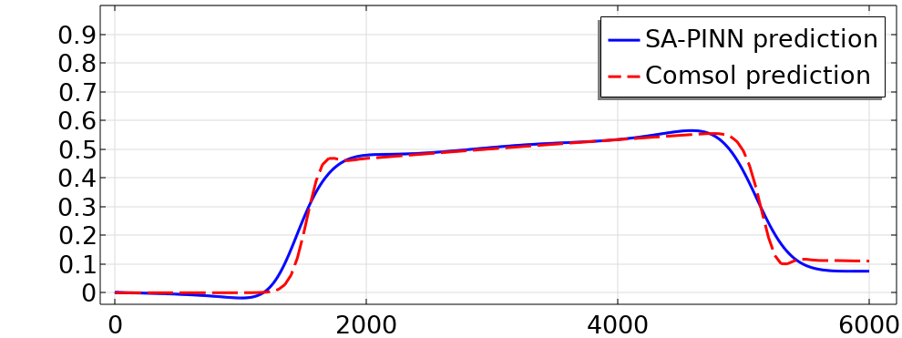
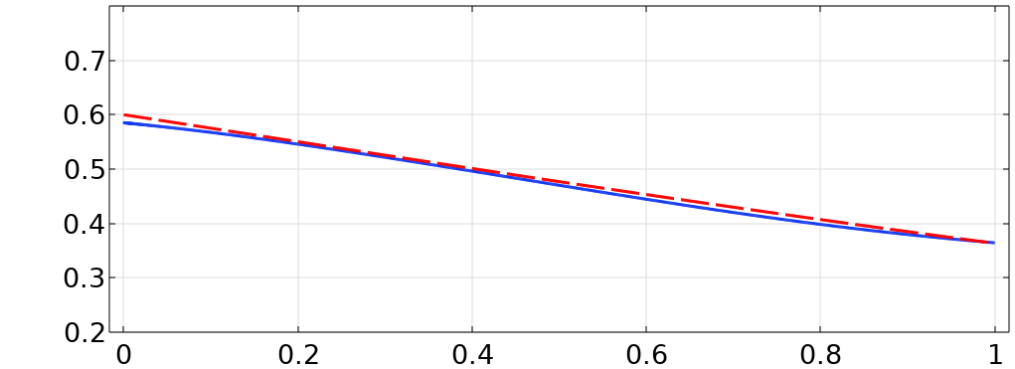
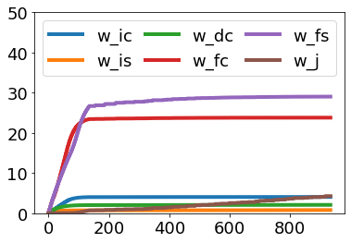
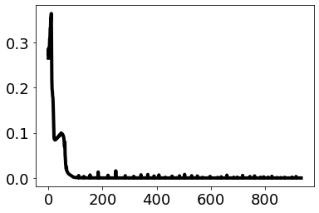

Slide 2
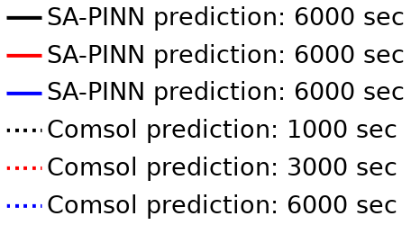
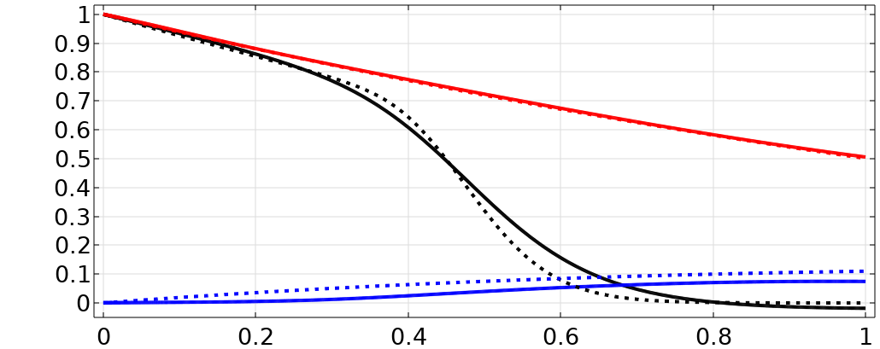

Slide 3
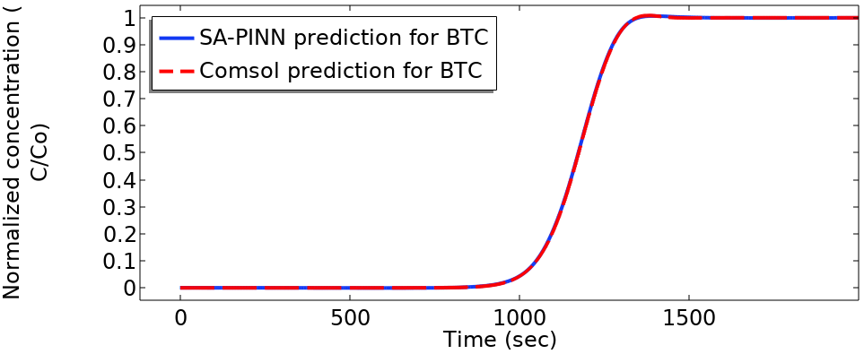
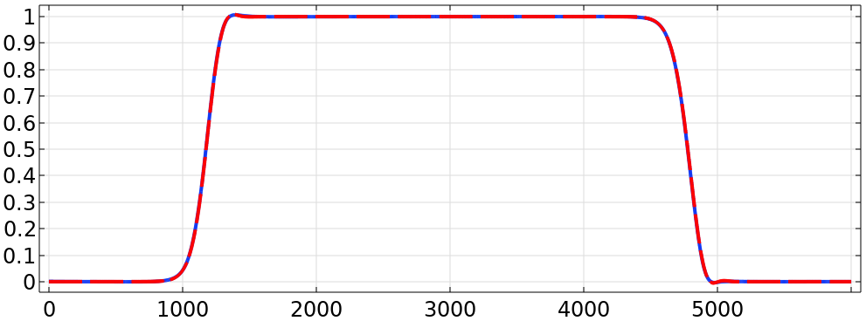
Aqueous concentration (kg·m⁻³)
Time (seconds)

Slide 4
Breakthrough curve
Retention profile
Aqueous concentration (kg·m⁻³)
Retained concentration (kg·m⁻³)
Time (seconds)
Column length (m)

Slide 5
∆λ_{ic}
∆λ_{b1}
∆λ_{fs}
∆λ_{is}
∆λ_{fc}
∆λ_{j}
Change in weights value
Epochs

Slide 6
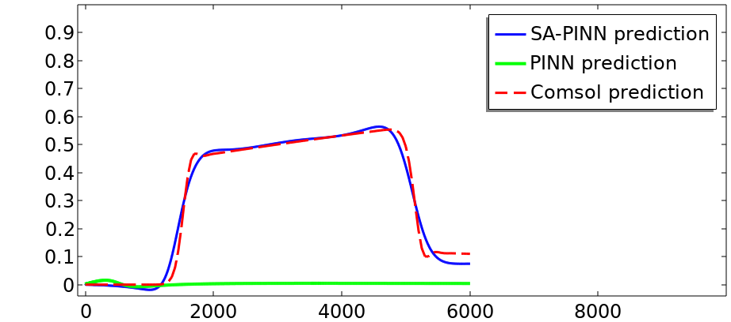
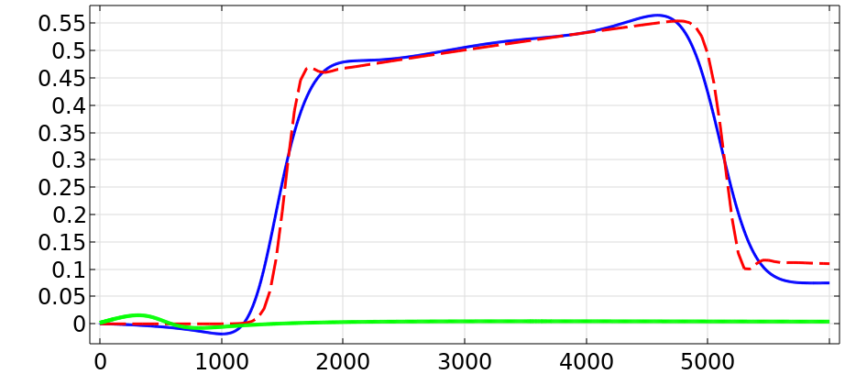
∆λ_{ic}
∆λ_{b1}
∆λ_{fs}
∆λ_{is}
∆λ_{fc}
∆λ_{j}
Change in weights value
Aqueous concentration (kg·m⁻³)
Epochs
Time (seconds)

Slide 7
∆λ_{ic}
∆λ_{b1}
∆λ_{fs}
∆λ_{is}
∆λ_{fc}
∆λ_{b2}
Change in weights value
Loss
Epochs
Epochs

Slide 8
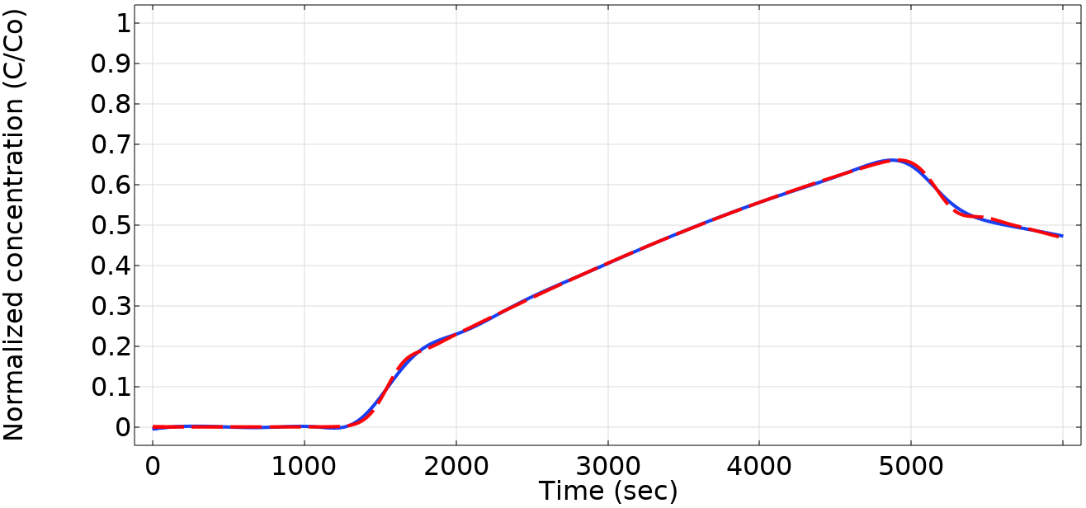
training dataset (tracer)
dw-PINN prediction (tracer)
Training dataset
(ENPs)
dw-PINN prediction (ENPs)
Aqueous concentration (kg·m⁻³)
Aqueous concentration (kg·m⁻³)
Time (seconds)
Time (seconds)

Slide 9
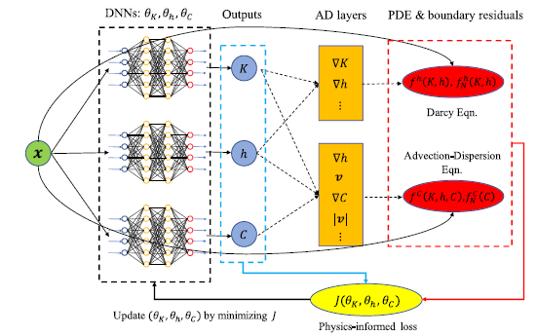
C

Slide 10
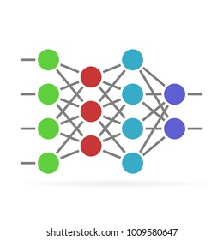
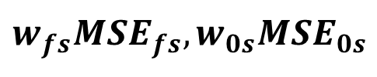
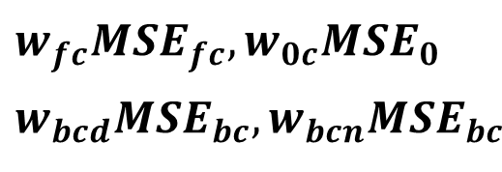


DNNs
Outputs
Physics informed loss function
$$w_{fc}MSE_{fc},w_{0c}MSE_{0}$$
$$w_{bcd}MSE_{bc},w_{bcn}MSE_{bc}$$
c
$${(x}_{i},t_{i})$$
s
$$w_{fs}MSE_{fs},w_{0s}MSE_{0s}$$
$$\min_{θ_{c},θ_{s}} \max_{ω} 𝓙\left(θ_{c},θ_{s},w\right)$$
Gradient descent/ascent step

Slide 11

DNNs
Outputs
Physics informed loss function
Equation driven loss
THETA
$${(p}_{i},q_{i})$$
OMEGA
Data-driven loss
$$\min_{θ_{c},θ_{s}} \max_{ω} 𝓙\left(θ_{c},θ_{s},w\right)$$
Gradient descent/ascent step

Slide 12
DNNs
Outputs
Physics informed loss function
$$w_{fc}MSE_{fc},w_{0c}MSE_{0}$$
$$w_{bcd}MSE_{bc},w_{bcn}MSE_{bc}$$
c
$${(x}_{i},t_{i})$$
s
$$w_{fs}MSE_{fs},w_{0s}MSE_{0s}$$
$$\min_{θ_{c},θ_{s}} \max_{ω} 𝓙\left(θ_{c},θ_{s},w\right)$$
Gradient descent/ascent step
Figure 1: Flowchart of dw-PINN framework representing two Deep Neural Networks with time and spatial points as input and concentration of aqueous and retained nano-particles as output. The loss function J consists of 6 Mean square error term MSEs corresponding to the boundary and governing PDE equations. For each MSE, a weight term is assigned to balance the loss function.

Slide 13
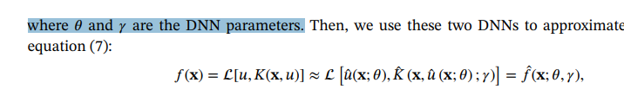
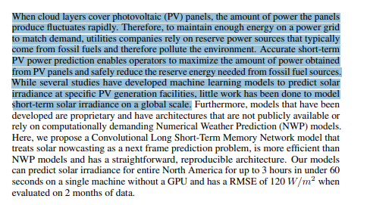
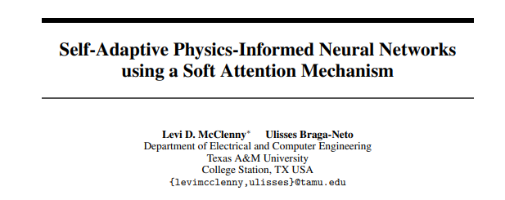

Slide 14
ENPs
Influent ENPs of 1 Kg·m⁻³

