Slide 1

SMS Spam Detection Using NLP Classification
AI APPLICATIONS · PROJECT PRESENTATION
96.86%
test accuracy · Naive Bayes
Separating unwanted messages from genuine texts with TF-IDF and machine learning
0
genuine messages flagged as spam
PRESENTED BY
SUPERVISOR
Shikhar Aasal
Neeru Goel
UID 26BDA70036 · BDS-111 (A)
B.E. (Hons.) CSE – Data Science
Notes:
Good morning. I am Shikhar Aasal, and my project is SMS spam detection using NLP classification. In short, it reads the text of a message and decides whether it is spam or genuine, and on our test set it was right 96.86% of the time without wrongly flagging a single genuine message.

Slide 2

Text-message fraud is growing fast
01 · THE PROBLEM
$470M
31 lakh
21 lakh
lost by US consumers to text scams in 2024, about 5× the 2020 figure (FTC)
spam and fraud complaints to TRAI in 2025, up from 13.6 lakh in 2023
mobile numbers disconnected in India in one year for spam and fraud
Sender blacklists and DLT registration cannot read what a message says. Users need a content-based filter that warns them without hiding genuine texts such as OTPs.
Sources: FTC press release, Apr 2025 · TRAI data via Kerala Kaumudi, Apr 2026 · Ministry of Communications via IANS, Nov 2025 · 2
Notes:
SMS is still how banks and delivery companies reach us, which is exactly why scammers use it. Americans lost 470 million dollars to text scams last year, and in India complaints to TRAI more than doubled in two years. Regulators can block known senders, but they cannot read the message itself. That gap is what this project addresses.

Slide 3
Classify an SMS as spam or ham from its text alone
02 · GOAL AND OBJECTIVES
1
Clean 5,572 labelled messages and make a reproducible, stratified 80/20 split
2
Train TF-IDF + Naive Bayes and TF-IDF + Logistic Regression pipelines
3
Reach at least 95% accuracy and 95% spam precision (baseline: 86.6%)
4
Validate with confusion matrices, precision/recall and 5-fold cross-validation
5
Deploy an explainable web app with an adjustable spam threshold
Out of scope:
live SMS interception
sender / URL metadata
non-English text
Shikhar Aasal · SMS Spam Detection · 3
Notes:
The problem definition is simple: given only the text of a message, decide spam or ham. I set five measurable objectives, from data preparation to a deployed app, and an explicit target of 95% accuracy and 95% spam precision, well above the 86.6% you would get by calling everything ham.

Slide 4
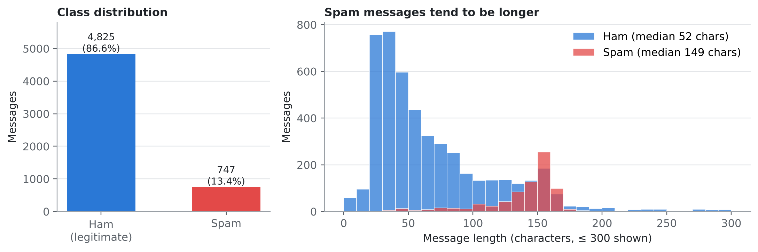
5,572 real, labelled SMS messages
03 · THE DATASET
4,825
ham (86.6%)
747
spam (13.4%): imbalanced
Spam is longer: median 149 vs 52 characters, and full of words like “free”, “claim” and “prize”.
Split: 4,457 training and 1,115 test messages, stratified so both keep 13.4% spam (random_state = 42).
Source: Almeida et al., UCI SMS Spam Collection (Kaggle copy) · 4
Notes:
The data is the public SMS Spam Collection. Only about one in seven messages is spam, so the classes are imbalanced, which means accuracy alone can mislead us. Spam is also noticeably longer and uses reward words. I held back 20% of the data, stratified, as a test set that the model never sees during training.

Slide 5
Three designs; classical ML fits best
04 · LITERATURE AND DESIGN SELECTION
Criterion | A · Rule-based keywords | B · TF-IDF + classical ML | C · Deep learning (LSTM / BERT)
Learns from data | No | Yes | Yes
Accuracy on benchmark | Low–medium | High (≈97%) | Very high (≈99%)
Training cost / model size | None / tiny | Seconds on CPU / ~380 KB | Hours on GPU / 10–400 MB
Explains its decisions | Yes | Yes, word by word | Hardly
Meets all constraints | Yes, but easily evaded | Yes: selected | No
Literature basis: Bayesian filtering (Sahami 1998), SMS filtering (Gómez Hidalgo 2006; Cormack 2007), the SMS Spam Collection benchmark (Almeida 2011), deep SMS filters (Roy 2020).
Shikhar Aasal · SMS Spam Detection · 5
Notes:
From the literature I considered three designs. Keyword rules are simple but cannot learn and are easy to evade. Deep learning is the most accurate, but it is heavy and hard to explain. TF-IDF with a classical classifier is the sweet spot: about 97% accuracy, a model under 400 KB, and every decision can be explained word by word. Within this design I compared two classifiers.

Slide 6

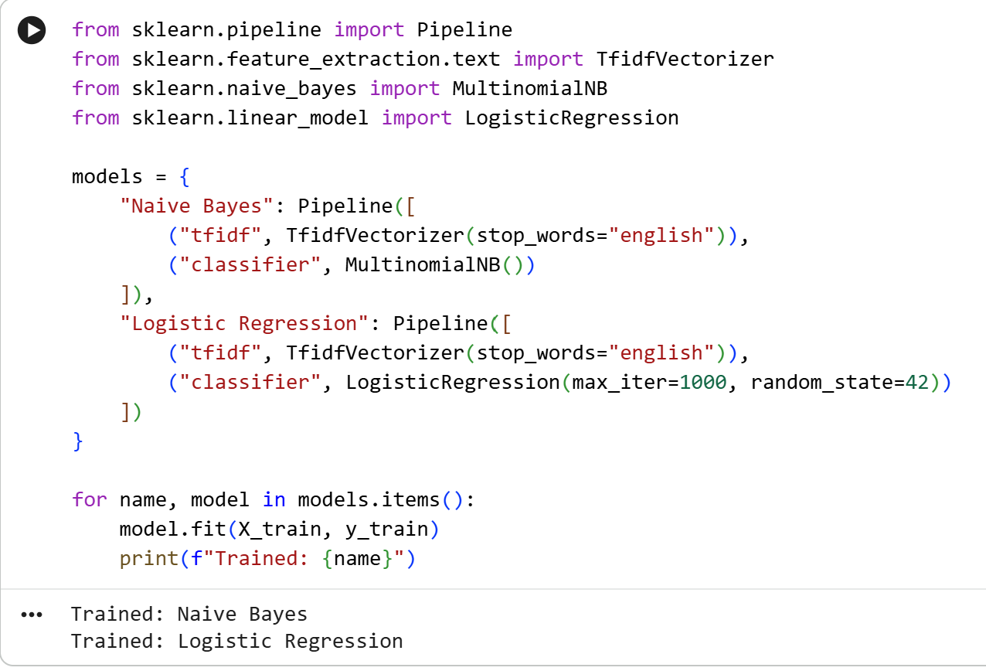
From raw text to a deployed classifier
05 · METHODOLOGY
LOAD
CLEAN
SPLIT
TF-IDF
TRAIN
DEPLOY
CSV with 5,572 messages
ham = 0, spam = 1
80 / 20, stratified
7,441-word vocabulary
Naive Bayes vs Logistic Reg.
best model in Streamlit
TF-IDF weighting
tf(t,d) × [ln((1+n)/(1+df(t))) + 1]
Multinomial Naive Bayes
ŷ = argmax [log P(c) + Σ xᵢ log P(tᵢ|c)]
TF-IDF is fitted on training messages only, so no test data leaks into training. The whole pipeline is saved as spam_model.pkl with joblib.
Shikhar Aasal · SMS Spam Detection · 6
Notes:
Here is the pipeline. I load and clean the data, split it, and convert each message into TF-IDF word weights, which reward words that are characteristic of a message and down-weight words that appear everywhere. Both classifiers are trained on exactly the same features, so the comparison is fair. The screenshot is the actual training code from Colab.

Slide 7
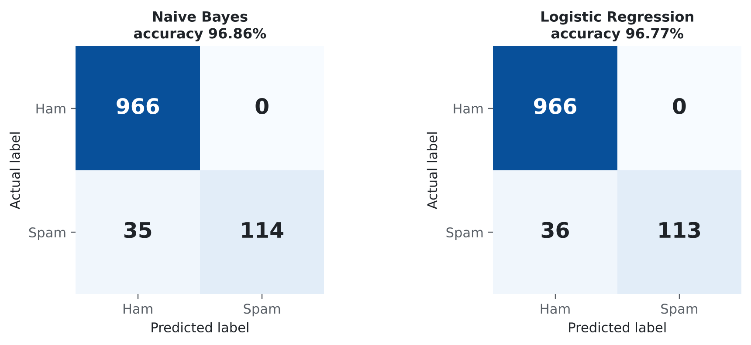
Naive Bayes wins, with zero false alarms
06 · RESULTS ON 1,115 UNSEEN MESSAGES
Measure | Naive Bayes | Logistic Reg.
Accuracy | 96.86% | 96.77%
Spam precision | 100% | 100%
Spam recall | 76.5% | 75.8%
F1-score (spam) | 0.867 | 0.863
ROC-AUC | 0.989 | 0.988
False alarms / missed spam | 0 / 35 | 0 / 36
A model that calls everything ham would already score 86.64% and catch no spam, which is why precision and recall matter more than accuracy here.
Shikhar Aasal · SMS Spam Detection · 7
Notes:
On the 1,115 held-out messages, Naive Bayes reached 96.86% accuracy and Logistic Regression 96.77%. The most important number is the zero: neither model flagged a single genuine message as spam. All the errors are spam that slipped through. Naive Bayes caught one more spam message, so it was selected.

Slide 8
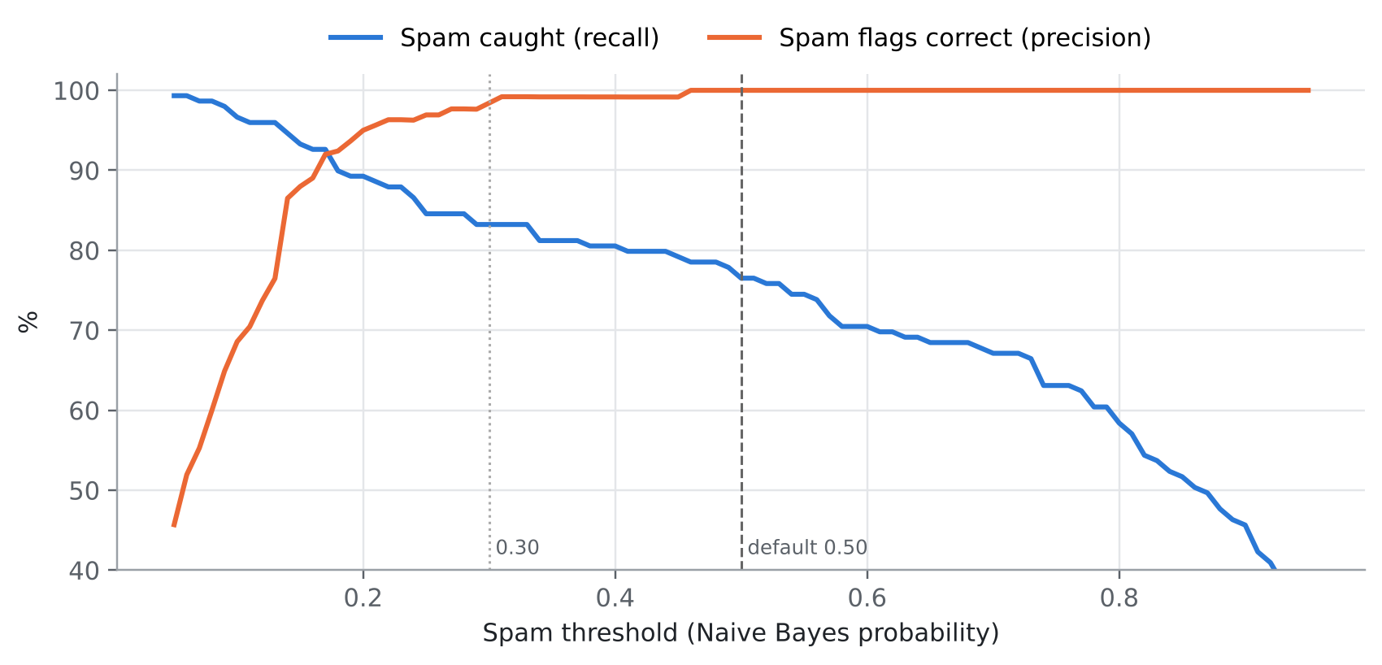
Robust results, tunable threshold
07 · VALIDATION
5-fold cross-validation
Spam threshold trade-off (NB)
Mean | NB | LR
Accuracy | 97.09% | 96.21%
Precision | 99.84% | 98.73%
Recall | 78.44% | 72.69%
F1-score | 87.84% | 83.73%
Naive Bayes leads on every metric except ROC-AUC (98.8 vs 99.1), so the selection is not a lucky split.
At 0.5: 76.5% recall, 0 false alarms · at 0.3: 83.2% recall, only 2 false alarms
Shikhar Aasal · SMS Spam Detection · 8
Notes:
Because the margin on one split was just one message, I re-ran both models with 5-fold cross-validation. Naive Bayes again wins on accuracy, precision, recall and F1. The chart shows the trade-off behind the threshold: lowering it from 0.5 to 0.3 catches noticeably more spam at the cost of only two false alarms, which is why the app lets the user choose.

Slide 9
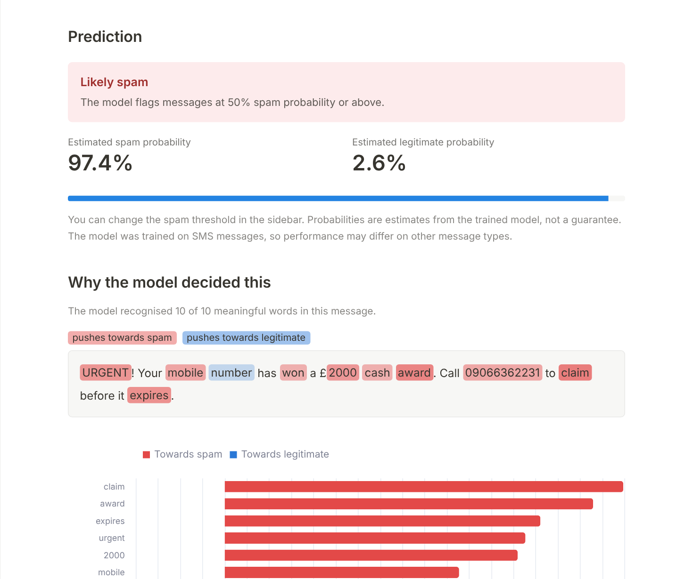




It explains every verdict
08 · THE WEB APP
Spam probability plus highlighted words
Adjustable spam threshold
Live performance and dataset tabs
6 of 6 functional test cases passed
Honest limitation
A modern fake-parcel scam scores only 37.2% and slips through: the training data predates such scams.
Live: sms-spam-detection-ai.streamlit.app · Code: github.com/shikharaasal/sms-spam-detection · 9
Notes:
The selected model is deployed as a Streamlit web app. You paste a message and it shows the spam probability, highlights which words pushed the decision, and lets you move the threshold. Here a classic prize scam scores 97.4%, driven by words like claim, award and urgent. One honest limitation: a modern parcel-delivery scam scores only 37%, because the dataset is from before such scams were common.

Slide 10
A small filter that met its targets
09 · CONCLUSION AND FUTURE WORK
Achieved
Next steps
96.86% accuracy, 100% spam precision
Robust in 5-fold cross-validation (97.09%)
Deployed, tested, explainable web app
Partly met: recall 76.5% (83.2% at 0.3)
Retrain on recent Indian and Hinglish scams
Add character n-gram and URL features
Compare SVM and DistilBERT
On-device Android version
Thank you · Questions?
Shikhar Aasal · 26BDA70036
Shikhar Aasal · SMS Spam Detection · 10
Notes:
To conclude: the filter met its accuracy and precision targets, held up under cross-validation, and is deployed as an explainable app. Recall is the part to improve, and the clear next step is retraining on recent, local scam messages, including Hinglish, plus richer features. Thank you, and I am happy to take questions.

