Slide 1

Jawaharlal Nehru university
academic year : 2022-23 school of computer & system sciences
Subject : programming in c
Submitted to: DR piyush pratap singh
Submitted by: swagatika Hial
Enrollment no.: 22/10/jc/049
\

Slide 2
Diary management system
Presented by : swagatika hial

Slide 3
Features of the project
Diary management project is a password protected diary system. In this project user can maintain their daily journal. They can perform various operations like :-
Add new page
View page
Edit page
Delete page
Change password

Slide 4
Concepts used in this project
This project is created using C language. Some basic concepts of this languageis used in this project.
Arrays
pointers
Structure
Switch case
Loops (for, while, do-while)
Conditional statement (if, else, nested is-else)
User defined functions
File handling

Slide 5
User defined function in this project
addPage()
viewPage()
editPage()
deletePage()
pass0()
editPass()

Slide 6
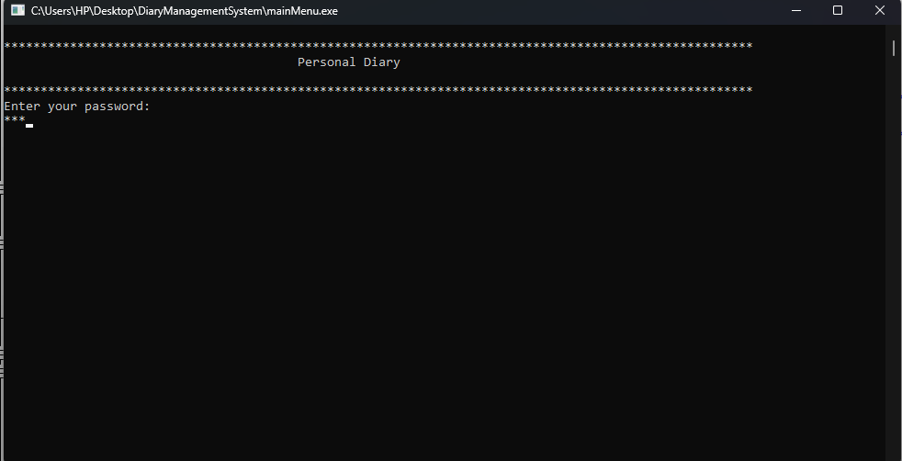

Slide 7
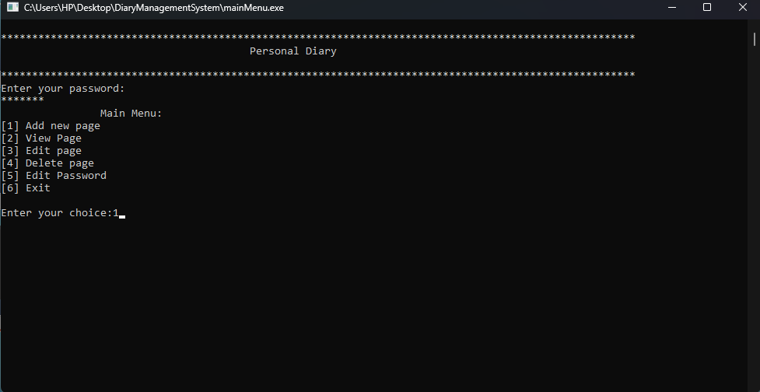

Slide 8
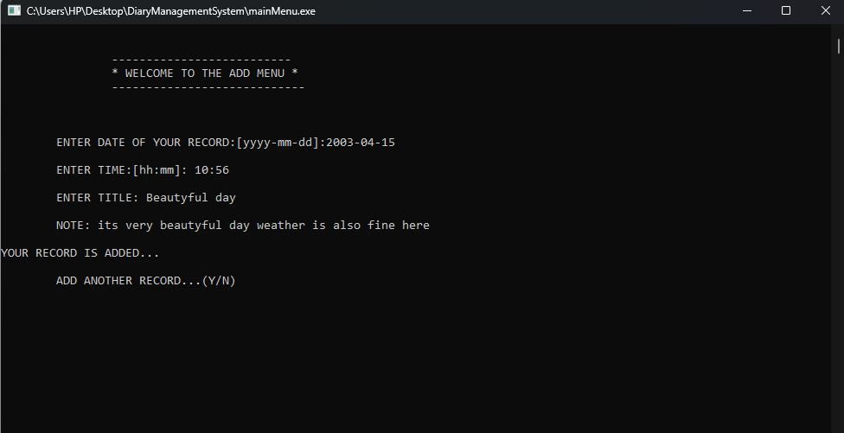

Slide 9
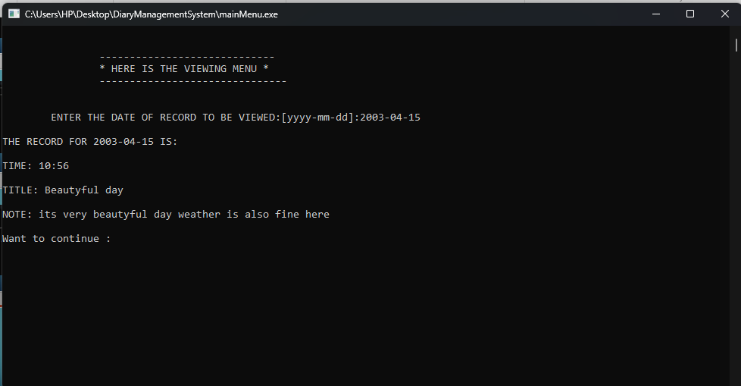

Slide 10
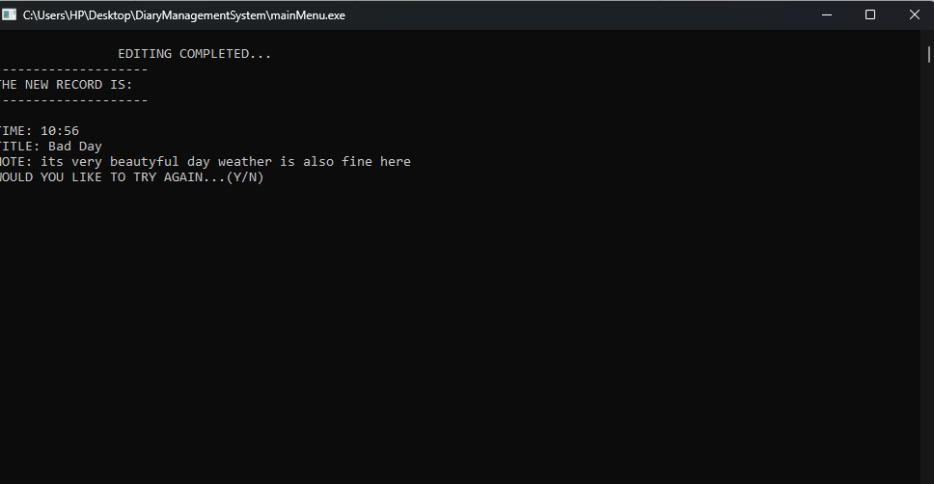

Slide 11
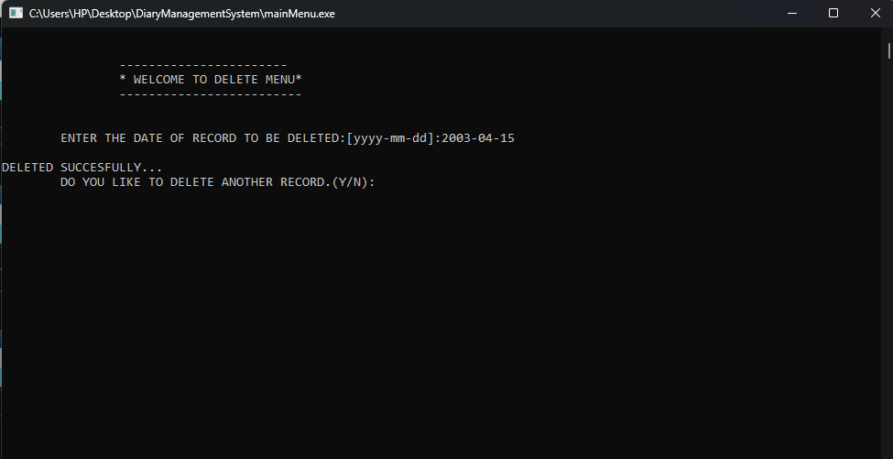

Slide 12
Thank you

