Slide 1

SHE ARISE TRAINING
PROJECT ON
EMI LOAN CALCULATOR
MEMBERS:
SHIKHA RANI
SHELLY RAOTEY
PRATIBHA SHARMA
RASHI JAISWAL
RISHIKA JAISWAL
RITESHWARI SINGH
SADHNA
SUBMITTED TO:
MR. RAJESH CHAUDHARY
MRS. RAVITA PARVANI

Slide 2
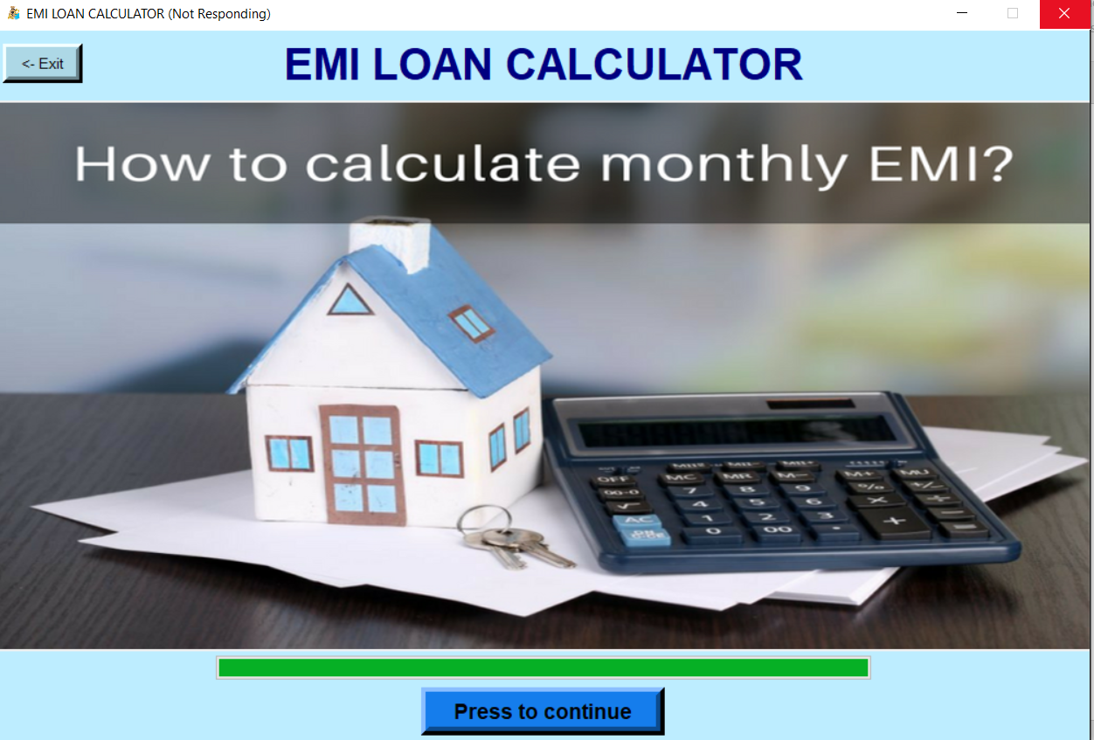
WHAT IS EMI
An equated monthly installment (EMI) is a fixed payment amount made by a borrower to a lender at a specified date each calendar month.

Slide 3
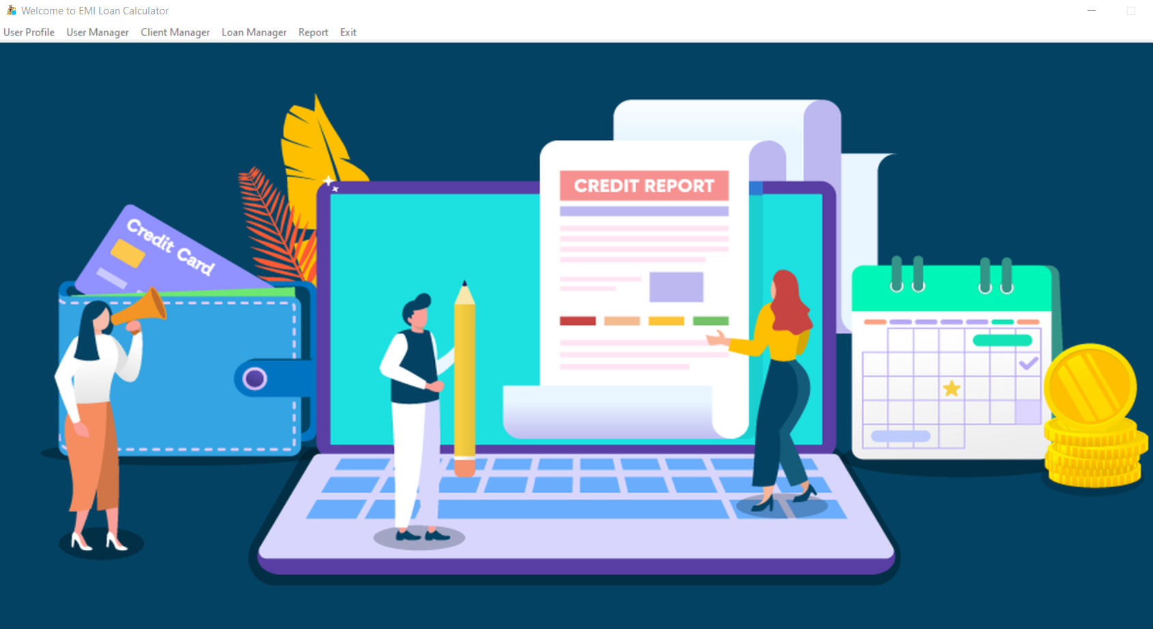
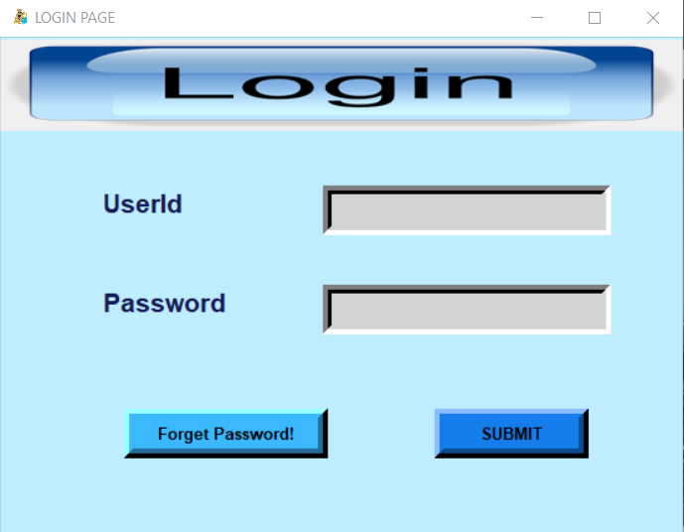
Front Page View

Slide 4
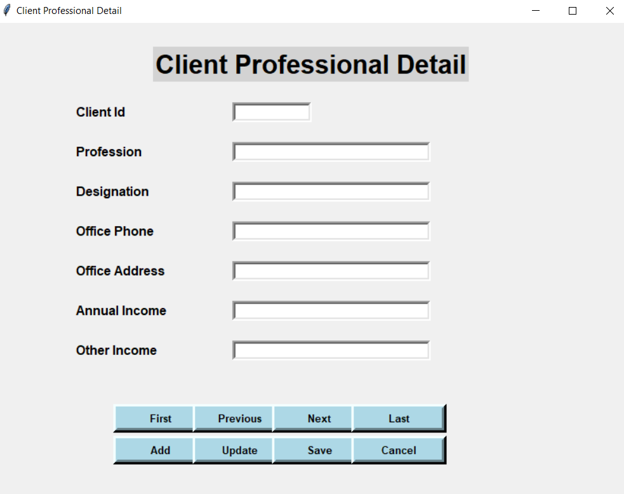
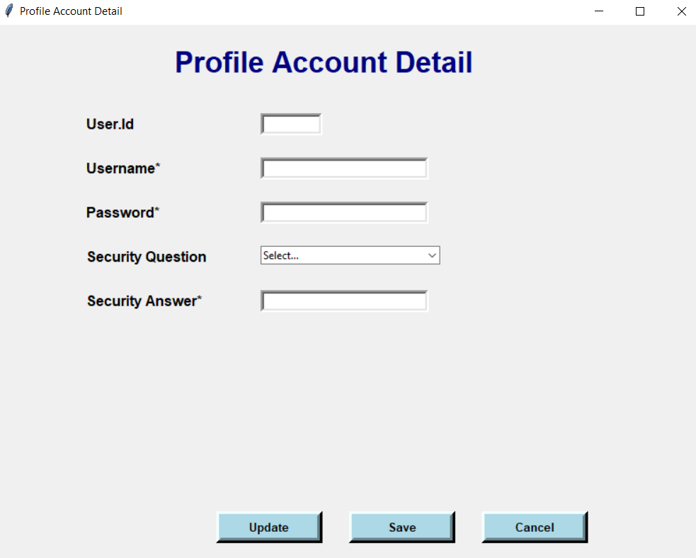
Desktop based Application.
User/Admin access.
Reports

Slide 5
PROPOSED SYSTEM ARCHITECTURE
INPUT
USERNAME & PASSWORD
BASIC DETAILS
CLIENT Personal Details
USING COMPOUND INTEREST FORMULA
DATA PROCESSING
Loan File Detail & Loan Evaluation
Loan Issue
PAYABLE AMOUNT
Reports
OUTPUT
DATA PROCESSING

Slide 6
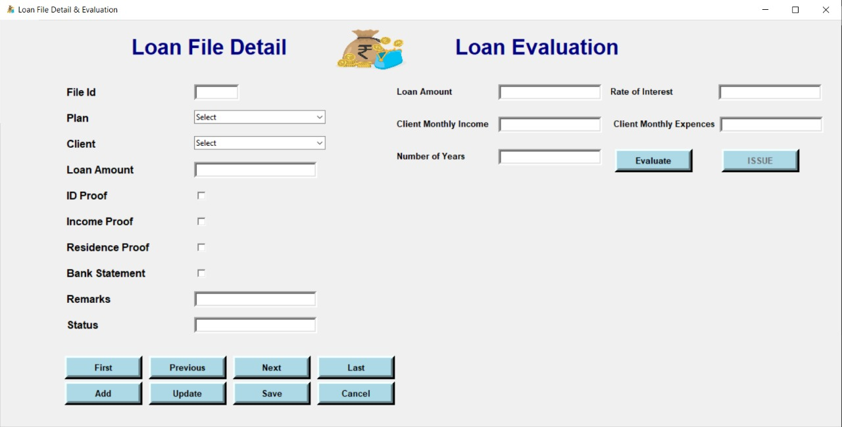

Slide 7
Working:
We plan to integrate Compound Interest formula and Desktop application to store the amount of a items to calculate particular monthly EMI with the help of additional information gathered with by users input which will be ask each users. There will be certain manually fed data by the users on the desktop application about the amount of the items in specific his salary.
The Desktop application will provide the processed data automatically such as monthly payable amount, which will be stored in the user’s database for a traction.
We will process the data which is stores by the user by using forms and figure out the best payable amount on monthly basis. The values fetched by the calculator.

Slide 8
User
Basic Details
Database
Name
DOB
Add
On the basis of Predictive Analysis based on that formula & Given Values
Client personal Detail
Login user Name & password
DATABASE
Value
Best amount Is Suggested
data

Slide 9
Unique and Innovative Part of The Project:
Accurate Result.
Smart Work.
Comparing loan offers.
Beneficial for loan management.
Choosing the right tenure.
Easy to access and use.

Slide 10
Value Proposition:
Social Impacts :
Eliminating Human error.
Improve productivity or increased quality of production
Continuously monitoring payment.
Real time data and current scheme.
Improved Principal
Improves GDP

Slide 11
THANKYOU

