Slide 1
SMART ATTENDANCE SYSTEM

Slide 2
Contents
Introduction
Motivation
Problem statement
Literature review
Face Recognition & steps
Algorithm
Proposed block diagram
Experimental Setup & Result
UseCase Diagram
Flow Diagram
Methodology
Future scope
Conclusion
References

Slide 3
INTRODUCTION
The Internet of Things has seen steady expansion and interest as the cost of computing devices, sensors, and internet has decreased.
The Internet of Things aims to solve real-world problems by providing sensing, processing, and networking capabilities to objects that would otherwise lack these capabilities.
This allows it to communicate with external devices and transfer data to the outside world, allowing for smart data processing and autonomous judgments. As a result, iot plays a critical role in the creation of a variety of helpful applications in sectors such as transportation, the environment, and health.
Cloud computing has seen a paradigm shift in the delivery of computer infrastructure, as well as the development and use of software applications. Cloud Computing is based on virtualization and dynamic provisioning of resources such as operating systems, database storage, and networking.

Slide 4
MOTIVATION
The main goal would be to investigate the approaches of smart attendance systems that use rfid and cloud , face recognition, as well as to properly compare the methods used by each system.
The most important aspects of this system would be the modeling and interfacing of the electrical hardware. The obtained parameters and design values (results) will aid in the implementation of the design on hardware.

Slide 5
PROBLEM STATEMENT
Most university attendance methods are still written on a piece of paper at the moment. The student must still sign the attendance sheet for classes, tutorials, and laboratory sessions. Because the risk of losing attendance data is very significant, this strategy is not adaptable.
The attendance data will be lost if the attendance sheet is missing. Aside from that, unethical issues such as signature fraud could arise. For example, if a student does not show up for class, his attendance form is signed by another student.
This system is presented as a solution to these issues. Furthermore, because the proposed system also records time, the lecturer can keep track of the students' punctuality.

Slide 6
LITERATURE REVIEW
SR. NO. | NAME OF AUTHER AND PUBLICATION OF PAPER | YEAR OF PUBLICATION | SUMMARY OF PAPER
1 | A Comparative Analysis on Smart Home System to control, Monitor and Secure Home based on IOT. | 2018 | Home Automation is used to control home appliances remotely to reduce efforts. It is beneficial in securing your home from fire and trespass.
2 | Fingerprint Based Smart Attendance System for Educational Institutions. | 2019 | Internet of Things (IoT) is rapidly changing the way we interact and gain information about ourselves and external world.

Slide 7
SR.NO. | NAME OF AUTHER AND PUBLICATION OF PAPER | YEAR OF PUBLICATION | SUMMARY OF PAPER
3 | A Raspberry Pi Based Event Driven Quasi Real Time Attendance Tracker. | 2020 | This project employs the IoT with an intelligent event-driven system in order to realize an efficient quasi real-time attendance tracker.
4 | Internet of Things – based Smart Classroom Environment. | 2019 | Interlinking technologies are playing major role in smart world with smart devices and has impact on computer science.

Slide 8
SR. NO. | NAME OF AUTHER AND PUBLICATION OF PAPER | YEAR OF PUBLICATION | SUMMARY OF PAPER
5. | Analysis of FDA-based facial recognition performance utilising correlation, ANN, and SVM. | 2018 | Face is Detected and Recognised using Artificial Intelligence and Neural Network for Automatic Attendance System.
6. | Combined Feature Extraction Method for Automated Face Recognition in Classroom Environment. | 2020 | Feature Extraction method is used to detect and recognise faces. It is also compared with other methods.

Slide 9
FACE RECOGNITION
A facial recognition system is a technology capable of matching a human face from a digital image or a video frame against a database of faces, typically employed to authenticate users through ID verification services, works by pinpointing and measuring facial features from a given image.
Facial recognition is a category of biometric security. The technology is mostly used for security and law enforcement, though there is increasing interest in other areas of use.

Slide 10
STEPS FOR FACE RECOGNITION
Step 1: Face detection
Step 2: Face analysis
Step 3: Converting the image to data
Step 4: Finding a match

Slide 11
ALGORITHM
We use LBPH (Local Binary Pattern Histograms) algorithm to detect faces. It labels the pixels of an image by thresholding the neighborhood of each pixel and considers the result as a binary number.
LPBH uses 4 Parameters :
(i) Radius : the radius is used to build the circular local binary pattern and represents the radius aorund the central pixels.
(ii) Neighbors : the number of sample points to build the circular local binary pattern.
(iii) Grid X : the number of cells in the horizontal direction.
(iv) Grid Y : the number of cells in the vertical direction.
3. The model built is trained with the faces with tag given to them, and later on, the machine is given a test data and machine decides the correct label for it.

Slide 12
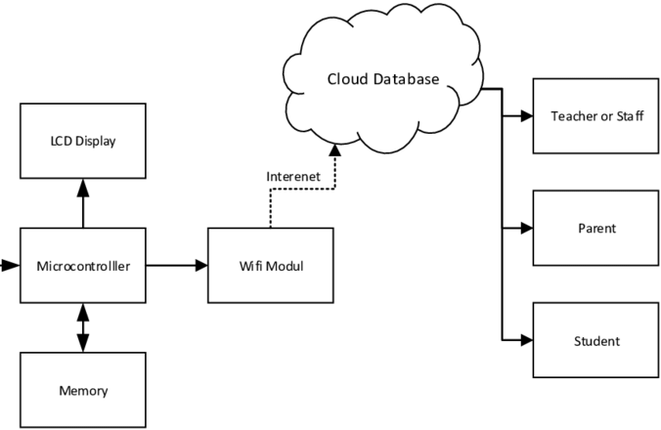
BLOCK DIAGRAM

Slide 13
EXPERIMENTAL SETUP
SOFTWARE REQUIREMENTS :
1. Python 3.10.0
2. OpenCV Library
HARDWARE REQUIREMENTS :
1. Webcam 720p HD

Slide 14
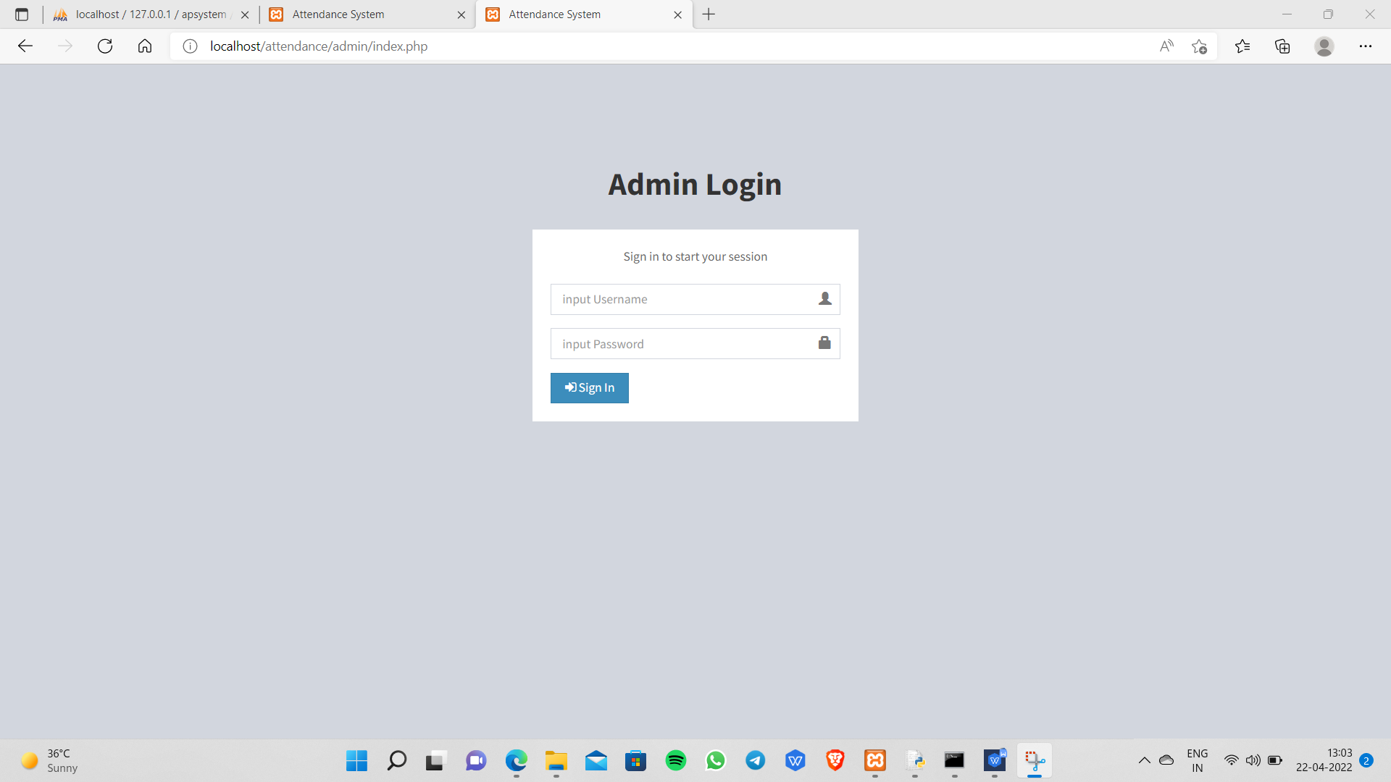
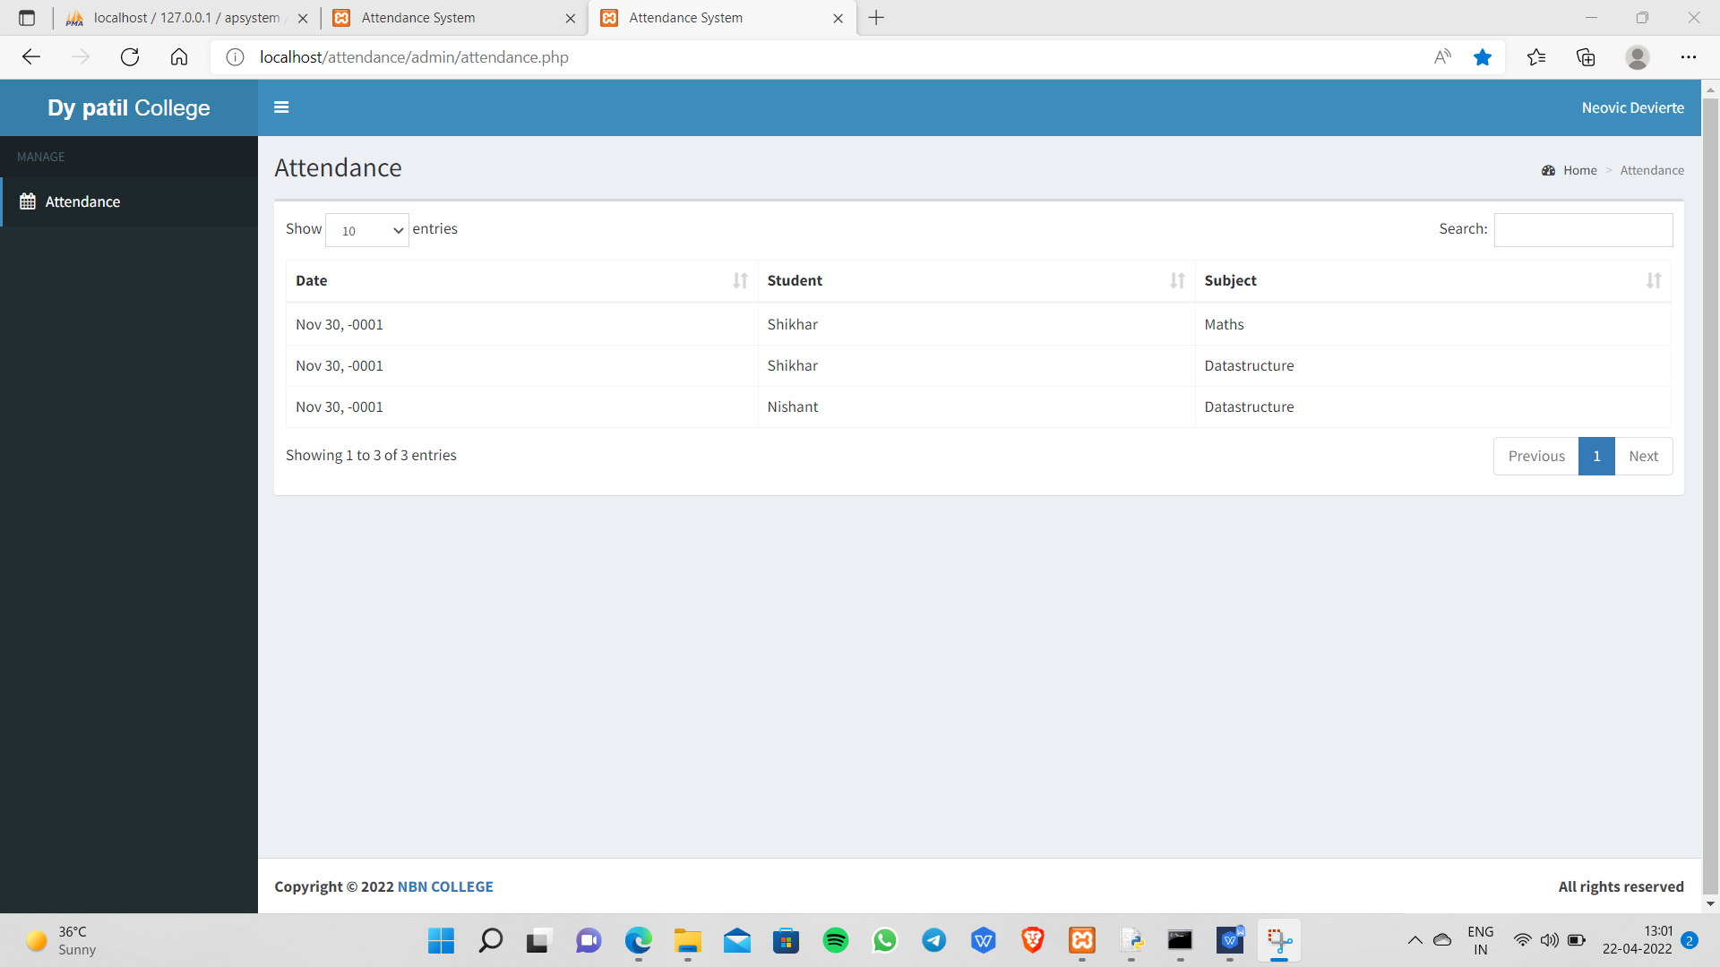
RESULT

Slide 15
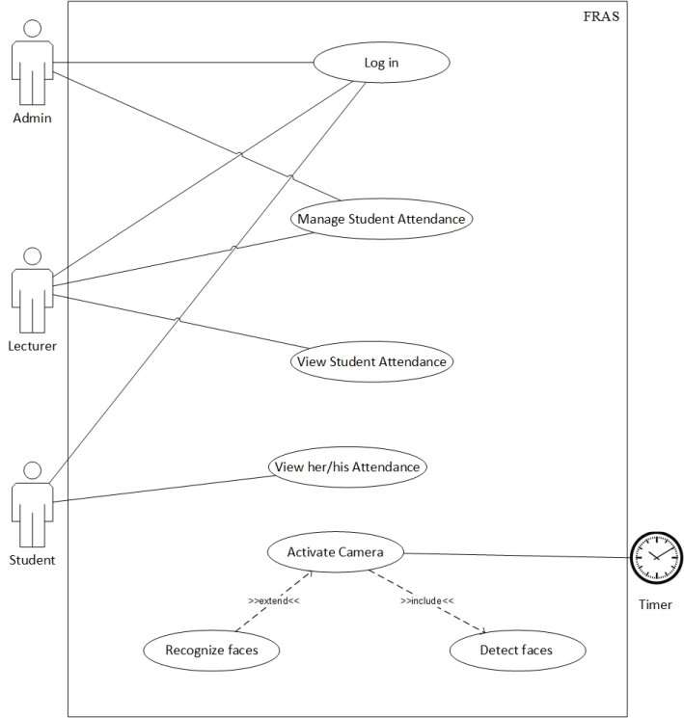
USECASE DIAGRAM

Slide 16
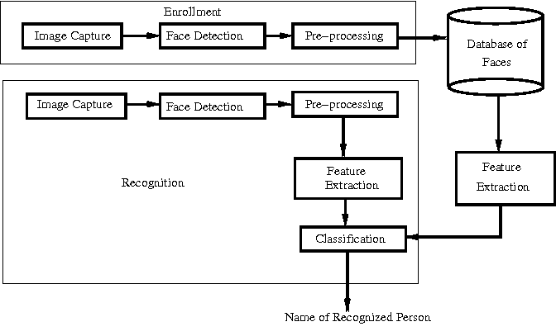
FLOW DIAGRAM

Slide 17
METHODOLOGY
The goal of this project is to create cloud integrated smart attendance system using sensor,wifi module, webcam.
Hardware used :
1. Webcam.

Slide 18
ADVANTAGES
The cloud-based attendance system has both a lcd and a computer interface. This allows for on-the-spot attendance viewing on an LCD or remotely from a computer.
Quick and efficient: identifies candidates in a matter of seconds.
• The technique allows for more precise identification.
• Educational institutions, such as schools, colleges, and universities, can track the frequency of students, teachers, and personnel in order to avoid proxy marking and errors.

Slide 19
OTHER APPLICATIONS
• Identification and authentication at the library – circulation fees collection counter.
• As a cash card in campus cooperative stores, canteens, gyms, library fines, and other locations.
• Faculty, officials, and non-teaching staff attendance management, as well as leave management.

Slide 20
FUTURE SCOPE
The system can be improved by incorporating a AI based face recognition module that can recognize students' faces and mark their attendance using artificial intelligence, resulting in more accuracy in the future.

Slide 21
CONCLUSION
This study shows a prototype of an end-to-end IOT solution for successful educational institute attendance management.
It has the potential to replace attendance sheets with a more efficient and dependable gadget.
It highlights how the internet of things may be used to make an educational institute's attendance system smart.
As the attendance data is saved in the cloud, it is easier to access and use it for various applications such as viewing, monitoring, reporting, and alerting.
It simplifies the process of taking attendance for students and the management of attendance data for the institution.
It gives both the institute and the students online and real-time access to attendance data, allowing them to take remedial action if they are not on time

Slide 22
REFERENCES
1. X. Jia, O. Feng, T. Fan, and Q. Lei, “RFID Technology and its Applications in Internet of Things (IoT)”, 2nd IEEE conference on Consumer Electronics, Communications and Networks, pp. 1282 - 1285, 2019.
2. C. Sun, “Application of RFID Technology for Logistics on Internet of Things”, AASRI Conference on Computational Intelligence and Bioinformatics, pp. 106- 111, 2018.
3, J. He, S. Ji, Y. Pan, and Y. Li, “Constructing Load Balanced Data Aggregation Trees in Probabilistic Wireless Sensor Networks”, TPDS IEEE Transactions on Parallel and Distributed Systems, Vol. 25, No.7, pp.1681-1690, July, 2014.
4. T.G. Zimmerman, “Personal area networks: Near-field intra body communication”, IBM System Journal, Vol. 35.
5. Tolga Soyata, 2012 IEEE Symposium on Computers and Communications (ISCC), pp. 000059000066.IEEE (Institute of Electrical and Electronics (2012).

Slide 23
REFERENCES
6."A review of distributed application processing frameworks in smart mobile devices for mobile cloud computing," by Muhammad Shiraz et al. IEEE Communications Surveys and Tutorials, vol. 15, no. 3, pp. 1294-1313. (2013).
7."A Combined Feature Extraction Method for Automated Face Recognition in Classroom Environment," by Md Shafiqul Islam and colleagues. Signal Processing and Intelligent Recognition Systems: An International
8. "Facial Recognition Vendor Test, 2000," US Department of Defense Available: http://www.dodcounterdrug.com/facialrecognition/FRVT
Sujatha, Shalini Punithavathani, and Jaya K. Priya
9. Krishnamurthy, Sumatra, Shalini Punithavathani, and Jaya K. Priya.
"Extraction of well-exposed pixels for image fusion in high dynamic range photos using a subbanding technique." 54-72 in International Journal of Image and Data Fusion, vol. 8.1 (2017).
10. K. Chang, K.W. Bowyer, and S. Sarkar, "Comparing and combining ear and facial images in appearance-based biometrics," IEEE Transactions on Pattern Analysis and Machine Intelligence, vol. 25, no. 9, September 2003.

Slide 24
THANK YOU!!

