Slide 1
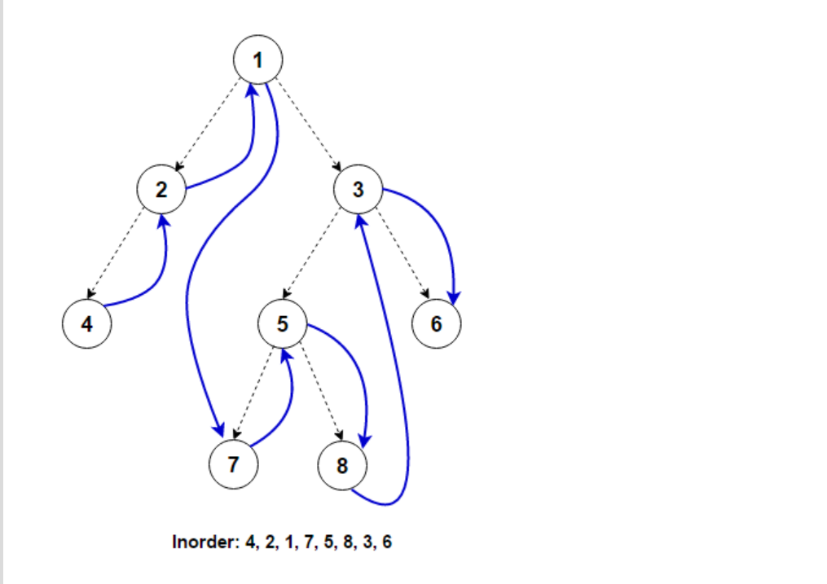
Curr =1
Curr = stack.push(1)
Curr =curr.left
Curr=2
Inorder={}
1

Slide 2
Curr ==2
Curr = stack.push(2)
Curr =curr.left
Curr=4
Inorder={}
2
1

Slide 3
Curr ==4
Curr = stack.push(4)
Curr =curr.left
Curr=null
Inorder={}
2
1
4

Slide 4
1
2
Current == null
Pop 4 from the stack . curr = stack.pop()
Curr = 4 curr = curr.right
Curr =null
Inorder={4}

Slide 5
1
Current ==null Pop 2 from the stack . curr = stack.pop()
Curr = 2 curr = curr.right
Curr = null
Inorder={4,2}

Slide 6
Current == null Pop 1 from the stack curr = stack.pop(1)
Curr=curr.right
(1.right=3)
Curr=3 inorder={4,2,1}

Slide 7
current =3
Stack.push(3);
Curr=curr.left
Curr=5
Inorder={4,2,1}
3

Slide 8
Curr=5
Stack.push(5)
curr =curr.left (3.left)
Curr = 7
Inorder={4,2,1}
3
5

Slide 9
Curr=7
Stack.push(7)
current =curr.left (7.left)
curr = null
Inorder={4,2,1}
3
7
5

Slide 10
Curr == null
Curr = stack.pop(7);
Curr = 7;
Curr = curr.right;
Curr = null inorder={4,2,1,7}
3
5

Slide 11
Curr == null
Curr = stack.pop(5);
Curr = 5;
Curr = curr.right;
Curr =8
Inorder={4,2,1,7,5}
3

Slide 12
Curr == 8
Curr = stack.push(8);
Curr = curr.left;
Curr==null
Inorder={4,2,1,7,5}
8
3

Slide 13
Curr == null
Curr = stack.pop(8);
Curr =8
Curr = curr.right;
8.right;
Curr==null
Inorder={4,2,1,7,5,8}
3

Slide 14
Curr == null
Curr = stack.pop(3);
Curr =3
Curr = curr.right;
3.right;
Curr==6
Inorder={4,2,1,7,5,3}

Slide 15
Curr == 6
stack.push(6);
Curr = curr.left;
6.Left = null;
Curr==null
Inorder={4,2,1,7,5,8,3}
6

Slide 16
Curr == null
Curr = stack.pop(6);
Curr = 6
Curr = curr.right;
6.right= null;
Curr==null
Inorder={4,2,1,7,5,8,3,6}

Slide 17
Curr == null
Stack is empty
Inorder = 4,2,1,7,5,8,3,6

