Slide 1
ISB PCPM CAPSTONE | PRODUCT PROPOSAL
Govern
Product Proposal for Cisco AI Sentinel
Protect
Optimize
Secure, governed and smarter use of any AI tool, right inside the browser
Shikhar Prakash
Cisco | October 2026
Notes:
Seeking approval for a 12-week MVP of Cisco AI Sentinel.

Slide 2
EXECUTIVE SUMMARY
Make secure AI use the easiest way to use AI
1
Problem
48%
of employees entered non-public company data into GenAI (Cisco, 2024)
Employees adopt AI tools faster than companies can govern them. 48% admit pasting non-public data into GenAI tools.
2
Solution
AI Sentinel: a browser extension + Cisco cloud that governs, protects and optimises every prompt across ChatGPT, Gemini and more.
$8.6B
shadow-AI governance market by 2032, 35.6% CAGR (MarketsandMarkets)
3
Why Cisco
Duo identity, Talos intel, AI Defense models and a channel into mid-market customers offset our late entry.
$77M
obtainable ARR by FY2029 (SOM, author estimate)
4
The ask
US$1.2M for one squad and a 12-week MVP, with a paid pilot and a launch / no-launch gate in Jan 2027.
Cisco AI Sentinel | Product proposal | Shikhar Prakash
2

Slide 3
1 INTRODUCTION
Cisco brings trust and reach; AI Sentinel adds the user-level AI layer
CISCO AT A GLANCE
“AI Sentinel sits quietly in the browser, catches the API key or customer list before it leaves, enforces company AI policy across every tool, and helps people write better prompts.”
$63.3B
FY2026 revenue, +12% YoY
Networking: Catalyst, Meraki
Security: Secure Access, Duo, XDR, AI Defense
Observability: Splunk, ThousandEyes
Collaboration: Webex
Customers: enterprises, mid-market, public sector; partner-led in 180+ countries
G
P
O
Govern
Protect
Optimize
Role-based access to AI tools: allow, warn or block by user, group and app
Real-time PII, secrets and injection checks, with one-click redaction on the device
Opt-in Prompt Copilot: clearer, leaner prompts with before/after preview
Buyers: CISOs and IT leaders at 100-5,000-employee firms (Duo / Meraki base first)
Users: knowledge workers | On-ramp: freemium for AI power users
Cisco AI Sentinel | Product proposal | Shikhar Prakash
3

Slide 4
2 TARGET MARKET LANDSCAPE
A fast-growing market with a ~$2.9B serviceable opportunity
TAM
Potential spend: ~300M enterprise GenAI seats + ~150M power users
$30B
SAM
Cisco-reachable: ~25M mid-market seats (NA, EMEA, India) + ~20M power users
$2.9B
SOM
ARR by FY2029: 0.75M seats + 0.4M paying individuals
$77M
35.6% CAGR 2026-2032. Source: MarketsandMarkets (Sept 2026). AI TRiSM: $3.1B to $11.6B by 2031.
Bottom-up sizing: author estimates (US$72/seat/yr; US$57/user/yr)
Cisco AI Sentinel | Product proposal | Shikhar Prakash
4

Slide 5
2 COMPETITIVE LANDSCAPE & ANSOFF
Rivals restrict the user; nobody makes AI both safer and more productive
ANSOFF MATRIX
AI Sentinel
Existing products
New products
PromptPerfect / AIPRM
Market penetration
Cross-sell AI Defense / Secure Access
Product development
AI Sentinel for Duo, Meraki & Secure Access customers (primary)
Existing markets
MS Purview + Edge
Productivity value to the user →
Native AI settings
Prompt Security
Market development
Take Duo / Secure Access into new regions
Related diversification
AI Sentinel Personal for prosumers (contained bet)
Prisma Browser
Island
New markets
Harmonic / LayerX
Zscaler / Netskope
Security & governance depth →
Cisco AI Sentinel | Product proposal | Shikhar Prakash
5

Slide 6
3 TIMING
We enter third; Cisco's reach can recover most of the late-entry penalty
-18 pts
share vs. pioneer = ~$54M ARR lost by FY2029
+7.5 pts
recovered: 33% share, ~$99M ARR
Late-mover advantages we will use
Pioneers already educated the buyer; budgets exist
Learn from rivals: heavy rollouts and noisy alerts
Duo / Meraki base and partner channel cut CAC
Bundling and brand trust in Enterprise Agreements
Window closing as SSE vendors bundle: ship in 12 weeks
Contested segment: browser-layer AI security, mid-market, ~$300M/yr by FY2029 (estimate)
Cisco AI Sentinel | Product proposal | Shikhar Prakash
6

Slide 7
4 CUSTOMERS
Three personas, one journey from 'unaware' to advocate
A
Ananya, 27
B
Vikram, 44
C
Meera, 33
AI power user | Developer, Bengaluru
Security leader | CISO, 1,200-staff IT firm
Knowledge worker | HR partner, fintech
Wants: precise answers, fewer tokens
Pain: vague prompts; once pasted an API key
Role: user and buyer (Rs 299-599/mo)
Wants: safe AI adoption, audit evidence
Pain: no visibility; bans backfire; noisy DLP
Role: economic buyer
Wants: finish writing faster, never leak PII
Pain: unsure what is 'sensitive'; cryptic blocks
Role: user and influencer
CUSTOMER JOURNEY (ENTERPRISE; INDIVIDUALS SKIP THE PILOT)
Unaware
Aware
Consider
Pilot
Purchase
Use
Advocate
AI-leak news, Talos blogs
Account team, partner, Web Store
Demo, free tier, reviews
4 weeks: monitor, then enforce
Partner / EA / in-app
MDM deploy, inline tips
Case study, referrals
Cisco AI Sentinel | Product proposal | Shikhar Prakash
7

Slide 8
4 CUSTOMER RESEARCH
Protection without friction wins; buyers and users value different things
SEGMENT SPLIT (MEAN SCORE)
Feature | Enterprise | Individual
Tool access (RBAC) | 5.0 | 1.5
Audit & reports | 5.0 | 1.0
Prompt optimizer | 3.0 | 5.0
Preview & undo | 3.5 | 5.0
Top 2 (4.6): data redaction and low friction. Latency is a must-have
Local-first (4.4) matters to everyone: lead with 'checked on your device'
Split confirms one core, two packages: governance for buyers, Copilot for users
Savings dashboard (3.4) moves to P1
Illustrative data: replace with real interview results
Cisco AI Sentinel | Product proposal | Shikhar Prakash
8

Slide 9
5 PRODUCT
Highest opportunity at moderate risk: build it, de-risked through an MVP
OPPORTUNITY COST & DEVELOPMENT RISK (same 12-week budget)
PRODUCT / COMPANY FIT
Criterion (1-5) | A. AI Sentinel | B. Secure Access AI-DLP | C. Prompt optimiser
Market opportunity | 5 | 4 | 3
Strategic fit | 4 | 5 | 2
Differentiation | 5 | 2 | 2
Revenue (3 yr) | 4 | 3 | 2
Technical risk (5 = low) | 3 | 4 | 4
Market risk (5 = low) | 3 | 4 | 2
Weighted score | 3.9 | 3.7 | 2.6
+
Duo identity, Talos intel, AI Defense models, Splunk, channel
–
Gaps: PLG / consumer motion, extension UX, prompt-quality ML
PRODUCT / MARKET FIT: HYPOTHESES TO TEST
Users prefer 'Redact & send' over a hard block
Friction acceptable: p95 under 100 ms, one click
40%+ accept optimiser suggestions
Mid-market pays US$6-8/user/month without SSE
A browser extension is an acceptable MVP control
Weighted: opportunity average x 60% + risk average x 40%. B stays in the plan as a later Secure Access integration.
Cisco AI Sentinel | Product proposal | Shikhar Prakash
9

Slide 10
5 PRODUCT STRATEGY
Positioned as security employees want installed
MARKETING MIX (4Ps)
THREE LEVELS OF THE PRODUCT
Product
Extension + console; Govern, Protect, Optimize; 4 tiers
Price
Freemium + per-seat + metered advanced ops
Core
Confidence to use any AI tool safely, with better results
Actual
Extension, inline redaction, Copilot, console, Cisco brand
Place
Chrome / Edge stores; Cisco account teams, partners, marketplaces, EA
Promotion
Talos AI-leak research, Cisco Live, partner enablement, communities
Augmented
Duo SSO, Splunk/XDR, Talos packs, audit reports, support
POSITIONING
For AI-using organisations, AI Sentinel is the browser-native layer that unites governance, data protection and prompt optimisation, so the secure way is the most productive way.
BUSINESS & REVENUE MODEL
B2B SaaS with a product-led B2C on-ramp
Seats + metered ops + Personal Plus + add-ons; 75%+ GM target
Cisco AI Sentinel | Product proposal | Shikhar Prakash
10

Slide 11
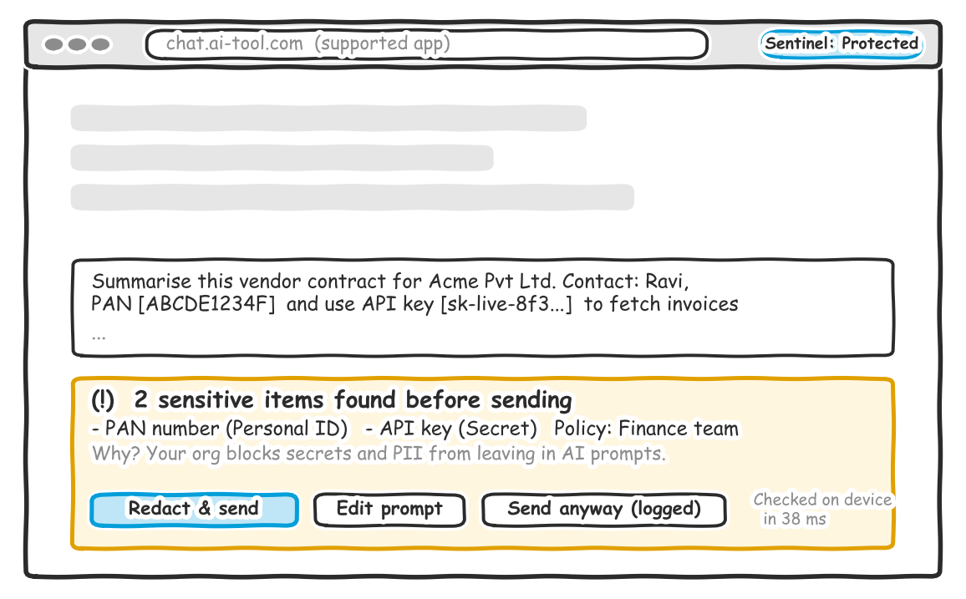
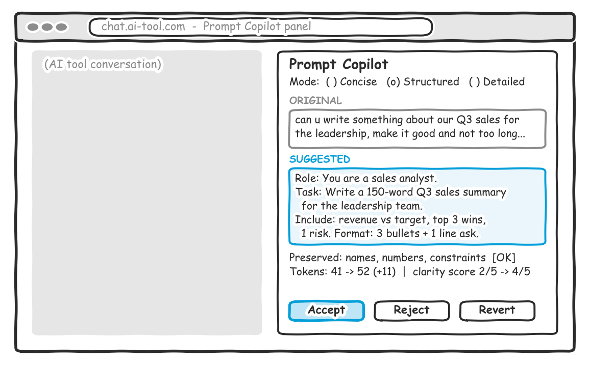
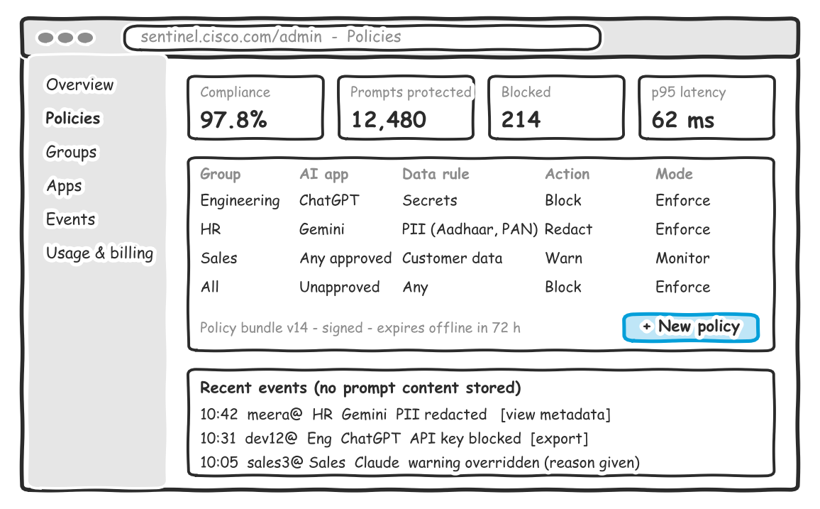
6 CONCEPT TESTING
Lo-fi prototype tested 1-on-1 with three target customers
Protect: inline detection + 'Redact & send'
Optimize: Copilot before/after, accept / revert
Govern: group policies, monitor / enforce, events
METHOD
PARTICIPANTS
TASKS
Qualitative think-aloud sessions (45 min) + 10-question survey with Likert, Sean Ellis and Van Westendorp questions
Ananya: developer (Persona A)
Vikram: CISO (Persona B)
Meera: HR partner (Persona C)
Send a prompt containing a PAN + API key
Improve a vague prompt
Create an HR policy (CISO)
Cisco AI Sentinel | Product proposal | Shikhar Prakash
11

Slide 12
6 CONCEPT TEST RESULTS
Validated: clear, trusted and wanted, if it fixes rather than blocks
3/3
4.7/5
67%
Rs 399
completed the redaction task unaided
warning clarity
'very disappointed' without it (PMF bar: 40%)
Personal price; US$6-8/user for business
What we learned | What we change
Meera hesitated at 'Send anyway' | 'Redact & send' is the default; overrides need a reason
Auto pop-ups annoyed Ananya | Copilot on demand only; add a 'Concise' mode
Vikram won't block on day one | Monitor mode default for pilots; one-click enforce
Auditors need evidence | Metadata-only event export (CSV / Splunk) in the MVP
On-device message missed (3.7/5) | Persistent 'Checked on device' badge
Illustrative results (n = 3): replace with real sessions before submission
Cisco AI Sentinel | Product proposal | Shikhar Prakash
12

Slide 13
7 MVP & PMF
Build a focused 12-week MVP, not a full platform
!
Dev risk moderate-high
Capability | MVP scope (P0)
Apps | ChatGPT + Gemini web; Chrome & Edge; status badge
Protect | Local secrets / PII checks; 'Redact & send'; warn / block
Govern | Duo / Entra SSO, groups, monitor -> enforce, signed policies
Optimize | On-demand Copilot, 3 modes, diff, accept / revert
Console | Policies, users, metadata-only event export
Out | Desktop apps, API traffic, every AI site, certification
UI changes break adapters; detection needs tuning
?
PMF unproven
n = 3 tests; willingness to pay needs real money
$
Opportunity cost
MVP = 1 squad x 12 weeks vs. 3 squads x 12 months
EARLY-SUCCESS FACTORS (PILOT EXIT CRITERIA)
≥ 60%
≤ 100 ms
≥ 95%
≥ 40%
≥ 35%
≥ 30%
session-1 activation
p95 local latency
detection precision
suggestion acceptance
week-4 retention
pilot-to-paid
Cisco AI Sentinel | Product proposal | Shikhar Prakash
13

Slide 14
7 ROADMAP, PMF & GROWTH
From discovery to commercial launch in six months
Wk 1-2
Wk 3-6
Wk 7-9
Wk 10-12
Mo 4-6
Mo 7-12
Discovery
Prototype
Alpha
Pilot
Launch
Scale
Interviews, threat model, pricing tests
2 apps, local checks, preview UX
RBAC, console, metering, red team
5 design partners + 500 beta users
Cisco Live EMEA; Business GA
Secure Access, Splunk, more apps
HOW WE REACH PMF
AARRR | Growth experiment | Success metric
Acquire | Store listing A/B: 'safer' vs. 'better prompts' | +20% installs
Activate | Guided first run with a sample risky prompt | 45% -> 60%
Engage | Shortcut + subtle Copilot button | +25% uses / WAU
Retain | Weekly 'you were protected' digest | +5 pts W4
Refer | Invite a teammate: +100 ops each | K ≥ 0.2
Revenue | Annual plan: 2 months free | ≥ 40% annual
Beachhead: mid-market Duo / Meraki firms + developers
Sean Ellis test ≥ 40% 'very disappointed'
Retention curves flatten by cohort
Weekly review of false positives and overrides
5 design partners as co-builders
Cisco AI Sentinel | Product proposal | Shikhar Prakash
14

Slide 15
8 PRODUCT DEVELOPMENT
Design Thinking decides what to build; Agile delivers it safely
1
2
3
4
5
Empathise
Define
Ideate
Prototype
Test
Interviews, shadow AI sessions
POV + 'How might we'
Workshops, Crazy 8s
Lo-fi -> Figma -> spike
Usability, pilots, A/B
DISCOVERY TRACK (Design Thinking)
S1-2
Empathise
S3-4
Ideate + lo-fi
S5-6
Hi-fi Copilot
S7-8
Console tests
S9-10
Pricing tests
S11-12
Pilot synthesis
DELIVERY TRACK (Scrum, 2-week sprints)
S1-2
Spike, CI/CD
S3-4
Extension, adapters
S5-6
Redaction, policy
S7-8
Console, RBAC
S9-10
Hardening
S11-12
Launch ready
Squad of ~10: PM, designer, 5 engineers, ML engineer, security researcher, QA. Definition of Done: no precision/recall regression, privacy review passed, adapter health checks green.
Cisco AI Sentinel | Product proposal | Shikhar Prakash
15

Slide 16
9 PRICING
Free where safety is cheap; charge for value and for costly inference
Personal Free
Personal Plus
Business
Enterprise
Rs 0
Rs 399/mo
US$8/user/mo
US$6-7 at volume
Local checks, basic clean-up, 50 advanced ops
1,000 ops, all Copilot modes; US$6.99 intl
RBAC, console, SSO, export; 500 pooled ops/user
EA bundle, Splunk/XDR, retention, support
Overage: US$2 per 1,000 advanced ops with default spend caps. Seat contribution margin ~65% of list, rising as local checks absorb more traffic.
↑
Raise price when |PED| < 1
↓
Lower price when |PED| > 1
Move Plus toward Rs 499-549 for new users
Grandfather early users 12 months
Raise enterprise price as new value ships
Test Rs 299, student plan Rs 149
Volume / EA bundle discounts
Time-boxed launch promotions
Cisco AI Sentinel | Product proposal | Shikhar Prakash
16

Slide 17
10 GO-TO-MARKET
Partner-led enterprise motion, fuelled by a product-led on-ramp
ENTERPRISE (CISO / IT)
INDIVIDUAL (POWER USER)
Awareness
Talos 'State of Shadow AI' report, Cisco Live demo, partner newsletters
Developer communities, creators, Product Hunt, Web Store SEO
Interest
CISO webinars; free 'Shadow AI Risk Check' (monitor mode)
Short demos of 'Redact & send'; free tier
Consideration
Comparison guides, ROI calculator, reference calls
Reviews, privacy page, in-product wins
Intent
4-week paid pilot (credited); security review pack
Nudges at quota limits; Plus trial
Purchase
Partner quote, EA add-on, Cisco / AWS marketplace
In-app upgrade (UPI / cards); annual offer
Cisco AI Sentinel | Product proposal | Shikhar Prakash
17

Slide 18
10 SCALING & THE ASK
From customer zero to hundreds, then the decision we need today
DECISION REQUESTED
100 → 1,000s
Approve the 12-week AI Sentinel MVP
PLG signals (10+ free users per domain -> PQL), Talos research flywheel, Cisco Live case studies.
10 → 100
50 Gold partners and MSSPs, Duo / Meraki in-console offers, Secure Access bundle at EA renewal.
~US$1.2M: one squad
5 paid design-partner pilots
Launch / no-launch gate in Jan 2027 against the exit criteria
Upside: path to US$77M ARR by FY2029
0 → 10
Customer zero: Cisco IT. 15 nominated Duo / Meraki accounts, 5 paid pilots (US$2,500, credited). Founder-led selling.
10 logos by month 6
100 customers by month 12
US$20M ARR by month 24
Cisco AI Sentinel | Product proposal | Shikhar Prakash
18

