Slide 1

Department of
Electrical & Electronics Engineering
RV College of Engineering
Go, change the world
Minor Project Phase-3
Smart Fault Detection In Home Automation System
Group B08
Under the Guidance of, Prof.Sushmita Sarkar
Rohini Raga
Rubleen Kaur Hanspal
Shrusti Channal
Varshini Tolpadi
1RV19EE036
1RV19EE038
1RV19EE0491RV19EE059

Slide 2
RV College of Engineering®
Go, change the world
TABLE OF CONTENTS
Introduction
Problem Statement 13. Timeline
Suggested Improvements 14. Future Scope
Objectives Met 15. Conclusion
Progress so far 16. References
Challenges faced
Tools Used
Algorithm
Online Workflow Platform Used
Hardware Model and Code
Online Coding Platform Used
Output and Results

Slide 3
INTRODUCTION
To meet the ongoing demand for efficient home automation system, project on smart fault detection and home automation system was taken into consideration.
The chosen way to improve the efficiency of home automation was by detecting the faults and informing the same to user and technician.

Slide 4
RV College of Engineering®
Go, change the world
PROBLEM STATEMENT//ask
To develop a Home Automation based model for Fault detection in few electrical appliances and user notification.

Slide 5
Suggested Improvements
Hardware Simulation
Focus on any one fault
Getting an alert on mail

Slide 6
RV College of Engineering®
Go, change the world
OBJECTIVES MET
Phase 2:
Home automation model using Proteus and Arduino Simulation Software.
Collection of real time data .
Storing the data in Blynk Software.
Phase 3:
Hardware Simulation using Node MCU, Arduino Software, IFTTT and Tunoit
Detecting Smoke using MQ2 sensor
Receiving mail regarding smoke detection

Slide 7

RV College of Engineering®
Go, change the world
PROGRESS SO FAR//ask**
Simulation using proteus and Arduino
Raw Data
Pre-Processing Of Data
Analyzing the range and fault detection
Results visualized graphically
Using python library (matplotlib)
Using sensors
(temperature, gas sensors)
Power consumption

Slide 8
RV College of Engineering®
Go, change the world
CHALLENGES FACED
Phase 2:
Code compilation and its interface with simulation software.
Libraries and Command Prompt Knowledge
Operation of virtual COM ports.
Software for Serial Communication
Non Availability of ESP Module in Simulation
Phase 3:
Code compilation and its interface with online workflow platform
Operation and Function of WebHooks
Writing and linking a code for automated email to respective personnel only
Difficulty in finding a compatible platform which abides by Google’s new condition to
link our Gmail.

Slide 9

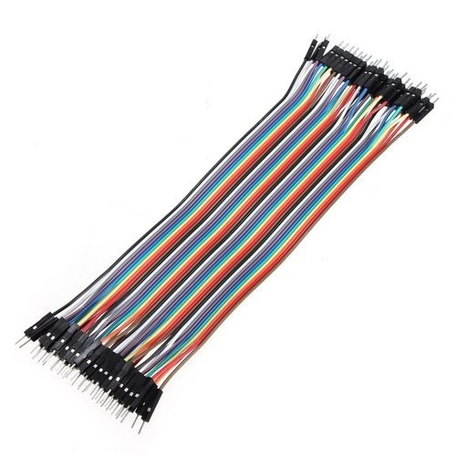
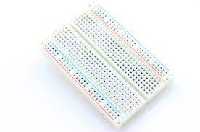
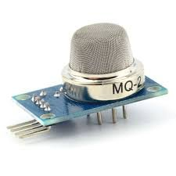
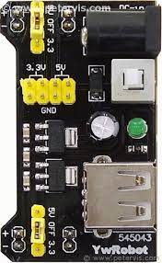
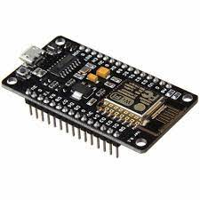
RV College of Engineering®
Go, change the world
TOOLS USED
Arduino Software
MQ-2 Sensor
Bread Board, Jumper Wire
Supply Voltage Using YW robot Adapter
Node- MCU(ESP8266)
IFTTT platform
Easy Coding (TURNOIT)

Slide 10
ALGORITHM
Create applet in IFTTT
Go to documentation of WebHooks and copy the key
On EasyCoding Platform create the code required and add-in the key, network’s name and wifi password in the required fields.
Save and import the code to Arduino software.
In Arduino initialize the i/p o/p pins.
Make connections as required for the hardware
Connect the Wifi module to the system
Run the code
If there is a gas leak: mail will be sent else ‘NO GAS LEAK’ is displayed

Slide 11
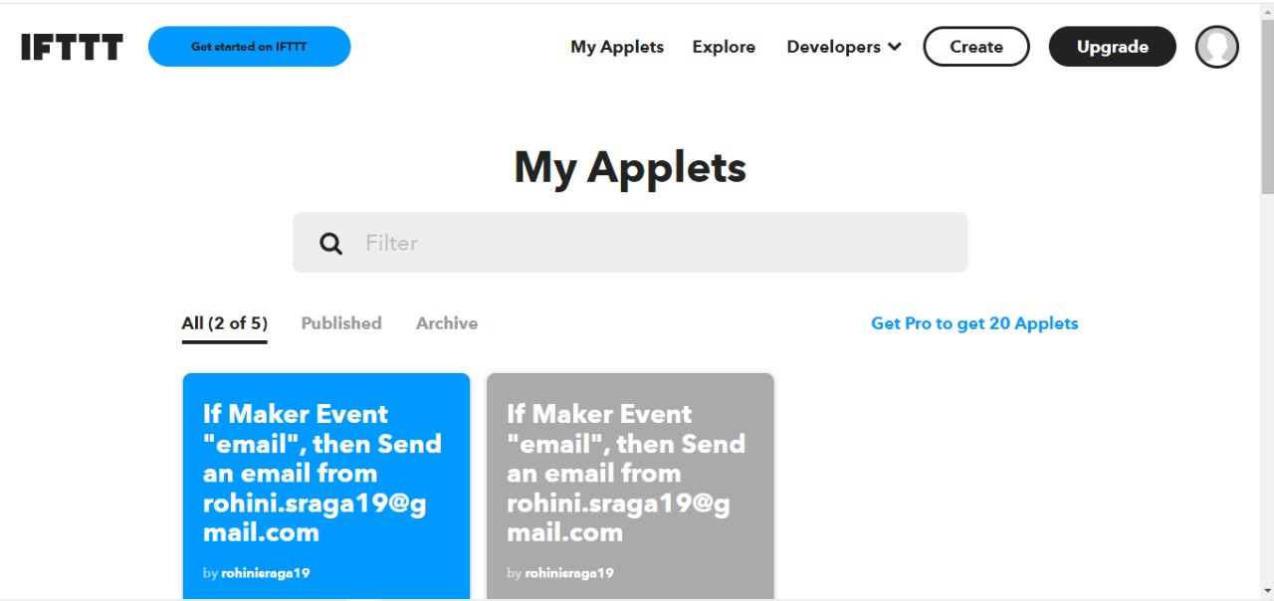
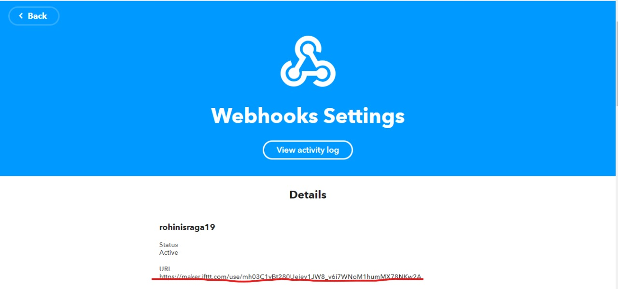
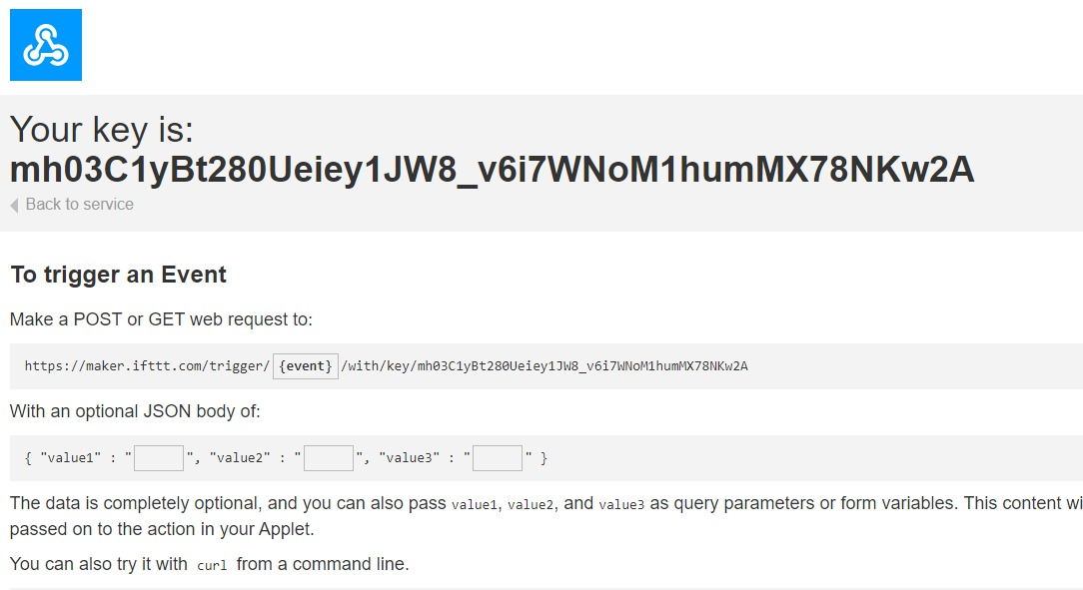
ONLINE WORKFLOW PLATFORM USED

Slide 12
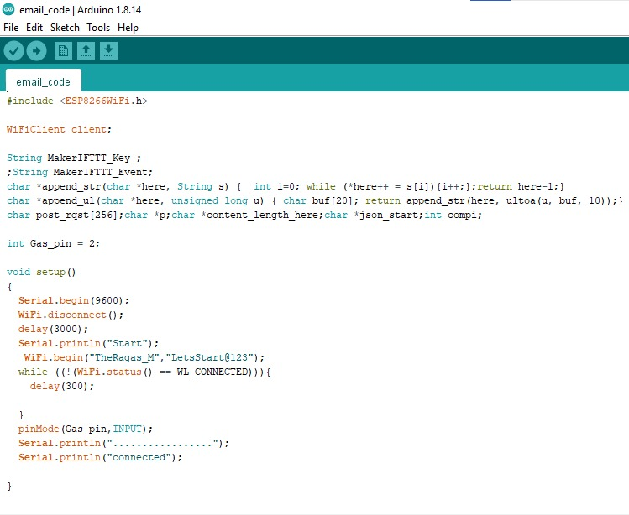
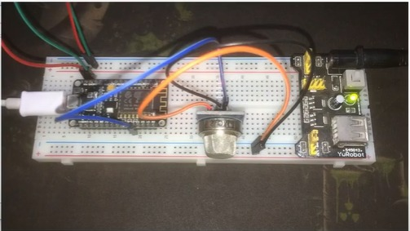
RV College of Engineering®
Go, change the world
GitHub link
HARDWARE MODEL AND CODE

Slide 13
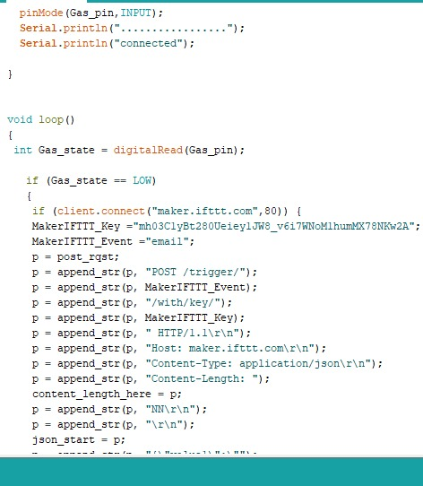
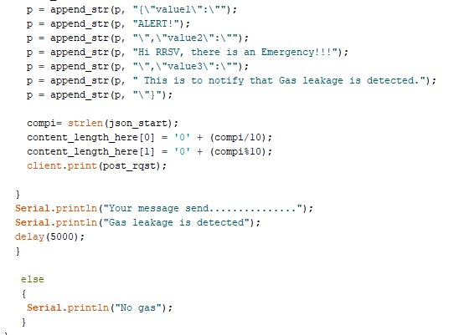
RV College of Engineering®
Go, change the world
CODE

Slide 14
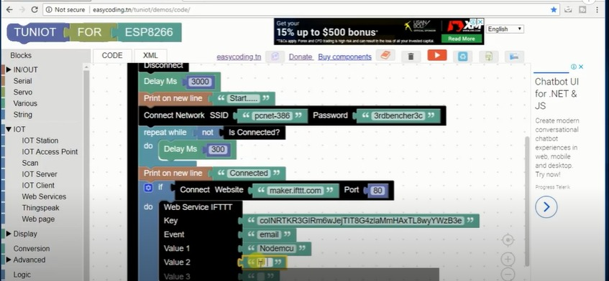
ONLINE CODING PLATFORM USED

Slide 15
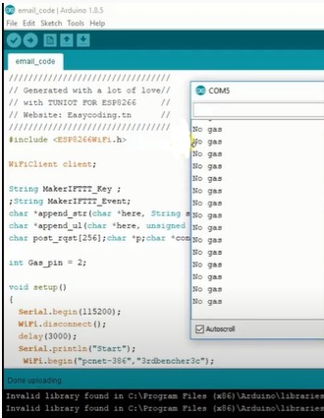
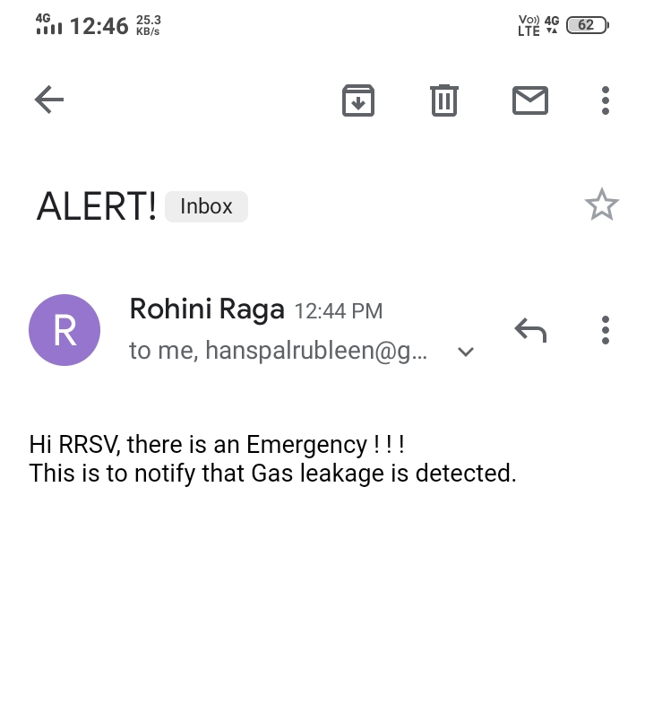
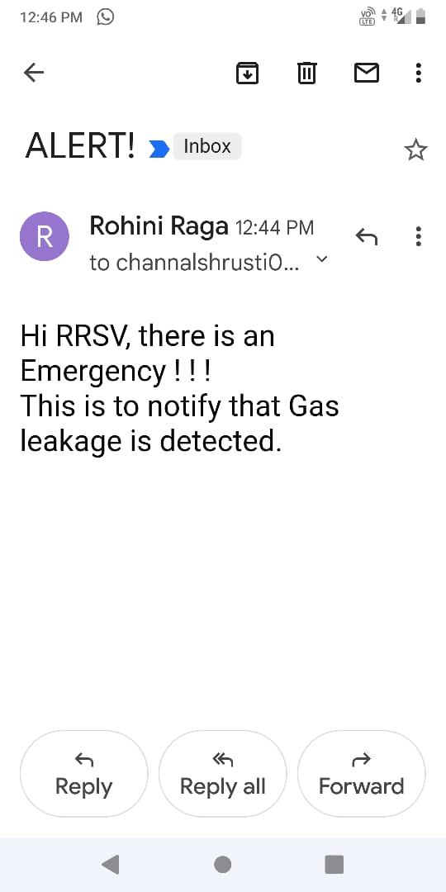
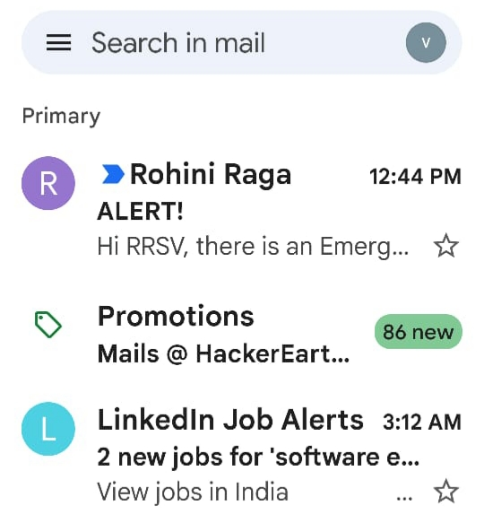
OUTPUT

Slide 16

Go, change the world
RV College of Engineering®
TIMELINE
25 Oct 2021
11 DEC 2021
19 Jan 2022
10 Jan 2022
Phase 1
Phase 2
Phase 3
Identified problem statement.
Literature Reviews.
Acquire knowledge for using required technology.
Raw data collection..
Algorithm design.
Basic model implementation.
Software Simulation
Simulating the hardware model
Getting a notification

Slide 17
FUTURE SCOPE
Our project is at it’s beginning stage, but it can be developed into a fullfledged app that can control and monitor a few other applications along with smoke and gas detection.
The system can be further developed with added features like web server interconnect, fire area tracking and fire extinguisher interfacing etc.
Large industrial or residential area can be monitored through tracking each floor or unit.

Slide 18
CONCLUSIONS
Smoke and gas detection is indeed a very common project with Arduino. But it also has several real-world applications.
There are sophisticated smoke and gas detectors in the market. It not only measures fire smoke but many other things including mustard gas, PM 2.5, PM 10, and smoke emitted by synthetic building materials, such as polyurethane, which are characterized by slow-burning or smoldering fires.
There are fire alert monitors by companies such as Dryad, with its main applications including prevention of wildfires. It is obvious that to scale our project to that level, we cannot depend on Arduino boards as the requirements are on a more industrial scale. That is where more rugged and capable boards come into the picture.

Slide 19
Go, change the world
SITE REFERENCES// ask (Paper Ref)
www.instructables.com/Beginners-Guide-to-Using-Webhooks-for-Home-Automat
www.electronicwings.com/sensors-modules/esp8266-wifi-module
www.lastminuteengineers.com/mq2-gas-senser-arduino-tutorial/amp
https://youtu.be/1er6XQ-BMp4
www.elprocus.com/esp8266-wi-fi-module/

Slide 20
Go, change the world
RV College of Engineering®
THANK YOU

