Slide 1
“ALGORITHMS FOR VLSI CAD”
Name : Shikhar Saxena
Roll No : MCS21007

Slide 2
Introduction
VLSI is the process of creating an IC by combining thousands of transistors into a single chip.
VLSI began in 1970s when complex semiconductor and communication technologies were being developed.
Before the introduction of VLSI technology, most ICs had a limited set of functions they could perform. An electronic circuit might consist of a CPU, ROM, RAM and other Logic Blocks. VLSI lets IC designers add all of these into one chip.
Designers uses CAD tools to make chips.
CAD tools increase the efficiency of chips and reduce efforts.

Slide 3
Basics Of CAD Tools In VLSI Design Flow
As per Moore’s law, complexity of IC’s is increasing over the years.
Designing of VLSI circuit with trillions of transistor in single IC is beyond humans brain.
To design VLSI circuit, Computer is required to check layout, circuit performance, process etc.
Computer are used to aid in the design and optimization process.
VLSI designers are normally given a set of design rules based on given technology.

Slide 4
Feature Of VLSI CAD Tools
VLSI CAD tools have the following tools to meet design features:
Physical Design(Layout, Editor, Circuit Schematics)
Physical Verification(DRC (Design Rule Check), Circuit Extractor, Plot Output, Visual Checking)
Behavioral Verification
- Predictive analysis to ensure that the synthesized design, when manufactured, will perform the given I/O function.
These are the major three features of VLSI CAD tools which plays a major role in order to make a IC.

Slide 5
VLSI Design Features
We will discuss two important features here:
Placement
- Placement is the process of finding a suitable physical location for each cell in the block.
Tool only determine the location of each standard cell on the die.
Placement does not just place the standard cell available in the synthesized netlist, it also optimized the design.
Routing
- Routing is the stage where the interconnections are made by determining the precise paths for each nets.

Slide 6
Different Task In Placement
Placement in Standard Cell
Optimization of area, power, congestion and timing.
Legalization
HFNS(High Fanout Net Synthesis)
It is the process of buffering the High Fanout Nets to balance the load.
Scan Chain Reordering
It is the process of reconnecting the scan chains in a design to optimize for routing by reordering the scan connection which improve timing and congestion.

Slide 7
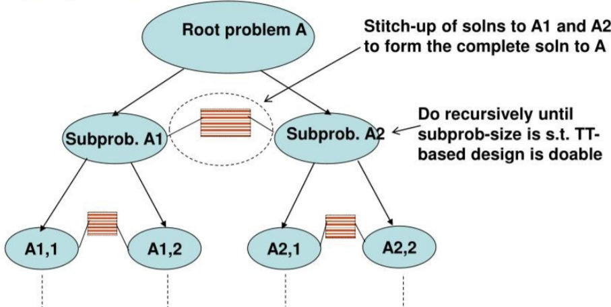
Algorithm Used For Placement of cells in VLSI
Divide & Conquer (D & C):
Determine if the problem can be solved in hierarchical or divide-&-conquer (D&C) manner.
Fig 1: General Representation Of D&C Algo

Slide 8
D&C Approach : See if problem can be “broken up” into 2 or more smaller subproblems that can be “stitched up” to a given solution to the parent problem.
Do this recursively for each large subproblem subproblem until subproblems are small enough for an “easy” solution technique.
Here we have implemented Merge Sort in order to place the cell to their exact position.
Merge Sort:
It is also a sorting algorithm. The algorithm divides the array into two halves, recursively sorts them, and finally merges the two sorted halves.
The merge() function is used for merging two halves. The merge(arr, l, m, r) is a key process that assumes that arr[l..m] and arr[m+1..r] are sorted and merges the two sorted sub-arrays into one. See the following C implementation for details.

Slide 9
Merge Sort Algorithm
MergeSort(arr[], l, r)
If r > l
Find the middle point to divide the array into two halves:
middle m = l+ (r-l)/2
2. Call mergeSort for first half:
Call mergeSort(arr, l, m)
3. Call mergeSort for second half:
Call mergeSort(arr, m+1, r)
4. Merge the two halves sorted in step 2 and 3:
Call merge(arr, l, m, r)

Slide 10
Algorithm Used For Routing In VLSI
Depth First Search:
Depth-first search is an algorithm for traversing or searching tree or graph data structures. The algorithm starts at the root node (selecting some arbitrary node as the root node in the case of a graph) and explores as far as possible along each branch before backtracking.
The Basic idea is to start from the root or any arbitrary node and mark the node and move to the adjacent unmarked node and continue this loop until there is no unmarked adjacent node. Then backtrack and check for other unmarked nodes and traverse them. Finally, print the nodes in the path.
Mainly used to find any solution when cost is not an issue. [Ex: FPGA detailed routing – cost generally determined at the global routing phase]

Slide 11
DFS Algorithm
Step 1: SET STATUS = 1 (ready state) for each node in G
Step 2: Push the starting node A on the stack and set its STATUS = 2 (waiting state)
Step 3: Repeat Steps 4 and 5 until STACK is empty
Step 4: Pop the top node N. Process it and set its STATUS = 3 (processed state)
Step 5: Push on the stack all the neighbours of N that are in the ready state (whose STATUS = 1) and set their STATUS = 2 (waiting state) [END OF LOOP]
Step 6: EXIT

Slide 12
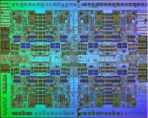
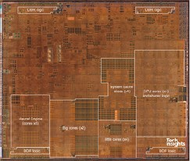
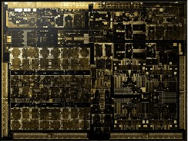
Machine Learning for VLSI CAD: A Case Study in On-Chip Power Grid Design
Modern VLSI size and complexity keeps increasing.
Power grid interconnects are designed in floor planning stage.
Power Planning plays a central role in the design flow.
Significant impact on design closure.
Check and satisfy IR drop and Electromigration margin.
Ensure reliability of chip/power grid.
IBM Power7 – 1.2B
Apple A13 – 8.5B
NVIDIA XAVIER – 9B

Slide 13
Power Grid Design Challenges
Large size of power grid circuit with increase in complexity.
IR drop violations occur.
Suffers from Electromigration violation.
IR drop and Electromigration margin should be ensured.
Optimal design point should be obtained.
Existing methods are semi-automated or manual.
Takes huge human labour and time for sign-off.
There is a need to explore, for better design methodology/tool.
AI/ML approach can be a good alternative.

Slide 14
Survey
If these two challenges(IR Drop & Electromigration Issues) are not handled during the design time, the chip may malfunction, or the chip’s longevity is reduced.
This phenomenon decreases the reliability of the chip.
The primary design challenge in the design of the power grid interconnects is that it takes a huge amount of circuit analysis time for a large-scale power grid network.
Further, iteratively it needs to perform circuit analysis in order to optimally find the widths of the power grid interconnects. This increases the design cycle time. Also, it consumes a significant working hour.
Existing methods of designing power grid are time-consuming as it checks for IR drop and EM violations over many iterations of the design cycle. Moreover, recent Intelligent Design of Electronic Assets (IDEA) program sponsored by DARPA in 2018, focuses on creating a “no human in the loop”, 24-hour turnaround layout generator for System-On-Chips. Therefore, we have demonstrated AI and ML techniques to improve the power grid interconnects’ design cycle.

Slide 15
Here we are working on two major Challenges
IR Drop:
It denotes voltage drop that occurs across metallic interconnects when current is passed through it. If the IR drop exceeds a certain threshold, the underlying transistors do not get the adequate voltage that is intended by it.
Electromigration:
It is the movement of metal atoms due to the exchange of momentum from the electrons to the metal atoms. A higher current density causes it. Due to the electromigration voids and hillocks are formed in the metal lines, which can short circuit or open circuit some of the metal interconnects causing malfunctioning of the chip.

Slide 16
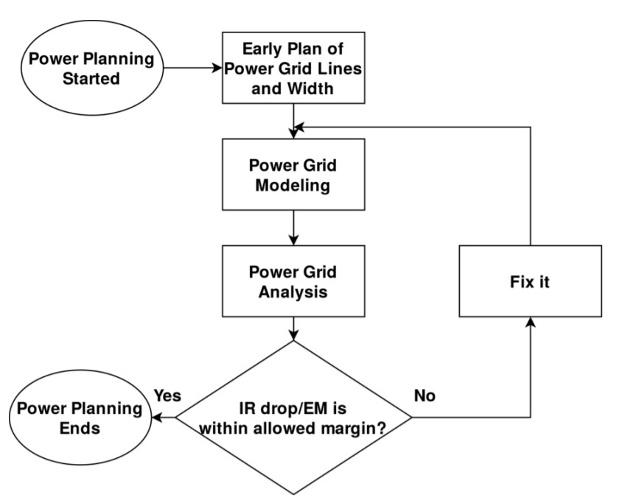
Traditional Way Of Fixing IR Drop
Fig 2: On-Chip Power Grid Design Flow

Slide 17
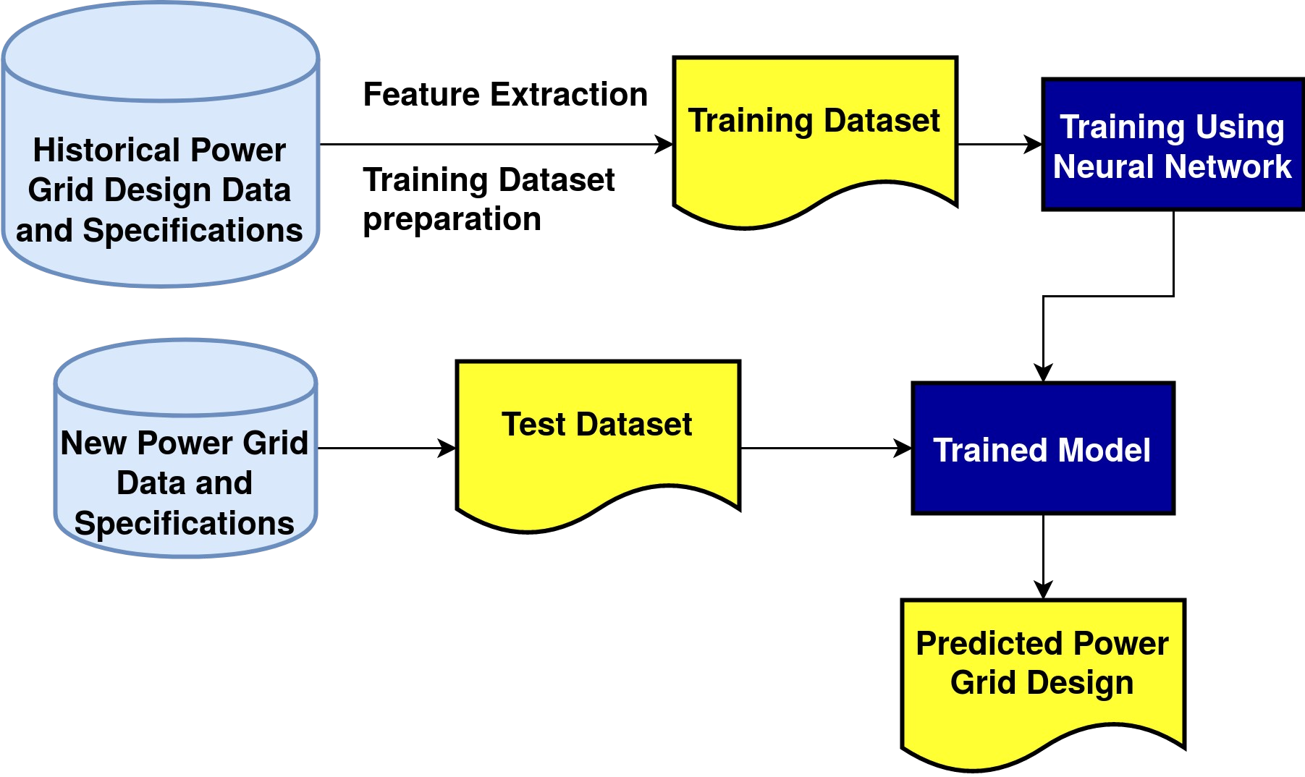
Power Grid Design Using Machine Learning
Fig 3: ML Based Power Grid Design Flow

Slide 18
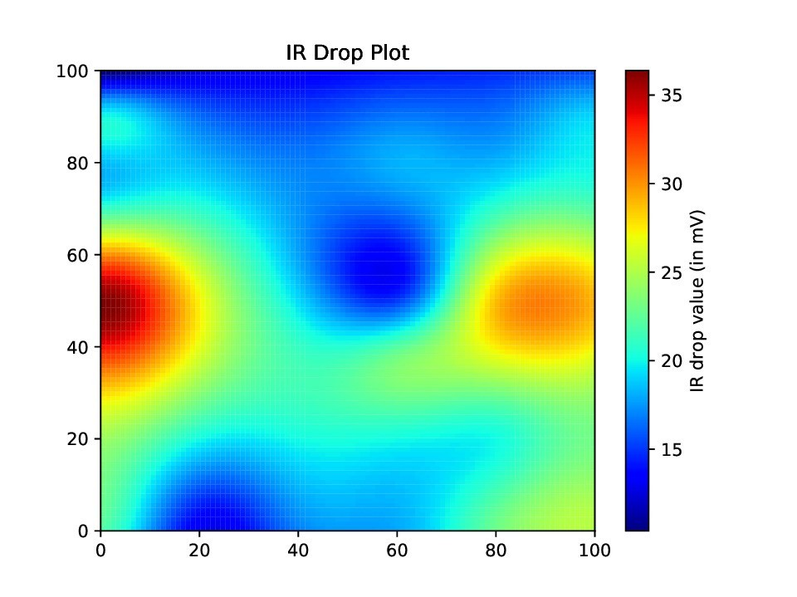
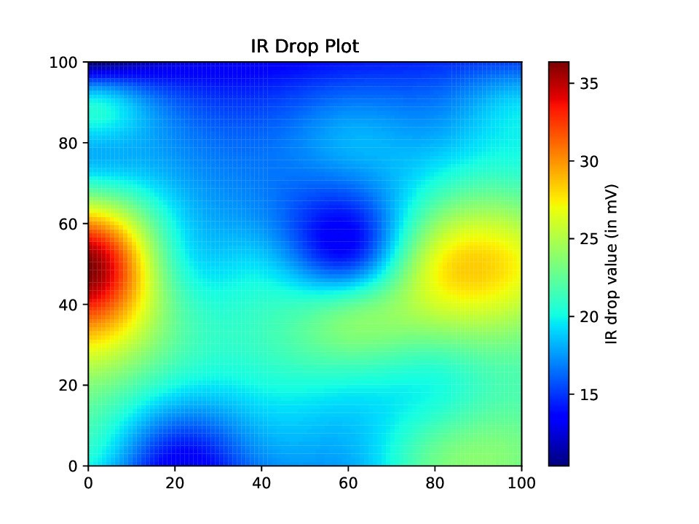
Results
Fig 4: IR Drop Map Of ibmg2 using conventional method
Fig 5: IR Drop Map Of ibmg2 using ML Approach
I got same quality Of Results using ML, and even speed is up by 5-6 times.

Slide 19
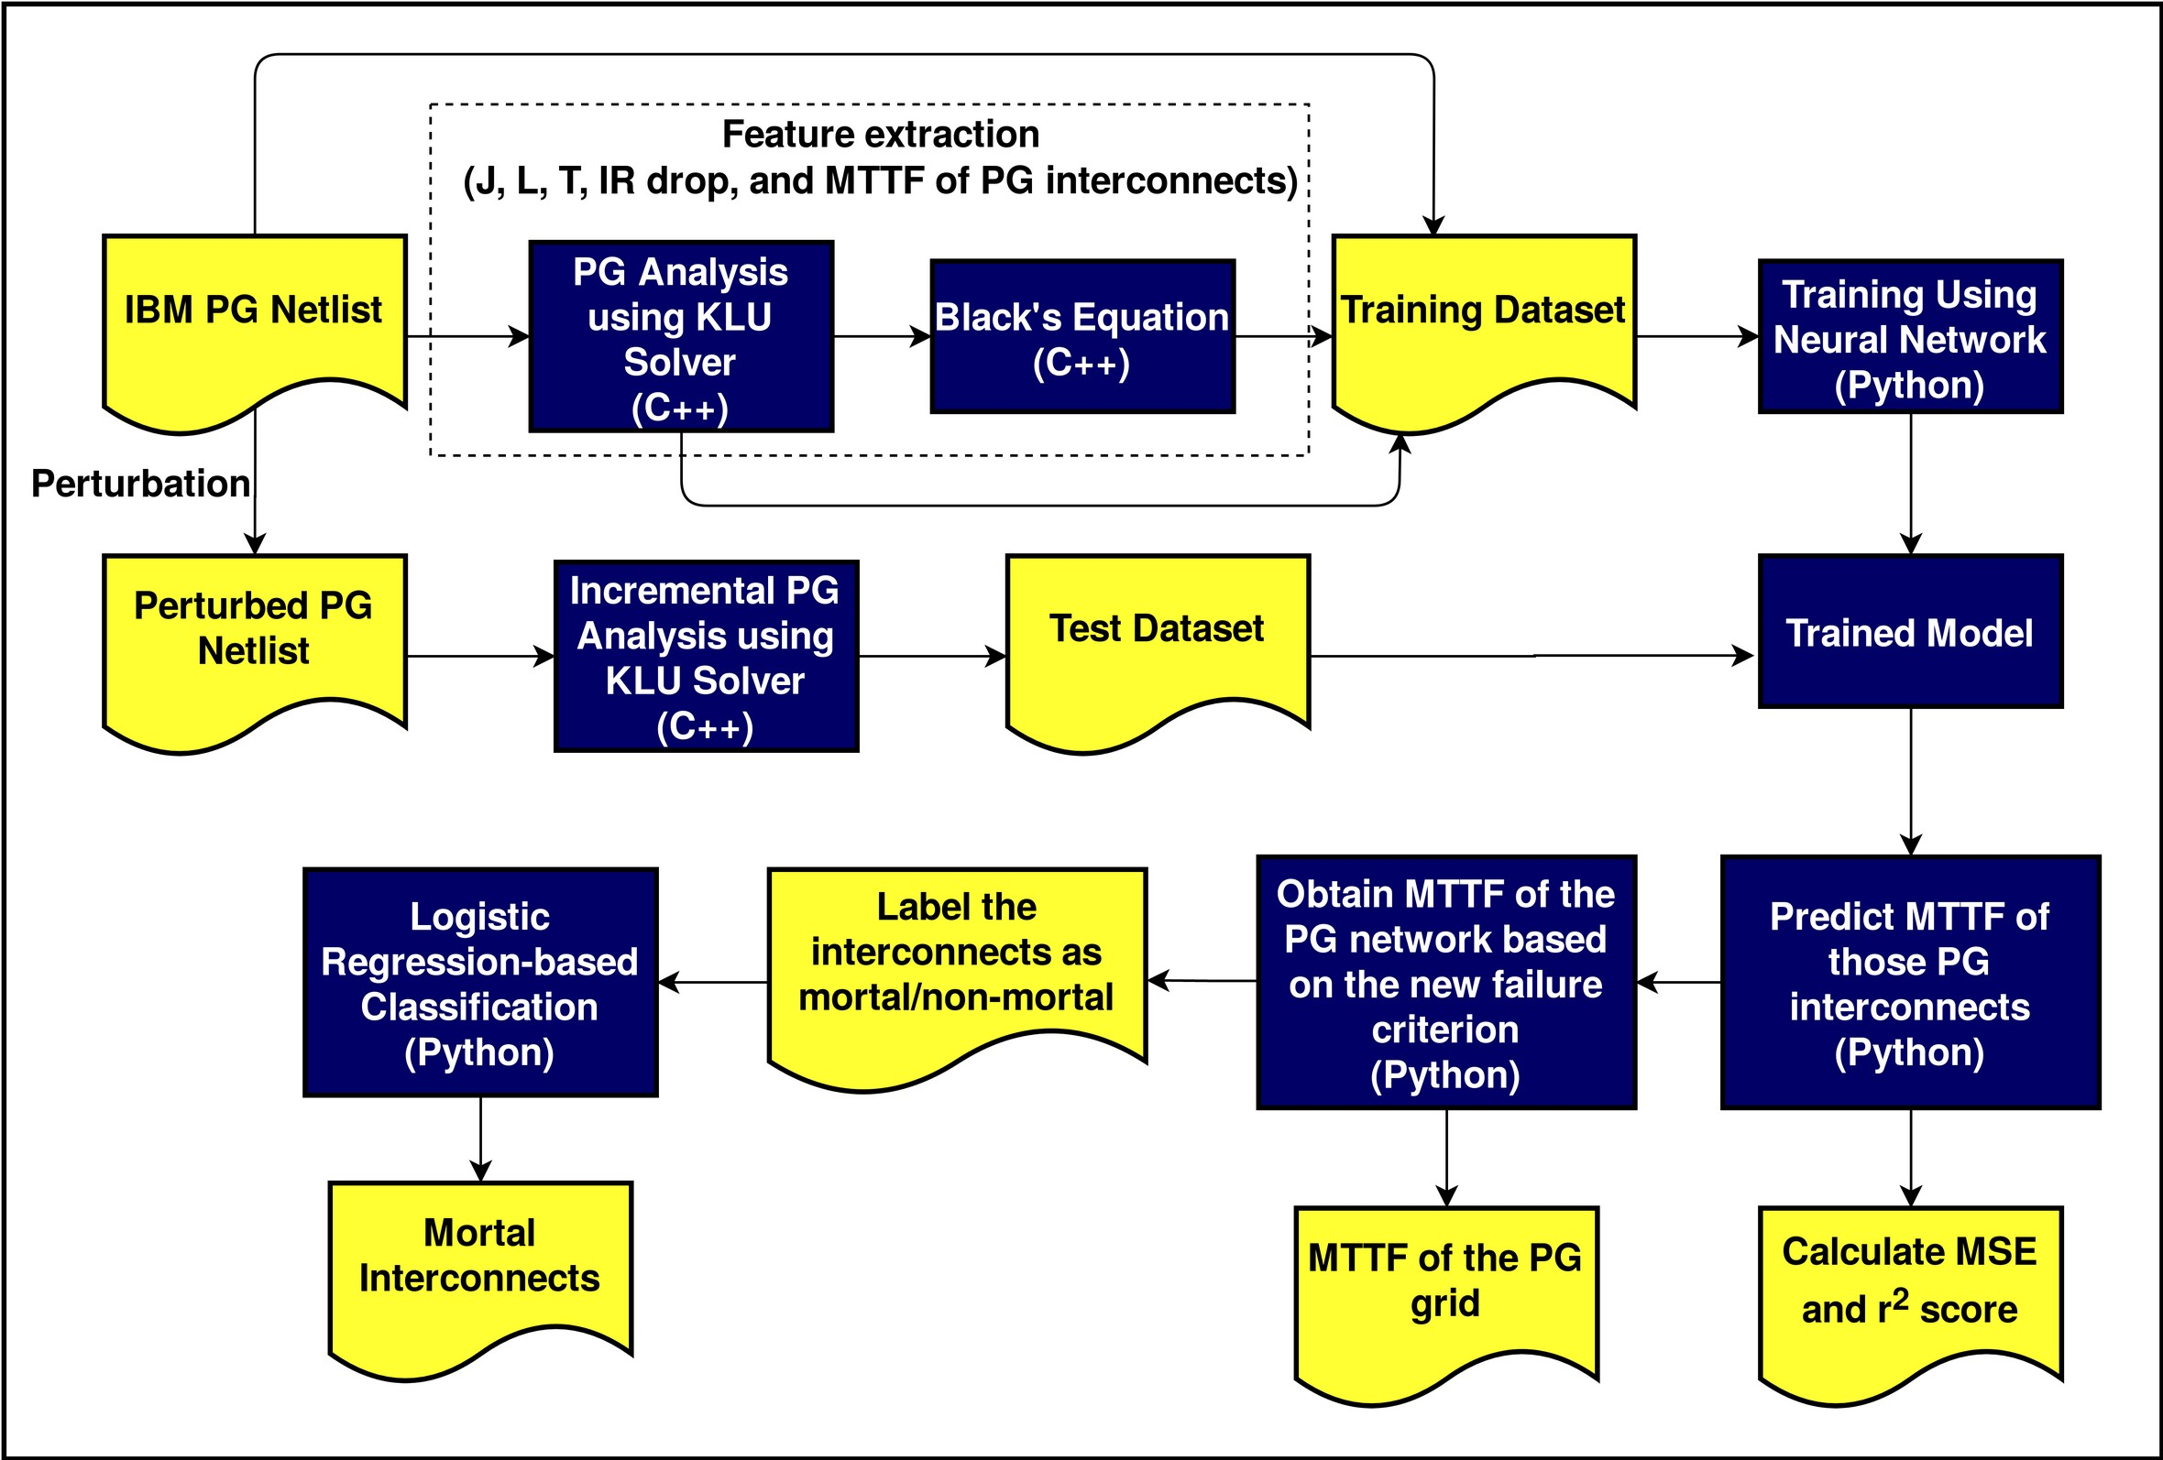
ML-Based Aging-Prediction
Fig 6: ML-based Electromigration-aware aging prediction flow

Slide 20
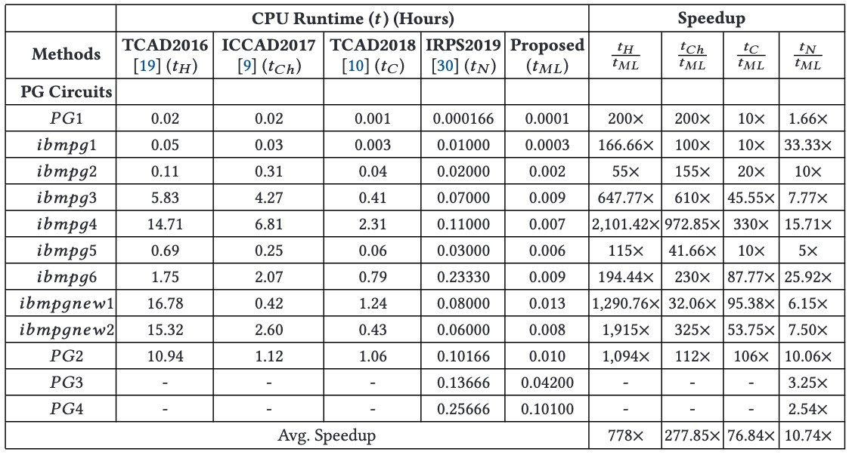
ML-Based Aging-Prediction(Speedup Data)
Table 1: Our ML- approach speedup values

Slide 21
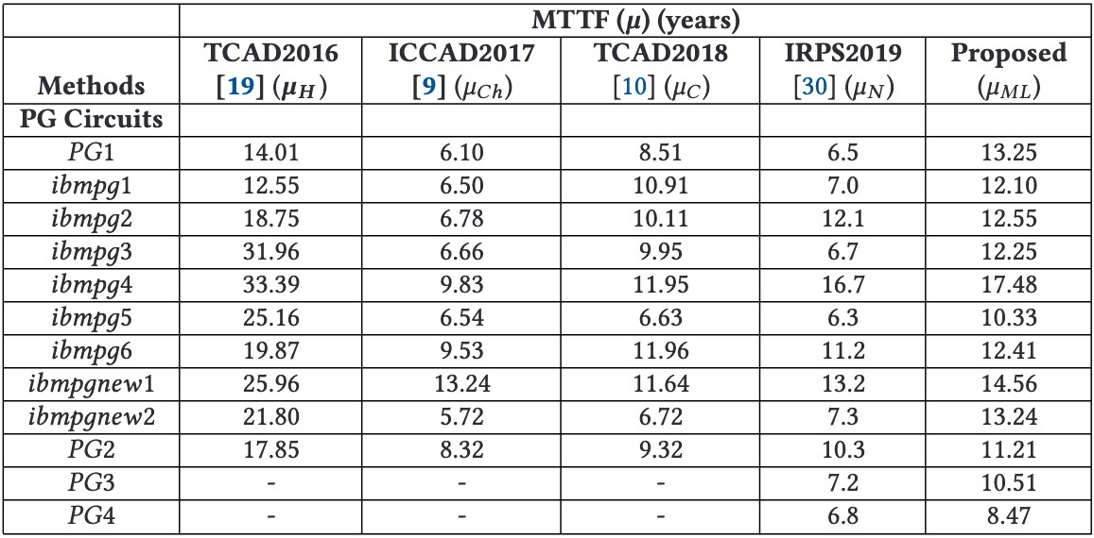
ML-Based Aging-Prediction(MTTF Table)
Table 2: Accuracy wise our ML approach is the better than all other results.

Slide 22
Conclusion
A fast and more effective power grid analysis technique is proposed, reducing the solving time of the circuit.
We also attempt to design the power grid interconnects more efficiently by obtaining an optimum trade-off.
This study includes machine learning techniques for power grid design and Electromigration-aware aging prediction of the power grid network.
These works will help the power grid designer to obtain an initial idea of different design metrics and to handle the reliability issues in the process of designing cost-effective as well as reliable chip.

Slide 23
References
https://www.google.com/imghp?hl=en
https://www.wikipedia.org/
https://scholar.google.com/
http://ece-research.unm.edu/jimp/vlsi_test/papers/fund_cad_algos.pdf
S. Dey, “Design Methodology for On-Chip Power Grid Interconnect: AI/ML Perspective,” 2021.
S. Dey, S. Dash, S. Nandi, and G. Trivedi, “Markov chain model using levy flight for VLSI power grid analysis,” in ´ 2017 30th International Conference on VLSI Design and 2017 16th International Conference on Embedded Systems (VLSID). IEEE, 2017, pp. 107–112.
S. Dey, S. Dash, S. Nandi, and G. Trivedi, “PGIREM: reliability-constrained IR drop minimization and electromigration assessment of VLSI power grid networks using cooperative coevolution,” in 2018 IEEE Computer Society Annual Symposium on VLSI (ISVLSI). IEEE, 2018, pp. 40–45.

Slide 24
Appendix
Some additional attachments:
https://drive.google.com/drive/folders/1O-Bh_RPszZeN5s6GgPX_OWFId7hPeDwI?usp=sharing
The above link contain:
Complete PPT
Code files
Research papers which I have gone through.

Slide 25


