Slide 1

STEM With Ashley
App User Guide
A step-by-step walkthrough for demonstrating the app to a student or teammate
Prepared for Ashley • stem-with-ashley.vercel.app

Slide 2
Stem With Ashley
INTRODUCTION
What Is STEM With Ashley?
• STEM With Ashley is a free website that helps students explore realistic five-year career paths in ten STEM fields, from entry-level to senior roles.
• It's built for two moments in a student's journey: choosing a major, and mapping out what a career actually looks like once they graduate.
• Beyond the roadmap itself, it now also connects students to real day-in-the-life media, a credible career-interest assessment, and an early-career job search tool — all in one place.
• This guide walks through every part of the app in the order you'd naturally show it to a student, ending with a quick troubleshooting reference.
1 / 12

Slide 3
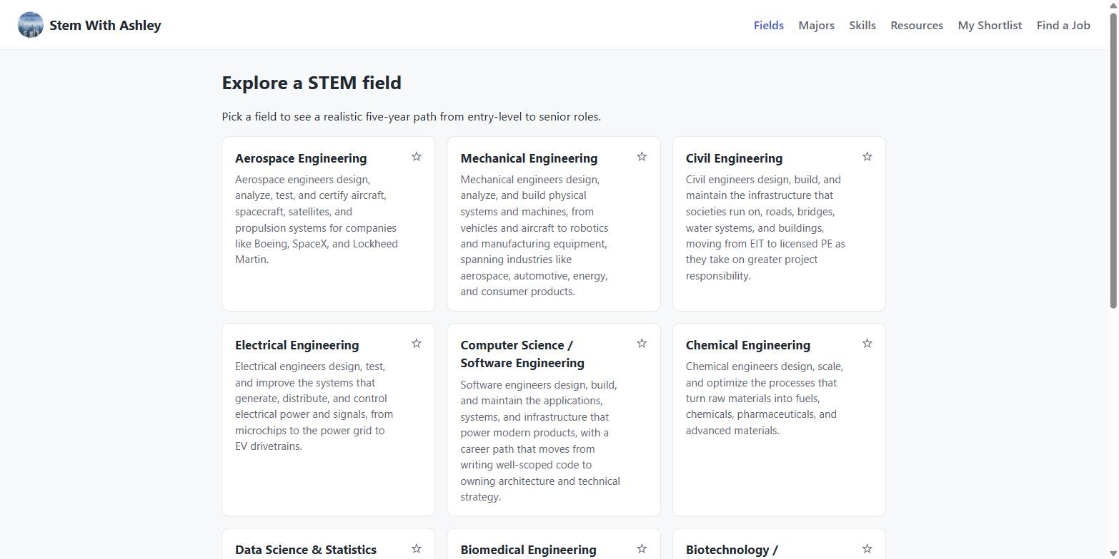
Stem With Ashley
STEP 1 · THE ROADMAP
The Home Page: Browsing STEM Fields
• The home page (“Fields” in the top navigation) is the main roadmap experience.
• It lists all 10 STEM career fields as cards, each with a short summary.
• Clicking any card opens that field's full five-year roadmap.
• The navigation bar at the top is how you move between every part of the app — Fields, Majors, Skills, Resources, My Shortlist, and Find a Job.
2 / 12

Slide 4
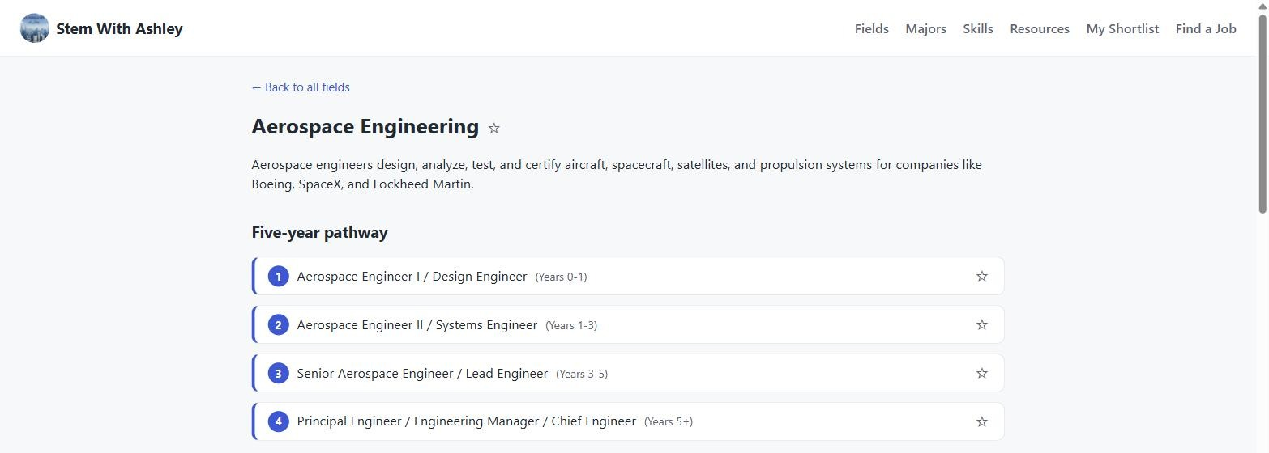
Stem With Ashley
STEP 2 · THE ROADMAP
Inside a Field: The Five-Year Pathway
• Clicking a field (here, Aerospace Engineering) opens its detail page.
• The pathway shows 4 realistic career stages, from entry-level to senior — with typical responsibilities and timeframes for each.
• Below the pathway: real companies, certifications, master's programs, conferences, and professional organizations for that field.
• The star icon on any item saves it to “My Shortlist” for later.
3 / 12

Slide 5
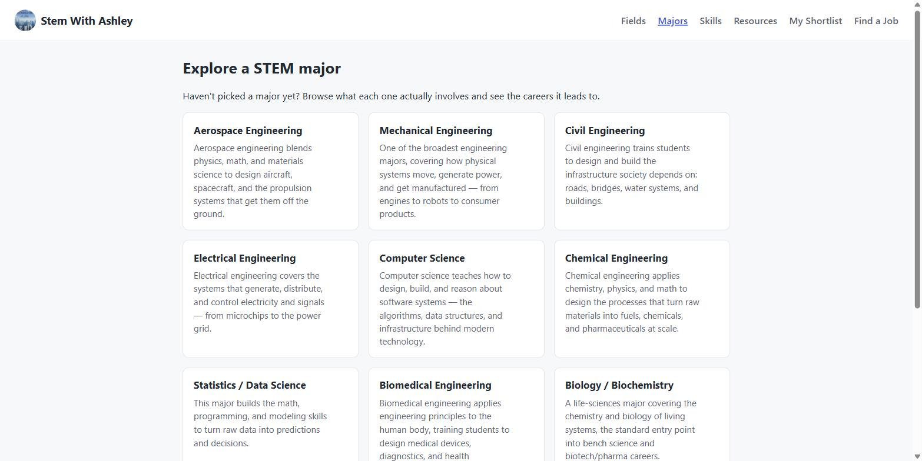
Stem With Ashley
STEP 3 · MAJORS
Exploring STEM Majors
• The Majors page is for students who haven't picked a major yet.
• It lists 10 common STEM majors with a plain-language summary of what each one actually involves.
• This is a good starting point to show a student before jumping into the career-level Fields pages.
• Click “Majors” in the top navigation to get here from anywhere.
4 / 12

Slide 6
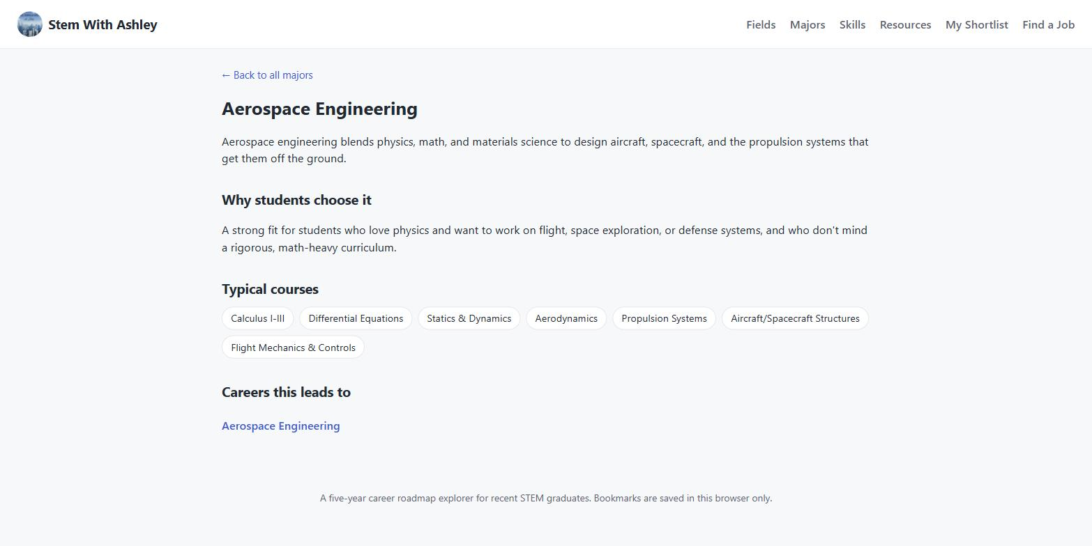
Stem With Ashley
STEP 4 · MAJORS
Inside a Major: Courses & Where It Leads
• Each major page explains why students choose it and lists the typical courses involved.
• The “Careers this leads to” section links directly into the matching Field page(s) — connecting the major decision to the career roadmap.
• This is the natural bridge between “what should I study” and “what will my career look like.”
5 / 12

Slide 7
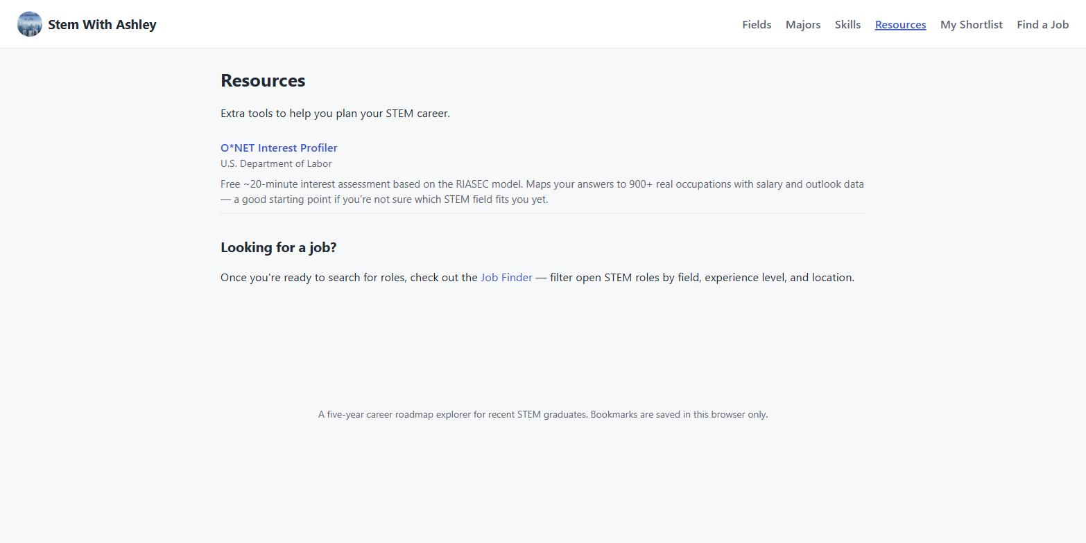
Stem With Ashley
STEP 5 · RESOURCES
The Resources Page
• The Resources page is a hub for extra tools that don't fit inside a single field or major.
• Right now it holds one featured resource — a free career-interest assessment — plus a link into the Job Finder.
• More resources can be added here over time as Ashley finds useful ones.
6 / 12

Slide 8
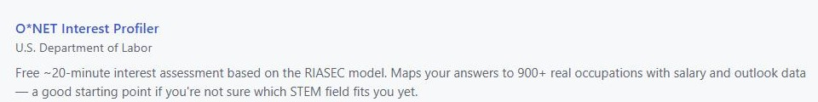
Stem With Ashley
STEP 6 · RESOURCES
Opening the Career Matchmaking Assessment
• The featured resource is the O*NET Interest Profiler, a free ~20-minute assessment from the U.S. Department of Labor.
• It maps a student's answers to 900+ real occupations, complete with salary and outlook data.
• Clicking the link opens it in a new browser tab — the student never leaves the assessment mid-way by accident, and can just close the tab to come back.
• This is a credible, government-run tool — not a custom quiz we built or maintain.
Click the blue title to open in a new tab
7 / 12

Slide 9

Stem With Ashley
STEP 7 · THE ROADMAP
“Day in the Life” Videos & Podcasts
• Every field page now has a “Hear/see what this is really like” section, below the pathway.
• Each field links to one real YouTube video and one podcast episode showing what that career actually looks like day-to-day.
• Every link was manually checked before being added — no dead or unrelated links.
• Like the assessment, these open in a new tab so the roadmap page stays open behind them.
8 / 12

Slide 10
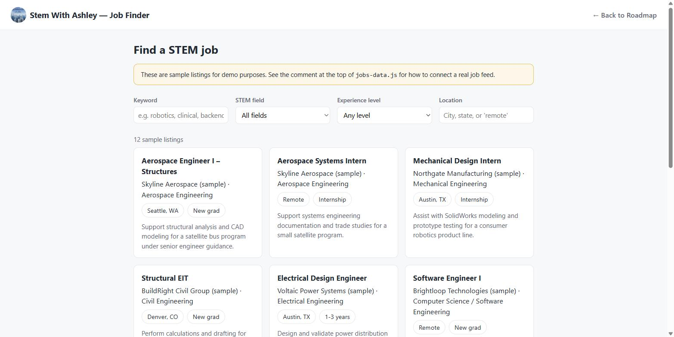
Stem With Ashley
STEP 8 · JOB FINDER
Using the Job Finder
• The Job Finder is a separate tool for students moving from college into their first role.
• Open it from “Find a Job” in the top navigation, or from the link on the Resources page.
• Listings shown today are clearly labeled sample data (see the yellow banner) — real listings can be connected later without changing how the page works.
9 / 12

Slide 11
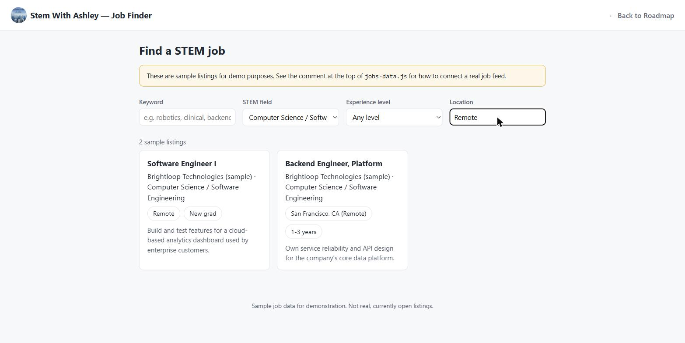
Stem With Ashley
STEP 9 · JOB FINDER
Applying Filters
• Four filters narrow the list: Keyword, STEM field, Experience level, and Location.
• Results update instantly as you type or choose — no need to click a search button.
• Example shown: STEM field set to Computer Science, Location set to “Remote,” narrowing 12 listings down to 2.
• Typing “remote” in Location (not Keyword) is what matches remote-friendly listings.
10 / 12

Slide 12

Stem With Ashley
STEP 10 · GETTING AROUND
Moving Between the Job Finder and the Roadmap
• From the Job Finder, use “← Back to Roadmap” in the top-right corner to return to the main app.
• From the roadmap, you can get to the Job Finder the same two ways: the “Find a Job” nav link, or the Resources page.
• Both the app and the Job Finder always keep the Stem With Ashley header, so it never feels like leaving the product.
11 / 12

Slide 13
Stem With Ashley
QUICK REFERENCE
Troubleshooting & Good Habits
If something looks wrong
If content needs to be updated
• Refresh the page first. This fixes the vast majority of odd behavior — the site has no login, so nothing is lost.
• Make sure you're clicking nav links, not the browser's own back button, when moving between pages inside the app.
• External links (the quiz, YouTube, podcasts) always open in a new tab — if one doesn't seem to load, check for a new tab that opened behind the current one.
• The Job Finder is a separate page from the main app — use its “← Back to Roadmap” link, not the browser back button, to return cleanly.
• Almost all content (fields, majors, resources, media links) lives in one file, data/roadmap-data.json, in the GitHub repository.
• data/README.md in the same repository explains how to edit it in plain language, with no coding experience required.
• For anything beyond a content edit — new features, design changes, or something that looks broken after an edit — contact Shikhar.
• Repository: github.com/shikharsisodia7/stem-with-ashley
12 / 12

