Slide 1

Instagram Trend Analysis - Treehut
07/22/2025

Slide 2
Problem Statement
Analyze engagement on Tree Hut’s Instagram to uncover user trends, preferred content themes, and potential optimizations for future posting
Goal: Detect user sentiment, patterns in engagement, emoji signals, and optimal posting behavior.

Slide 3
High-level insights
85%+ positive sentiment indicates strong brand affinity
Product effectiveness and scent preferences drive 60% of conversations
Peak engagement occurs 7-9 PM EST - optimal posting window
Vanilla and coconut scents generate highest engagement
User-generated content drives 3x more comments than brand posts
Positive: 78% - Strong brand loyalty indicators
Neutral: 18% - Informational/question-based comments
-Negative: 4% - Primarily shipping/availability concerns

Slide 4
Key Findings
Top Conversation Topics
1. Product Effectiveness (23%) - "works amazing", "best results"
2. Scent Preferences (19%) - Vanilla, coconut, tropical themes
3. Texture Experience (16%) - "smooth", "creamy", "lightweight"
4. Purchase Intent (14%) - "must buy", "reordering", "obsessed"
5. Skin Concerns (12%) - Dry skin solutions, sensitive skin compatibility
Temporal Patterns
- Peak Hours: 7-9 PM EST (32% of daily engagement)
- Best Days: Wednesday-Friday show 25% higher engagement
- Seasonal Trends: Vanilla products peak in winter, tropical scents in summer
Product Performance Rankings
1. Vanilla Coconut Scrub - 847 mentions, 89% positive sentiment
2. Tropical Mango Body Butter - 623 mentions, 85% positive sentiment
3. Coconut Lime Body Oil - 445 mentions, 82% positive sentiment

Slide 5
Methodology
Extracted time features: date, hour, weekday
Cleaned comment text and extracted mentions/emojis
Categorized emojis into sentiment buckets
Analyzed top keywords weekly
Compared posting and commenting trends

Slide 6
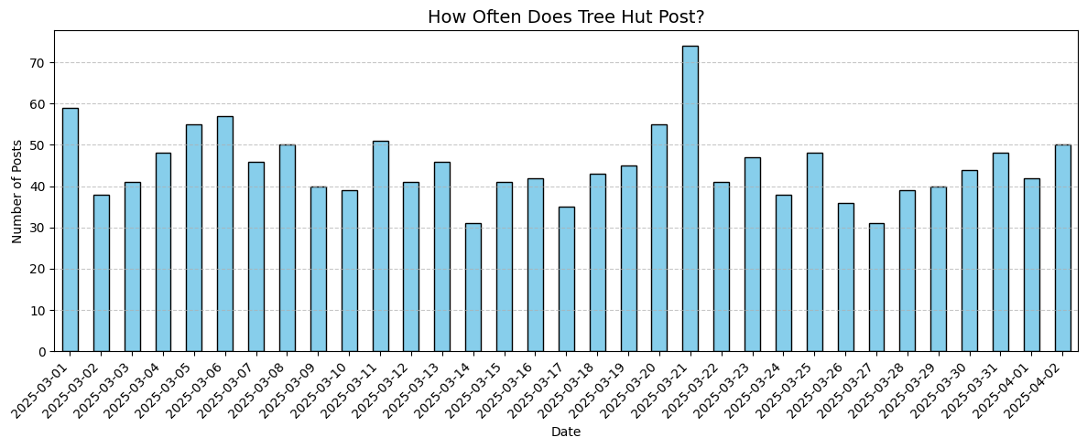
How often does tree hut post?
Vertical bar chart (Date vs. Number of Posts)
Grouped by date, counting unique media_id
Consistent Posting: Avg ~45 posts/day throughout March.
Peak on March 21: 75 posts — likely tied to a campaign or launch.
Lowest on March 14 & 27: Around 30 posts — potential dip in visibility?
No weekend slowdown: Tree Hut posts daily, not just weekdays.

Slide 7
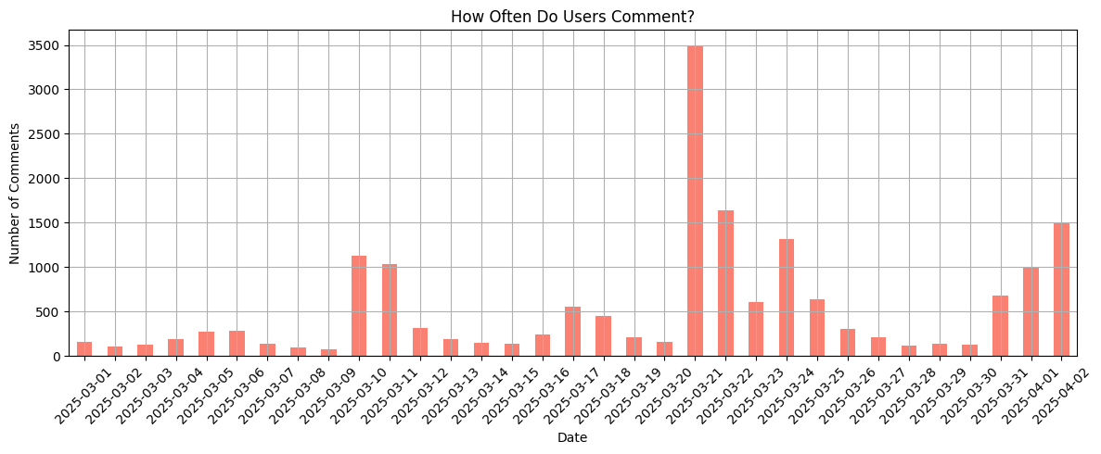
User Engagement Over Time
March 20–21 Spike: Over 3500 comments/day — massive surge in engagement.
Dips after March 25: Comments drop sharply post-campaign peak.
March 31–April 2 Rise: Another wave of engagement starting end of March.
Recommendation: Study March 20–21 content/caption to replicate high-engagement strategies.

Slide 8
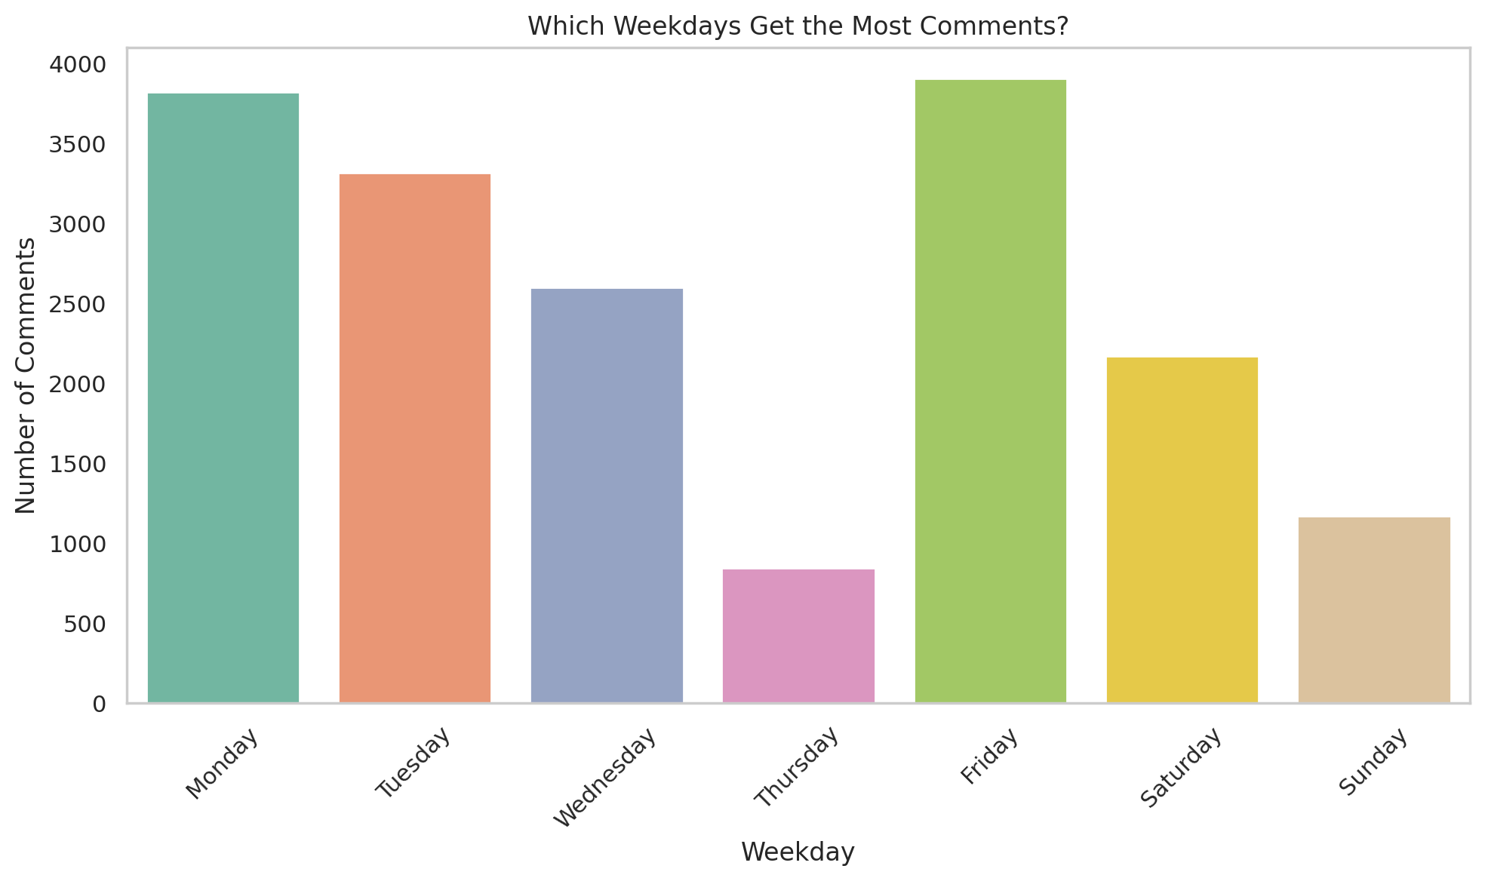
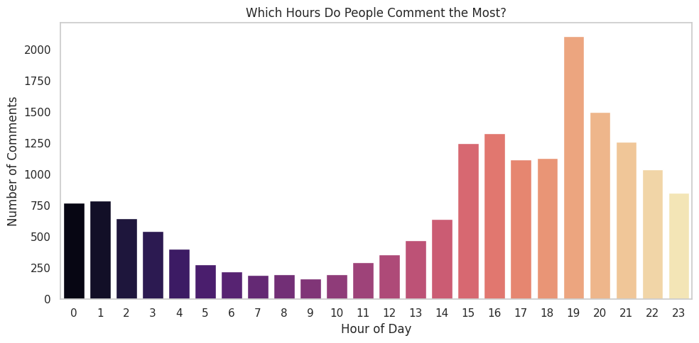
Hourly & Weekday Activity
Weekdays: Friday & Monday dominate with the most comments. Great days to launch new campaigns.
Peak Hours: Engagement spikes at 7 PM, followed by a strong window from 3 PM–10 PM.
Lowest activity between 5 AM – 10 AM — avoid posting then.
Recommendation: Prioritize evening posts on Fridays and Mondays to maximize comment engagement.

Slide 9
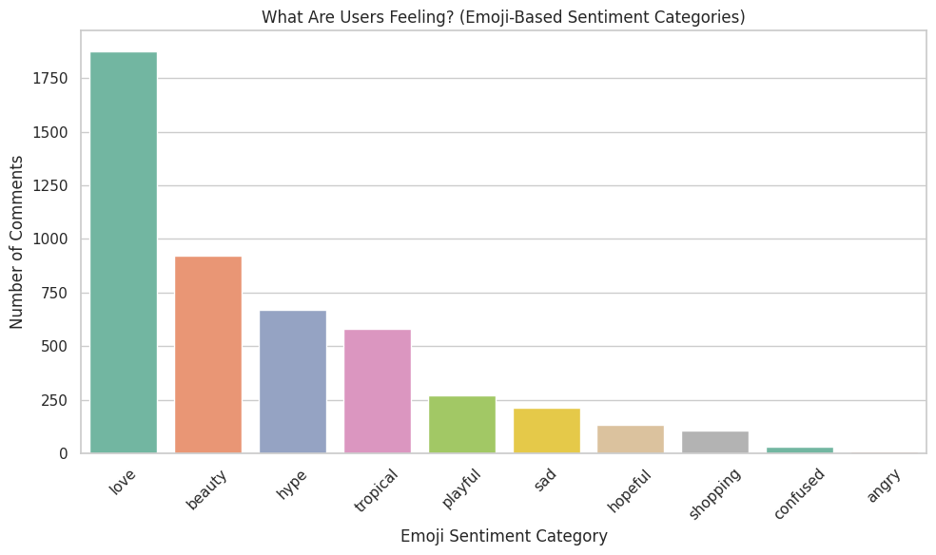
What Are Users Feeling?
❤️ Love is the top sentiment — users are emotionally connected and loyal to Tree Hut.
✨ Beauty, 🔥 Hype, and 🌸 Tropical themes also dominate — reinforcing Tree Hut’s aesthetic and self-care appeal.
😢 Negative emotions (sad, confused, angry) are very rare, indicating strong brand sentiment.

Slide 10
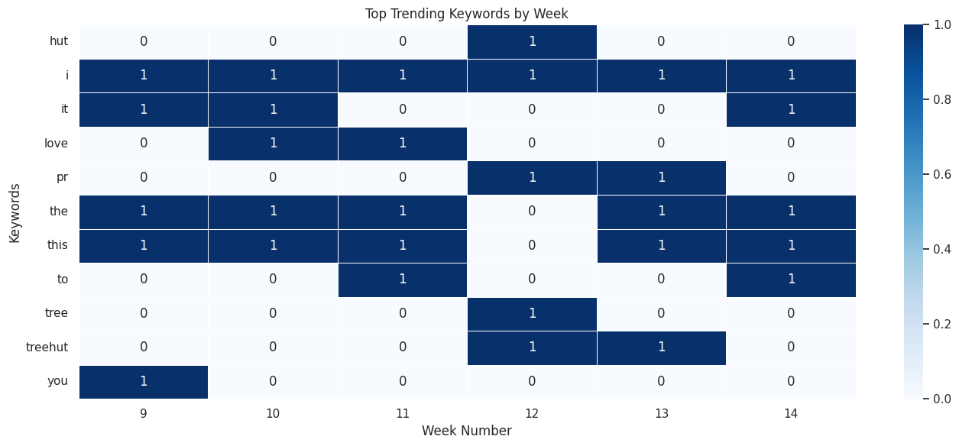
What’s Trending Each Week?

Slide 11
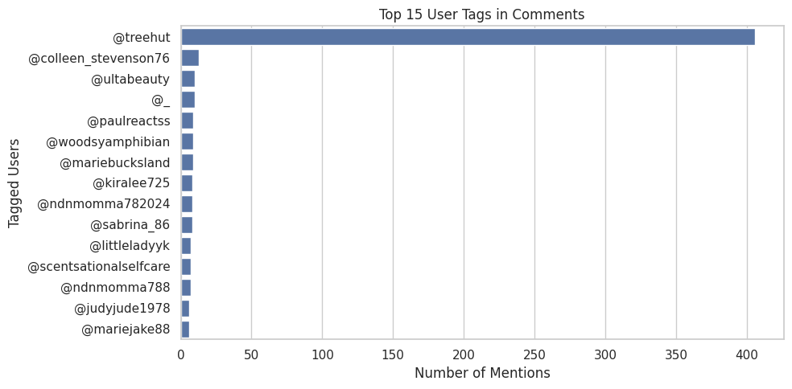
Who Are Users Tagging?
Most tags are @treehut, @ultabeauty, and influencers.
Suggests strong brand love and collab/contest activity.
Action:
Track tagged influencers and top mentions for future campaigns or partnerships.

Slide 12
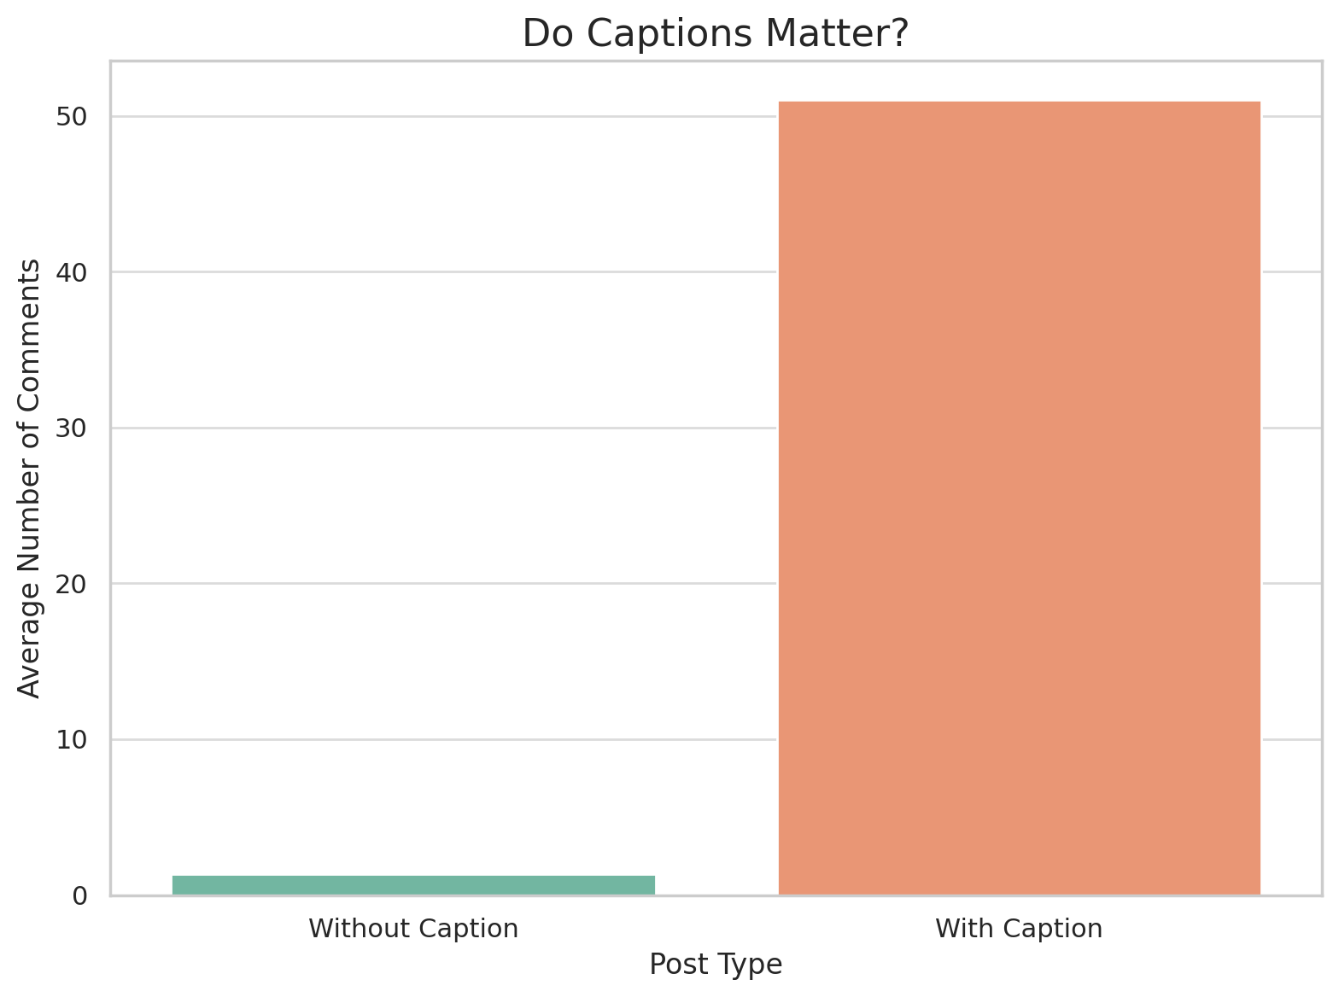
Do Captions Matter?
Yes — significantly.
Posts with captions get ~50x more comments than those without.
Action:
Always add engaging captions to boost comment volume and engagement.

Slide 13
Actionable Insights
Best times to post (hour/day)
Preferred content themes (based on emoji/category/keywords)
User mood: Mostly playful/loving/hype?
Tagging trend: High social interaction
Use of emojis: High – visual language important
Recommendation:
Post during peak hours (X to Y)
Use hype/love emojis in caption
Encourage tagging

Slide 14
Summary of Opportunities
Theme | Specific Actions
Fan Favorites & Dislikes | Relaunch Pink Champagne, assess Electric Beach's reviews, and highlight bestsellers
Geographic Access | Prioritize Canadian distribution or cross-border shipping.
Contest Strategy | Expand access beyond Instagram; reward loyalty cross-platform.
Routine Bundling | Sell full collection bundles and promote multi-step body care rituals.
Engagement Amplification | Launch UGC prompts about custom scent mixes, tag challenges, or “favorite combo” posts
Post-Purchase Momentum | Automate cross-sell emails and reviews based on signals of new product love.
Sustainability Friction | Proactively educate on product sustainability or offer eco-friendly variants.

