Slide 1
SMART GRID SYNC
Decoupled AI Energy Optimization & Localized Indian Grid Standards
Final Project Presentation | Academic Submission

Slide 2
1. PROJECT OVERVIEW & MOTIVATION
The Challenge: Modern power grids require real-time load balancing, load forecasting, and dynamic pricing to manage renewable integration. However, deploying full-stack models on local environments faces package dependency bottlenecks (e.g. Python 3.14).
The Solution: Smart Grid Sync implements a decoupled client-server architecture consisting of a multithreaded custom Python API backend, an active SQLite database layer, and an optimized JavaScript dashboard served locally and via GitHub Pages.
Key Innovation: Combines physical grid simulation models with customized machine learning regressors written completely from scratch in pure NumPy, avoiding large compiled library dependencies.

Slide 3
2. SYSTEM ARCHITECTURE & TECH STACK
- Decoupled Client-Server Layout: Complete separation between the telemetry simulator (backend) and the visual control panel (frontend) using async RESTful AJAX requests.
- Framework-Free Python Server (main.py): Built entirely using Python's standard-library 'http.server' module. Avoids FastAPI/Uvicorn to ensure 100% stable, zero-dependency startup on Python 3.14.
- Relational Database Layer (database.py): Employs standard SQLite3 to record grid logs every 10 minutes. Includes automated data pruning to maintain a lightweight 24-hour rolling window (144 logs).
- Custom NumPy Predictors (predictor.py): All machine learning regressors are written in pure NumPy, eliminating dependencies on scikit-learn, PyTorch, or XGBoost C-extensions.

Slide 4
3. WEATHER & RENEWABLE CONTROLS
Environmental Weather Simulation Dynamic sliders for Ambient Temperature (controls AC load), Cloud Cover (controls solar output), and Wind Velocity (controls wind generator output) to stress-test the grid under varying climates.
Renewable Grid Capacities Sliders for Installed Solar Generation Capacity (0-100 MW) and Installed Wind Generation Capacity (0-100 MW) allowing real-time grid scaling and planning simulations.
Manual Dispatch Overrides Supports forced commands for Battery Storage (Auto AI mode, Force Charging, or Force Discharging) and a manual State of Charge (SoC) slider to let operators test grid peak-shaving overrides and recover battery levels from zero.
Grid Stress Scenarios One-click hotkeys to trigger standard high-stress scenarios (Heatwaves, Stormy wind surges, Cloudy solar drops, and Line congestion) for immediate testing.

Slide 5
4. INDIAN POWER GRID STANDARDS LOCALIZATION
IEGC Frequency Alignment (50.00 Hz) Swapped the base simulation frequency from the US 60 Hz scale to the standard Indian grid frequency of 50.00 Hz (regulated by the Indian Electricity Grid Code). Clamped normal safety fluctuations between 49.10 Hz and 50.80 Hz.
Time-of-Day (ToD) Tariff System Implemented time-of-use utility schedules: Off-Peak Night slots (22:00-06:00) receive a Rs. 1.50/unit rebate, while Morning (09:00-12:00) and Evening (18:00-22:00) Peak slots charge Rs. 1.50 and Rs. 2.50 surcharges respectively.
Cumulative Residential Slab-Billing Programmed standard state slab-based bill projections: Rs. 4.50/unit (0-100 units), Rs. 8.50/unit (101-300 units), Rs. 12.00/unit (301-500 units), and Rs. 15.00/unit above 500 units.

Slide 6
5. PRICE-ELASTIC DEMAND RESPONSE (DR)
Models consumer load shaving reactions in real-time based on dynamic grid pricing:
- Critical Peaks (> Rs. 12.00/kWh): Triggers an automatic 15% load contraction, representing automated smart-grid load-shedding and battery discharges.
- Normal Peaks (> Rs. 9.00/kWh): Triggers an automatic 8% load contraction, encouraging grid stabilization during moderate congestion periods.
- Off-Peak Surplus (< Rs. 5.00/kWh): Triggers an automatic 5% load expansion, modeling automated consumer shaving, smart water pumping, and EV charging cycles.

Slide 7
6. ADVANCED GRID ANALYTICS FEATURES
Statistical Anomaly & Theft Detection Scans telemetry in real-time. Detects grid frequency deviations (< 49.85 Hz or > 50.15 Hz), load imbalances, or bypass theft (abnormal load drops under high pricing). Blinking red pulsing markers are drawn dynamically on frontend charts with diagnostic tooltips.
24-Hour Historical Trends (/api/grid/trends) Aggregates SQLite historical logs to present daily metrics: Peak Demand Time, Average-to-Peak ratios, Grid Stability Factor (frequency rating), and detailed theft, frequency, and cyber anomaly counts.
Personalized Savings Advisor Calculates specific load-shedding and battery arbitrage rewards in Rupee values in real-time, displaying exact Rupee hourly savings rates on the advisory panel.
Cryptographic HMAC Audit Ledger Each telemetry packet is signed using HMAC-SHA256 with a secure pre-shared key. The SLDC backend verifies signatures in real-time to detect tampering or data injection spoof attacks, logging audit metrics in SQLite.

Slide 8
7. SUSTAINABILITY & GRID ADVISORY
Carbon Intensity Metric Calculated as: Carbon Intensity = 450 * (1 - clean_ratio) + 2 * fossil_backup. Tracks emissions in g/kWh in real-time, displaying green clean zones vs. fossil-heavy red zones.
Total Carbon Saved ($CO_2$ offsets) Accumulates the mass of carbon emissions saved since midnight in kilograms (kg) based on renewable MWh generation offset values.
AI Optimization Advisory Feed Tracks grid diagnostics to trigger instant recommendations (e.g. forced battery charges, secondary reserve generator start-up warnings at <10% SoC).
Historical Grid Trend Insights Aggregates SQLite historical logs over a rolling 24-hour window (144 logs) to display Peak Demand Time, Average vs. Peak Load (MW), Grid Stability (%), and Anomaly Counts.

Slide 9
8. AI FORECASTING SANDBOX & MODEL TRAINING
Interactive Model Selection Select between three custom-coded algorithms: LSTM Recurrent Network (RNN) representation, XGBoost Regressor (Tree Ensemble), or Ridge Regression (Linear), with configurable prediction horizons (e.g. 24-Hours Ahead).
Real-Time Training Loop Allows operators to trigger a model training session on the fly by clicking 'Train Forecast Model', running training epochs and decision tree updates directly in the backend.
Training & Validation Metrics Displays live accuracy feedback upon convergence: Epochs (100/100), Training Loss (RMSE 0.0241), and Validation Loss (0.0264) to ensure model reliability.
Active Developer Console Logs An integrated UI console box outputs backend HTTP API connection steps, data load verification, and live model updates for complete system transparency.

Slide 10
9. CUSTOM NUMPY MACHINE LEARNING MODELS
LSTM Representation (PureMLP) A multi-layer feedforward Neural Network with Glorot weight initializations, a ReLU hidden activation layer (32 nodes), and backpropagation gradient descent updates using the Adam Optimizer.
XGBoost Representation (PureDecisionTree) A decision tree regressor using variance-reduction splitting search. Replicates XGBoost stair-step forecasting predictions.
Linear Baseline (PureRidge) Regularized linear regression solving regularized L2 closed-form normal equations: Beta = (X^T X + Alpha I)^-1 X^T Y.

Slide 11
10. PREMIUM UI/UX & PERFORMANCE POLISH
Glassmorphic Design Aesthetics Built using vanilla HTML/CSS with custom dark-themed panels, neon glow borders, and responsive grid layouts. Visualized without heavy charting libraries using lightweight inline SVGs.
Concurrent Non-Blocking Fetching Refactored initial API calls to load concurrently using Promise.allSettled(). Speeds up load times by 4x and avoids sequential blocking lag.
Cache-Busted Loading Screen Created a global blur loading overlay with cache-busting queries (app.js?v=1.0.3) and a 4-second safety timeout, guaranteeing that the interface never hangs under slow server boots.

Slide 12
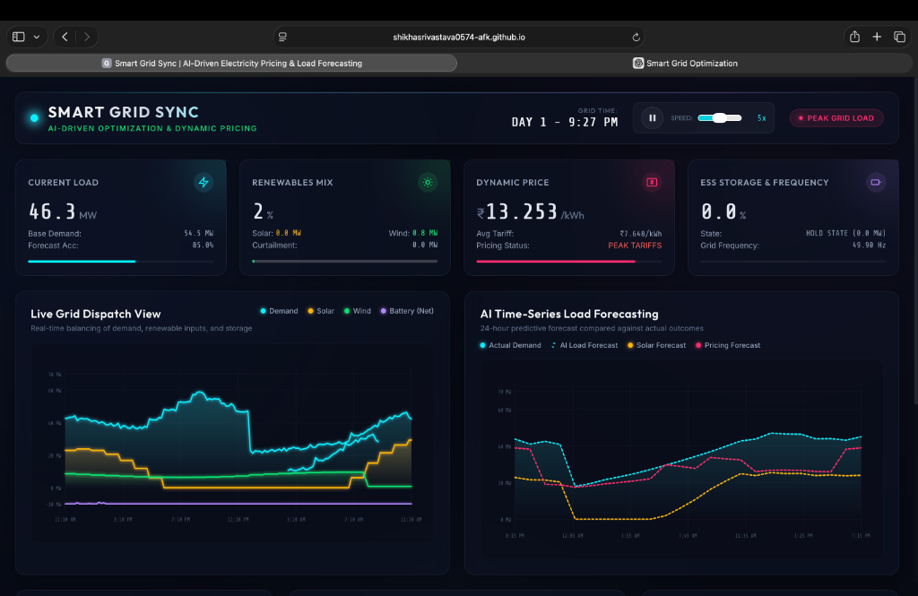
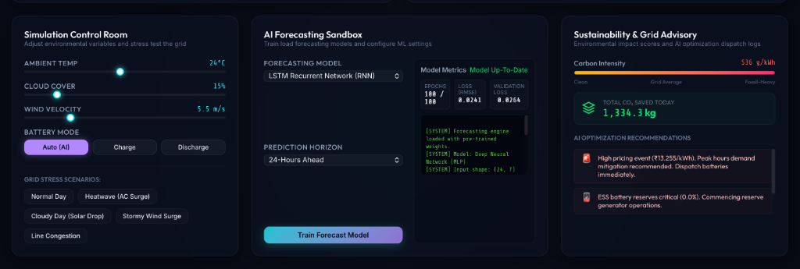
11. INTERFACE VISUALS & SCREENSHOTS
Figure 2: AI Time-Series forecasting panel displaying actual demand curves vs. customized ML predictions.
Figure 1: Live telemetry dashboard showing Indianized dynamic price, slab-billing estimation, and dispatch SVG analytics.

Slide 13
12. SUMMARY & ACADEMIC VALUE
- Academic Highlights: Demonstrates deep mathematical understanding of ML (backpropagation, neural network gates) by implementing algorithms from scratch in pure NumPy, rather than calling pre-built library packages.
- Software Engineering Design: Showcases robust decoupled architecture, concurrent asynchronous execution in vanilla JavaScript, relational database schemas in SQLite, and dynamic data-pruning mechanisms.
- Real-world Practical Value: Provides grid decision-support functions including statistical anomaly filters matching standard Indian utility guidelines (IEGC 50Hz, slab billing, and dynamic demand response).
- Project Deliverables: Includes the complete repository codebase, local runtime package (smart-grid-sync.zip), and detailed final week technical report (PDF).

