Slide 1
Response To RFP IFM – Building All in One System for Residential Community - Nortcele Systems
Date : 22022022
Version : 3.0
By Team Nortcele Systems
Ashok Kumar
Rajesh

Slide 2
Contents
Introduction – Context.
Requirement Analysis – Feature Bucketing.
Execution Plan
Delivery Milestones & Payment Schedule
Team & Team Structure
Approach & Methodology.
Architecture Options.
Deployment Options.
Scalable and Resilient hosting.
7. Q&A

Slide 3
Introduction - Context
GaiAzea a real state company involved in building economy and luxurious hi tech abodes for human being. It is a hi tech real state company which is pioneer in building and communities with amalgamation of contemporary technologies.
After delivery of homes, they wanted to keep in touch with their client for ever. With this objective and being always connected with all of their clients. they wanted to build a Community Engagement System, which, we can name as Integrated Facilities Management Application Services (IFM).
The whole system will be developed and deployed by their technology partner M/S .Nortcele Systems Private Limited, Bangalore.

Slide 4
Requirement Analysis
Functional Requirement
S# | Req Description | H/M/L | Req ID
 | Community financial management |  | R1
 | Report |  | R2
 | Stock & Inventory management |  | R3
 | Asset management |  | R4
 | Contract & Compliance management |  | R5
 | Work Order management |  | R6
 | SLA, Reminders & Escalations |  | R7
 | Notifications & Bulk upload |  | R8
 | Visitor management |  | R9
 | Communication management |  | R10
 | Daily staff management (Residents hired staff) |  | R11
 | Child Security management |  | R12
 | Amenities booking |  | R13
 | Helpdesk/Complaints Management |  | R14
 | Multi property management |  | R15
 | In-house & third party application accessibility |  | R16
 | Health, Safety & trainings |  | R17
 | Mobility |  | R18
 | Buy, Sell & Rent |  | R19
 | Socializing |  | R20
 | Private business promotions |  | R21
 | e-commerce platform |  | R22
 | E-Library |  | R23
 | Blue Collar Recruitment |  | R24
 | Suggestions & Feedback |  | R25
Sub Reqs will be created and tracked through out the life cycle of development

Slide 5
Requirement Analysis – Feature Bucketing
Phasing of Web Based Implementation
Phasing of Mobile App Based Implementation
Phase of Exe | S# | Module | Complexity | Mode
Phase 1 | 1 | User Management | MEDIUM | web
 | 2 | Staff Management | MEDIUM | web
 | 3 | Visitor Management | MEDIUM | web
 | 4 | Raise Invoices for various society charges | HIGH | web
 | 5 | Report | HIGH | web
 |  | R&M Services (Paid)
 | 6 | Complaints, Suggestions & Feedback | MEDIUM | web
 | 7 | Notifications, Bulk upload & Announcement | MEDIUM | web
Phase 2 | 8 | Communication management | HIGH | web
 | 9 | Daily staff management (Residents hired staff) | MEDIUM | web
 | 10 | Child security management | MEDIUM | web
 | 11 | Amenities booking | HIGH | web
 | 12 | Helpdesk/Complaints Management | HIGH | web
 | 13 | Multi property management | HIGH | web
 | 14 | Stock and inventory management | MEDIUM | web
Phase 3 | 15 | Contract & compliance management | HIGH | web
 | 16 | Work Order Management | HIGH | web
 | 17 | SLA, Reminder & Escalations | LOW | web
 | 18 | Asset Management | MEDIUM | web
 | 19 | In-house & third party application accessibility | HIGH | web
 | 20 | Health, Safety & Trainings | HIGH | web
Phase 4 | 21 | Mobility | HIGH | web
 | 22 | Buy, Sell & Rent | MEDIUM | web
 | 23 | Socializing | MEDIUM | web
 | 24 | Recruitments | MEDIUM | web
 | 25 | Stand alone service provider | MEDIUM | web
Phase of Exe | S# | Module | Complexity | Mode
Phase 5 | 1 | User Management | MEDIUM | MOBILE
 | 2 | Staff Management | MEDIUM | MOBILE
 | 3 | Visitor Management | MEDIUM | MOBILE
 | 4 | Raise Invoices for various societycharges | HIGH | MOBILE
 | 5 | Report | HIGH | MOBILE
 | 6 | Stock and inventory management | MEDIUM | MOBILE
 | 7 | Asset Management | MEDIUM | MOBILE
 | 8 | Communication management | HIGH | MOBILE
 | 9 | Daily staff management (Residents hired staff) | MEDIUM | MOBILE
 | 10 | Child security management | MEDIUM | MOBILE
 | 11 | Amenities booking | HIGH | MOBILE
 | 12 | Helpdesk/Complaints Management | HIGH | MOBILE
 | 13 | Multi property management | HIGH | MOBILE
 | 14 | Suggestions & Feedback | MEDIUM | MOBILE
Phase 6 | 15 | Contract & Compliance management | HIGH | MOBILE
 | 16 | Work Order Management | HIGH | MOBILE
 | 17 | SLA, Reminder & Escalations | LOW | MOBILE
 | 18 | Notifications & Bulk upload | MEDIUM | MOBILE
 | 19 | In-house & third party application accessibility | HIGH | MOBILE
 | 20 | Health, Safety & Trainings | HIGH | MOBILE
 | 21 | Mobility | HIGH | MOBILE
 | 22 | Buy, Sell & Rent | MEDIUM | MOBILE
 | 23 | Socializing | MEDIUM | MOBILE
 | 24 | Recruitments | MEDIUM | MOBILE
 | 25 | Stand alone service provider | MEDIUM | MOBILE

Slide 6
Execution Plan
Development process -> Agile and Scrum,
Development Team Constituted – Product Owner, Scrum Master and Team Members.
Product Owner will be interact with client and will be SPOC
Backlog creation for every 15 days
Kick Start
Team & RR Definition.
Process setup
SCM Plan
Kick-off meeting
Req Approval
Requirement Analysis
Customer Dis
WBS
Schedule
UI/UX Design& Appr
1 Referring top 5 world fame such services
2.Hiring appropriate agency for UI/UX
Dev & Test
Development in order of prio
Testing in Dev server
Setting CI/CD pipeline
Deployment
To production Env
Testing in production server
Final Testing
Deployment & Approval
Post Dev Support

Slide 7
Execution Team Structure
Role | Domain/Tech | Number of People | Name
Product Owner | SPOC to Client/Feature defi/prioritization/feature tracking (Part Time) | 1 | Ashok
SME/Architect | Knowledge of Multiple Technologies, help in defining strategies (Part Time) | 1 | VTR
Dev | Team Lead/Tech Lead/Architect | 1 | Rajesh
Dev/Tester | Software Engineer | 2 | Sekhar,TBD1
DevOps | AWS,CI/CD (Part Time) | 1 | Vipin

Slide 8


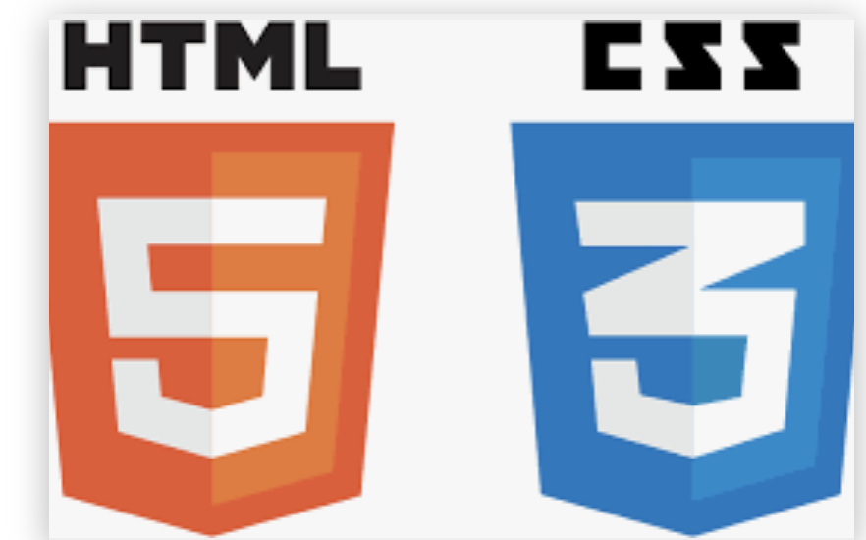




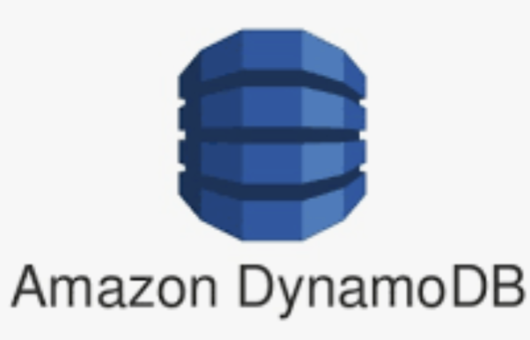




Web & Cloud Solution Expertise
FULLSTACK DEVELOPMENT
MOBILE APPLICATION DEVELOPMENT

Slide 9
Architecture Options
Directory/ Folder structure
App title & FavIcon
Backend/ DB connectivity
React Js aplication architecture
Route for Navigation
Node.js
Notes:
API First
COPE approach (Create once, publish everywhere
API-first, not API-only approach
TWIG– Template engine for drupal

Slide 10
Architecture Options ( contd..)
Client
React front end
Renderer
Node.js, MongoDB
Server
Notes:
progressive decoupling, where Drupal renders templates on the server to provide an initial application state, and JavaScript then manipulates that state. This means we can have the best of both worlds:
isomorphic React, this means that the server renders the initial HTML for the client using React components and React.renderToString(). the server does a "partial render, then compress" of the content, so you need to use hydrate to undo the compression process and use the partially-rendered parts
Server driven world: server is responsible for UI too along with business logic and data model.
Client driven world or Single page application world: server was responsible mostly for business logic and data model
'Isomorphic JavaScript’ is the way to obtain the best of both the worlds.

Slide 11
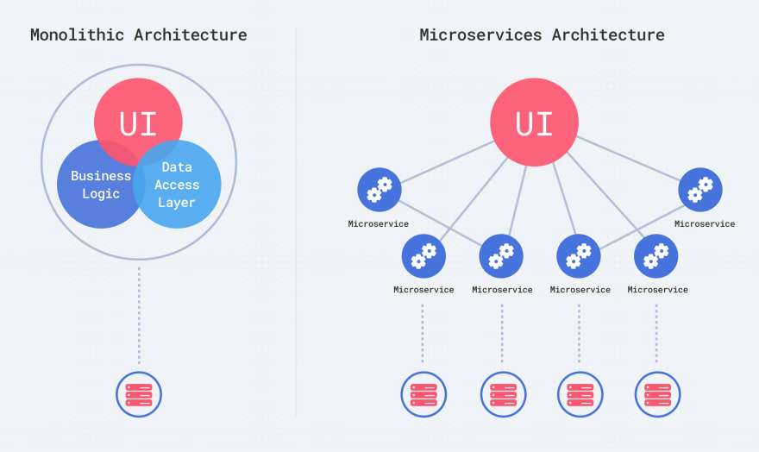
Architecture Options ( contd..)
Notes:
progressive decoupling, where Drupal renders templates on the server to provide an initial application state, and JavaScript then manipulates that state. This means we can have the best of both worlds:
isomorphic React, this means that the server renders the initial HTML for the client using React components and React.renderToString(). the server does a "partial render, then compress" of the content, so you need to use hydrate to undo the compression process and use the partially-rendered parts
Server driven world: server is responsible for UI too along with business logic and data model.
Client driven world or Single page application world: server was responsible mostly for business logic and data model
'Isomorphic JavaScript’ is the way to obtain the best of both the worlds.

Slide 12

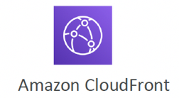
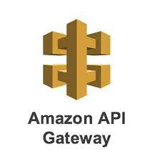
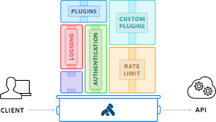


Scalable, Resilient & Secure Hosting with AWS
Notes:
API GW– Application throttling, RATE LIMITING
XSS attack, DoD Attack.
Latyency – with CFDN

Slide 13
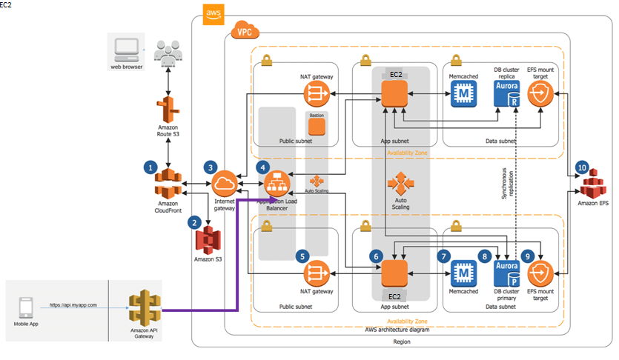
Scalable, Resilient & Secure Hosting with AWS
Notes:
API GW– Application throttling, RATE LIMITING
XSS attack, DoD Attack.
Latyency – with CFDN

Slide 14
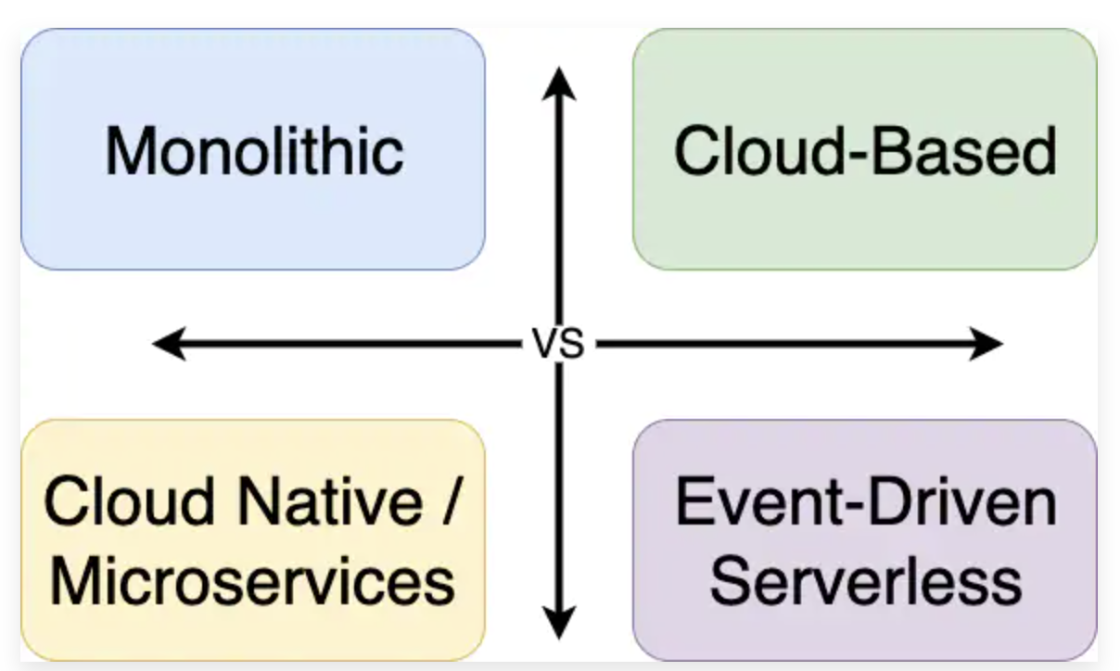
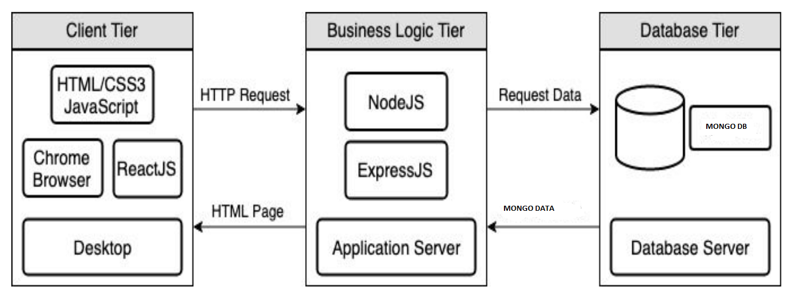
Deployment Options
Notes:
A traditional cloud-based application architecture involves load balancers, web servers, application servers, and databases
Cloud native is an approach to building and running applications that exploits the advantages of the cloud computing delivery model, Containerisation/micro services , deployment CI/CD pipe lines

Slide 15
Thanks

Slide 17





Location #92, Ist Floor, Natraj building, Near SNS Arcade, Konnena , Old Airport Road, Bangalore 560017 www.nortcele.in Contacts
Contact us
Nortcele Systems
+919380528940
aks@nortcele.in
www.nortcele.in

Slide 18
MoM – 24/2/2022
- Re-priortize the Phase1 feature and include below features in phase 1 - done
1. Feedback or Complaints
2. Notice board
3. Communication
-MVP along with essential feature shall be part of Phase1 – Nortcele - done
-Engage with UI/UX consultant from beginning in agreement of cost with Annurudh.- Nortcele - (in process of Identification)
-Analyze other such services applications such as Apna Complex and MYGate – Nortcele (In progress)
-First priority is to Desktop then to Mobile - Nortcele
- Nortcele should keep track of latest features of MyGate and Apna Complex - Nortcele
- As an USP, Nortcele shall keep provision for introduction of Micro services in future - Nortcele
- System shall be flexible enough to get interfaces with any kind of devices in complex - Long term Nortcele
- Mr. Annurudh will share the details of Benchmarking web sites for his defense project and Nortcele shall analyze the same.- Mr Annurudh
- Commercial shall be added to slides 7 for fund allocation for project - Nortcele - Done

