Slide 1


Services and Solutions Streamlined (S3)
Version 1.0 Release
(All in One System for Residential Community)
By - Team

Slide 2
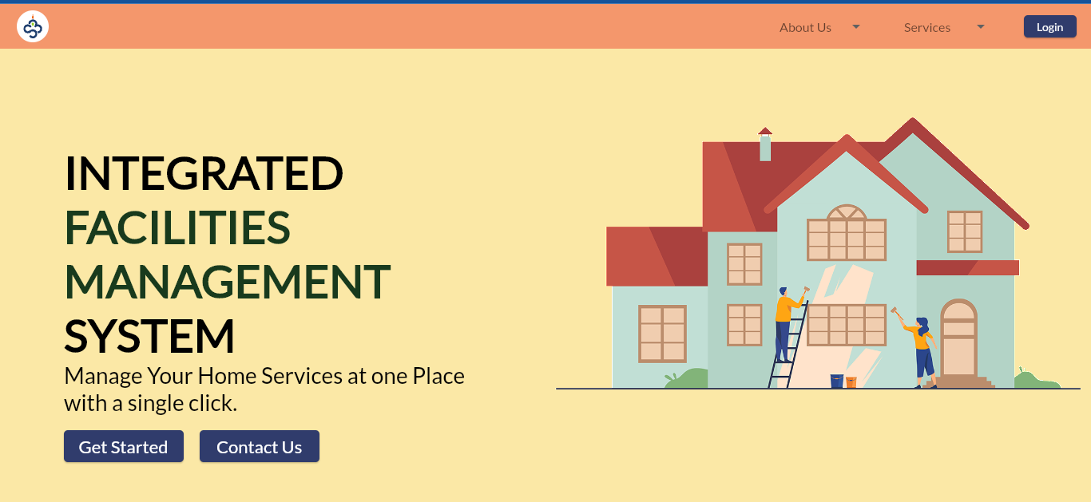
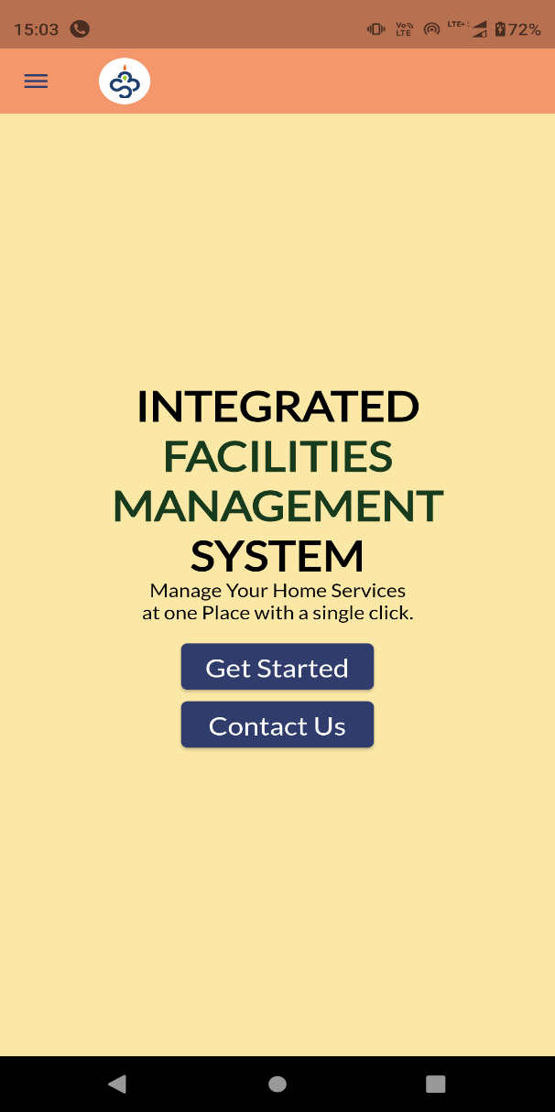
Landing Page

Slide 3
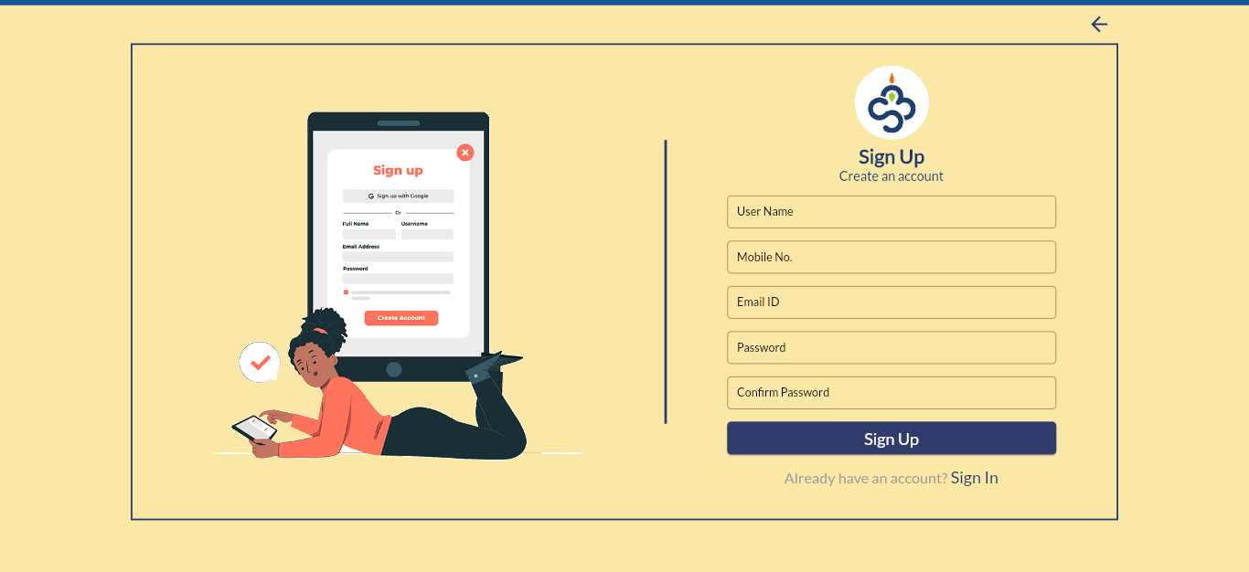
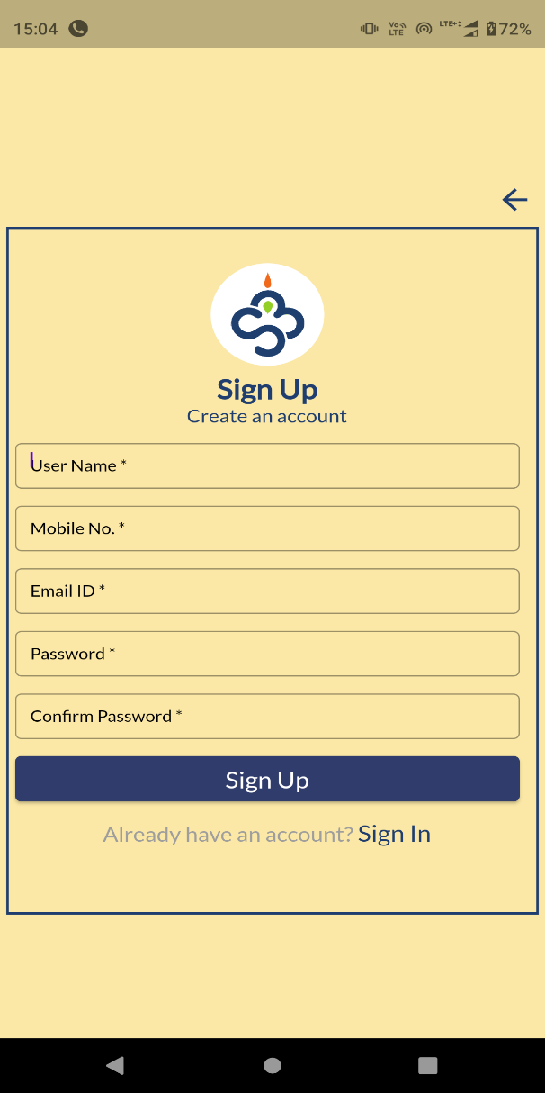
Sign Up

Slide 4
Sign Up
A new user can create account using sign-up option. Any user with valid email id can be register in application.
Every newly signed in user will be considered as resident/normal user with limited access.
A predefined admin user can change the user type to security, office admin like that.

Slide 5
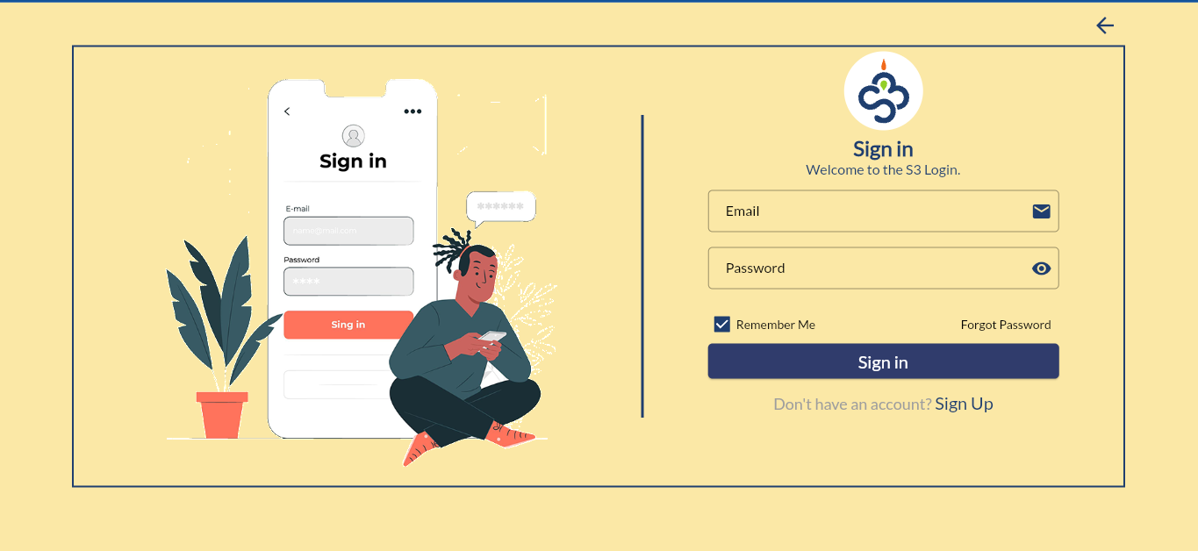
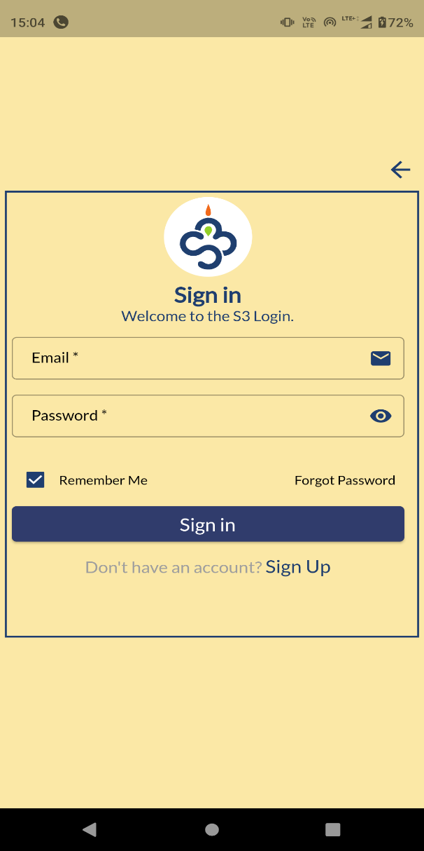
Sign In

Slide 6
Sign In
A registered user can sign-in with credentials.

Slide 7
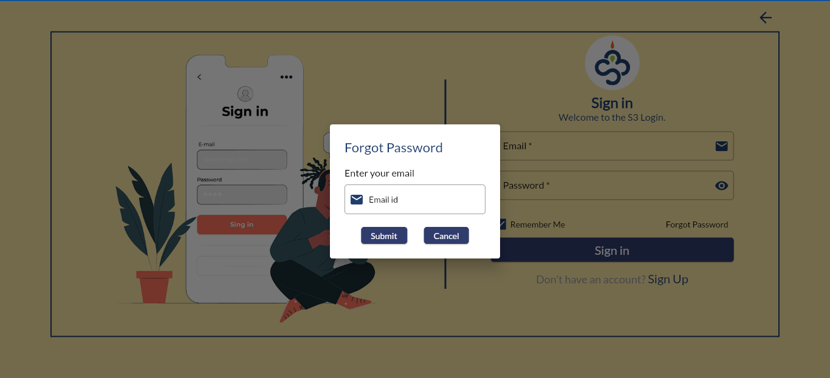
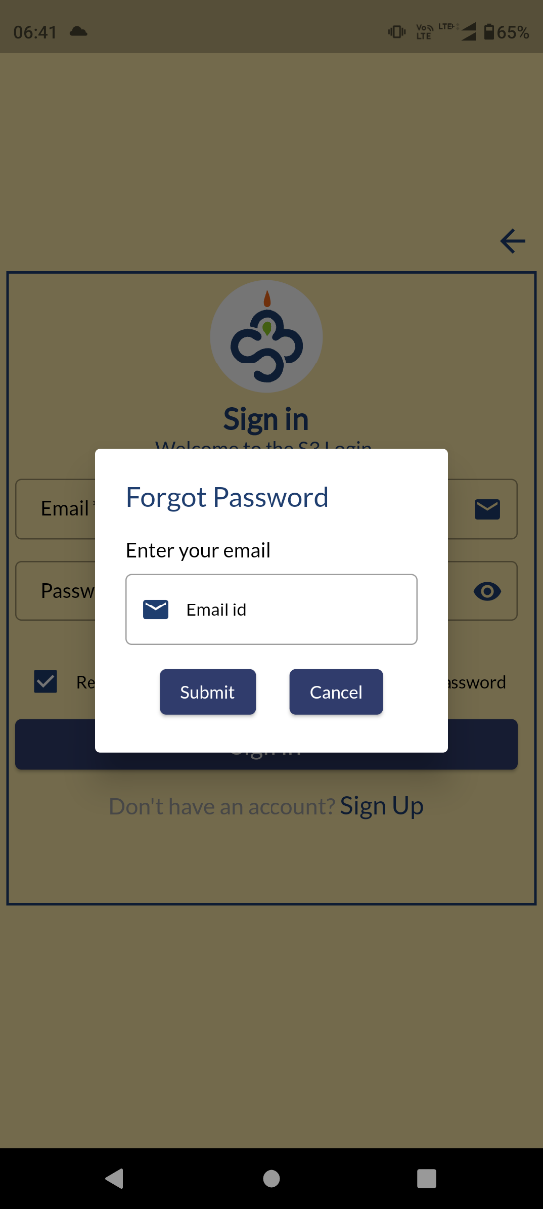
Forgot Password

Slide 8
Forgot Password
Forgot password option provides user, a facility to reset the password.
User will get an reset link in the registered email id.

Slide 9
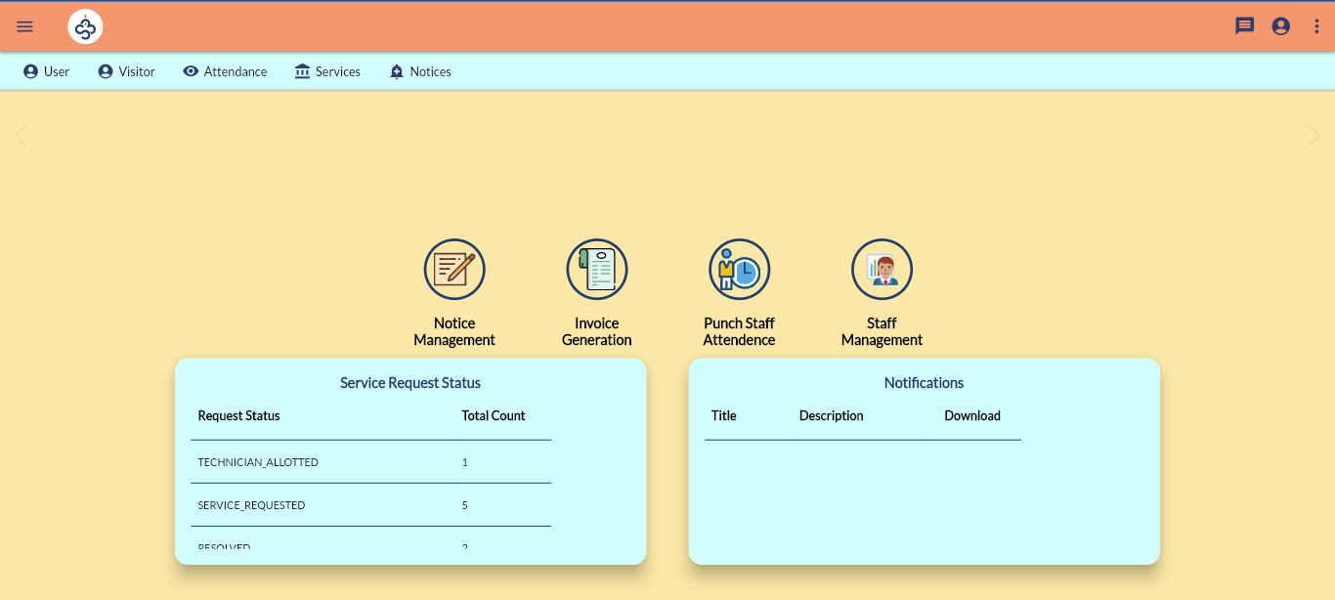
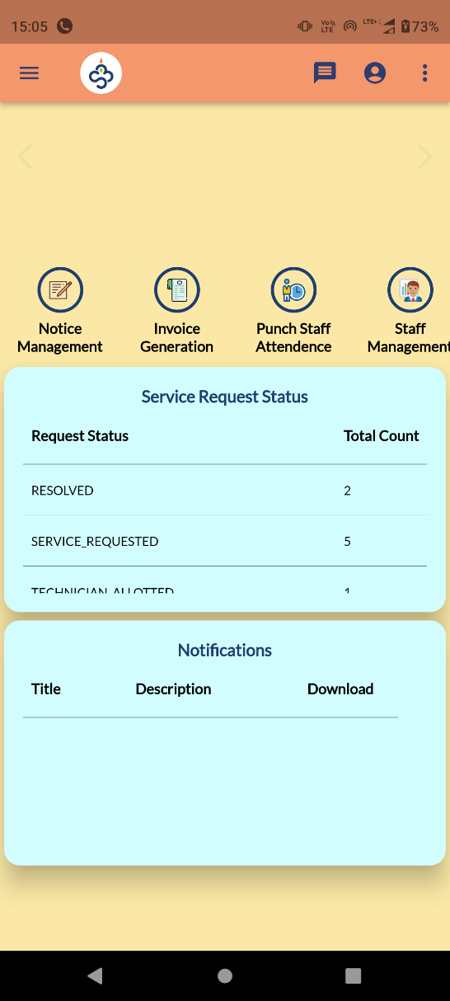
Home Page

Slide 10
Home Page
Home page menu will vary as per the user type.

Slide 11
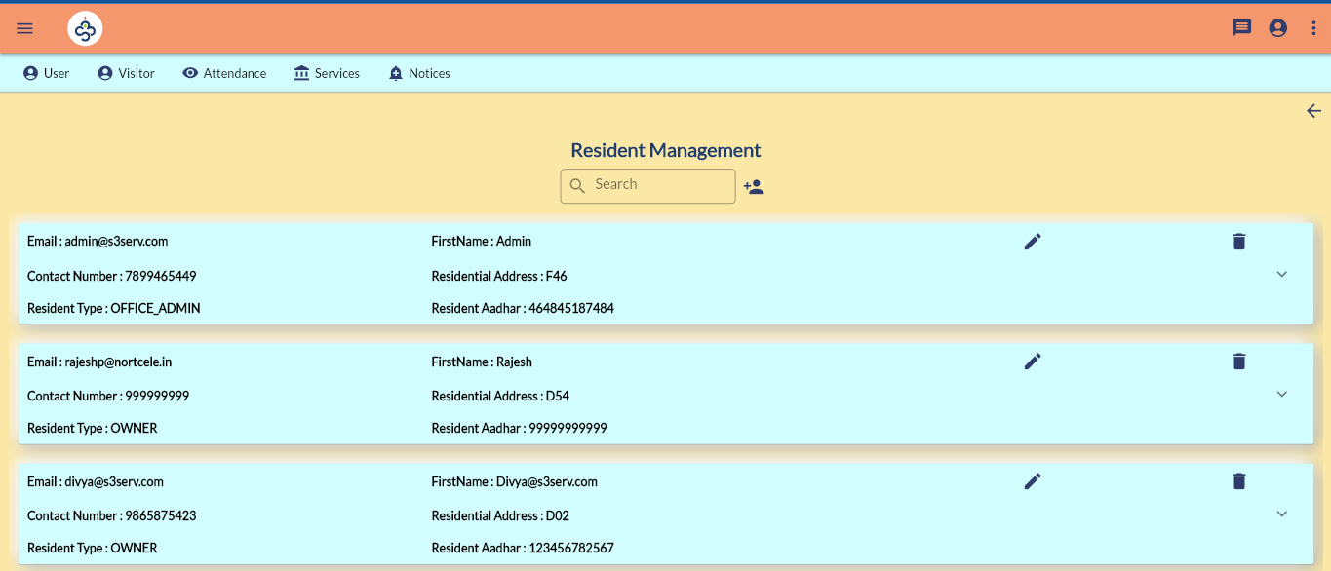
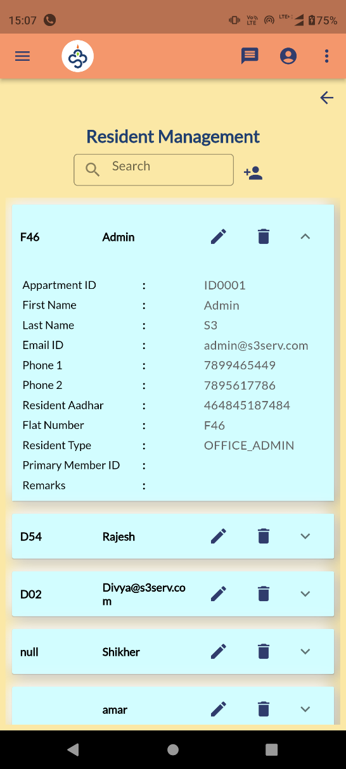
Resident Management

Slide 12
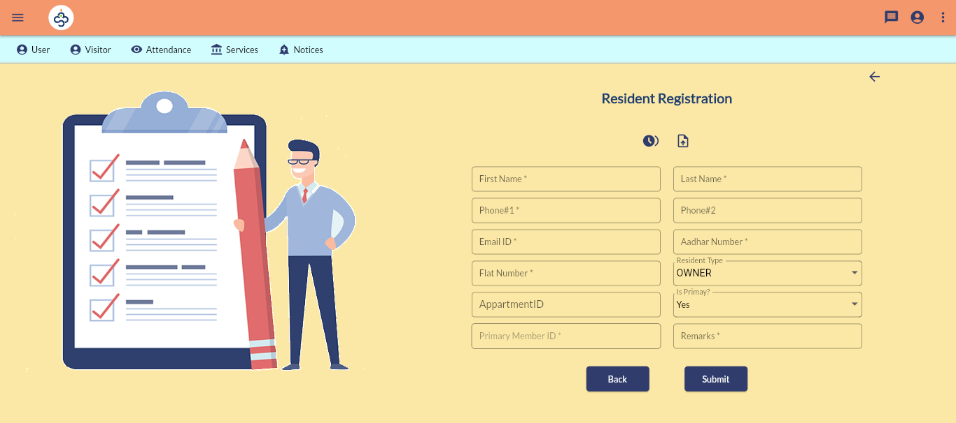
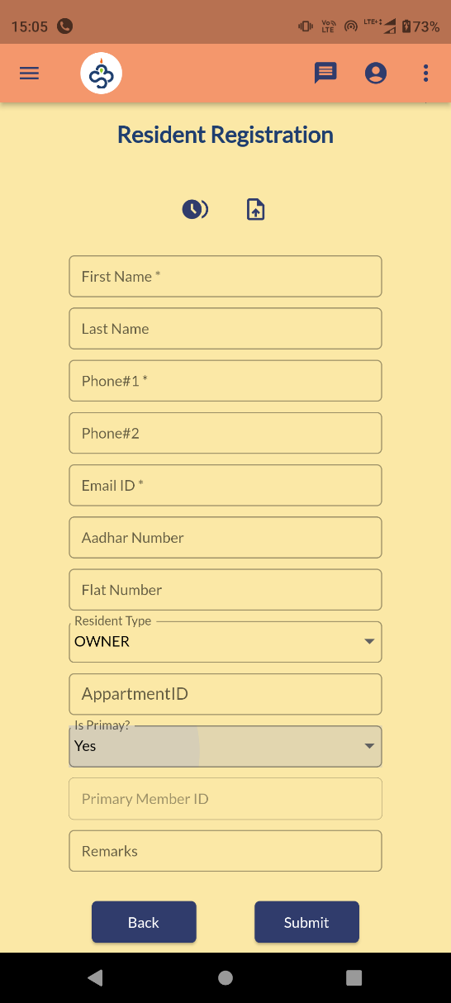
Resident Registration

Slide 13
Resident Management
User >>Resident Management
An admin user can see and edit all registered users.

Slide 14
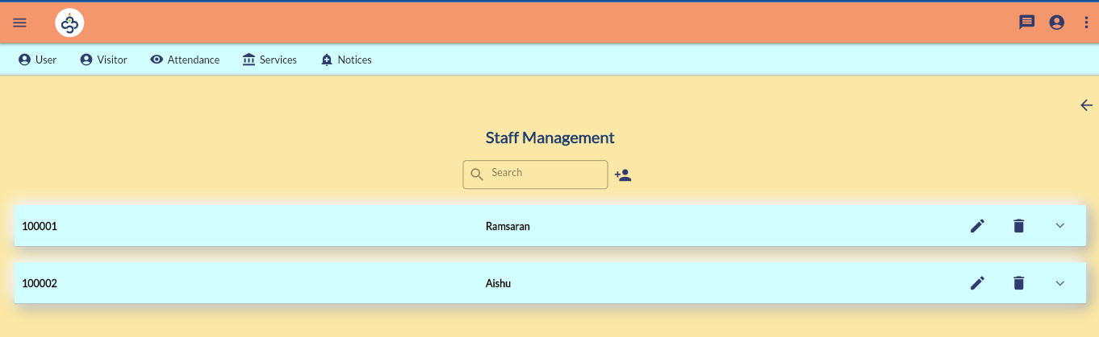
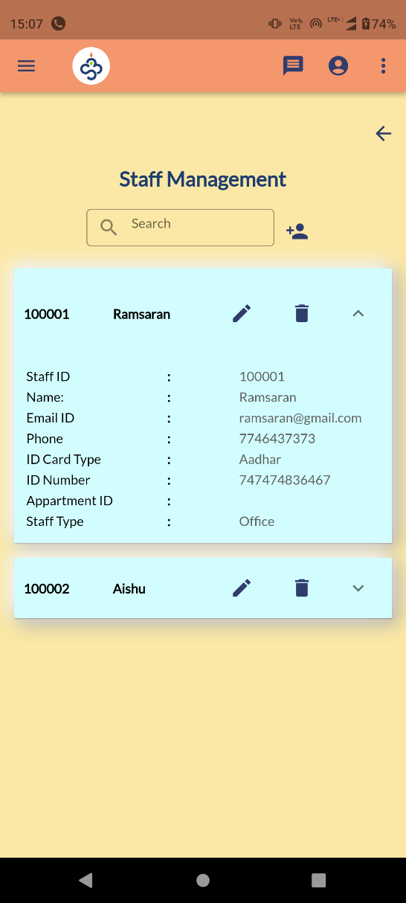
Staff Management

Slide 15
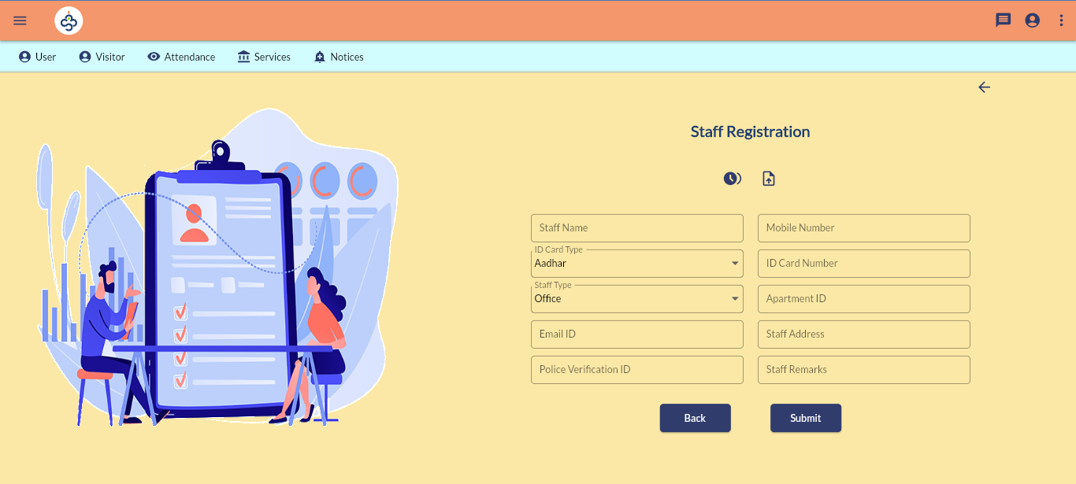
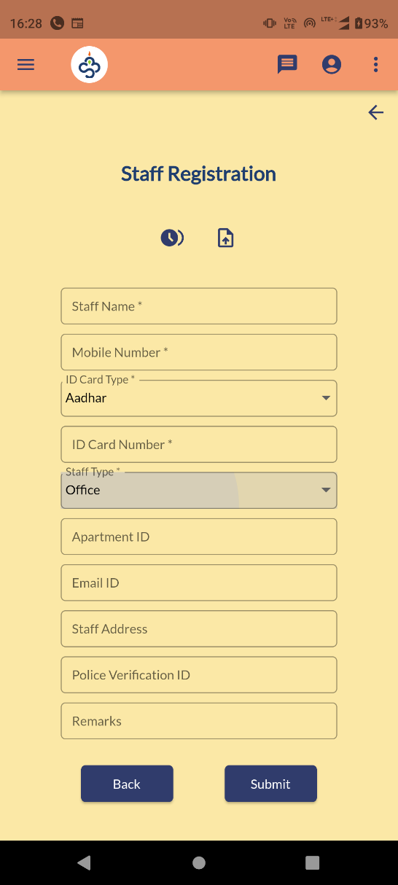
Staff Registration

Slide 16
Staff Management
User >> Staff Management
Currently this menu will act as register for staffs related to office/maids.

Slide 17
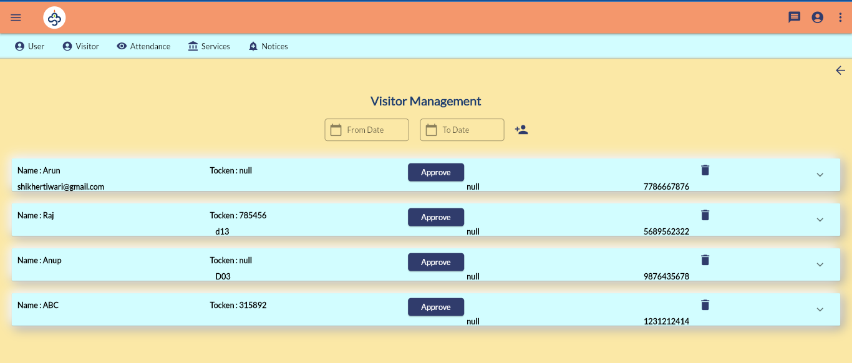
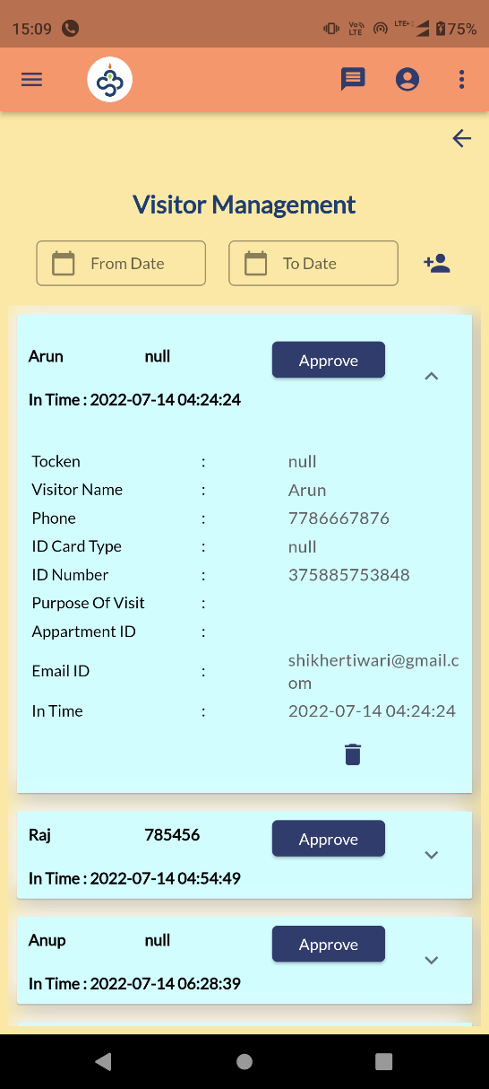
Visitor Management

Slide 18
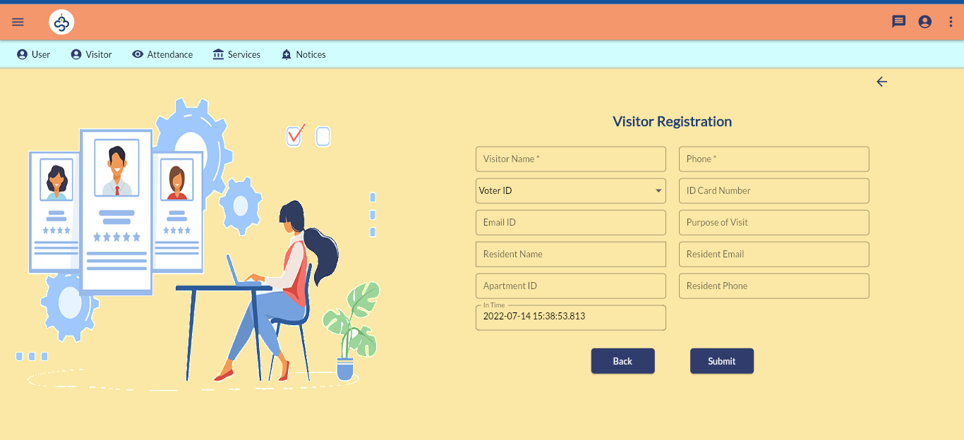
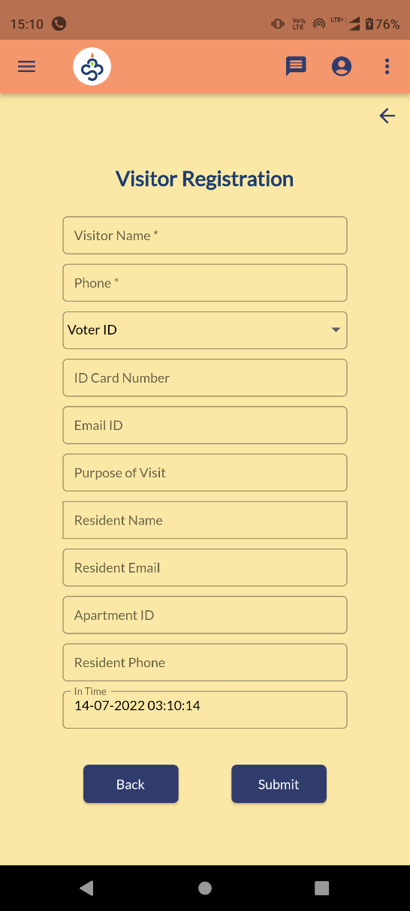
Visitor Registration

Slide 19
Visitor Management
Visitor >> Visitor Management
Admin/security can add a visitor/guest against a resident.
Scenario is as follows
Security adding a guest against you with your registered phone number in App.
You have to logged in to app as resident.
you will get a push notification titled Guest Notification.
Resident can go to visitor screen/ if app is in open state you will get a pop up message to approve visitor.

Slide 20
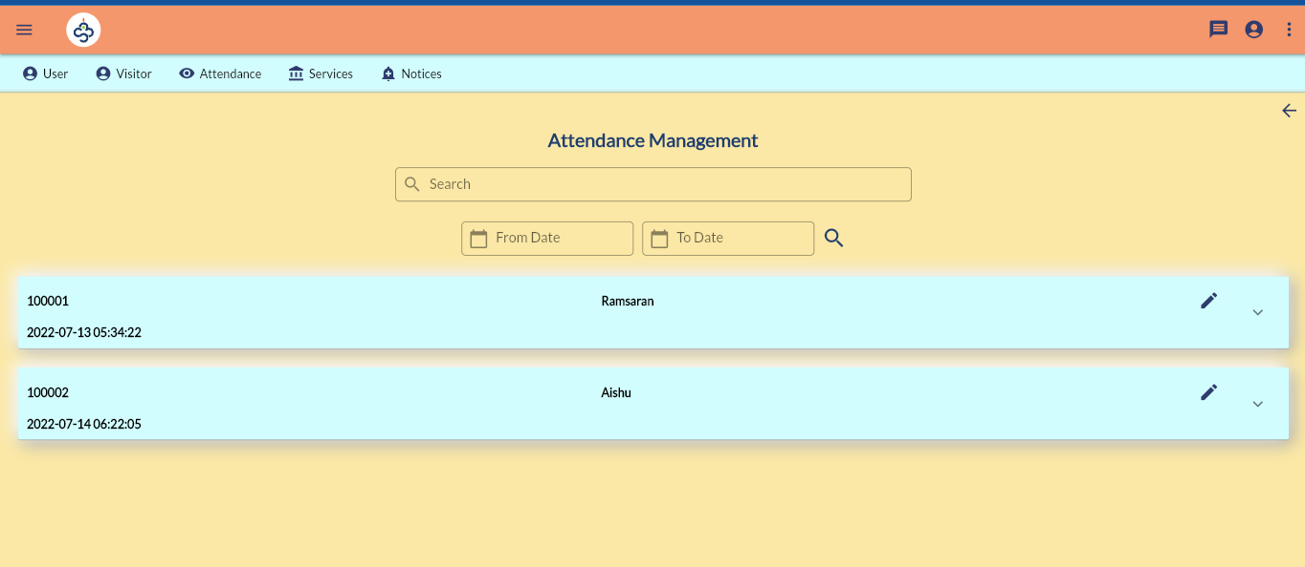
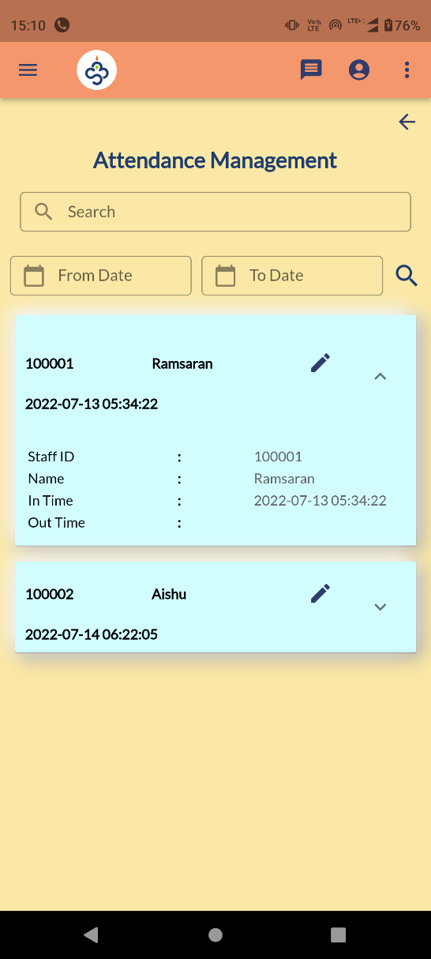
Attendance Management

Slide 21
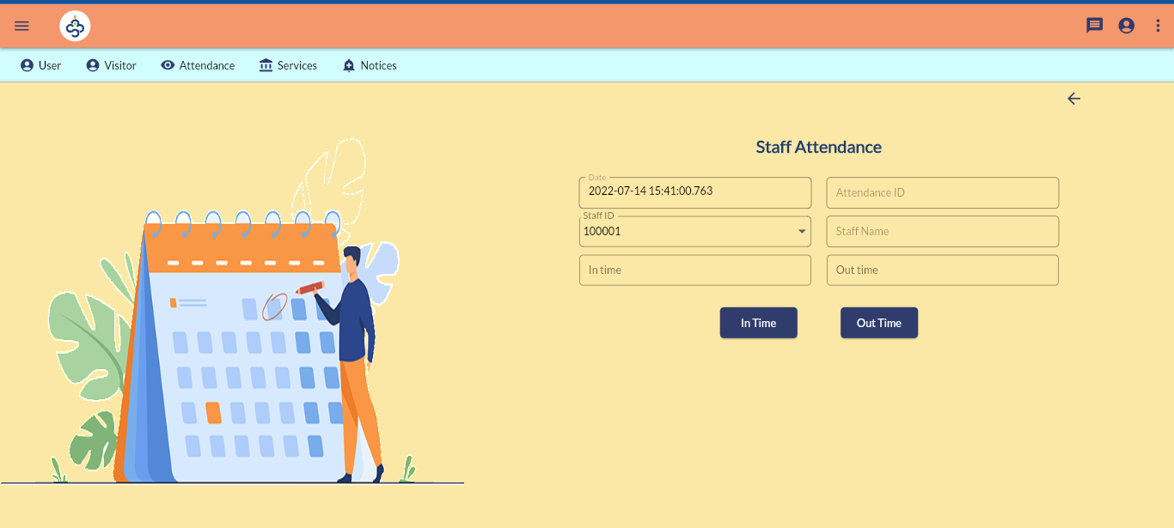
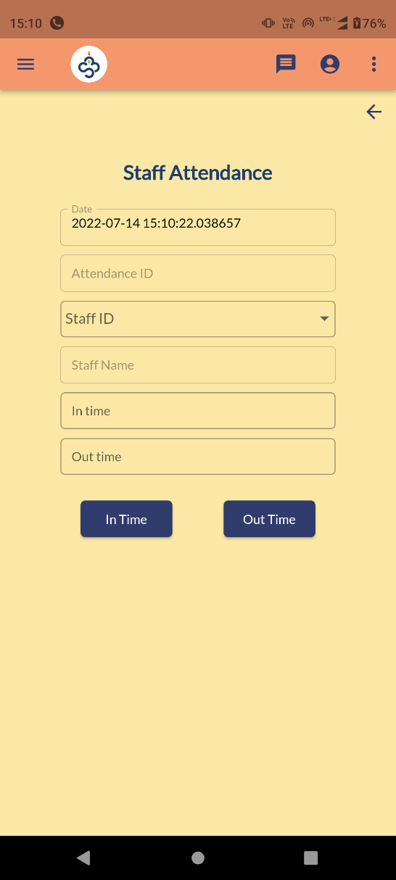
Staff Attendance

Slide 22
Attendance Management
Attendance >> Punch Attendance
Attendance can be marked against staffed.
Currently it is a manual process. Later it will be integrated with punching devices.
Attendance >> View Attendance
Use edit option to mark the out punch of a staff.

Slide 23
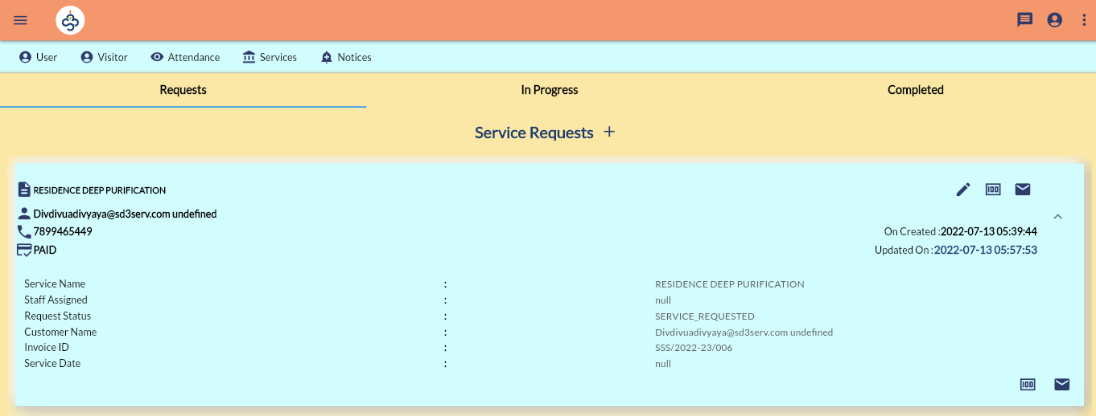
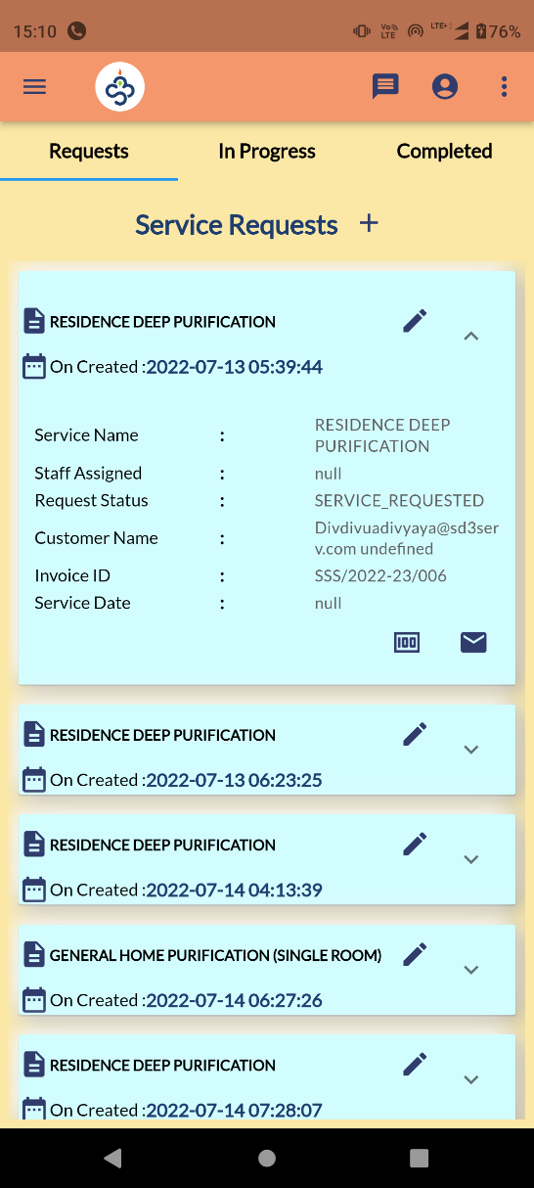
Service Request

Slide 24
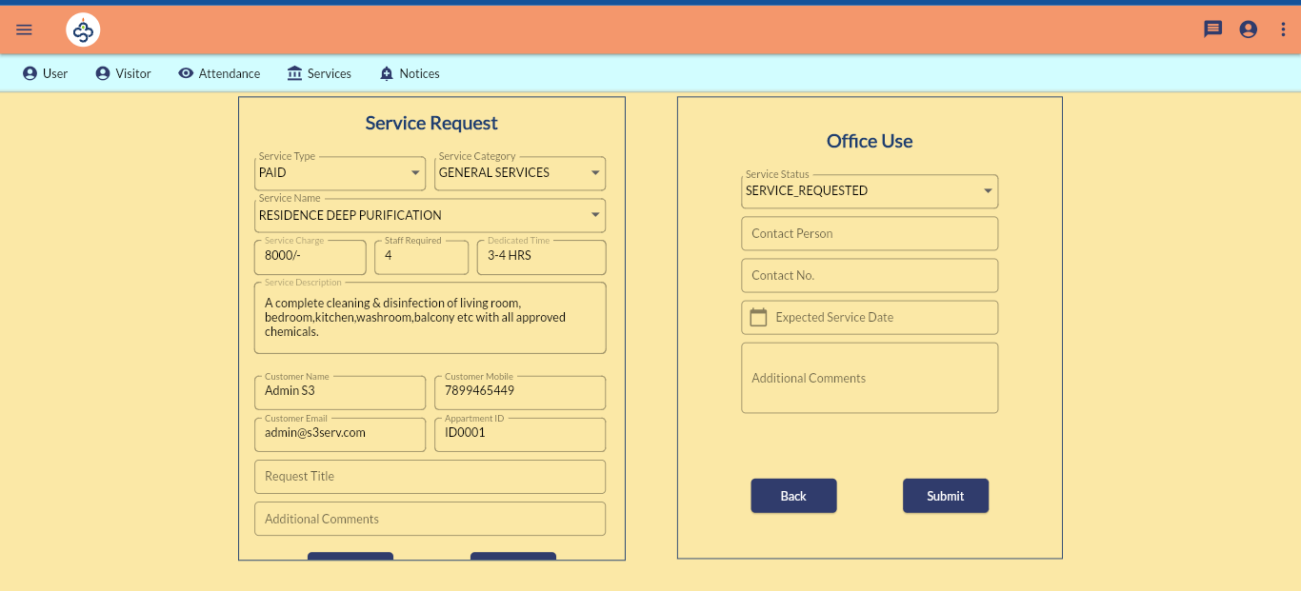
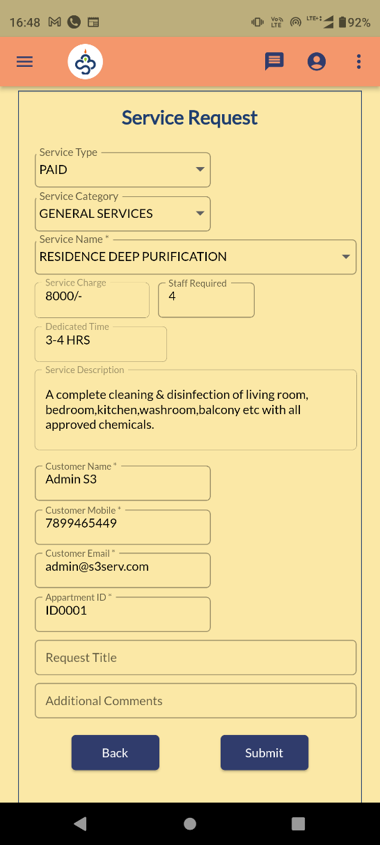
Service Request

Slide 25
Service Request
Services >> Service Requests
This is a page where resident can raise a complaint/service requests.
Admin raise requests on behalf of residents.
Resident can escalate the ticket to higher authority by clicking the email icon.
Admin can raise the invoice against the request by tapping the money icon.
Admin can only edit the request status.
Any change in service request status will be notified by toast message on login for user.

Slide 26
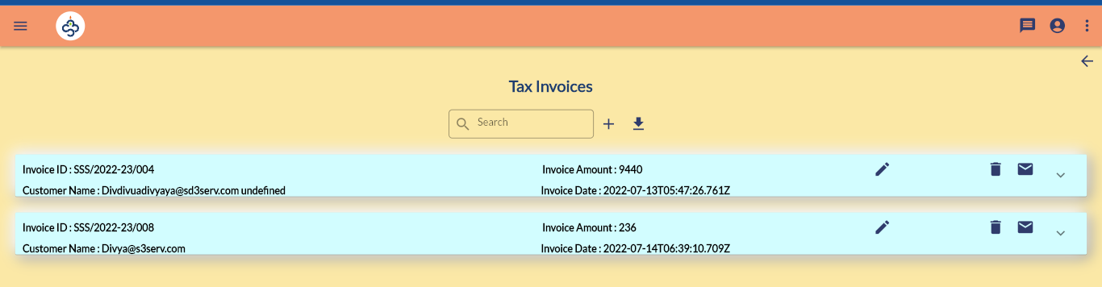
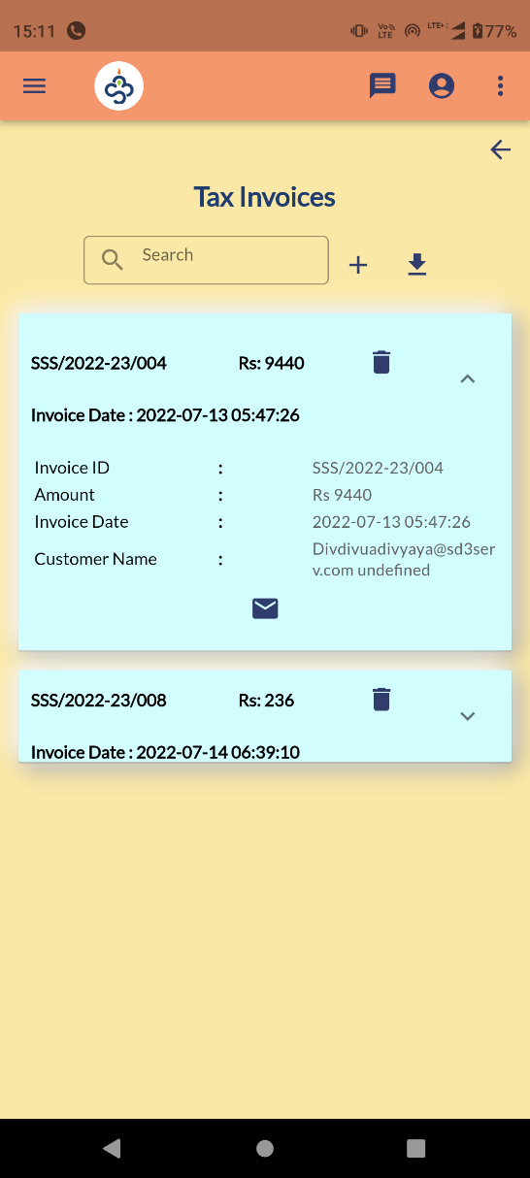
Invoice

Slide 27
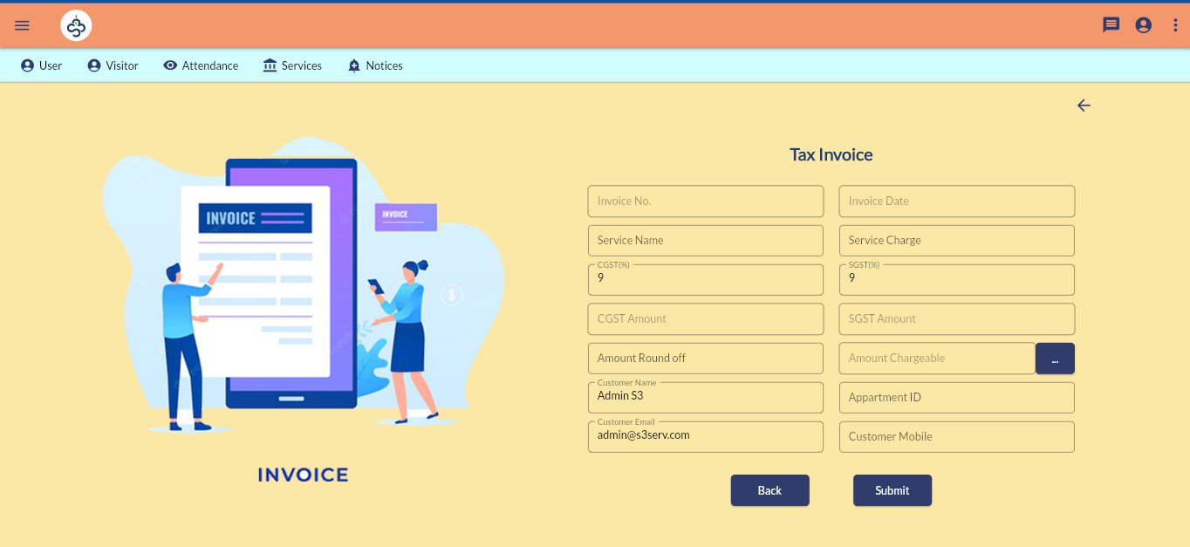
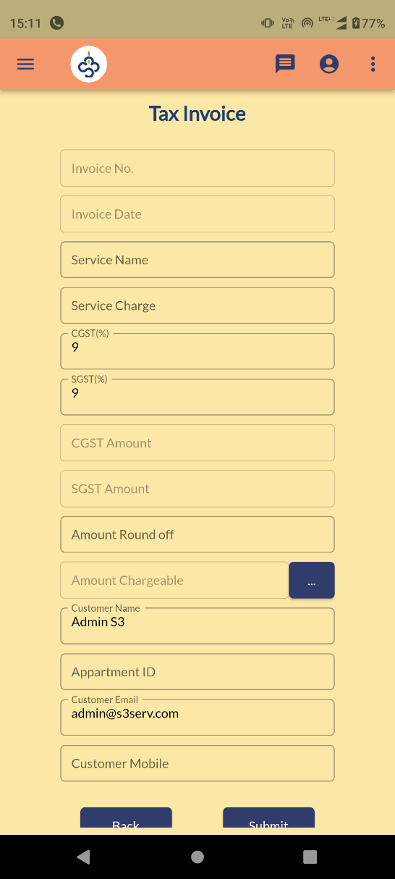
Invoice

Slide 28
Invoice Generation
Services >> Invoice Generation
An admin user can raise an invoice for miscellaneous purpose other than service request.
User email/phone should be proper so that resident can personally see the invoices generated against him.

Slide 29
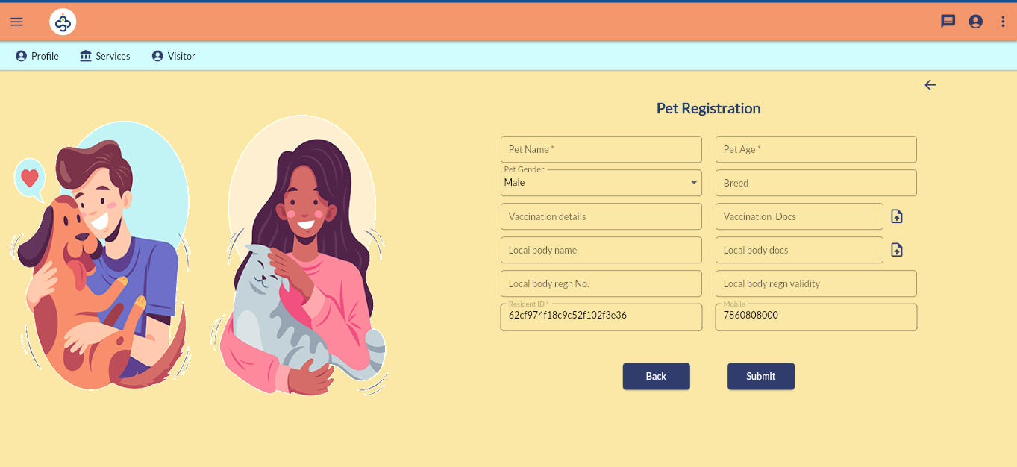
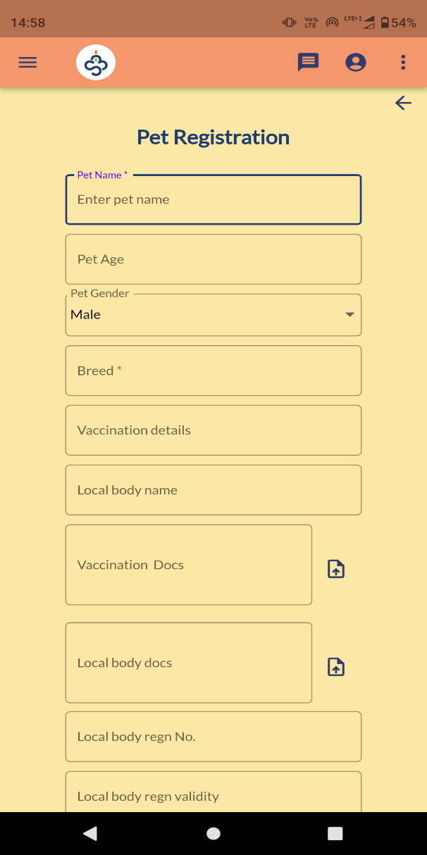
Pet Registration

Slide 30
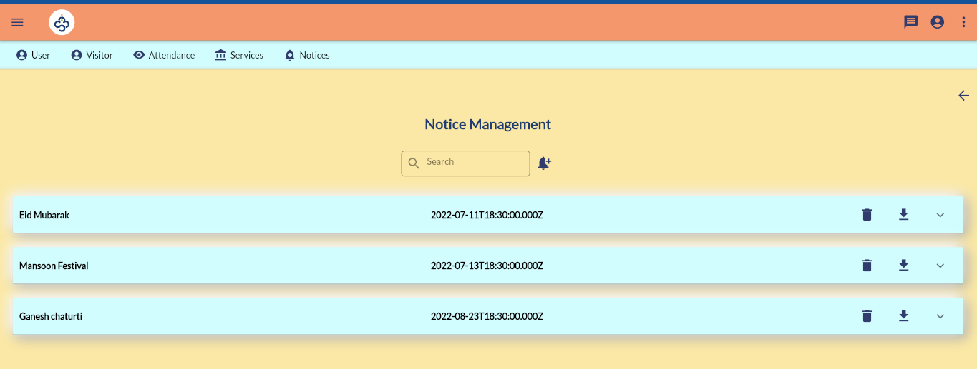
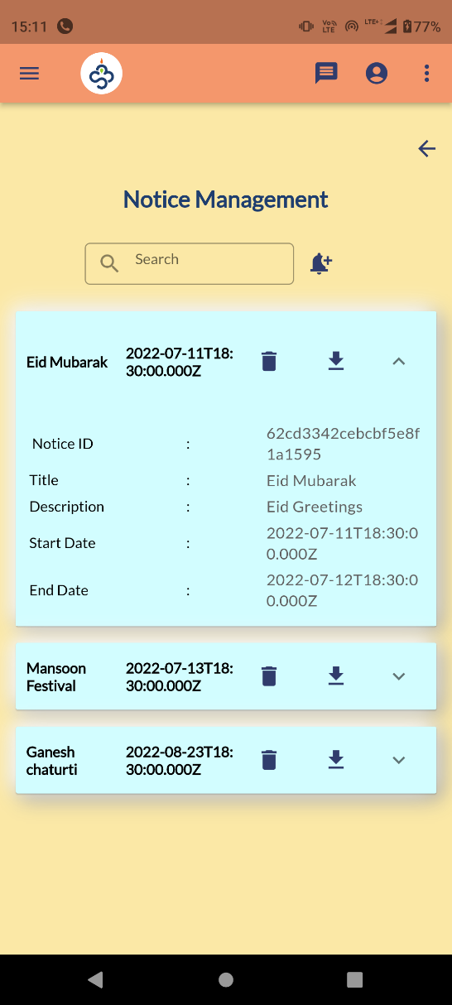
Notice Management

Slide 31
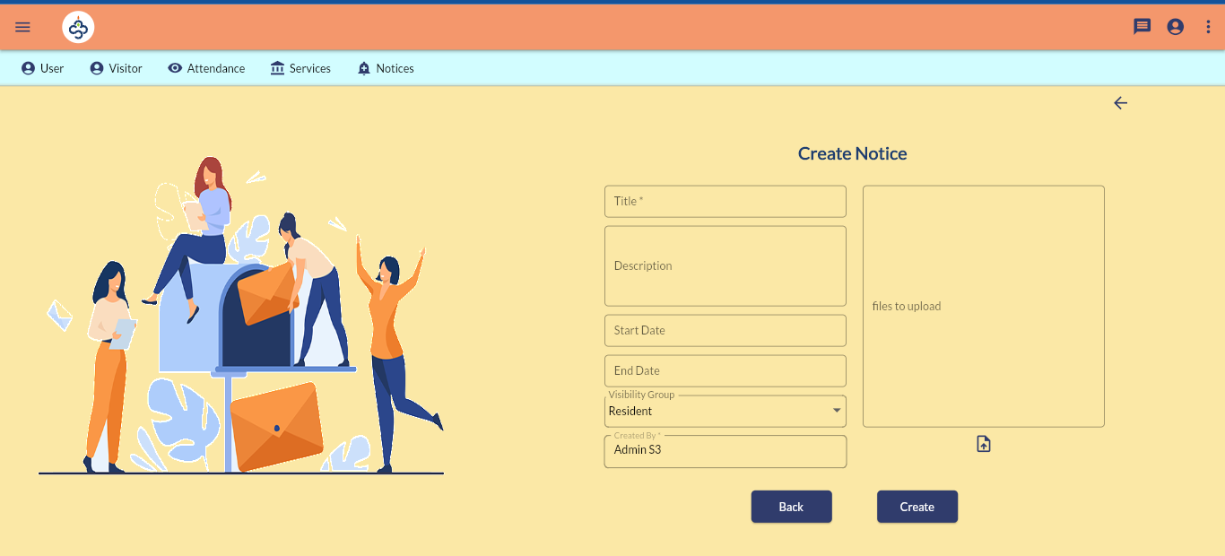
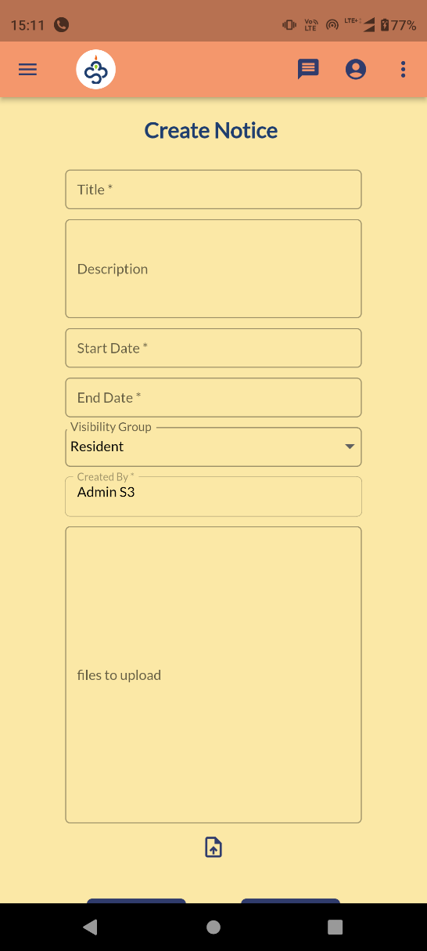
Create Notice

Slide 32
Notice Management
Notices >> Notice Management
An admin can create notifications/announcements for the registered users from here.
He can also provide related documents also.
Currently every registered user can see all notifications and can download docs attached if any.

Slide 33
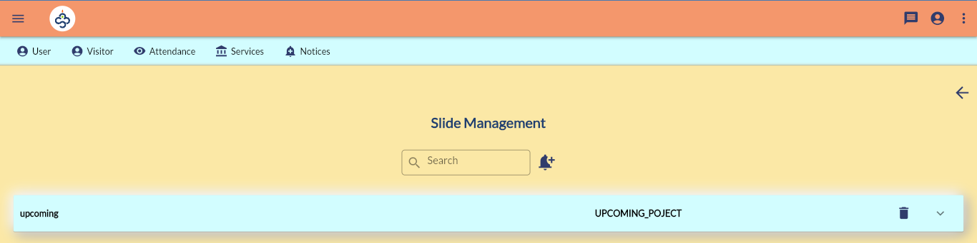
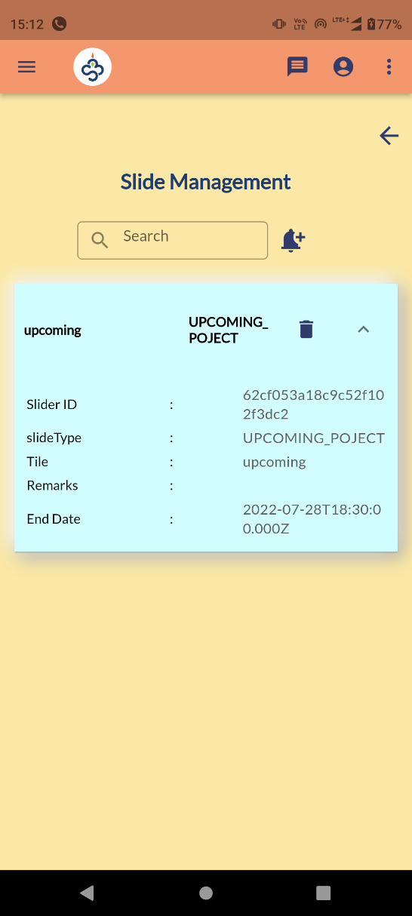
Slide Management

Slide 34
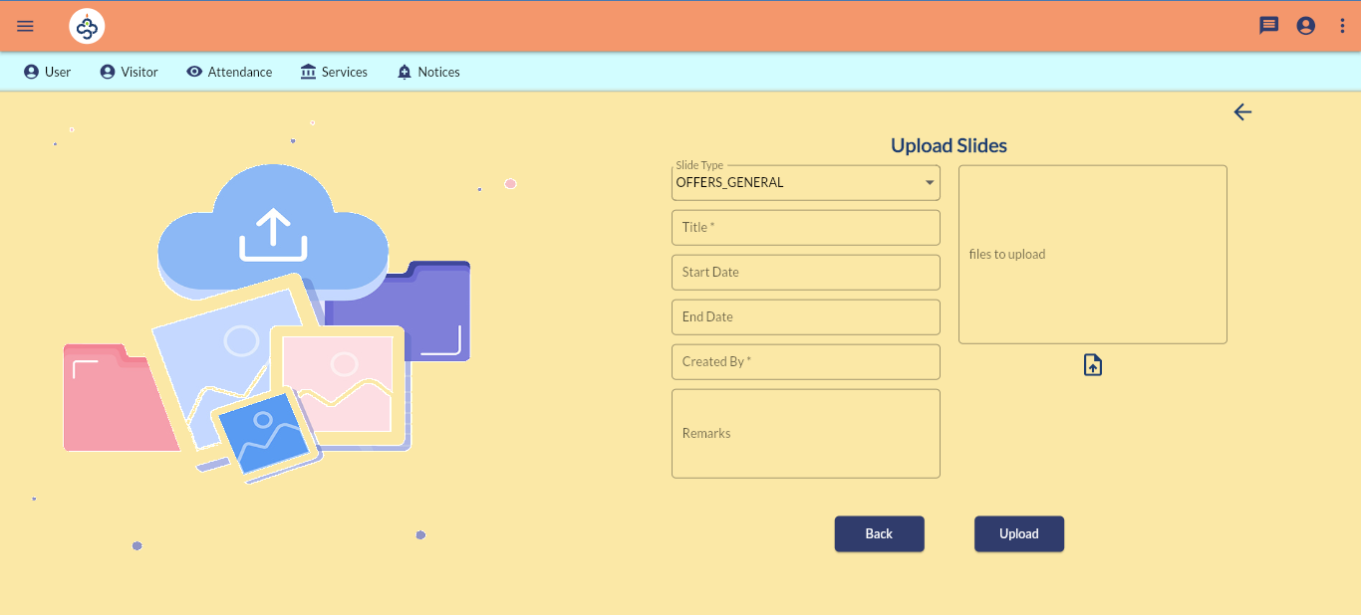
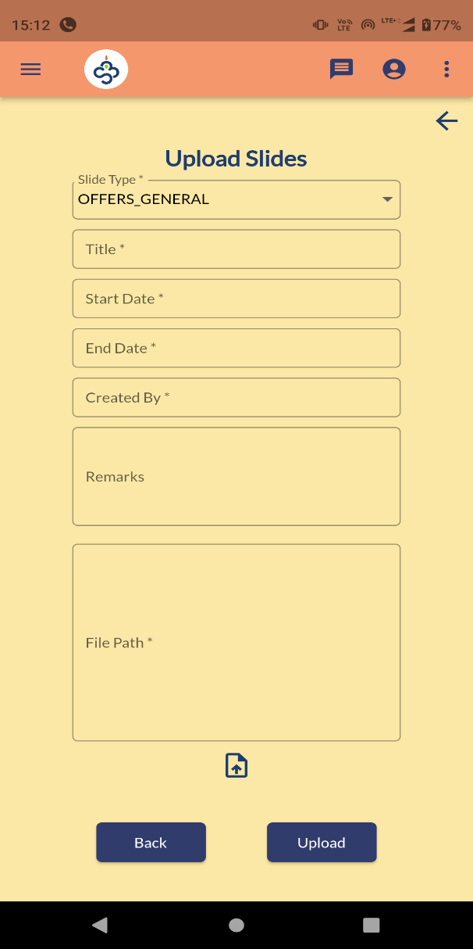
Slide Upload

Slide 35
Slide Management
Notices >> Upload Slides
Slide Management is an option to set offers, ads in the application
Currently it contains 4 types of options
OFFERS_GENERAL – to show any offer to general public and will be displayed in landing page of Web Application.
UPCOMING_PROJECT – Ads for upcoming projects
COMPLETED_PROJECT – Portfolio for completed ones.
OFFERS_USER - To provide offer for registered users and will be displayed in home page.

Slide 36


Contact us
Location #92, Ist Floor, Natraj building, Near SNS Arcade, Konnena , Old Airport Road, Bangalore 560017
+919380528940
www.nortcele.in

aks@nortcele.in

Slide 37
Thank You.

