Slide 1
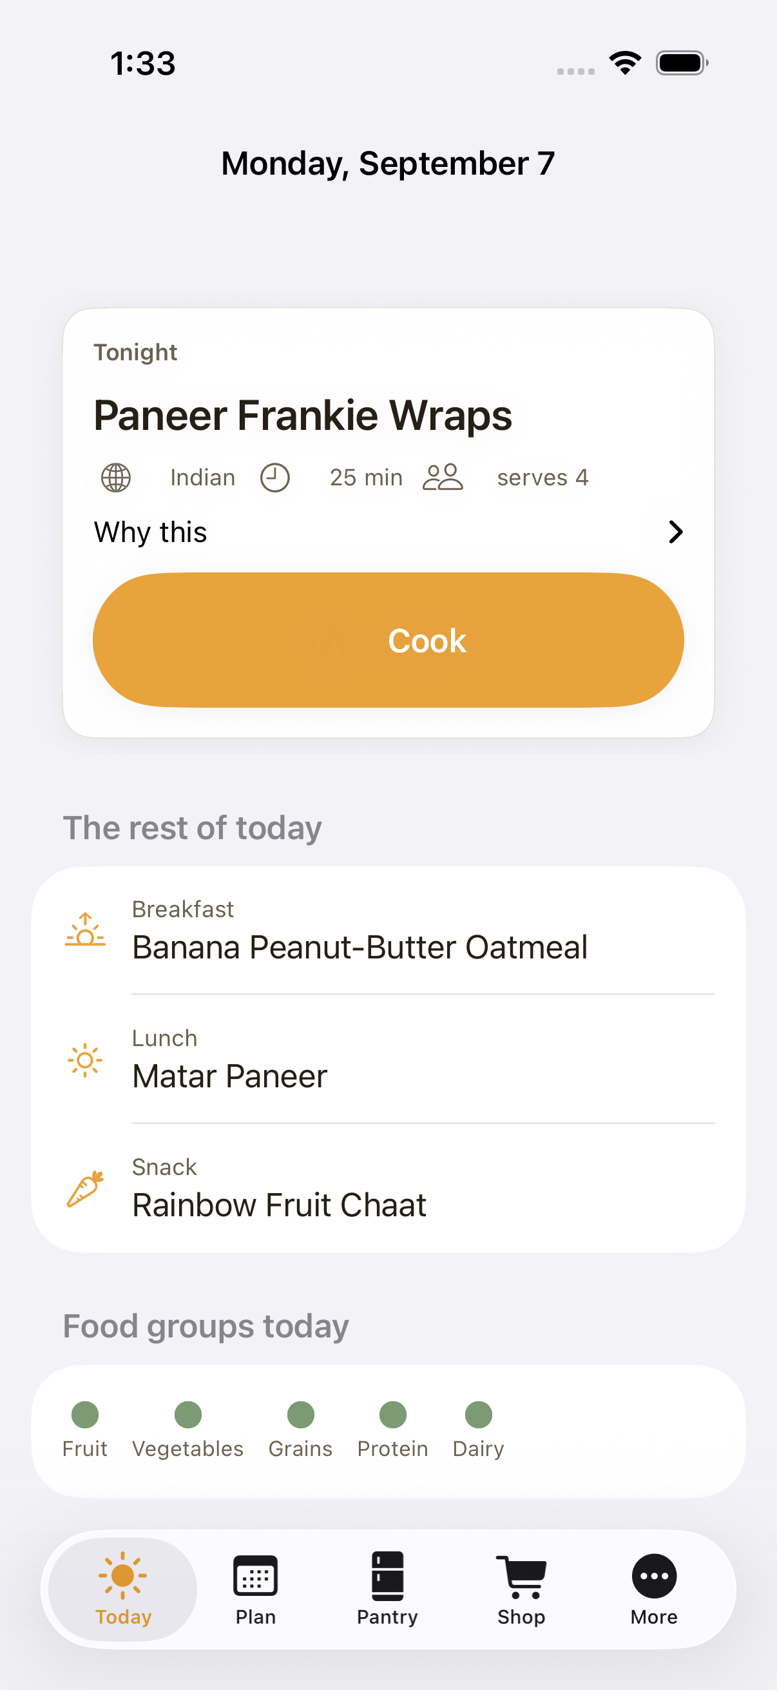
Rasoi
रसोई — “kitchen”
A private kitchen planner for one family's iPhone.
The pantry drives the plan. The plan drives the list. The children decide what comes back.

Slide 2
THE PROBLEM
Weeknight dinner is a decision nobody wants to make at 6pm
Four people, two of them children, one vegetarian kitchen, one weekly shop.
• The plan lives in someone's head, so it collapses on a bad Tuesday.
• What the children actually eat is remembered by feel, not by record.
• Food goes off at the back of the fridge while the list repeats itself.
• Every app that would help wants an account, a subscription, and your family's data.

Slide 3
HOW IT WORKS
One loop, and it gets better every week
Pantry → Plan → List → Cook → How did it go? → a better Plan
• The planner starts from what is already in the kitchen and what is about to go off.
• It ranks meals by what the children actually ate, not by what a magazine says.
• Every meal can explain itself: “uses the spinach before it turns”, “25 minutes on a school night”.
• Same inputs, same plan — it is deterministic, so a week can be reproduced exactly.

Slide 4
TODAY
Tonight, in one glance
• The dinner, its cuisine, total time and how many it serves.
• “Why this” opens the planner's actual reasons.
• The rest of the day underneath: breakfast, lunch, snack.
• A use-it-up banner when something is about to turn.
• Three quick snacks a child can have right now, from the pantry.
• Five food-group dots for the day — presence, never portions.

Slide 5
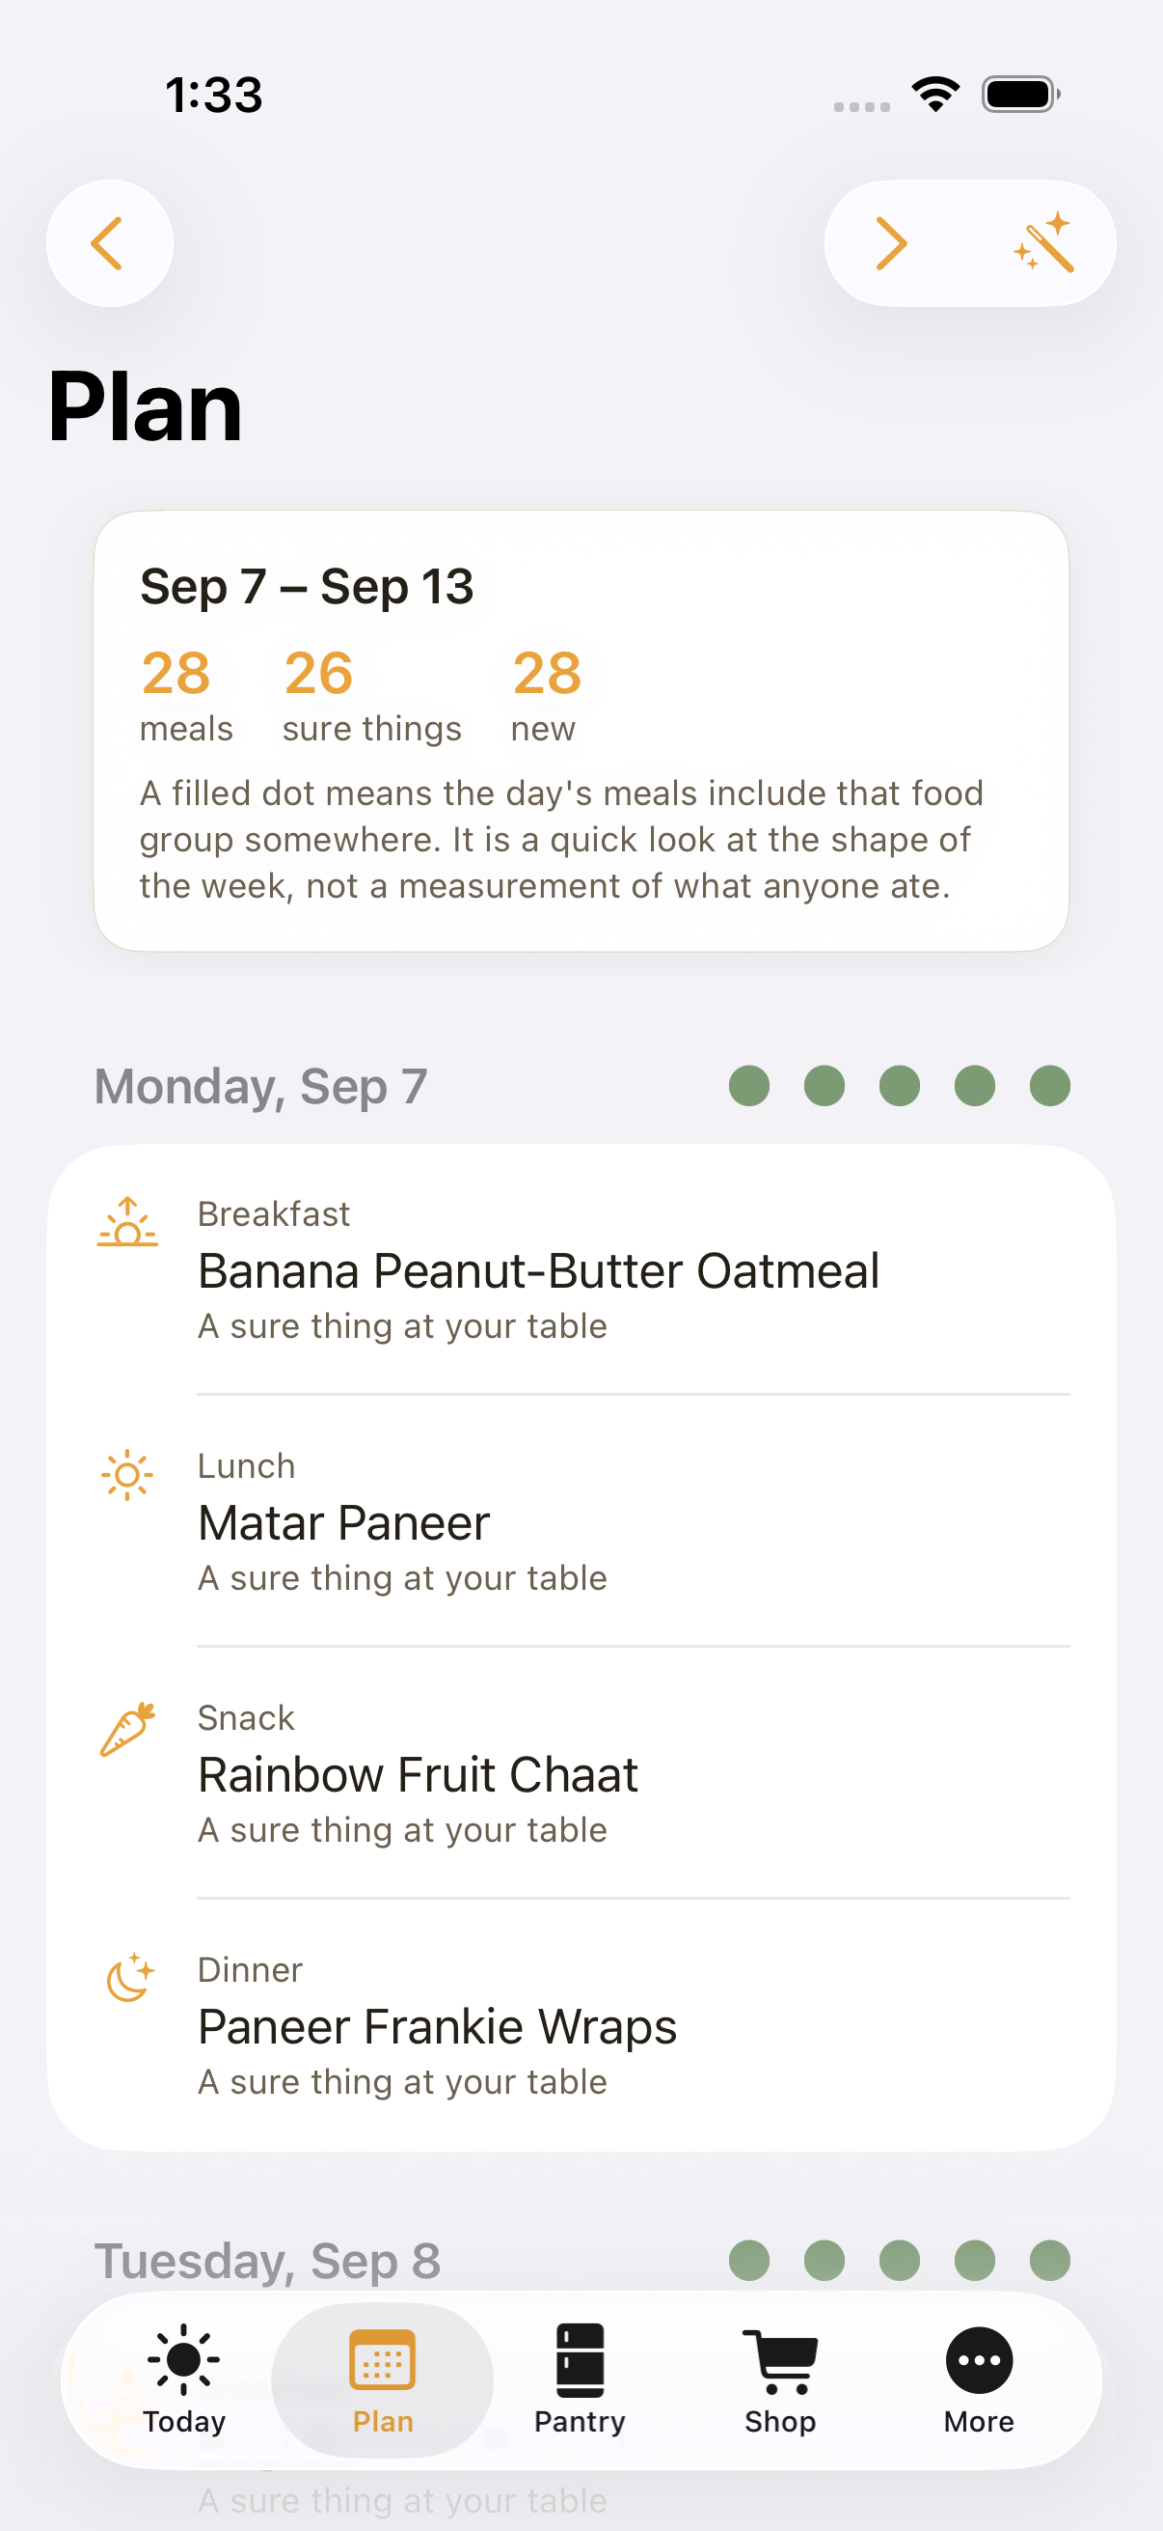
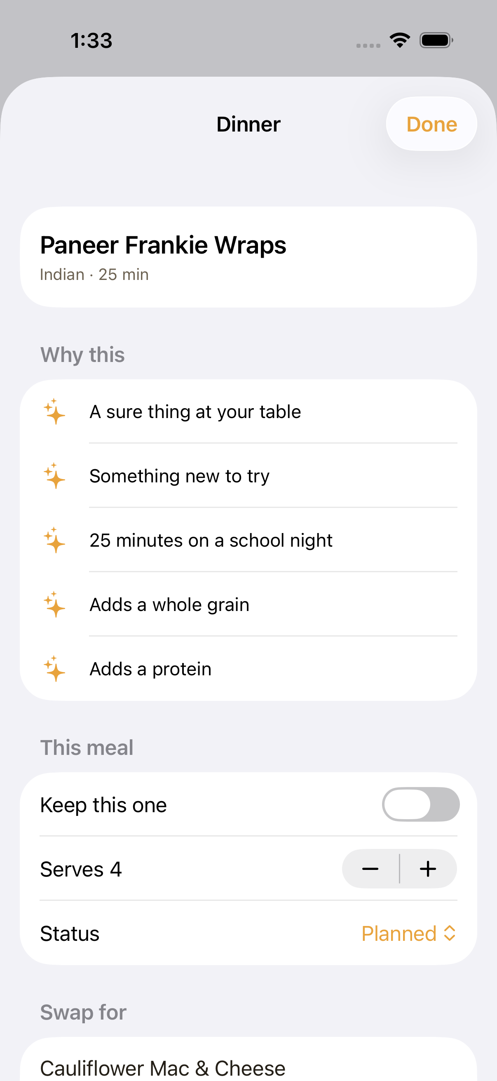
PLAN
A whole week in one tap
• Seven days × four meals, generated in under a second.
• No repeat within three days; no two dinners of the same cuisine running.
• Weeknight dinners fit your time cap; the long cook lands at the weekend.
• At least two sure things a week, at most two brand-new dishes.
• Tap a slot to see why it is there and swap it for a ranked alternative.
• Keep, skip or mark eating-out — regenerating never touches those.

Slide 6
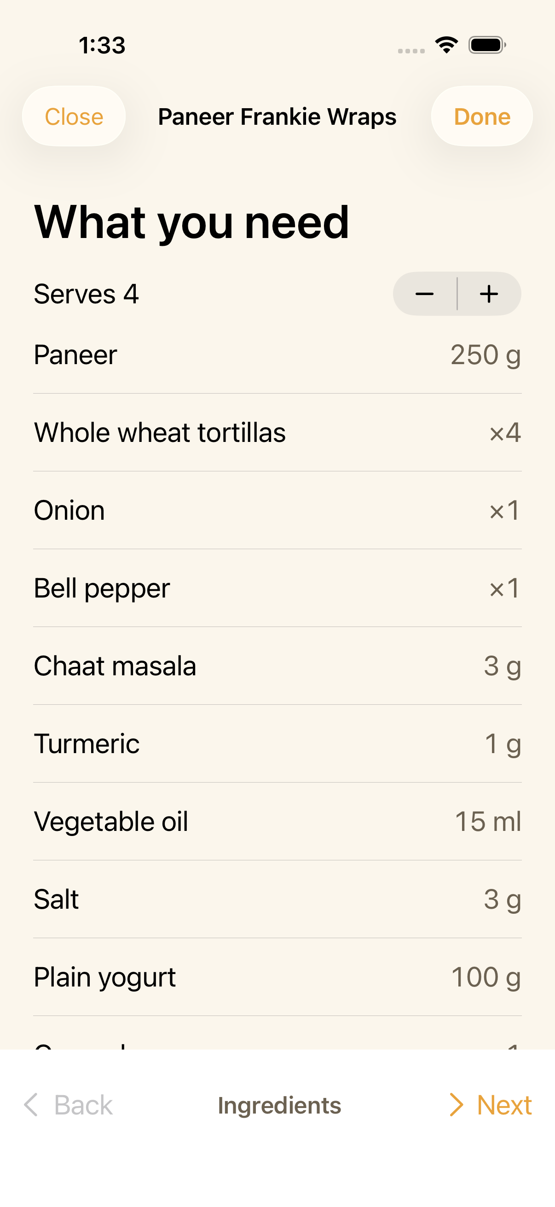
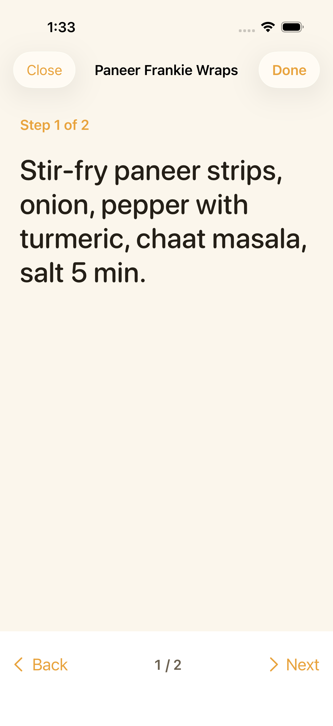
COOK
Cook mode, readable from a metre away
• One step per screen, in large type, swipe to move on.
• The screen stays awake while you cook.
• A servings stepper rescales every quantity — to sensible amounts, not 1.6667 onions.

Slide 7
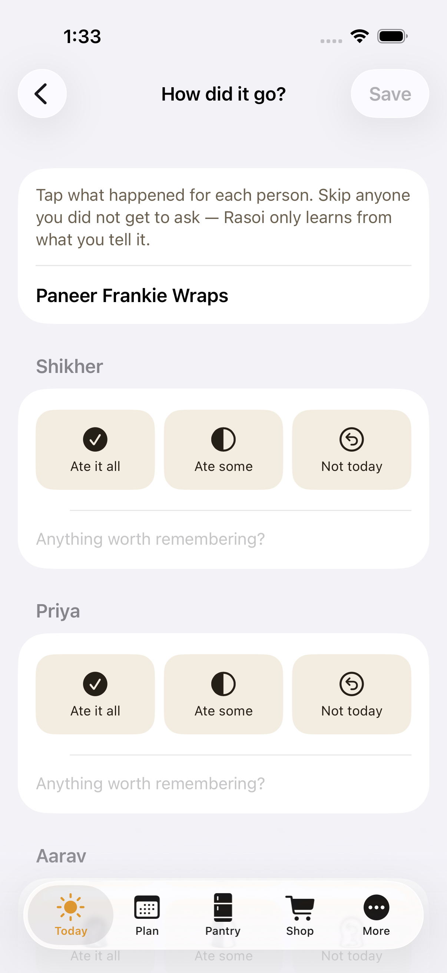
FEEDBACK
Three taps per person, and the app learns
• Ate it all · Ate some · Not today — for whoever was at the table.
• Skip anyone you didn't get to ask; silence is never counted as a refusal.
• Reactions decay: a meal refused four months ago barely counts today.
• A dish every child turns down three times running rests for a month, then comes back.
• No scores, no streaks, nothing a child could read as a mark against them.

Slide 8
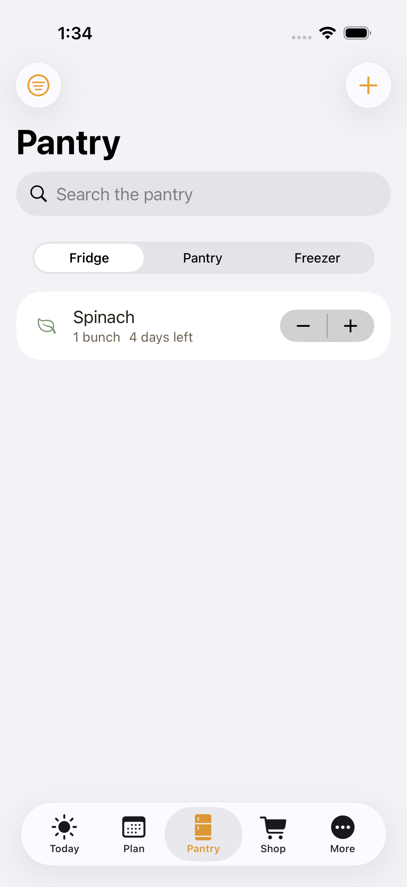
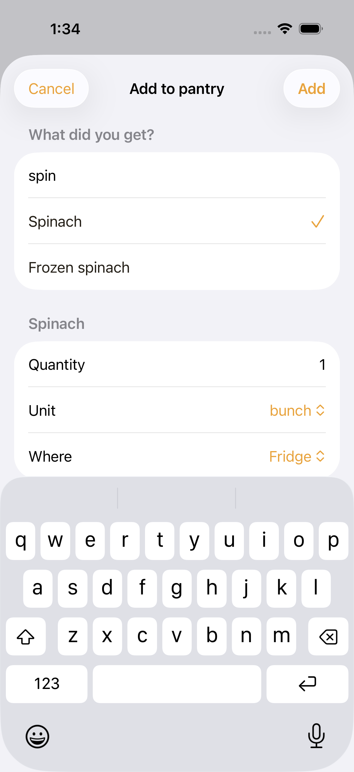
PANTRY
The kitchen, as it actually is
• Fridge, pantry and freezer — the freezer keeps things six times as long.
• Type “toor” or “palak”: 185 ingredients, searchable by alias.
• Shelf-life dates, soonest first, with plain words: “use today”, “2 days left”.
• Mark used or ran out with a swipe; weekly staples stay at zero so the list tops them up.

Slide 9
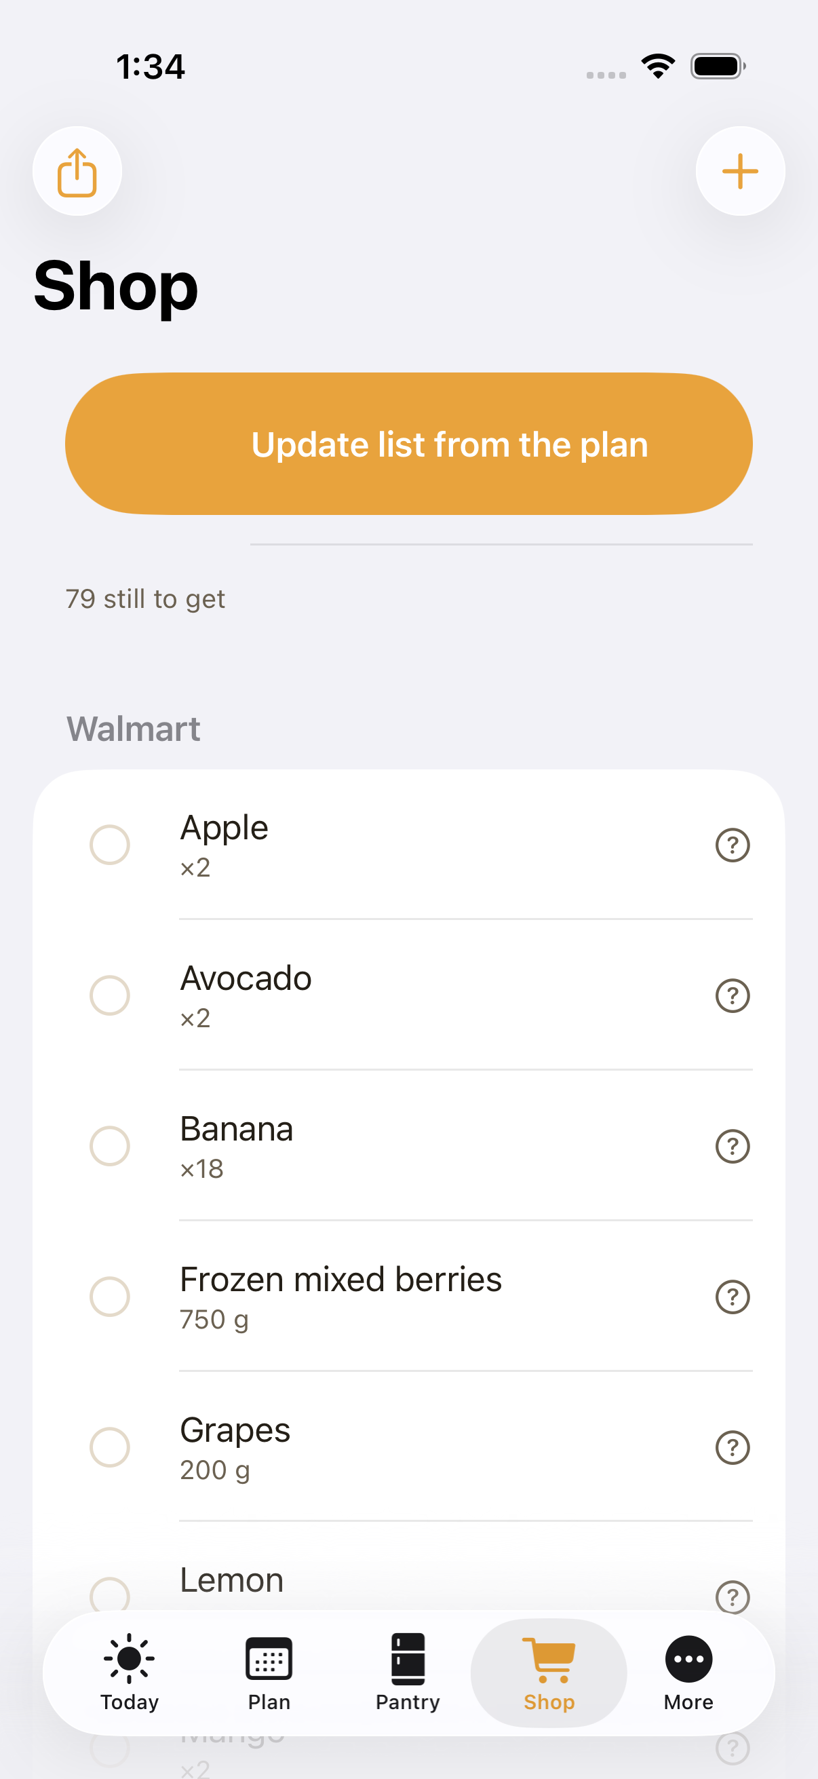
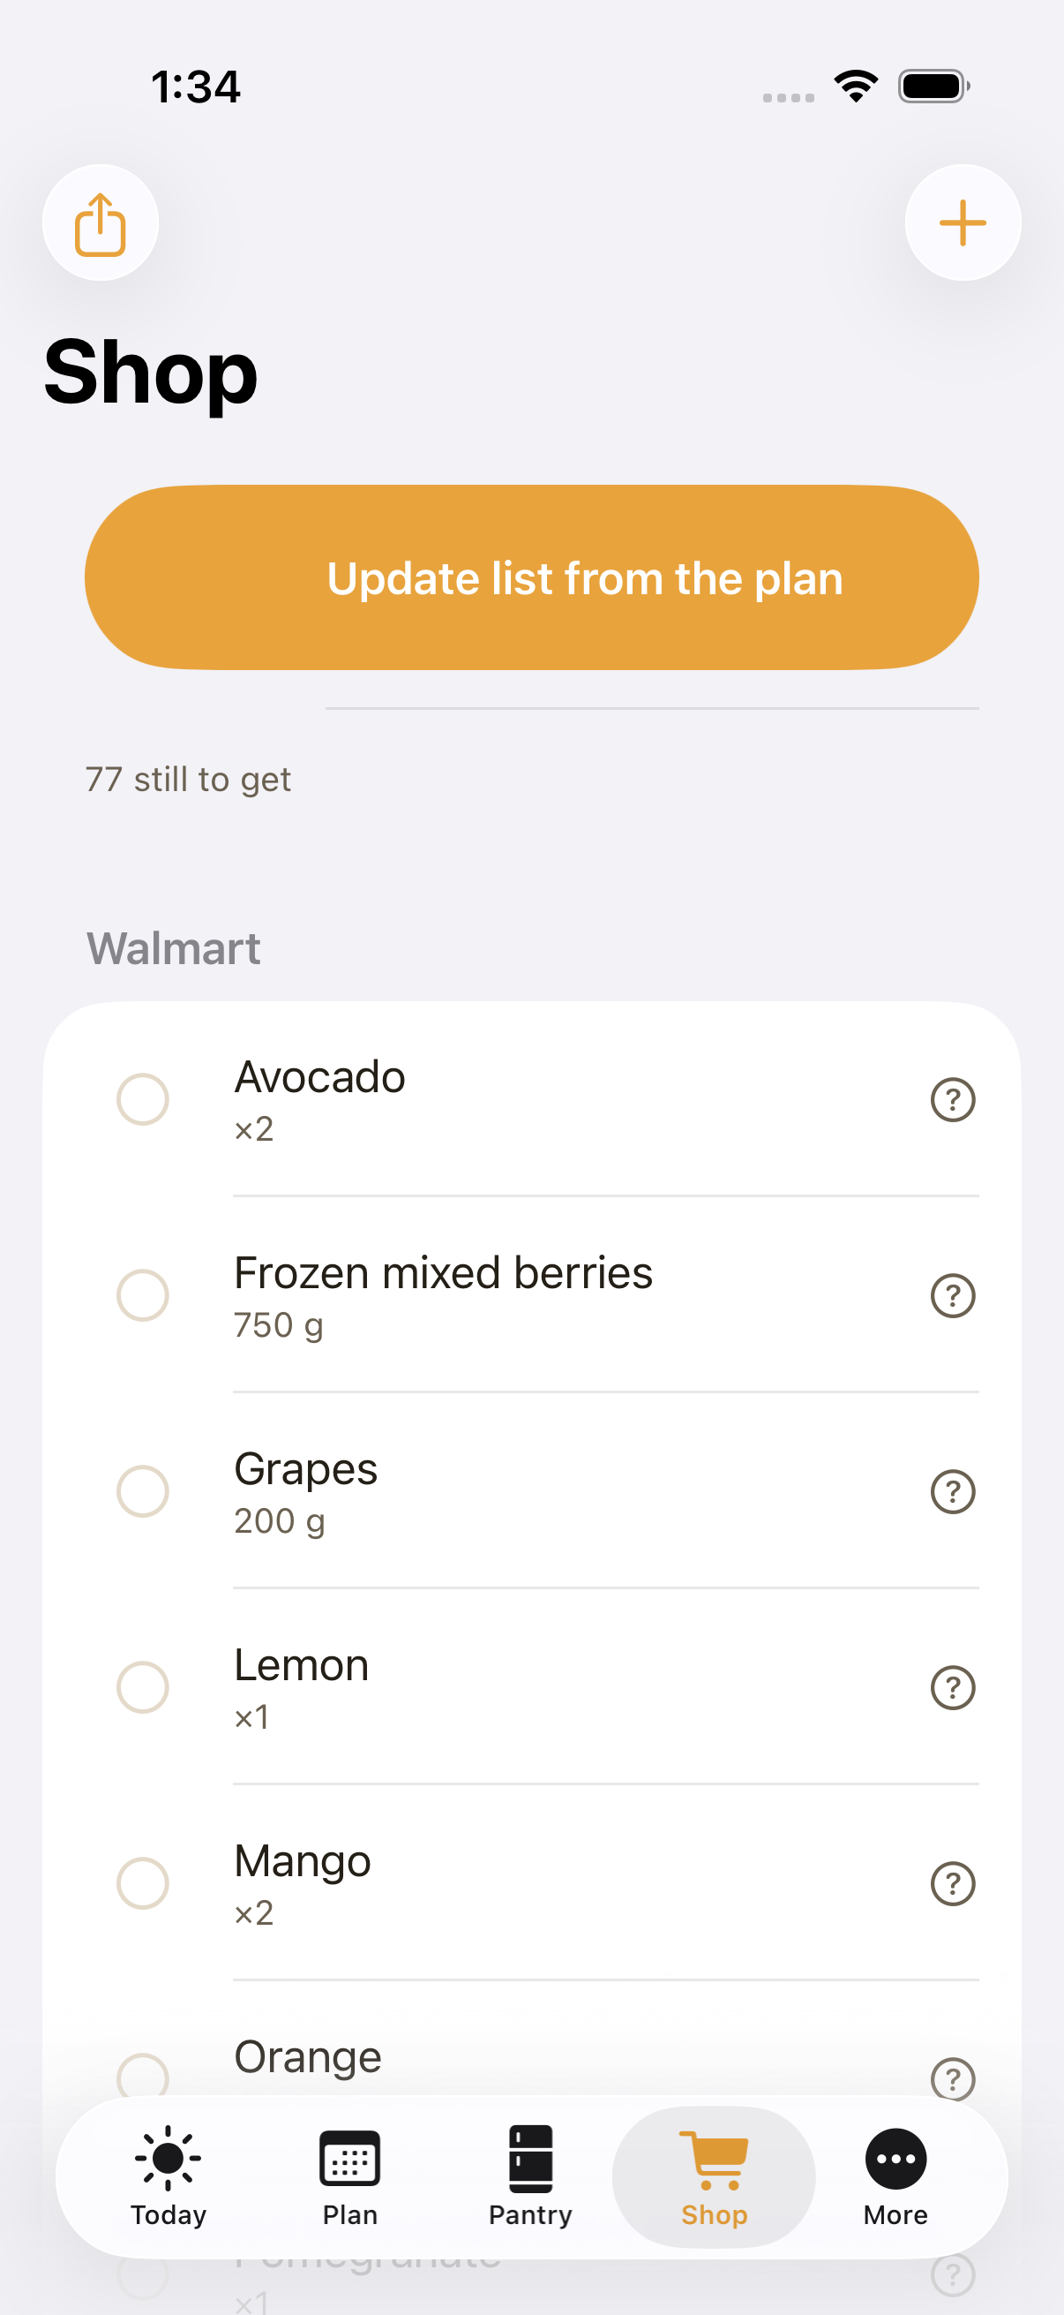
SHOP
One list, split the way you shop
• Built from the week's plan: quantities summed, units normalised, pantry subtracted.
• Grouped by store, then by aisle — dal and spices at the Indian grocery, the rest at the supermarket.
• Ticking an item puts it in the pantry with its expiry date already worked out.
• “Why?” shows which meals need it. Rebuilding never disturbs what you have already ticked.
• Share the whole list as plain text.

Slide 10
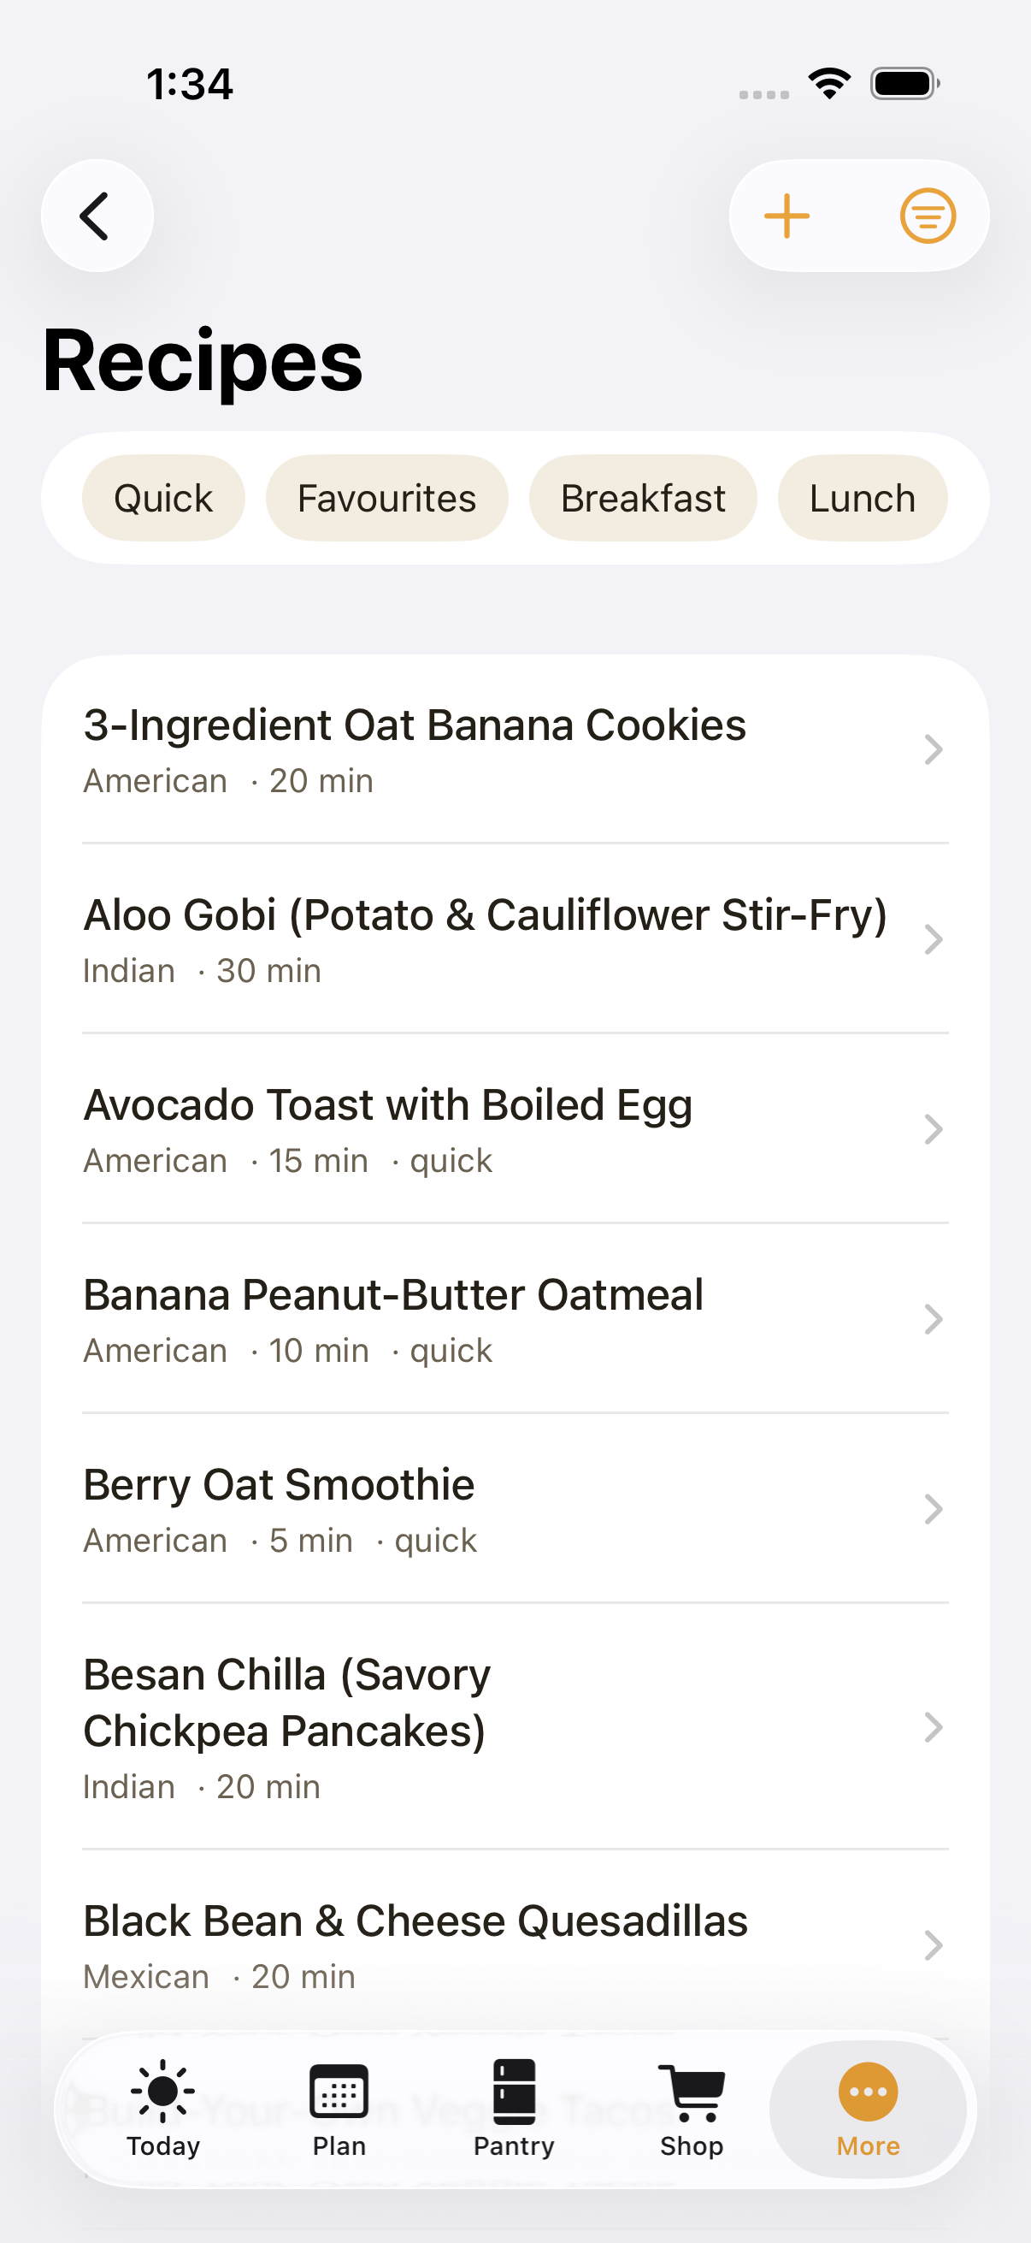
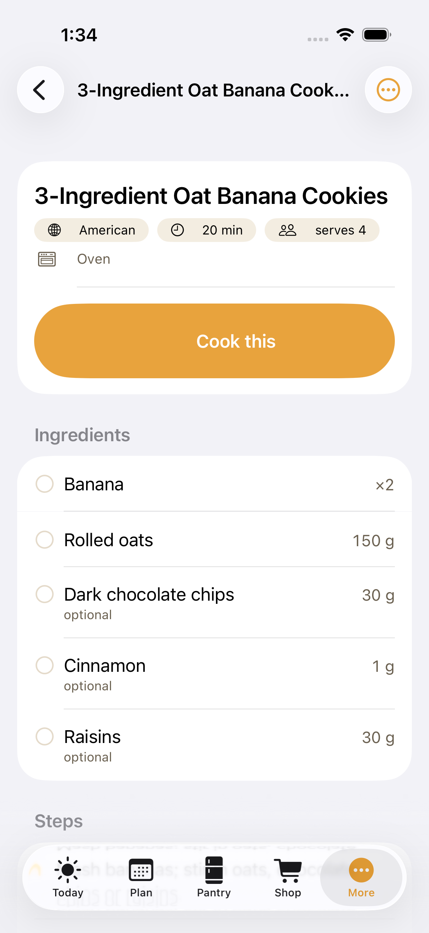
RECIPES
51 vegetarian recipes, and room for yours
• Indian, Mexican, Italian, Chinese-style, American and Mediterranean.
• Filter by meal, cuisine, appliance, quick, favourites or lunchbox.
• Every recipe carries a “make it kid-friendly” note.
• Ingredients you already have are ticked off against your pantry.
• Write your own: allergen flags are worked out from the ingredients, not typed by hand.

Slide 11
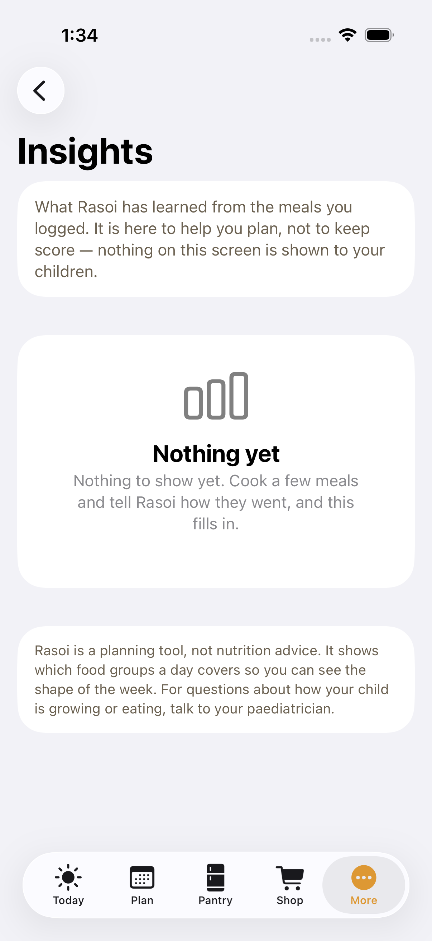
INSIGHTS
What your own table has taught it
• Per child: what goes down well, and what has not lately — counted in words, never scored.
• Most-cooked meals and how much variety the last four weeks held.
• One gentle weekly hint: “this week is light on fruit”.
• Food groups only. No calories, no weight, no diet language, anywhere in the app.

Slide 12
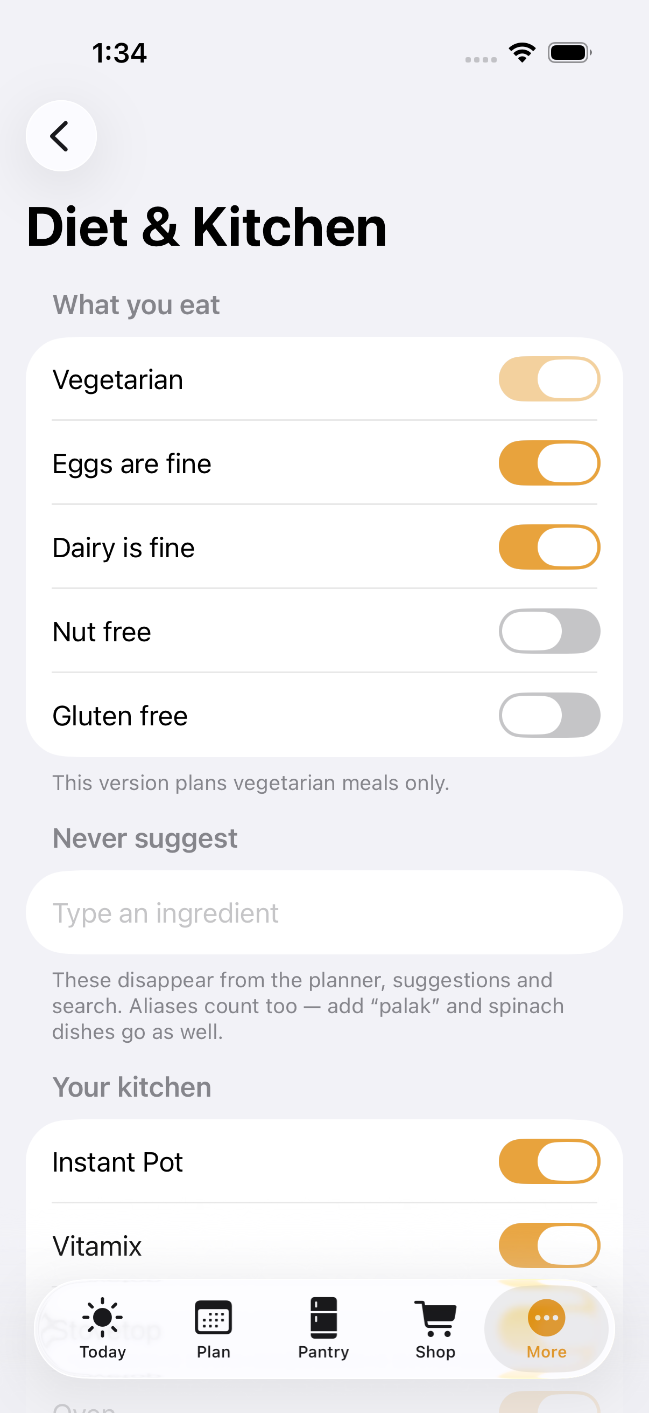
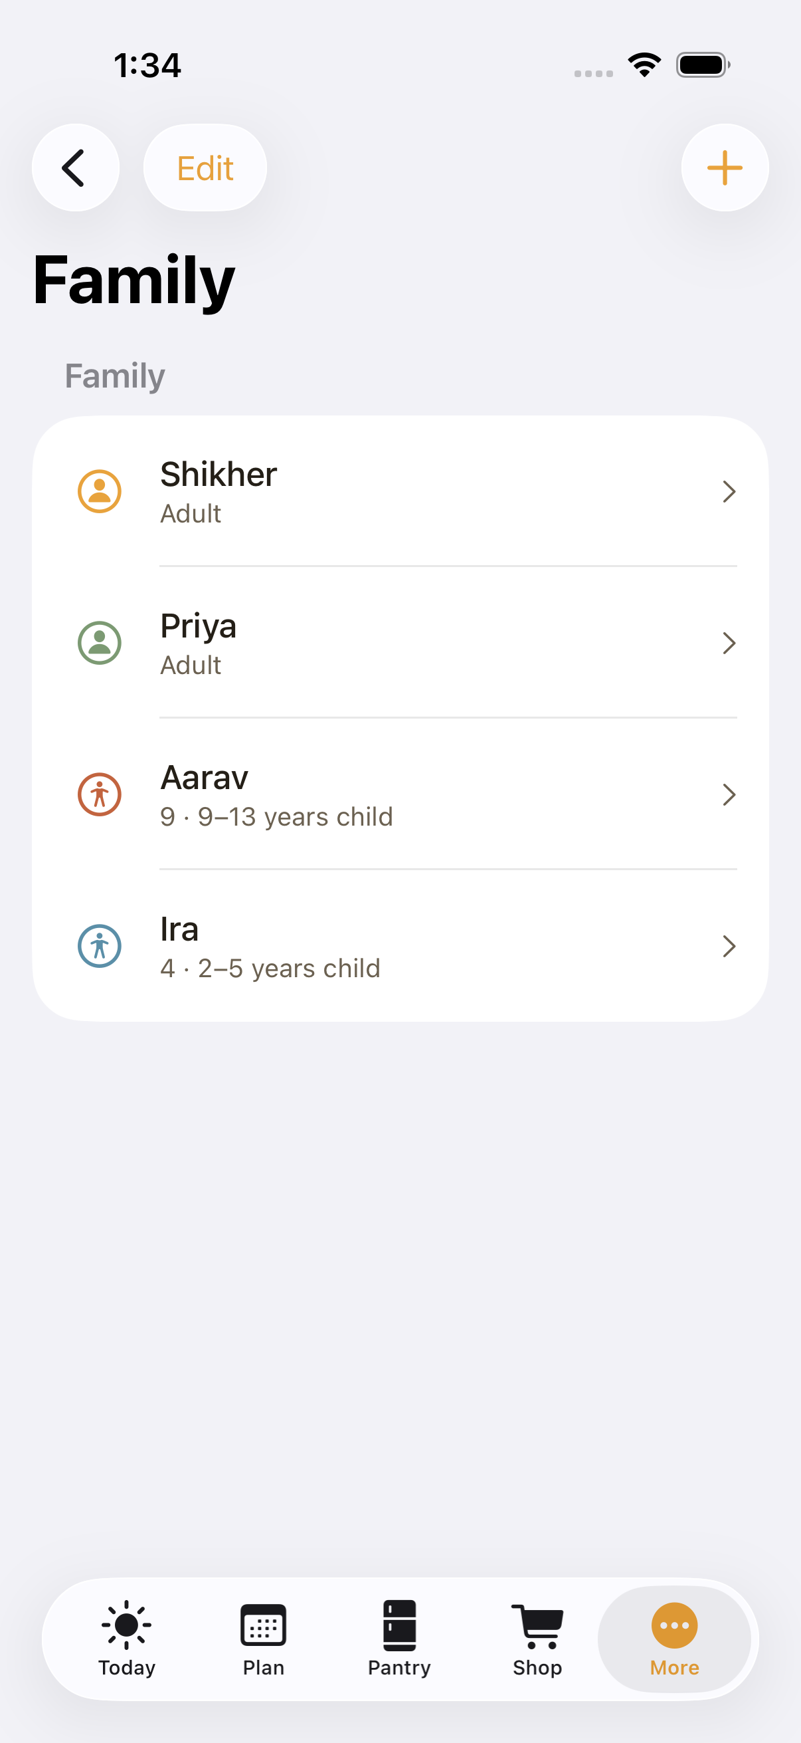
YOUR HOUSEHOLD
Set up once, in under two minutes
• Family with dates of birth — ages decide what suits everyone at the table.
• Vegetarian is fixed; eggs, dairy, nuts and gluten are yours to set.
• Never-suggest list, alias-aware: exclude “palak” and the spinach dishes go too.
• Your appliances, your cuisines, your weeknight time cap, your shopping day.

Slide 13
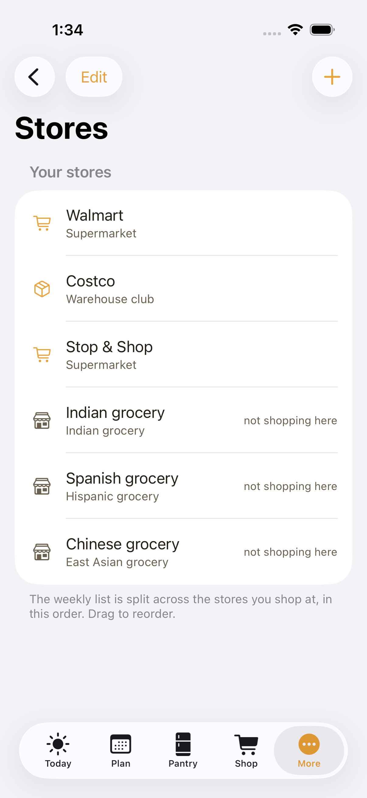
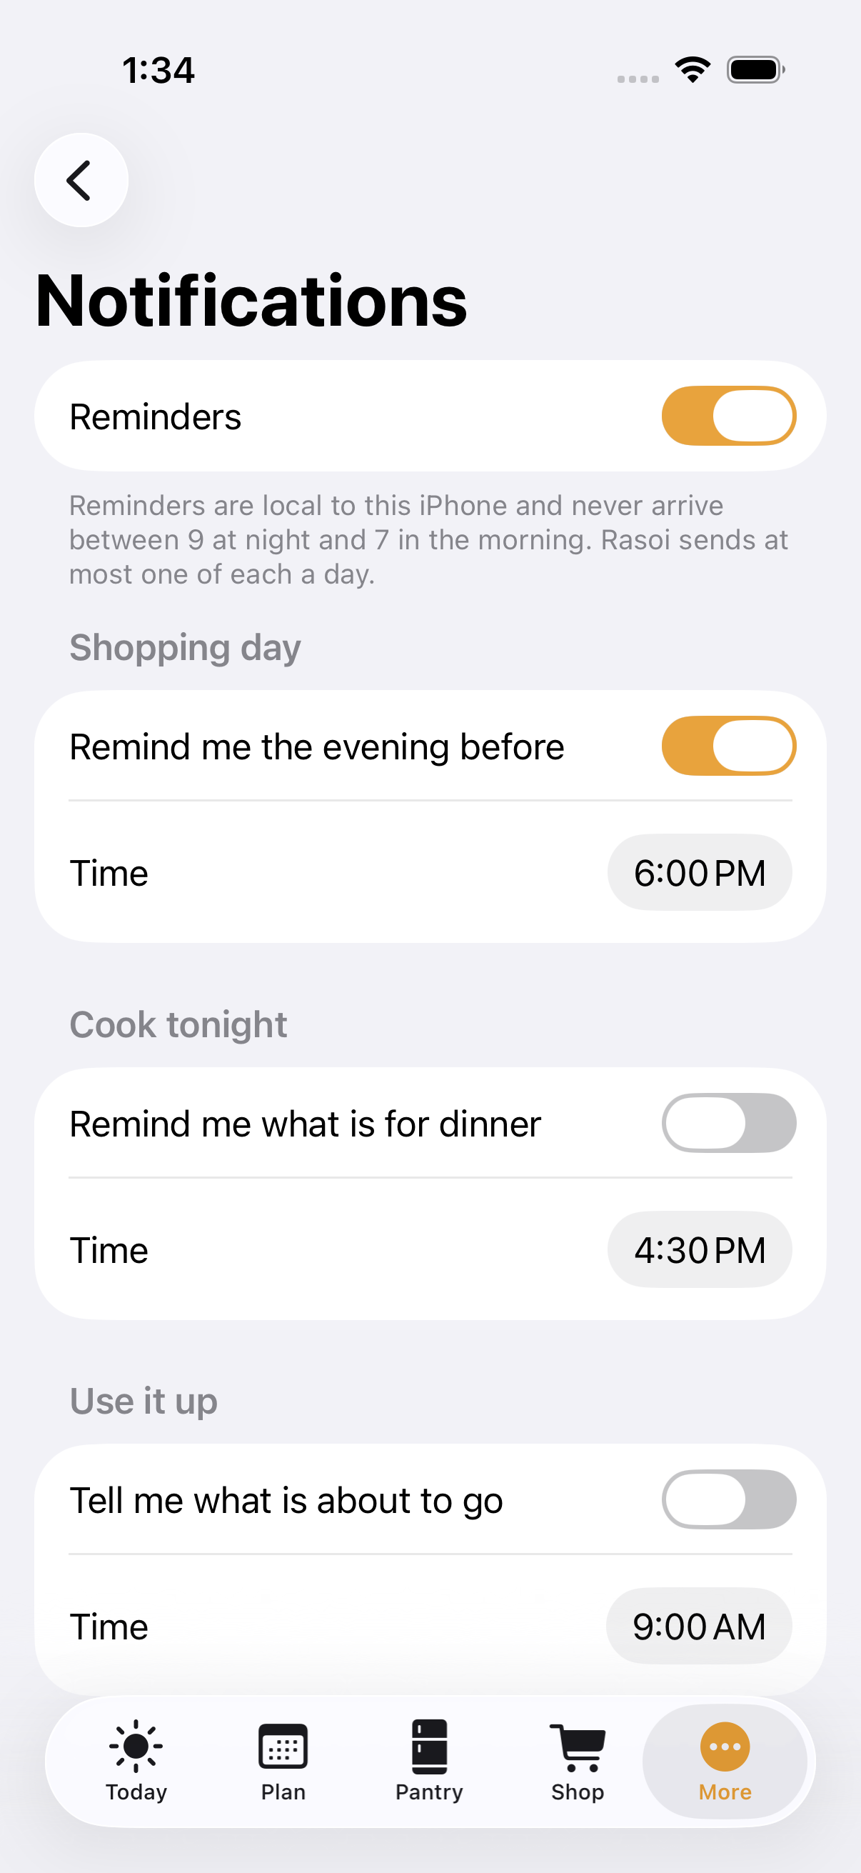
STORES & REMINDERS
Where you shop, and the three reminders
• Six stores to start with, reorderable, each claiming the aisles you use it for.
• “Find nearby” searches Apple Maps around your zip code — the only network call in the app.
• Shopping-day reminder the evening before, cook-tonight, and use-it-up.
• One of each a day at most, never between 9pm and 7am.

Slide 14
PRIVACY
Nothing about your family leaves the phone
Checked mechanically on every build, not just promised in a settings screen.
• No account, no sync, no analytics, no ads, no third-party code at all.
• The one exception: tapping “Find nearby” sends a zip code and five grocery search words to Apple Maps.
• scripts/privacy-audit.sh greps the sources, the imports, the dependencies and the built binary — and fails the build on a single hit.
• Export gives you a JSON copy of everything; “Delete all data” really deletes it.

Slide 15
UNDER THE HOOD
Small, deterministic, and covered by tests
SwiftUI + SwiftData, iOS 26, one target, zero dependencies.
• Views → view models → pure Swift engines: planner, kid scores, grocery builder, nutrition, units, shelf life.
• 51 recipes and 185 ingredients ship as JSON data, imported idempotently — data bugs are fixed in data.
• 385 tests, including one per planner rule, and a plan generated from the real catalog in 0.17s.
• 22 screens captured and reviewed — five real bugs were found by looking at them, not by the tests.

Slide 16
Built, tested, and quiet about it.
62 automated build tasks · 385 tests green · 22 screens reviewed · zero third-party code · zero analytics
Next: install on the iPhone with a free Apple team, then two weeks of real cooking before Phase 2 (photo scan, AI suggestions, family sync).

