Slide 1
Intel Xeon Processor Analysis
Output & Graphs

Slide 2
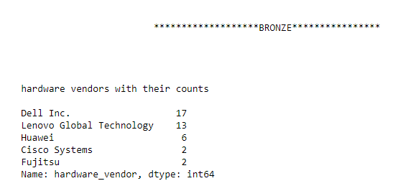
BRONZE
HARDWARE VENDOR WITH THEIR COUNTS

Slide 3
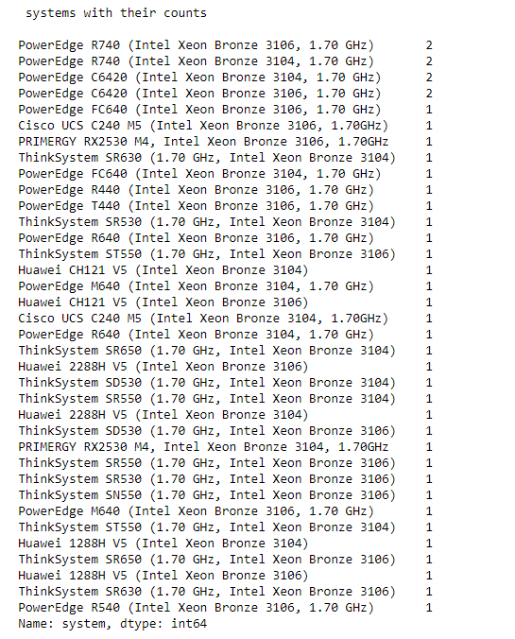
PROCESSOR SYSTEM WITH THEIR COUNTS

Slide 4
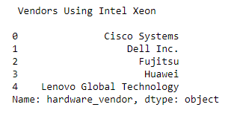
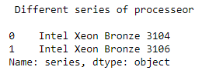
HARDWARE VENDOR USING INTEL XEON BRONZE
DIFFERENT BRONZE SERIES OF PROCESSORS

Slide 5
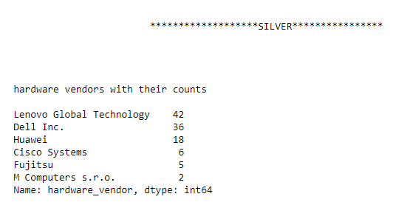
SILVER
HARDWARE VENDOR WITH THEIR COUNTS

Slide 6
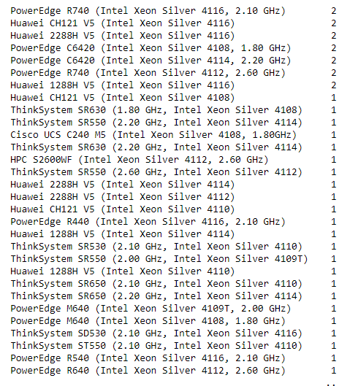
PROCESSOR SYSTEM WITH THEIR COUNTS

Slide 7
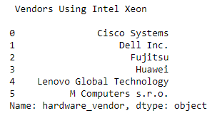
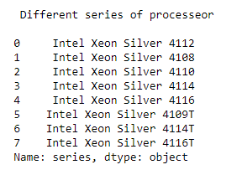
HARDWARE VENDOR USING INTEL XEON SILVER
DIFFERENT SILVER SERIES OF PROCESSORS

Slide 8
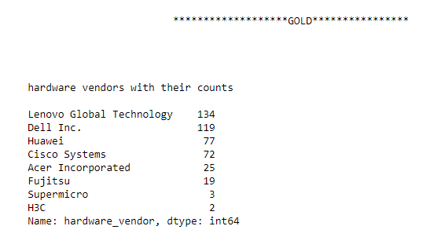
GOLD
HARDWARE VENDOR WITH THEIR COUNTS

Slide 9
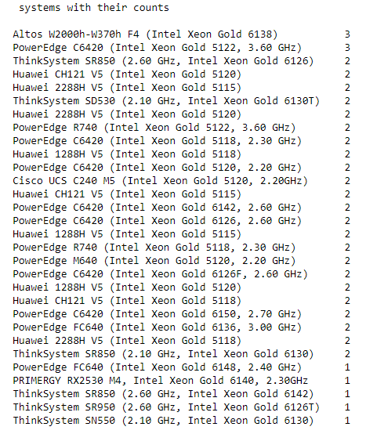
PROCESSOR SYSTEM WITH THEIR COUNTS

Slide 10
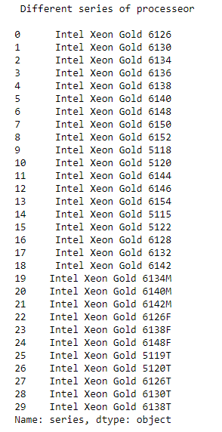
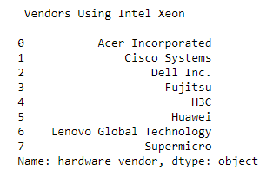
DIFFERENT GOLD SERIES OF PROCESSORS
HARDWARE VENDOR USING INTEL XEON GOLD

Slide 11
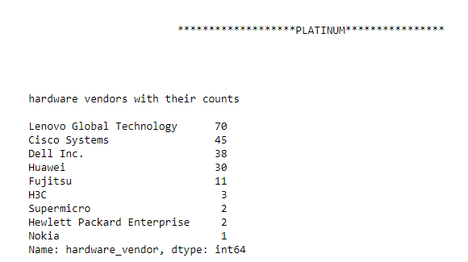
PLATINUM
HARDWARE VENDOR WITH THEIR COUNTS

Slide 12
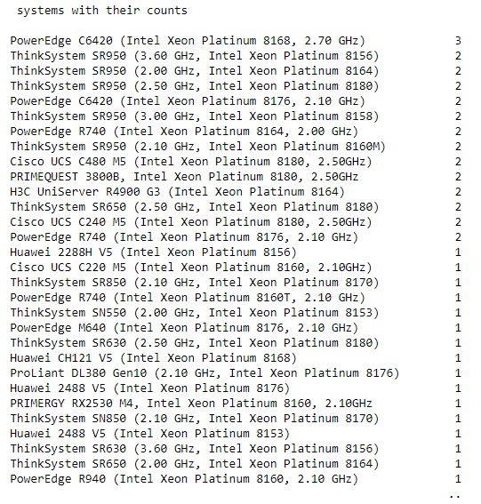
PROCESSOR SYSTEM WITH THEIR COUNTS

Slide 13
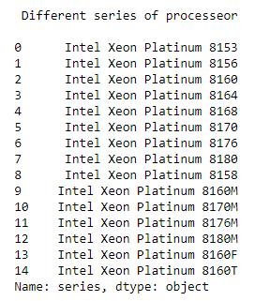
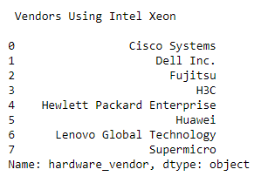
DIFFERENT PALTINUM SERIES OF PROCESSORS
HARDWARE VENDOR USING INTEL XEON PLATINUM

Slide 14
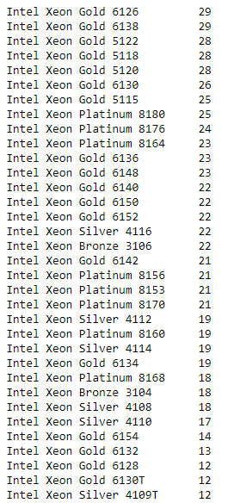
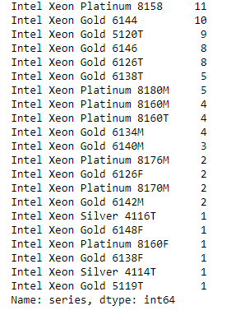
PROCESSOR SERIES WITH THEIR COUNTS AMONG ALL BRONZE, SILVER, GOLD & PLATINUM

Slide 15
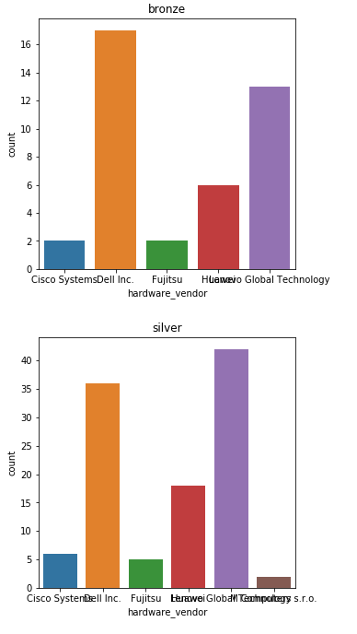
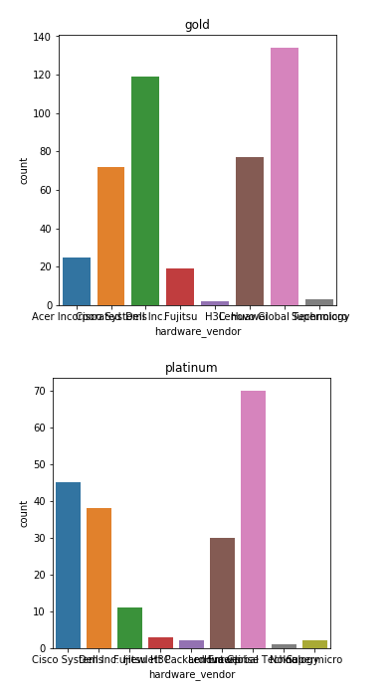
HARDWARE VENDORS WITH THEIR COUNTS

Slide 16
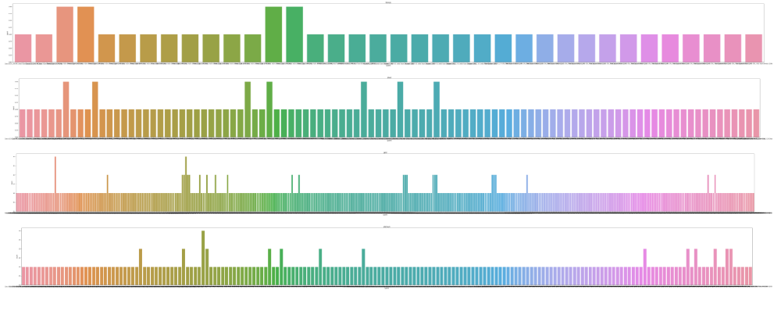
PROCESSOR SYSTEM WITH THEIR COUNTS

Slide 17
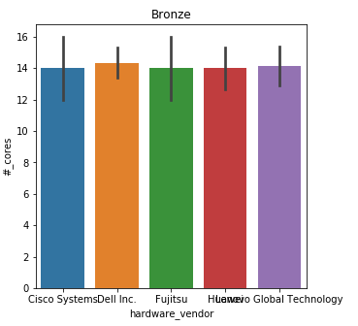
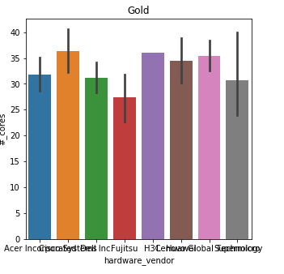
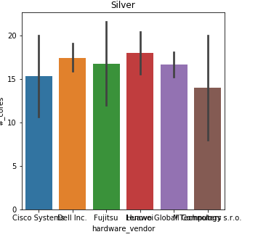
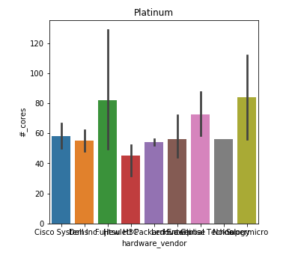
NO. OF CORES

Slide 18
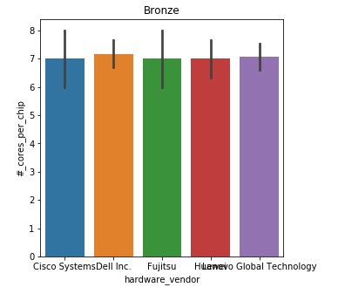
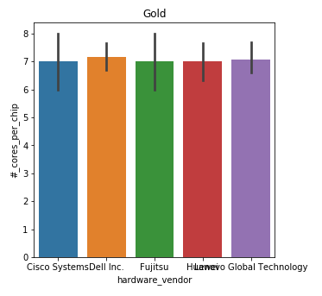
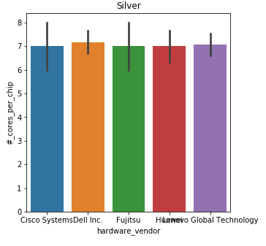
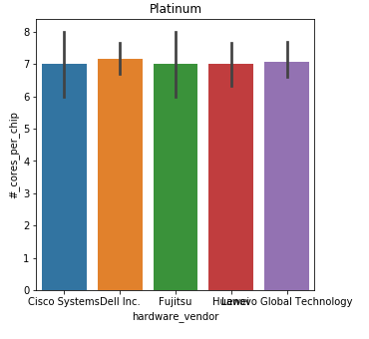
NO. OF CORES PER CHIP

Slide 19
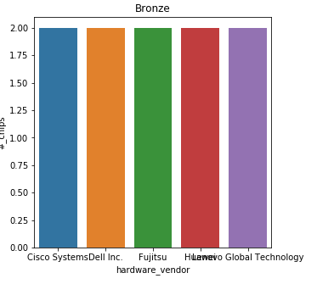
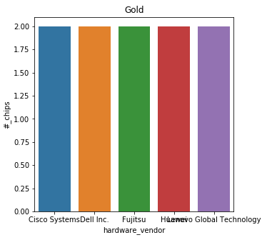
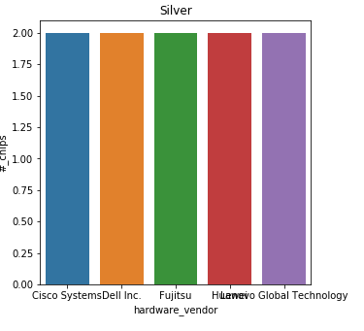
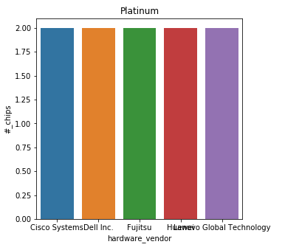
NO. OF CHIPS

Slide 20
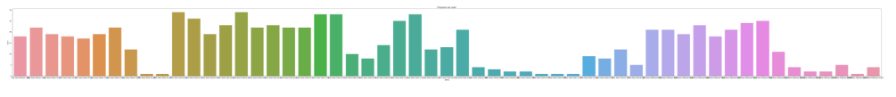
PROCESSOR SERIES WITH THEIR COUNTS AMONG ALL BRONZE, SILVER, GOLD & PLATINUM

