Slide 1
PRODUCT ANALYTICS
INTEL XEON PROCESSORS

Slide 2
PRODUCT ANALYTICS
Product analytics is a specialized application of business intelligence (BI) and analytical software that help manufacturers evaluate product defects, identify opportunities for product improvements, detect patterns in usage or capacity of products, and link all these factors to customers. Product analytics allows companies to fully understand how users engage with what they build.
Without analytics, the data they collect is often inconsistent and improperly formatted (known as unstructured data). Product analytics makes that data useful again by integrating all data sources into one single organized view.

Slide 3
Intel Xeon Processor Analysis
Output
&
Graphs

Slide 4
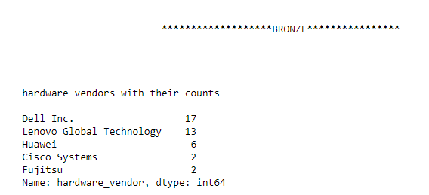
BRONZE
HARDWARE VENDOR WITH THEIR COUNTS

Slide 5
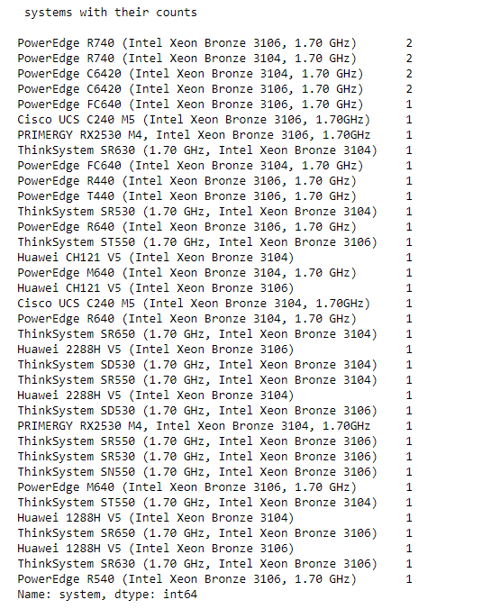
BRONZE
PROCESSOR SYSTEM WITH THEIR COUNTS

Slide 6
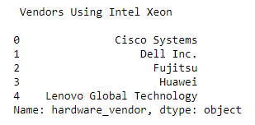
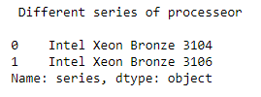
BRONZE
HARDWARE VENDOR USING INTEL XEON BRONZE
DIFFERENT BRONZE SERIES OF PROCESSORS

Slide 7
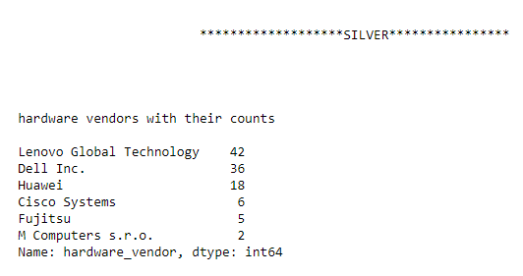
SILVER
HARDWARE VENDOR WITH THEIR COUNTS

Slide 8
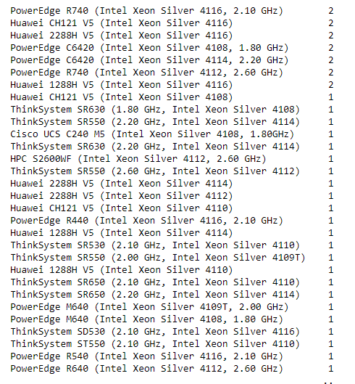
BRONZE
PROCESSOR SYSTEM WITH THEIR COUNTS

Slide 9
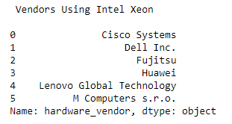
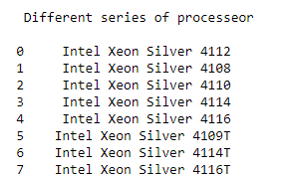
BRONZE
HARDWARE VENDOR USING INTEL XEON SILVER
DIFFERENT SILVER SERIES OF PROCESSORS

Slide 10
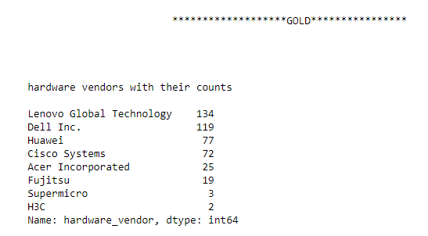
GOLD
HARDWARE VENDOR WITH THEIR COUNTS

Slide 11
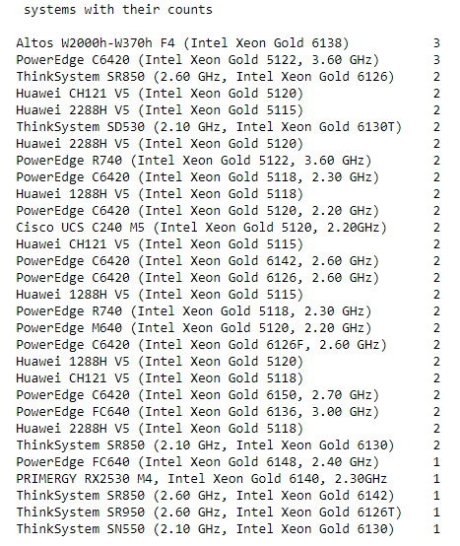
BRONZE
PROCESSOR SYSTEM WITH THEIR COUNTS

Slide 12
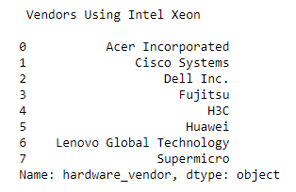
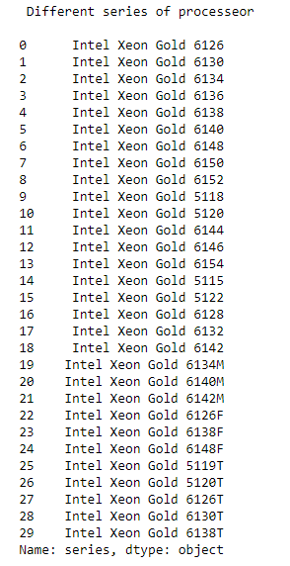
BRONZE
HARDWARE VENDOR USING INTEL XEON GOLD
DIFFERENT GOLD SERIES OF PROCESSORS

Slide 13
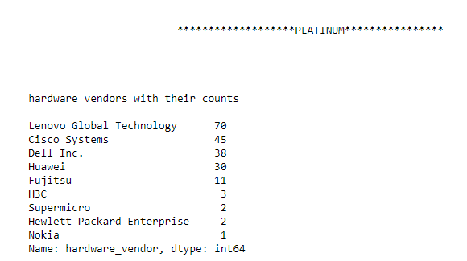
PLATINUM
HARDWARE VENDOR WITH THEIR COUNTS

Slide 14
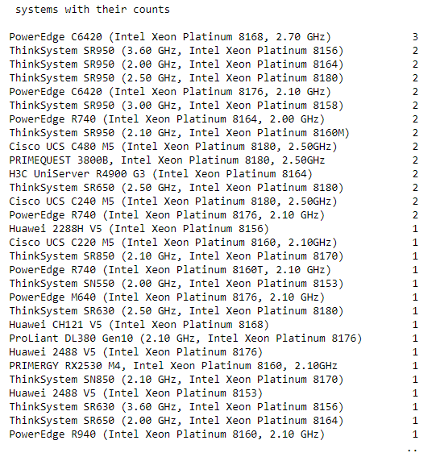
BRONZE
PROCESSOR SYSTEM WITH THEIR COUNTS

Slide 15
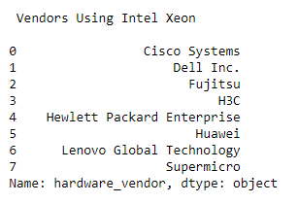
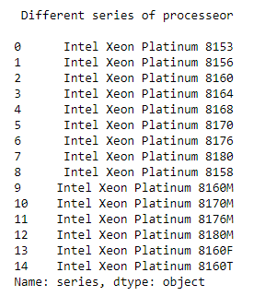
BRONZE
HARDWARE VENDOR USING INTEL XEON PLATINUM
DIFFERENT PLATINUM SERIES OF PROCESSORS

Slide 16
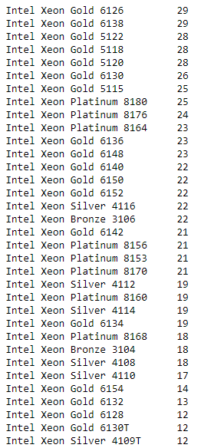
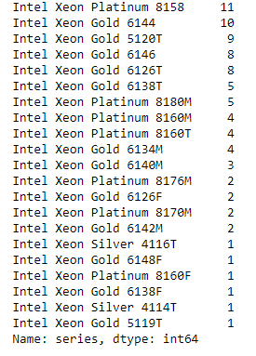
BRONZE
PROCESSOR SERIES WITH THEIR COUNTS AMONG ALL (BRONZE, SILVER, GOLD & PLATINUM)

Slide 17
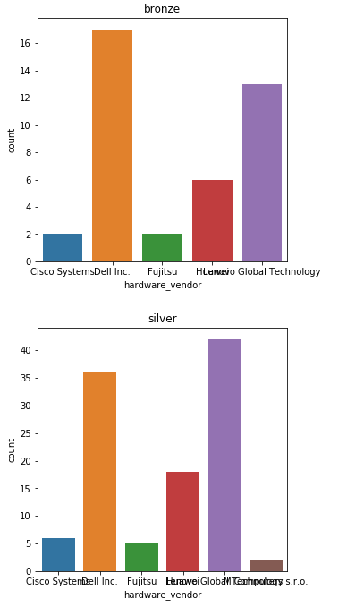
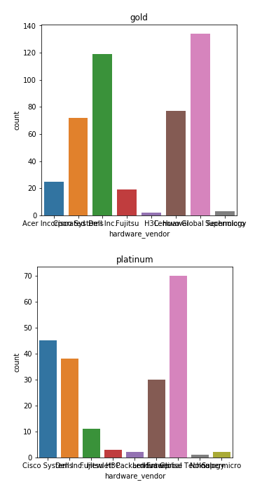
BRONZE
HARDWARE VENDORS WITH THEIR COUNTS

Slide 18
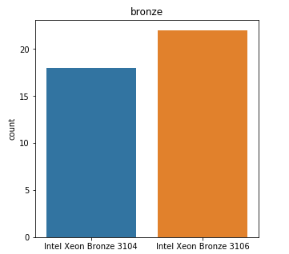
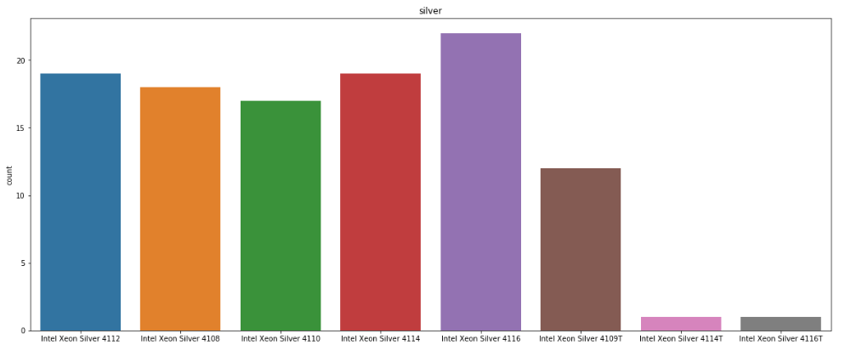
BRONZE
PROCESSOR SERIES WITH THEIR COUNTS (BRONZE & SILVER)

Slide 19
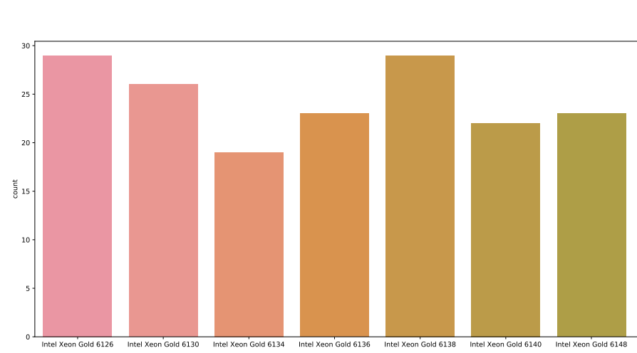
BRONZE
PROCESSOR SERIES WITH THEIR COUNTS (GOLD)

Slide 20
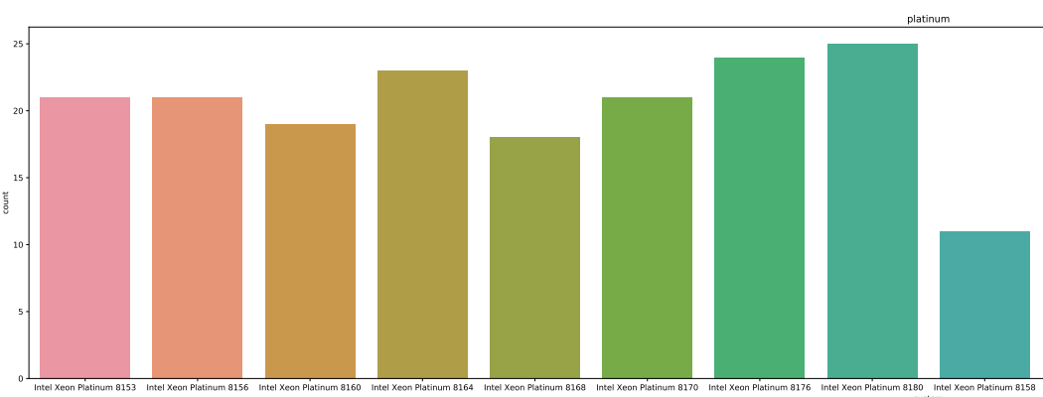
BRONZE
PROCESSOR SERIES WITH THEIR COUNTS (PLATINUM)

Slide 21
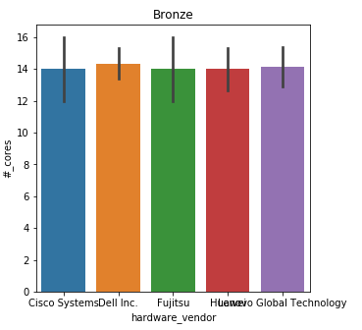
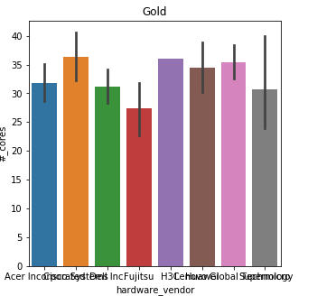
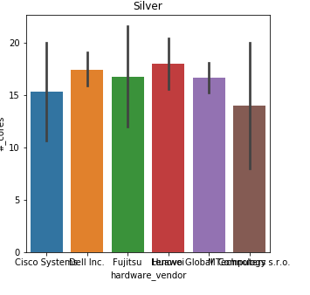
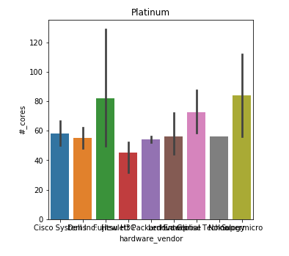
BRONZE
NO. OF CORES

Slide 22
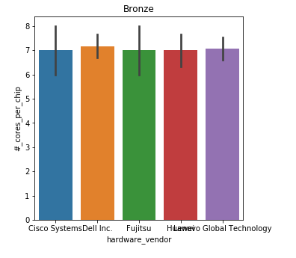
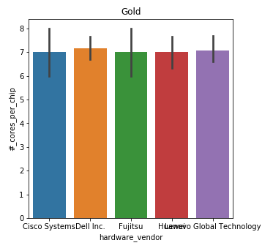
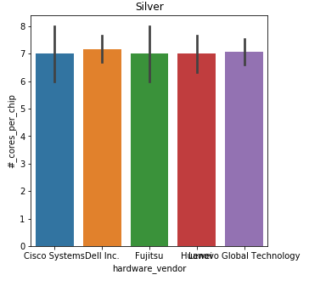
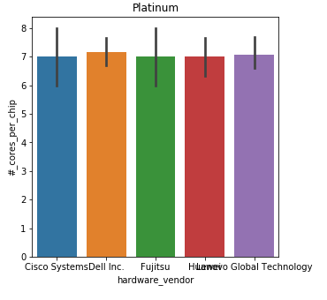
BRONZE
NO. OF CORES PER CHIP

Slide 23
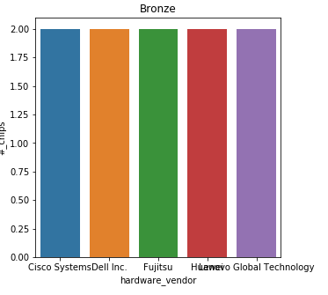
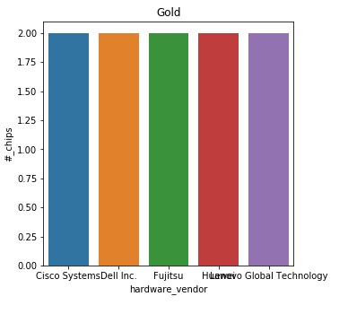
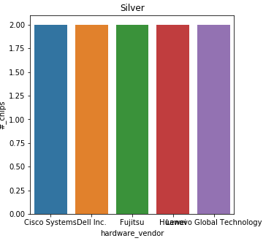
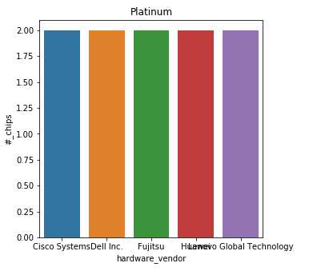
BRONZE
NO. OF CHIPS

Slide 24
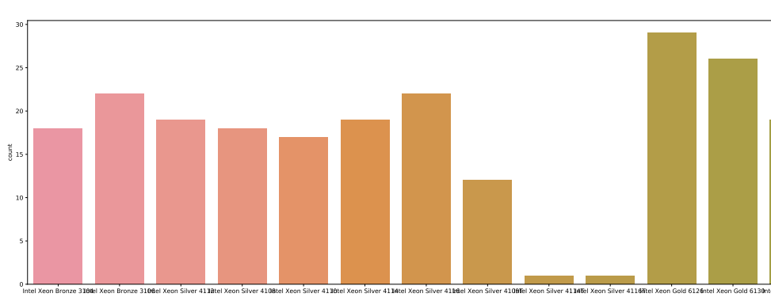
BRONZE
PROCESSOR SERIES WITH THEIR COUNTS
AMONG ALL BRONZE, SILVER, GOLD & PLATINUM

