Slide 1
PERSONAL TRACKER
AIM:
To report the current position of the owner
of the system using wifi and an online server.

Slide 2
SUBSYSTEMS:
ARDUINO
ESP8266 module
GPS module
FTDI usb to serial

Slide 3
WORK DONE
In this project we have used ESP8266 module with GPS module to get the latitude and longitude of the system using an online server as user interface.
The GPS module fetches the coordinates from the satellites. This data is transferred to the ESP module which then uploads it on an existing server. The coordinates can be accessed by any device connected to the internet by accessing that server.

Slide 4
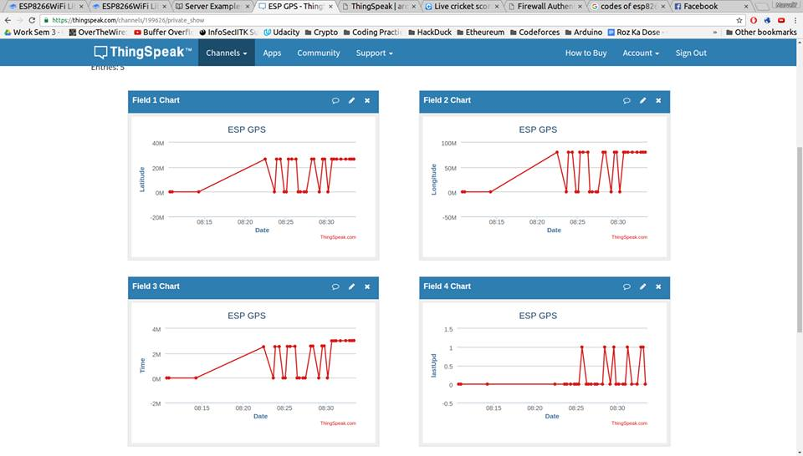
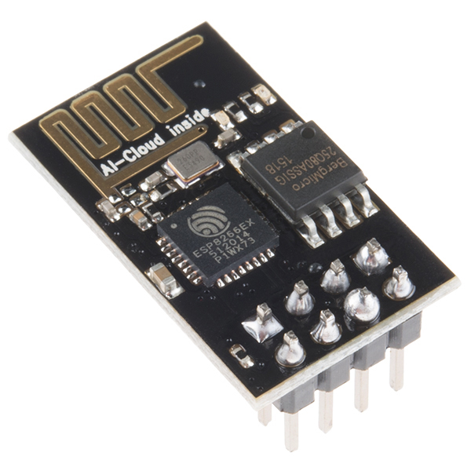
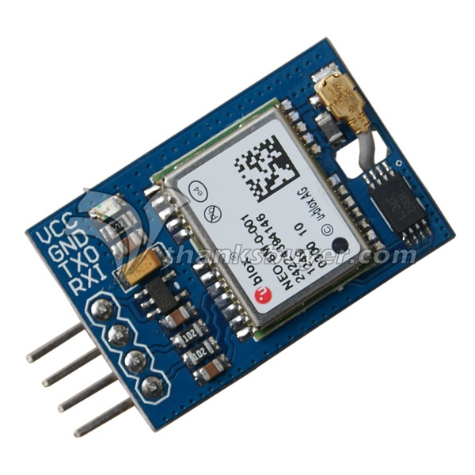
PHOTOS

Slide 5
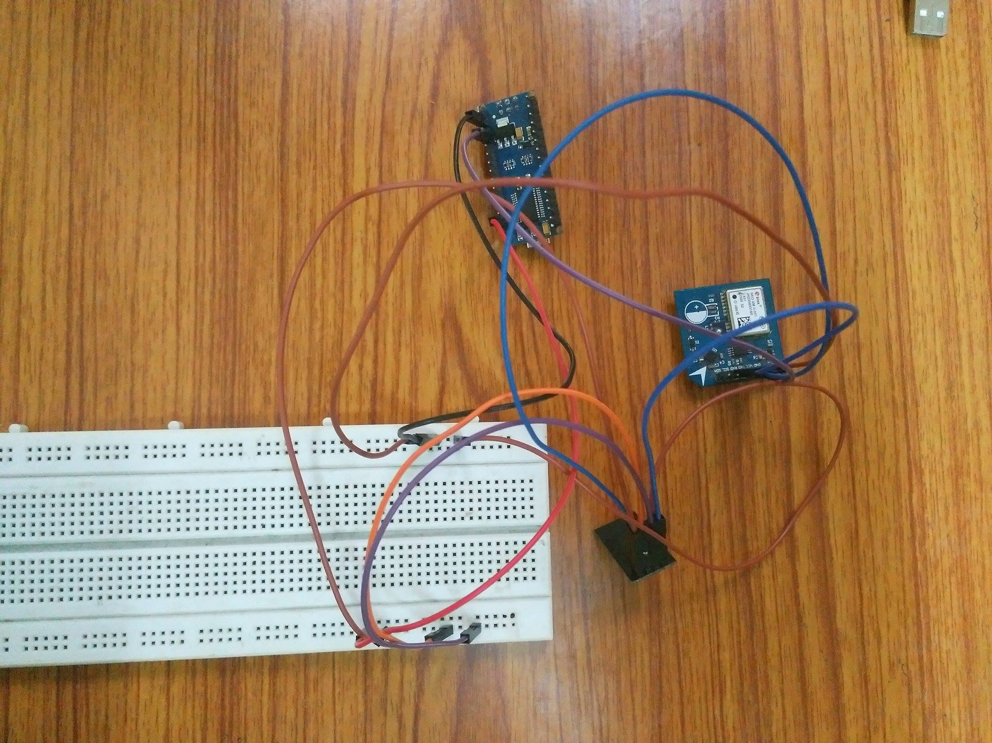
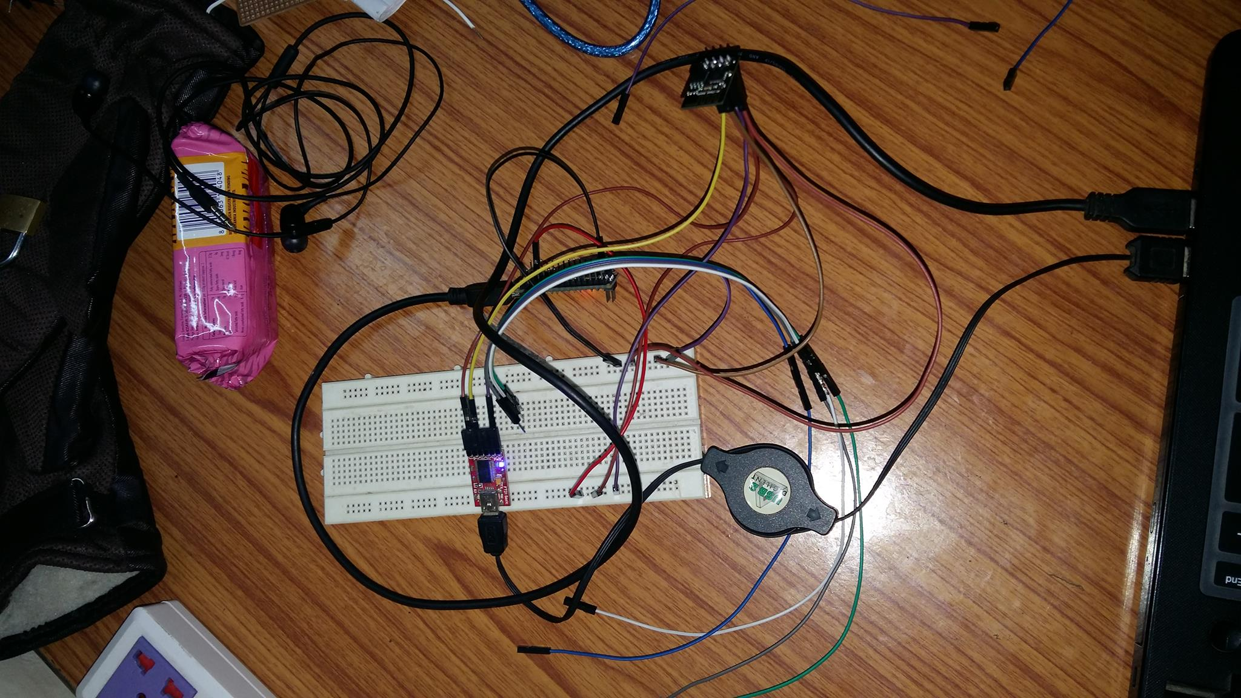

Slide 6
LIMITATIONS:
The major limitation of this system is that a person will not be able to access the server to get the coordinates if he/she is not connected to the internet. The ESP module should also be connected to a network to upload the data to the server.

