Slide 1
Programming in C
To create images using C Graphics functions

Slide 2
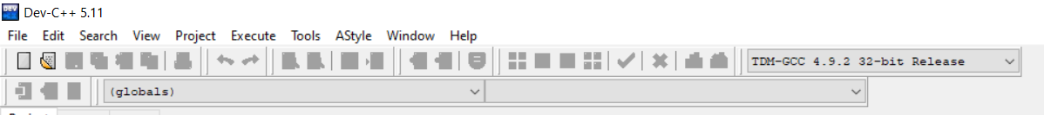
Initializing Graphics in DEV C++
In folder \Dev-Cpp\MinGW64\include copy these two files
  Graphics.h
  Winbgim.h
In folder \Dev-Cpp\MinGW64\lib copy this one file
  Libbgi.a
Open DEV C select TDM-GCC 32-bit release from the dropdown

Slide 3
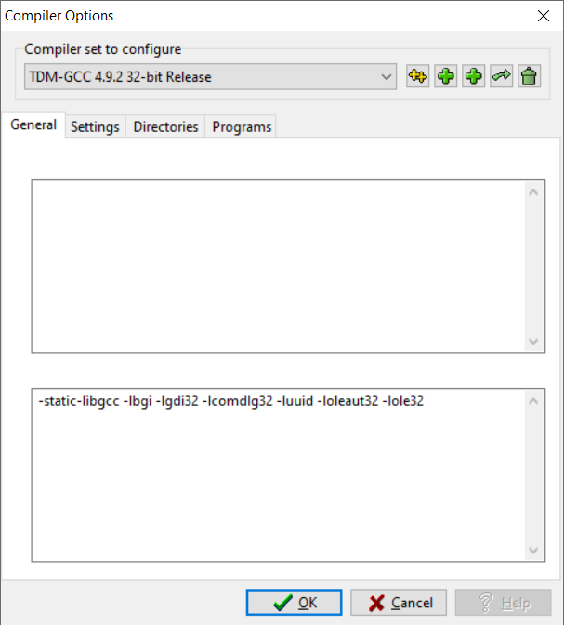
Initializing Graphics in DEV C++
4. In DEV C++ interface
  open menu Tools->Compiler Options
  add the following options in the Linker section at the bottom
-lbgi -lgdi32 -lcomdlg32 -luuid
-loleaut32 -lole32
… and press OK
Now you are ready to run your first graphics program in C

Slide 4
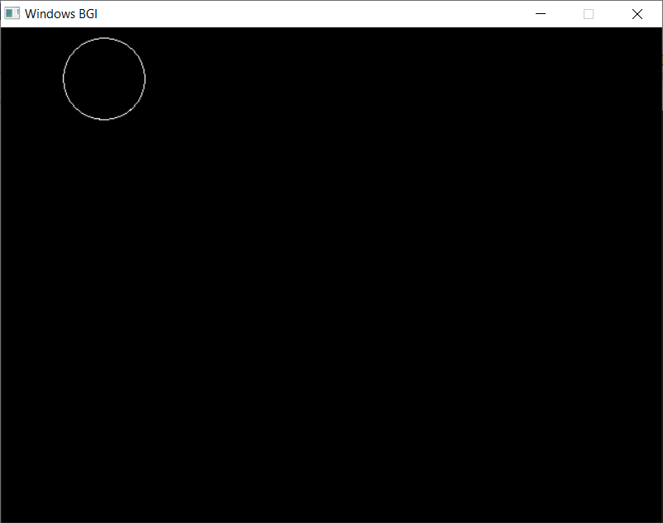
Graphics Program
#include <graphics.h>
int main( )
{
int gd=DETECT, gm;
initgraph(&gd, &gm, (char *)"");
circle(100, 50, 40);
getch();
closegraph();
return(0);
}

