Slide 1
Meeting: 14/11-2024
Management meeting

Slide 2
Election of moderator and refer

Slide 3
Summary from last meeting
Management:
We looked at other races
We set up the work evenings
We talked about finishing up loose ends
We talked about team organization – both cleaning up the teams group and where to put physical access
Generel:
We agreed on drawing in Kicad
We are going to clean up the bitbucket, and do a how to solbil
We are looking for alternative communication platform
We would make a time plan at the work evening

Slide 4
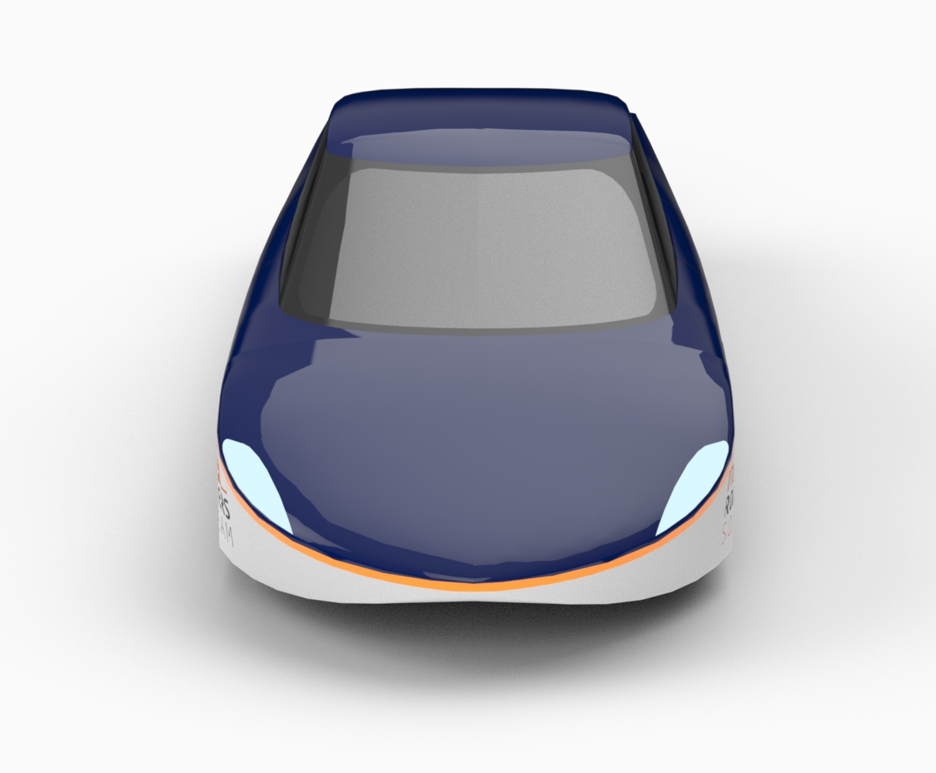
Agenda
Time plan
Work evening follow up
Team organization

Slide 5
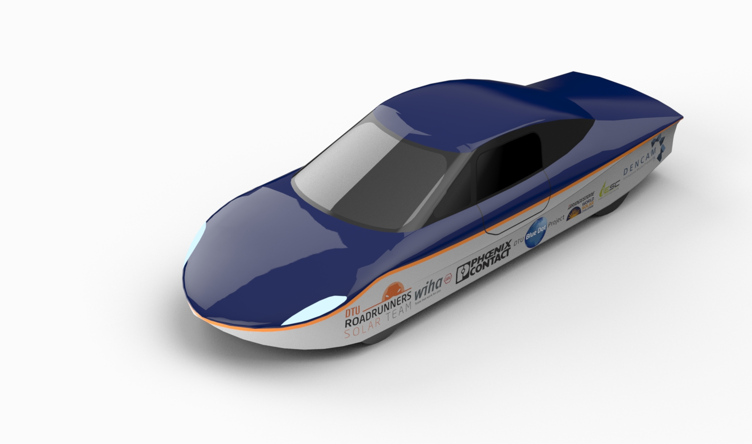
Time plan?

Slide 6
Work evening follow up
What is working?
Anything needs changing?

Slide 7
Team organization
Bitbucket
Ecocar people
How to solbil
Communication
Where to put physical projects?
Skabelon for meetings

Slide 8
Agenda points for next meeting
Next management meeting (??/12-2024):
-
Next general meeting (general 05/12-2024):
Who is the next person to do the slides?
Remember:
Agenda points should be sent to:
-mail here or on discord
At the latest 2 days before the meeting

Slide 9
Feedback
What worked?
What can be improved?
Wishes for upcoming meetings?

