Slide 1
Meeting: 05/12-2024
General meeting

Slide 2
Selection of moderator and minute-taker

Slide 3
Summary from last meeting
Management:
Louise made “How to Solbil” on Discord
Sponsor list of things we would want
Battery mysteries, what can we use, can we limit in BMS? Check with WSC
Sponsor limits (alcohol & tobacco)
Annual wheel of overview (ecocar)
Hal 8 lights to be changed, clean
Louise has contacted DTU Recycle people
General:
We agreed on drawing in KiCad
We are going to clean up the bitbucket, and do a how to solbil
Discord is our alternative communication platform
We would make an updated time plan at the work evening (yet to be done)
Notes:
We setup a discord

Slide 4
Follow-up from last meeting
Battery on break, any news?
New members from ecocar, have they been added?
Bitbucket status

Slide 5
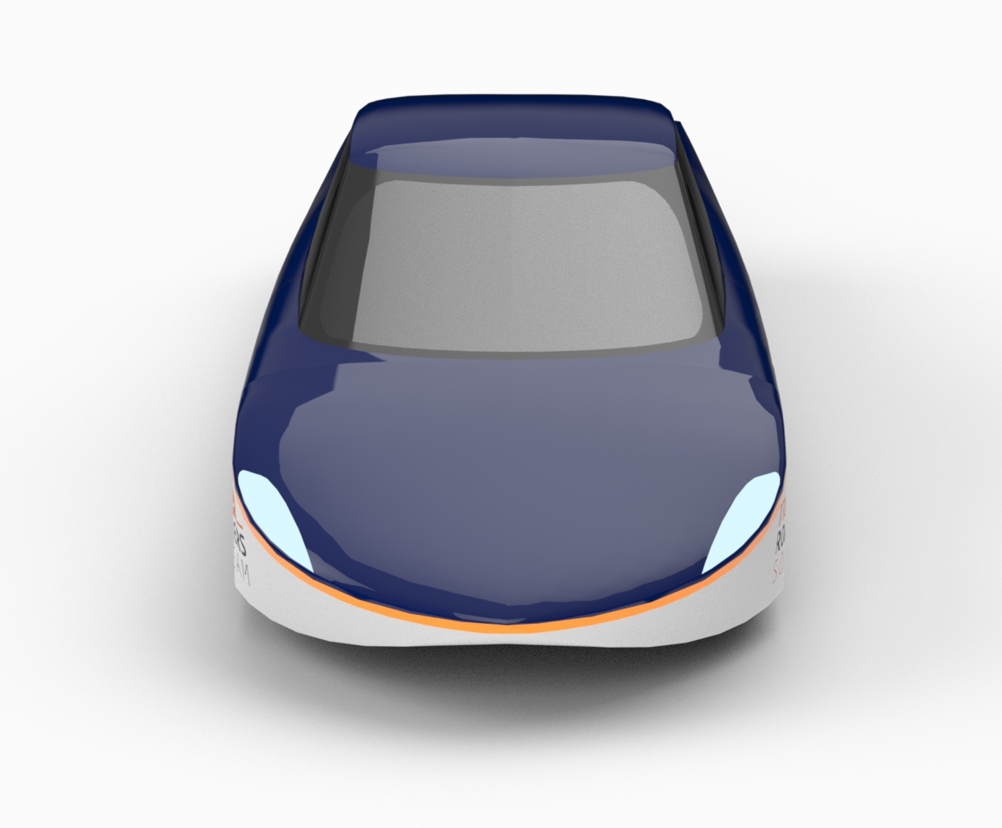
Agenda
Overview of projects
Project status

Slide 6
Overview of current projects (mech)
Project | Start | End | Members
Shell | Stand by |  | Victor & Nikolaj
Suspension | October 2023 |  | Victor
Steering | December 2023 |  | Asger & Rasmus
Cooling system | September 2023 |  | Anders
Motor test | February 2024 |  | Anders
Digital sidemirror shell | January 2024 |  | Anders
Cabine cooling | February 2024 |  | Adam V., Jonathan L. Marcus G.
Pedals | September 2024 |  | Adam V., Jonathan L. Marcus G.
PVC-pat | September 2024 |  | Mads
Seats + Seatbelts | September 2024 |  | Nanna, Alexander
Front light | September 2024 |  | Nanna, Alexander
Rear lights | September 2024 |  | Adam V., Jonathan L. Marcus G.

Slide 7
Overview of current projects (Electro)
Project | Start | End | Members
CAN Bus | February | June | Lauge. H, Aleksander H., Markus K. Sebastian B.
Battery | February | June | Emil G., Victor S.
Rear lights | February | June | Hatem A., Søren R.
Front lights | February | June | Georg B., Alexander W., Frederik Ø.
Digital side mirrors | February | Maj | Sebastian
Telemetry | February | ? | Philip Bonke, Phillip Taastrup

Slide 8
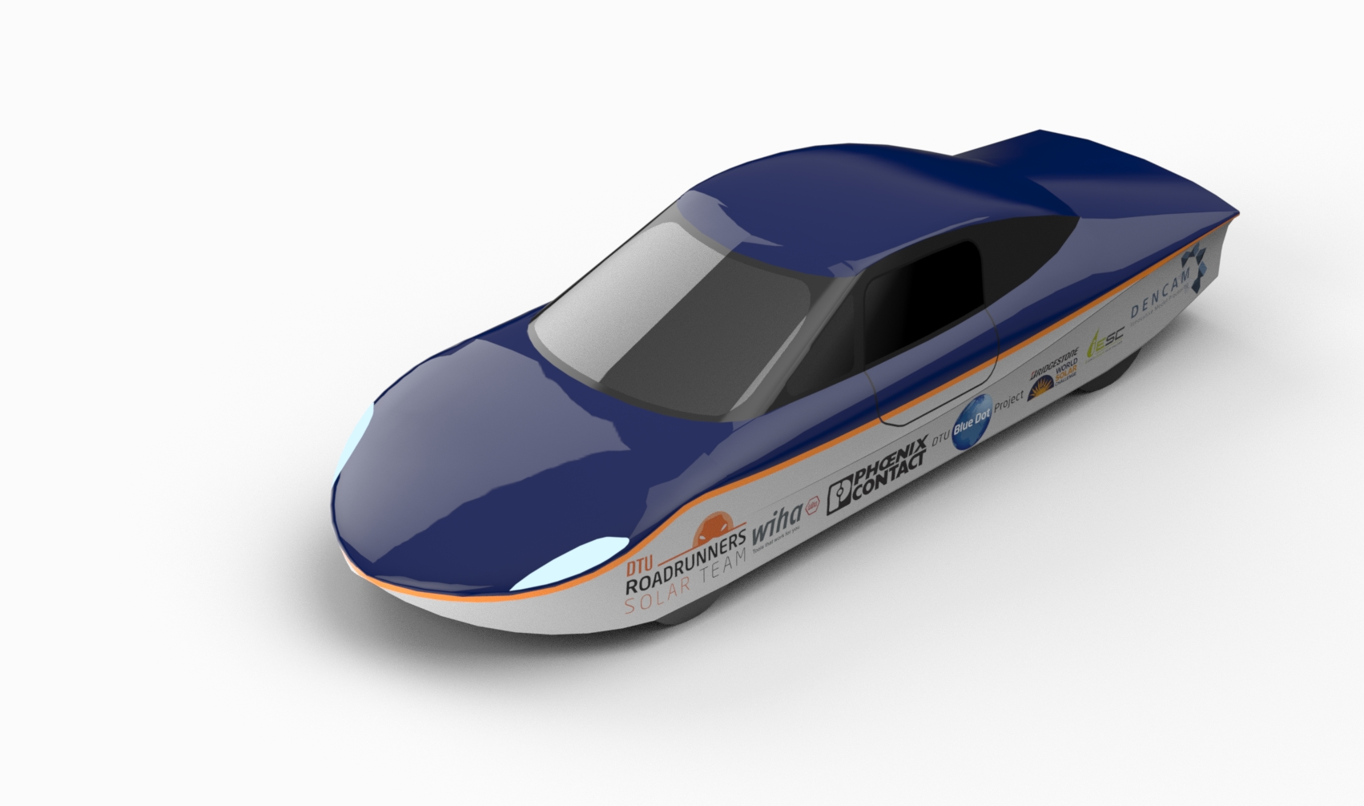
Project Status
Any new members?
Winter projects?
Limitations?
General questions

Slide 9
Agenda points for next meeting
Next management meeting (09/01-2025):
Next general meeting (16/01-2025):
Remember:​
Agenda points should be put in the discord channel or mailed to the responsible person at the latest 2 days before the meeting ​

Slide 10
Feedback
What worked?
What can be improved?
Wishes for upcoming meetings?

