Slide 1
Meeting: 09/04-2024
General meeting

Slide 2
Election of moderator and refer

Slide 3
Summary from last meeting
Roadrunners Open House
Project status

Slide 4
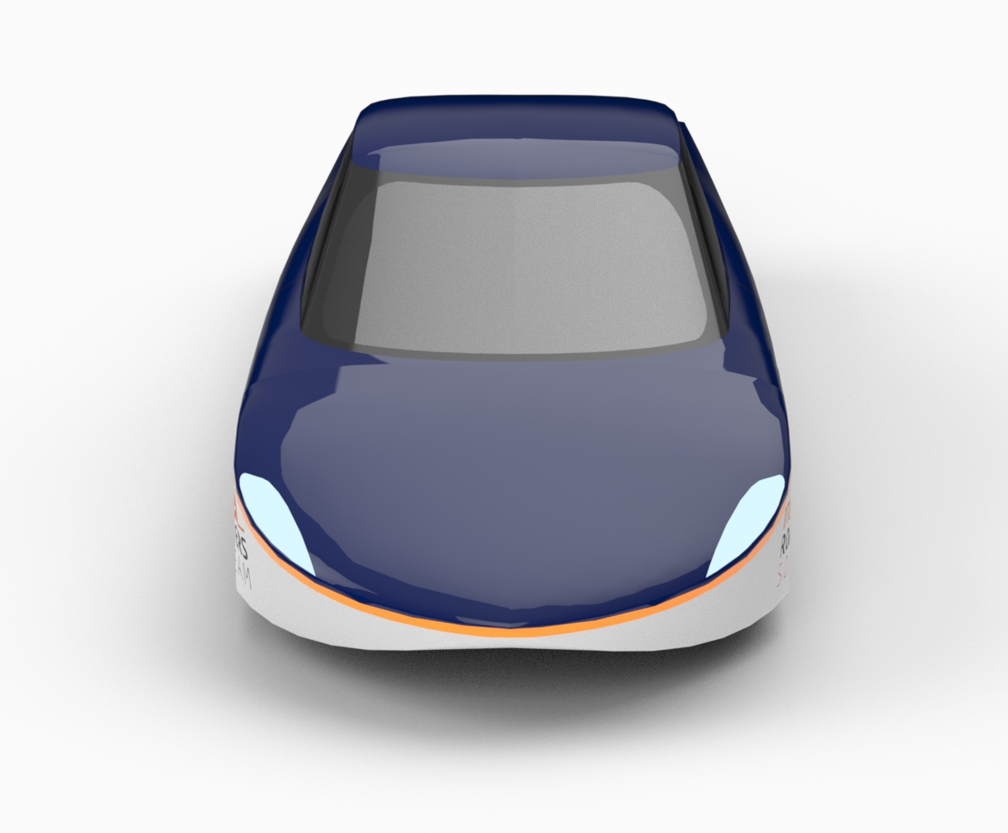
Agenda
Project status (18 min)
Open management positions (2 min)
Summer Projects (2 min)

Slide 5
Overview of current projects (mech)
Project | Start | End | Members
Shell | Stand by |  | Victor, Nikolaj, Peter, Kent & Asgar
Suspension | October 2023 | April 2024 | Victor
Steering | December 2023 | April 2024 | Asger & Rasmus
Cooling system | September 2023 | Maj 2024 | Anders
Motor test | February 2024 | Maj 2024 | Anders
Digital sidemirror shell | January 2024 | June 2024 | Anders
Mechanical sidemirror | February 2024 | June2024 | Magnus V., Jakob B., Magnus R., Carl C., Frederik S.
Head light shells | February 2024 | June 2024 | Thomas
Wheels | February 2024 | June 2024 | Thomas V., Hector B., Mikkel R., Mads. H.,
Cabine cooling | February 2024 | June 2024 | Adam V., Jonathan L.
Windscreen wipers | February 2024 | June 2024 | August T.
Brake system | November 2023 | December 2023 | Alexander og Co.

Slide 6
Overview of current projects (Electro)
Project | Start | End | Members
CAN Bus | February | June | Lauge. H, Aleksander H., Markus K. Sebastian B.
Battery | February | June | Emil G., Victor S.
Rear lights | February | June | Hatem A., Søren R.
Front lights | February | June | Georg B., Alexander W., Frederik Ø.
Digital side mirrors | February | Maj | Sebastian
Telemetry | February | ? | Philip Bonke, Phillip Taastrup

Slide 7
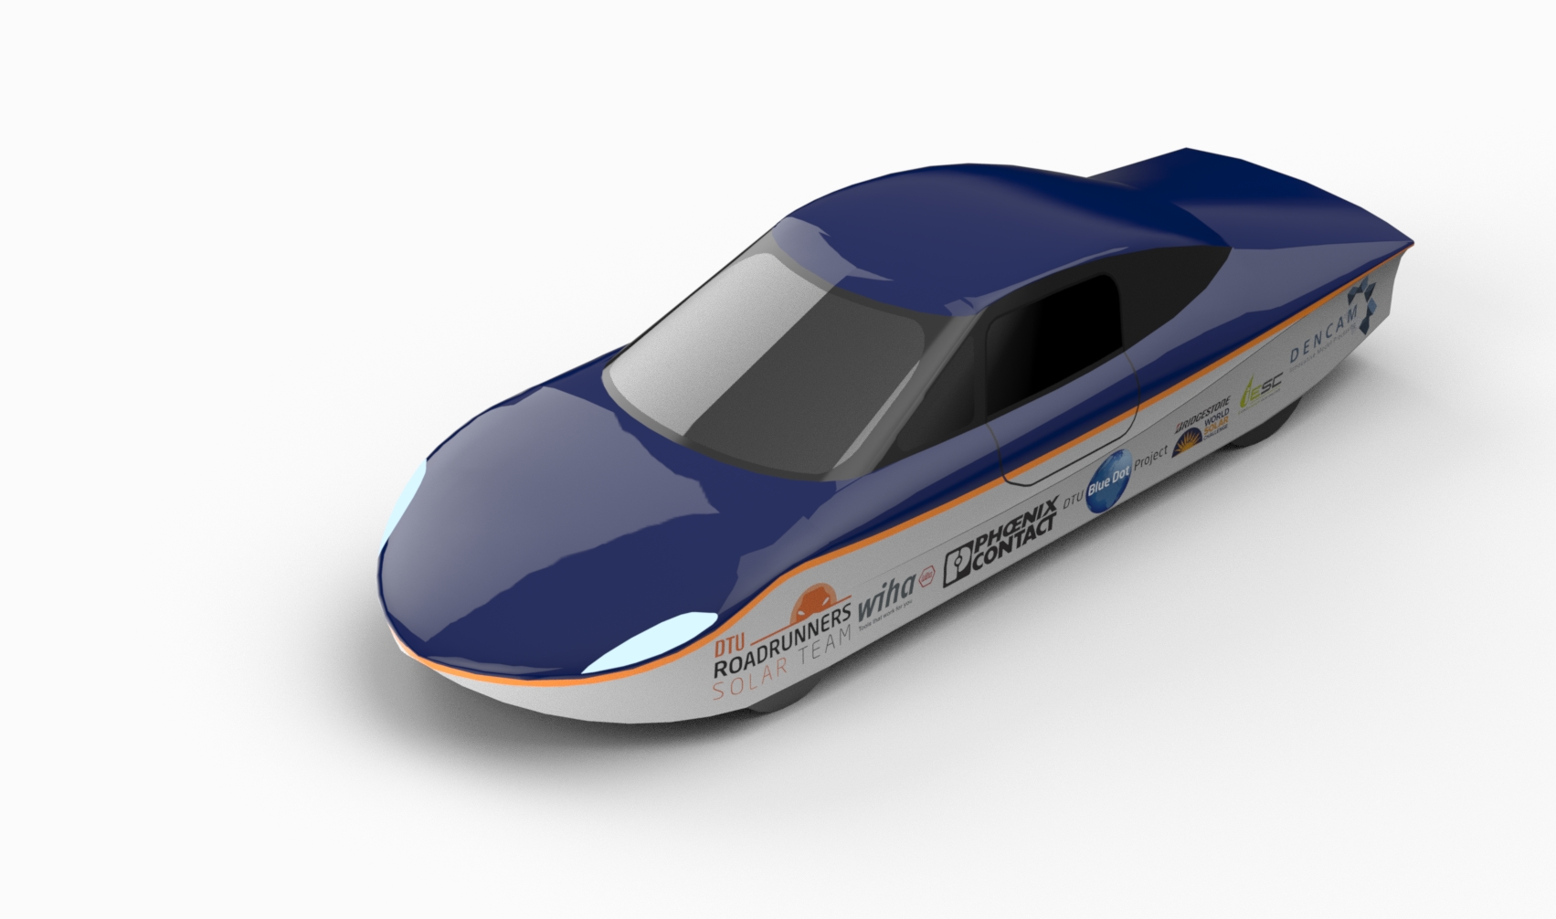
Project Status (18 min)
Status
Limitations?
Generel questions

Slide 8
Open positions in Management team (2 min):
Mechanical team leaders
Gain management skills
Invision the project
Jobs include:
Manage meetings
Update project descriptions
Create social events
Manage fagprojekter, bachelor and other ECTS courses
Become an expert in the solar car
SoMe responsible:
Want a broader network
Interested in startup and fund securing
Jobs include:
Create sponsor framework
Create sponsor events
Manage SoMe (not intitled to post)

Slide 9
Summer projects (2 min)
Updated project folder (Special Summer edition)
Summer period start-up date probably 2nd of July (Victor will send a mail with further information)
Victor will be there 1st week of July and most of August
Probably include some workdays with BBQ evenings
Time for fun and weird projects!

Slide 10
Agenda points for next meeting
Next management meeting (??/06-2024):
- Summer projects
- Wiki
- Start of next semester
Next general meeting (general ??/08-2024):
HUSK:
Agenda forslag sendes til:
s194483@dtu.dk
Senest 2 dage før mødet

Slide 11
Feedback
What worked?
What can be improved?
Wishes for upcoming meetings?

