Slide 1
Batteries are taken from a VW ID.3
Total/nominal cell mass needs be confirmed.

Slide 2
Battery Characteristics
Battery
Battery Cell
Configuration | 8s3p
Model | LGX E78
Nominal capacity | 234 Ah
Nominal energy | 6.85 kWh / 24.66 MJ
Min voltage | 20.8 V
Max voltage | 33.6 V
Weight
Dimension | 51*9.5*0.9cm
Chemistry | NCM 712
Nominal Voltage | 3.67 V
Gravimetric energy density | 265 Wh/kg
Weight | 1079.6 g
Capacity | 78 Ah

Slide 3
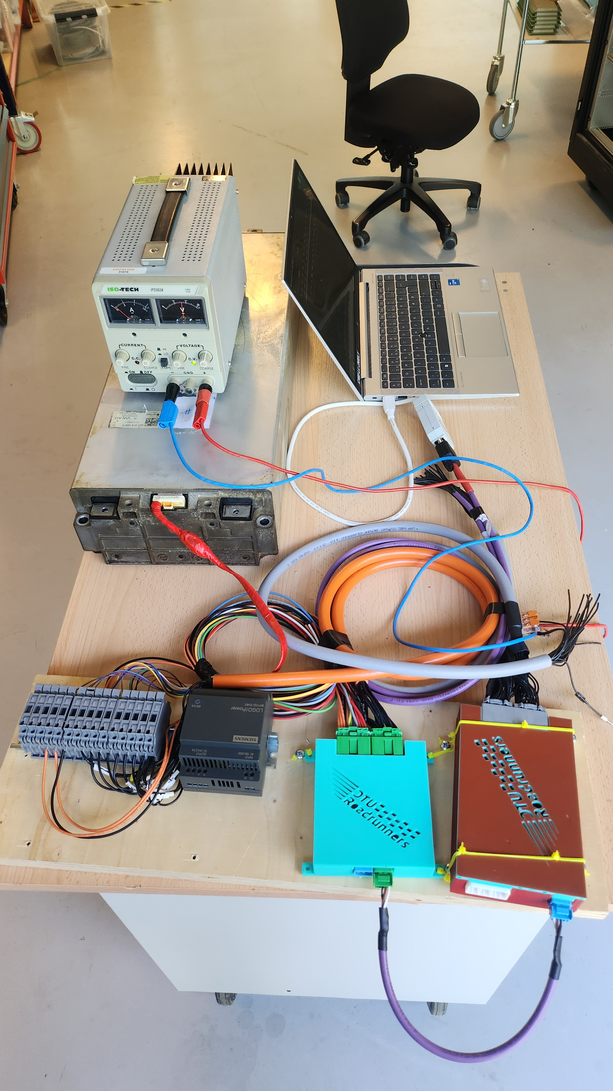
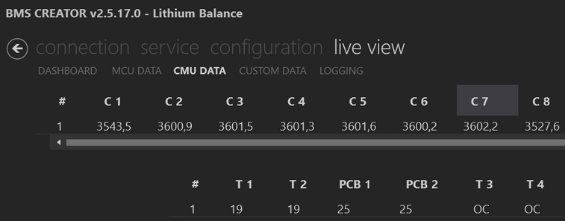
Healthy cell voltages

Slide 4

Confirmed battery cell model

Slide 5
If you approve the batteries, we will make a charge test of them.

