Slide 1
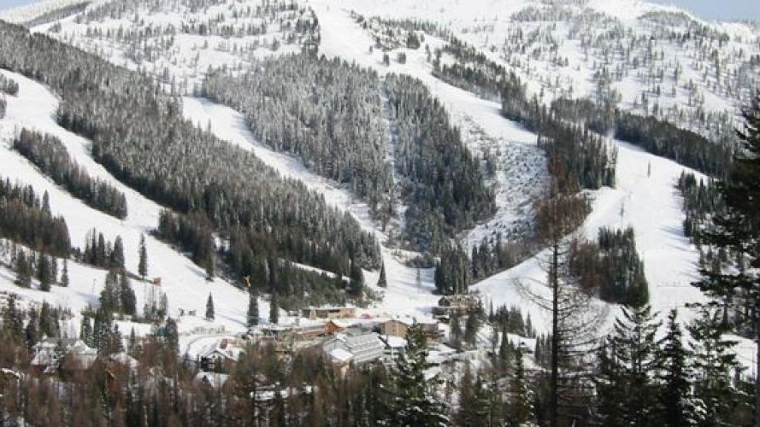
Big Mountain Resort – Increasing Ticket Prices
Executive Presentation
Pic Credit: https://explorewhitefish.com/entries/a-little-history-of-a-big-mountain/a9b38eb2-0dd9-4fac-9d6c-077f3ed75846

Slide 2
Problem Identification
How can Big Mountain resort increase its revenue by 10% over the next year by reducing the operational costs by closing some facilities and increasing the ticket prices by utilizing other facilities?
A sustainable business investment strategy:
Reducing operation cost
Increasing ticket prices by utilizing facilities

Slide 3
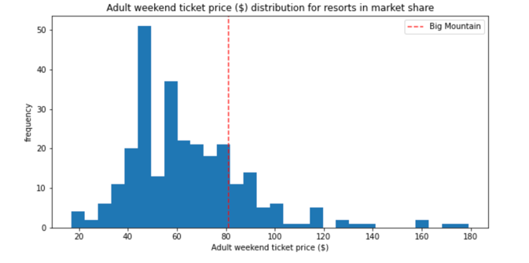
Key Findings
Modelled price = $96.52; actual price = $81.00
Vertical Drop, Fast Quads, Total Chairs, Runs, Snow Making Area
Positively correlated with ticket price
Recommendations
A run, vertical drop - 150 ft, add. chair lift
increase in price by $1.07
Total increase : $1,876,812
Operation cost reduced by closing runs:
1 run – no affect
2-3 – decrease, no effect if 4-5 closes down
6 – sig. decrease

Slide 4
Modeling Results and Analysis
Developed and ran two models:
the linear regression model
the random forest model
Both models indicated the following to have the biggest impact: vertical drop, fast quads, and snow making area.
Additionally, Runs - in the linear model
Total chairs - in the random forest model

Slide 5
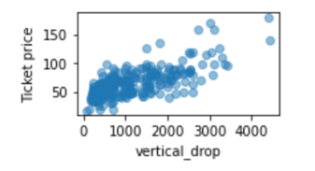
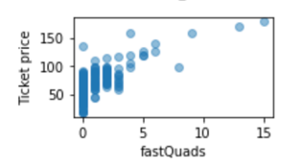
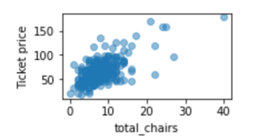
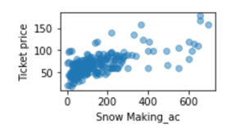
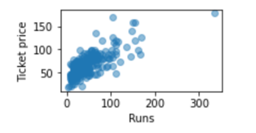
Modeling Results and Analysis
Features were positively correlated with the ticket price

Slide 6
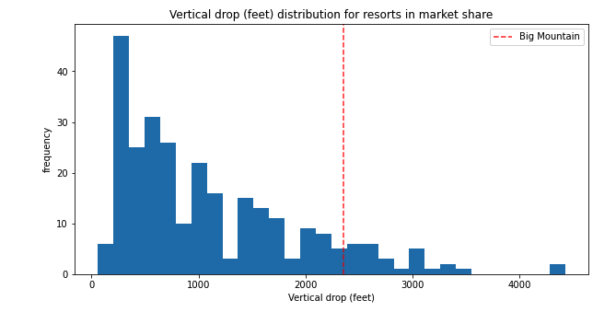
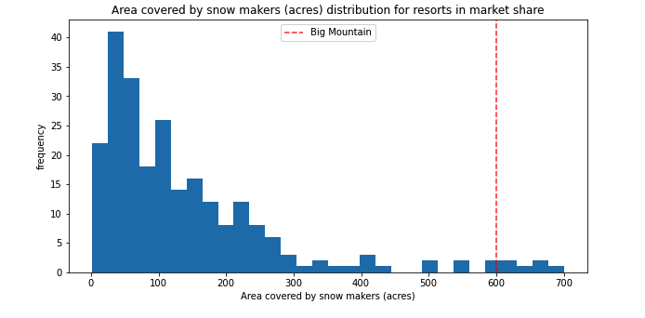
Modeling Results and Analysis The resort’s imp. features do well in comparison
Vertical drop – higher end than other resorts
Snow making area – very high up

Slide 7
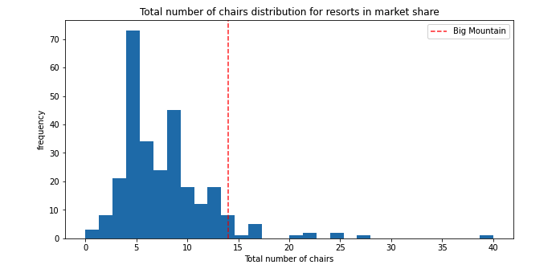
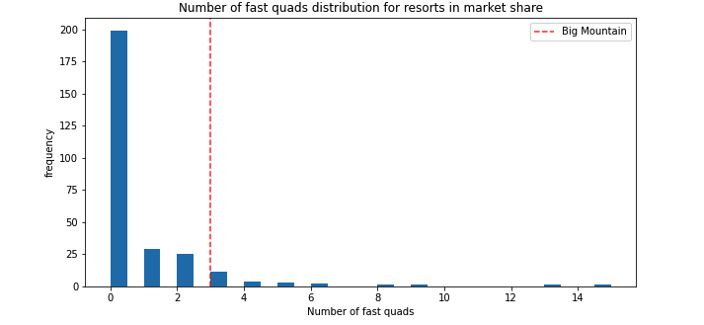
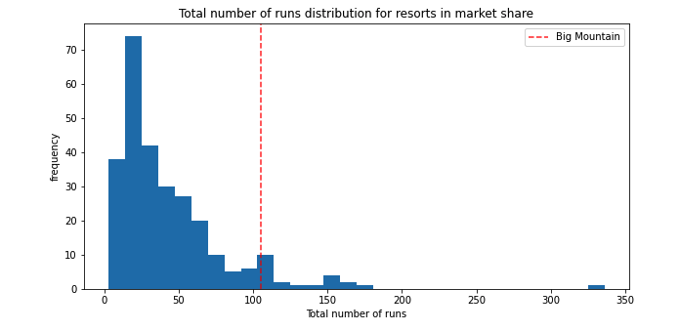
Modeling Results and Analysis
Total chairs– resort has high # of total chairs
Fast quads – has 3, with rare higher values
Total runs– resort has higher # of total chairs

Slide 8
Summary & Conclusion
Big Mountain Resort has significant facilities that can be capitalized to increase ticket prices!
The resort has more important facilities than its competitors!
The resort currently charges less money than its competitors.
Even with some buffer (mean absolute error) of ~$10 USD, prices can increase

