Slide 1
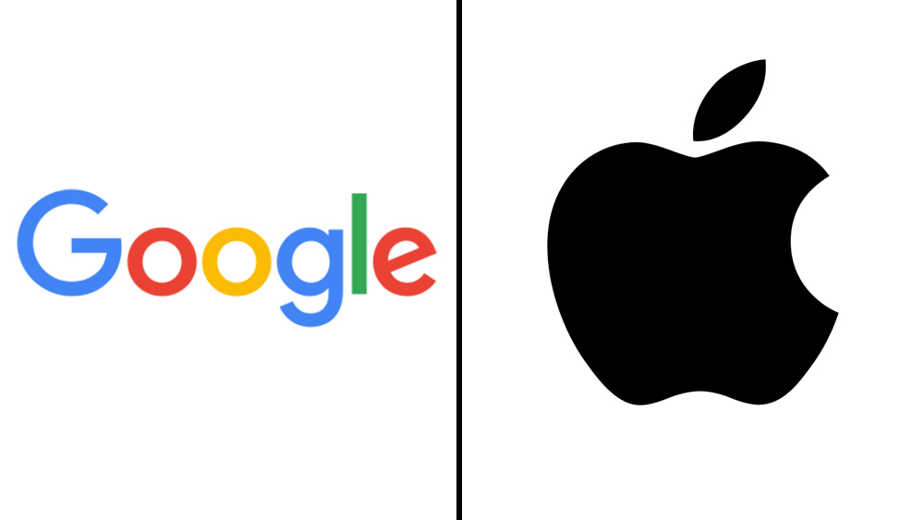
Google or Apple Which platform received better reviews?
Picture credit: https://deadline.com/2021/01/parler-banned-google-play-store-apple-1234667862/

Slide 2
Overview – we are developing an app!
Android?
(Google)
IOS?
(Apple)
Did Apple Store apps receive better
reviews than Google Play apps?
We will prioritize developing an app for the platform that has better reviews.

Slide 3
Cleaning
Google: Category, Rating, Reviews, Price
Apple: Prime_Genre, User_Rating, Rating_Count_Tot, Price
Cleaning Data:
Apple data didn’t require much cleaning
Google Data:
Removed the observation with ‘Everyone’ for price
Removed ‘$’
Changed the Price column to ‘numeric data’ type – to perform mathematical calculations
Removed apps with no reviews

Slide 4
Merging Datasets
Created a new variable called ‘platform’ in the apple and google dataset
Indicated whether the platform was ‘apple’ or ‘google’
Merged the two datasets
Eliminated the observation without any values

Slide 5
Summarizing
Apple Mean Rating: 4.049697
Observed Diff: 0.136506
(Google Mean Rating – Apple Mean Rating)
Google Mean Rating: 4.186203

Slide 6
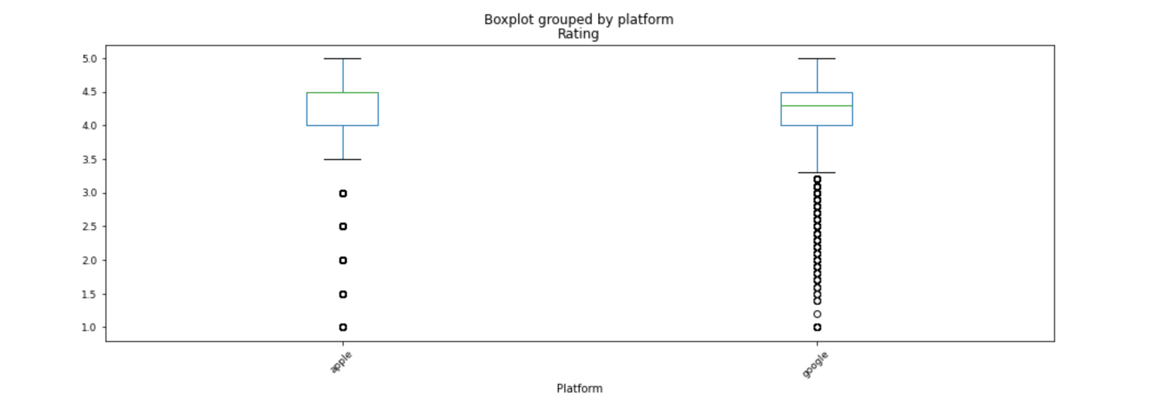
Summarizing - Boxplot

Slide 7
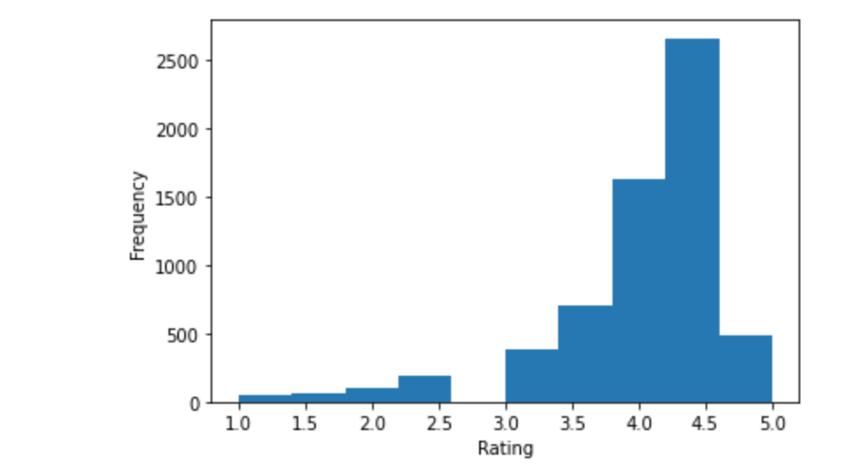
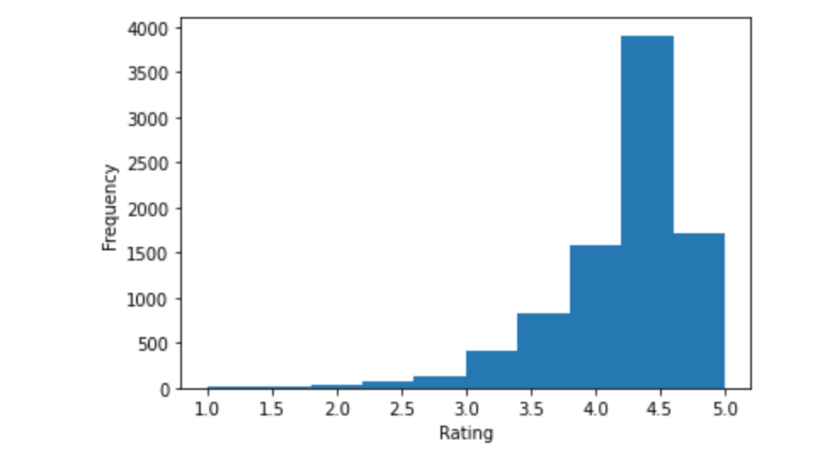
Modeling
We want to test that the difference in ratings of apple and google is due to the different platforms
Apple
Google

Slide 8
Modeling
Distributions are not normal – we used permutation test to determine whether the difference in ratings is due to platforms.
After running the permutation test, we see that there are no difference that are as least as extreme as the observed difference.
The P-Value is zero, at the significance level of 0.05

Slide 9

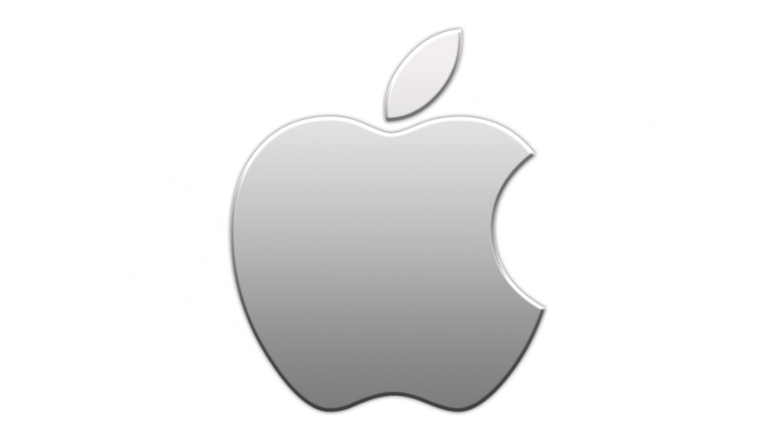

Recommendation – Platforms do impact ratings!
Prioritize the development of Android Applications
Then move on to developing IOS Applications
Picture credit: https://www.creativebloq.com/news/iphone-11-apple-logo-change
https://dev.to/rs9110/google-logo-with-just-html-css-3bmi

