Slide 1
Search content in this table. All columns expect 1st column are searchable.
Set number of entries per page
Click triangles to rank column
Retrieve corresponding results
Navigation bar
Delete the selected jobs

Slide 2
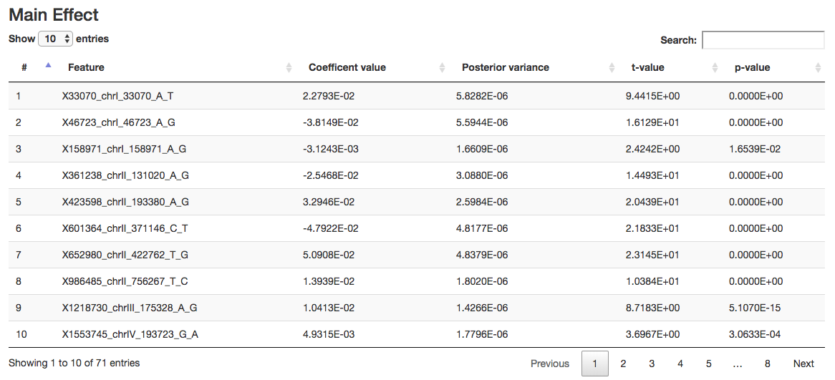
Set number of entries per page
Search content in this table. All columns expect 1st column are searchable.
Click triangles to rank column
Total results
Navigation bar

