Slide 1
Part II: Potential Genetic Privacy Risks
Notes:
Good morning! Today I am going to talk about a software program recently developed by me and my colleagues, PEAKS, for de novo sequencing and protein identification.

Slide 2
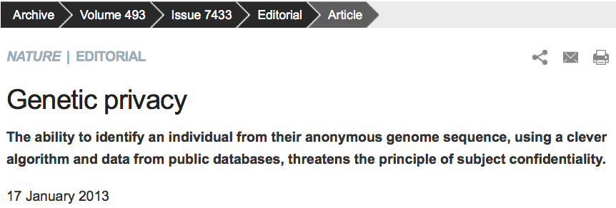
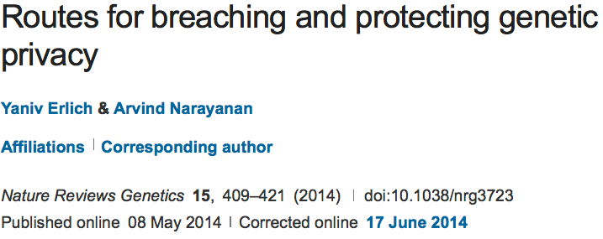
Genetic Privacy

Slide 3
Genetic Privacy
Breaching genetic privacy techniques: identity or trait attacks by aggregating data such as genotypes, genome-wide association study (GWAS) statistics, DNA sequences, and metadata.
Erlich, Yaniv, and Arvind Narayanan. "Routes for breaching and protecting genetic privacy." Nature Reviews Genetics 15.6 (2014): 409.

Slide 4
Infringement of Genetic Privacy
Identity attack
  Personal identifiable information
Trait attack
  Trait information associated with genomic
  information (e.g. genotypes/sequences)
Erlich, Yaniv, and Arvind Narayanan. "Routes for breaching and protecting genetic privacy." Nature Reviews Genetics 15.6 (2014): 409.

Slide 5
Genetic Privacy Risks
Identity tracing attacks
Attribute disclosure attacks via DNA
Completion attacks
Erlich, Yaniv, and Arvind Narayanan. "Routes for breaching and protecting genetic privacy." Nature Reviews Genetics 15.6 (2014): 409.

Slide 6
Identity Tracing attacks
The goal of identity tracing attacks is to uniquely identify an anonymous DNA sample using quasi-identifiers – residual pieces of information that are embedded in the dataset.
Searching with meta-data
Identity tracing by genealogical triangulation
Identity tracing by phenotypic prediction
Identity tracing by side-channel leaks
Erlich, Yaniv, and Arvind Narayanan. "Routes for breaching and protecting genetic privacy." Nature Reviews Genetics 15.6 (2014): 409.

Slide 7
Searching with meta-data
Unrestricted demographic information conveys substantial power for identity tracing.
Health Insurance Portability and Accountability Act (HIPAA) Privacy rule
Pedigree structures contain rich information, especially when large kinships are available.
Another vulnerability of pedigrees is combining demographic quasi-identifiers across records to boost identity tracing despite HIPAA protections.
Erlich, Yaniv, and Arvind Narayanan. "Routes for breaching and protecting genetic privacy." Nature Reviews Genetics 15.6 (2014): 409.

Slide 8
Identity tracing by genealogical triangulation
Genetic genealogy attracts millions of individuals interested in their ancestry or in discovering distant relatives.
One potential route of identity tracing is surname inference from Y-chromosome data
The main limitation of surname inference is that haplotype matching relies on comparing Y chromosome Short Tandem Repeats (Y-STRs).
An open research question is the utility of non Y chromosome markers for genealogical triangulation.
Erlich, Yaniv, and Arvind Narayanan. "Routes for breaching and protecting genetic privacy." Nature Reviews Genetics 15.6 (2014): 409.

Slide 9
Identity tracing by phenotypic prediction
Predictions of visible phenotypes from genetic data could serve as quasi-identifiers for identity tracing.
Twin studies have estimated high heritabilities for various visible traits such as height and facial morphology.
Age prediction is possible from DNA specimens derived from blood samples.
But the applicability of these DNA-derived quasi-identifiers for identity tracing has yet to be demonstrated.
Erlich, Yaniv, and Arvind Narayanan. "Routes for breaching and protecting genetic privacy." Nature Reviews Genetics 15.6 (2014): 409.

Slide 10
Identity tracing by side-channel leaks
Side-channel attacks exploit quasi-identifiers that are unintentionally encoded in the database building blocks and structure rather than the actual data that is meant to be public.
The mechanism to generate database accession numbers can also leak personal information
Erlich, Yaniv, and Arvind Narayanan. "Routes for breaching and protecting genetic privacy." Nature Reviews Genetics 15.6 (2014): 409.

Slide 11
Attribute disclosure attacks via DNA (ADAD)
ADAD attack: The adversary gains access to the DNA sample of the target. He or she uses the identified DNA to search genetic databases with sensitive attributes. A match between the identified DNA and the database links the person and the attribute.
The simplest scenario
The summary statistic scenario
The gene expression scenario
Erlich, Yaniv, and Arvind Narayanan. "Routes for breaching and protecting genetic privacy." Nature Reviews Genetics 15.6 (2014): 409.

Slide 12
ADAD: the simplest scenario
The adversary can simply match the genotype data that is associated with the identity of the individual and the genotype data that is associated with the attribute.
Such an attack requires only a small number of autosomal single nucleotide polymorphisms (SNPs).
ADAD is a theoretical vulnerability of virtually any individual level DNA-derived omics dataset such as RNA-seq and personal proteomics.
Genome-wide association studies (GWAS) are highly vulnerable to ADAD.
Erlich, Yaniv, and Arvind Narayanan. "Routes for breaching and protecting genetic privacy." Nature Reviews Genetics 15.6 (2014): 409.

Slide 13
ADAD: the summary statistic scenario
With the target genotypes in the case group, the allele frequencies will be positively biased towards the target genotypes compared to the allele frequencies of the general population.
The actual risk of ADAD has been the subject of intense debate.
Erlich, Yaniv, and Arvind Narayanan. "Routes for breaching and protecting genetic privacy." Nature Reviews Genetics 15.6 (2014): 409.

Slide 14
ADAD: the gene expression scenario
NIH’s Gene Expression Omnibus (GEO) publicly hold hundreds of thousands of gene expression profiles.
ADAD technique: The method starts with a training step that employs a standard expression quantitative trait loci (eQTL) analysis with a reference dataset. Next, the algorithm scans the public expression profiles. Last, the algorithm matches the target’s genotype with the inferred allelic distributions of each expression profile and tests the hypothesis that the match is random.
This ADAD technique has the potential for relatively high accuracy in ideal conditions.

Slide 15
Completion attacks
Genotype imputation: Jim Watson’s predisposition for Alzheimer’s disease from the ApoE locus despite masking of this gene
In the basic setting, the adversary obtains access to a single genetic dataset of a known individual. He then exploits this information to estimate genetic predispositions for relatives whose genetic information is inaccessible.
This attack is taking advantage of self-identified genetic datasets from OpenSNP.org
Erlich, Yaniv, and Arvind Narayanan. "Routes for breaching and protecting genetic privacy." Nature Reviews Genetics 15.6 (2014): 409.

Slide 16
Completion attacks
In the advanced setting, the adversary has access to the genealogical and genetic information of multiple relatives of the target.
The algorithm finds relatives of the target that donated their DNA to the reference panel and that reside on a unique genealogical path that includes the target.
Erlich, Yaniv, and Arvind Narayanan. "Routes for breaching and protecting genetic privacy." Nature Reviews Genetics 15.6 (2014): 409.

Slide 17
Homer’s attack
Homer’s attack motivated the NIH to move the genotype and phenotype data from public domain to controlled access through dbGaP.
This paper use high-density single nucleotide polymorphism (SNP) genotyping microarrays to demonstrate the ability to accurately and robustly determine whether individuals are in a complex genomic DNA mixture.
Homer N, Szelinger S, Redman M, et al. Resolving individuals contributing trace amounts of DNA
to highly complex mixtures using high-density SNP genotyping microarrays. PLoS Genet. 2008;

