Slide 1
R Programming
Dahlia Shvets

Slide 2
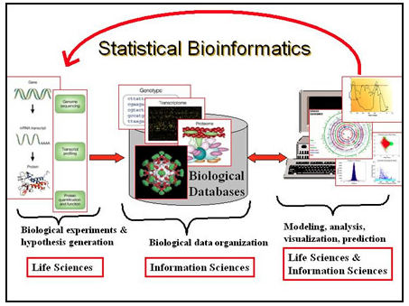
Statistics in Bioinformatics
Notes:
photo from Purdue University : http://www.stat.purdue.edu/sbc/

Slide 3
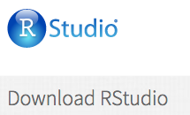

Set up Rstudio at home
Download Rstudio:
First you will need
to download R

Slide 4
Creating Variables in R
Variables are called vectors in R
You can create a vector like this:
name <- “Dahlia”
names <- c(“Dahlia”, “Elizabeth”,”Shvets”)
age <- 24
age <- c(24,10,2,90)

Slide 5
Data in R
R automatically includes several datasets that you can play around with at home
Access them by typing :
data()

Slide 6
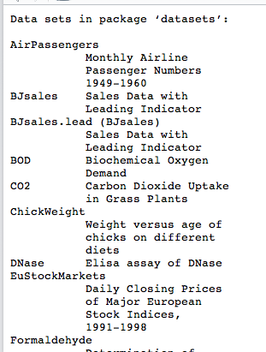
Data Sets in R
Pick a data set!
Type the name into R and see what happens.
head(ChickWeight)
Column: ChickWeight[,1]
Row: ChickWeight[1,]

Slide 7
Fun with R
time <- ChickWeight[,2]
weight <- ChickWeight[,1]
plot(time,weight,col=“red”)
hist(weight) boxplot(weight)

Slide 8
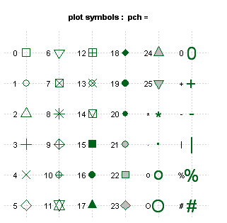
Edit your plot
Change the shapes type: pch=

Slide 9
Make Fancy Plots
install.packages(“ggplot2”)
library(ggplot2)
qplot(time,weight,color=”red”)
qplot(weight,data=ChickWeight, geom= ”histogram”, binwidth=1)

Slide 10
More ggplot2 samples
p <- ggplot(mtcars,aes(factor(cyl),mpg))
p + geom_boxplot()
p + geom_boxplot(aes(fill=cyl))
p + geom_boxplot(notch=TRUE)
p + geom_boxplot(aes(fill=factor(am)))

Slide 11
Graphics using R
library(graphics)
example(plot) example(barplot) example(boxplot) example(coplot) example(hist) example(fourfoldplot)
example(stars) example(image) example(contour) example(filled.contour) example(persp) ← (This one is cool!)

Slide 12


Practice at Home!
http://tryr.codeschool.com/
http://swirlstats.com/

