Slide 1
AI emotion detection Marcin Wojnarowski, Weronika Piotrowska, Patryk Prusak, Mikołaj Stańczyk

Slide 2
Dataset
https://www.kaggle.com/datasets/msambare/fer2013
48x48 pixel grayscale images of faces
7 emotions: Angry, Disgust, Fear, Happy, Sad, Surprise, Neutral
Training set size: 28,709 images
Test set size: 3,589 images

Slide 3
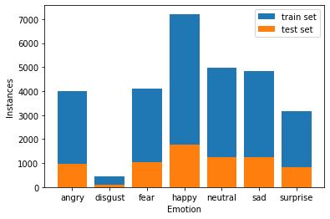
Distribution of pictures

Slide 4
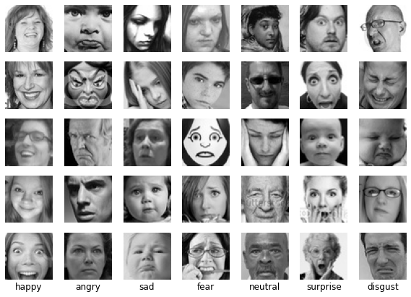
Training samples

Slide 5
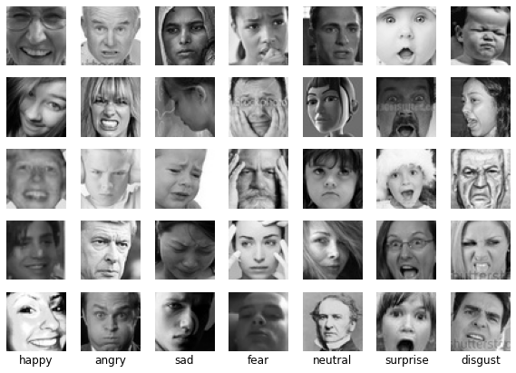
Testing samples

Slide 6
Dataset analysis
Faces are centered
Training and testing sets do not differ substantially
Emotions are grossly exaggerated
Different lightning conditions
Mixture of real pictures with computer drawn pictures

Slide 7
Dataset preparation
All images are normalized by rescaling pixels to the range [0;1]
Introduction of noise: rotation, scaling, and horizontal flips. To act as a simple regularizer
Examples prepared in batches

Slide 8
Results
Training set:
1. accuracy: 0.8003
2. loss: 0.6216
Test set:
1. accuracy: 0.6698
2. loss: 1.0202

Slide 9
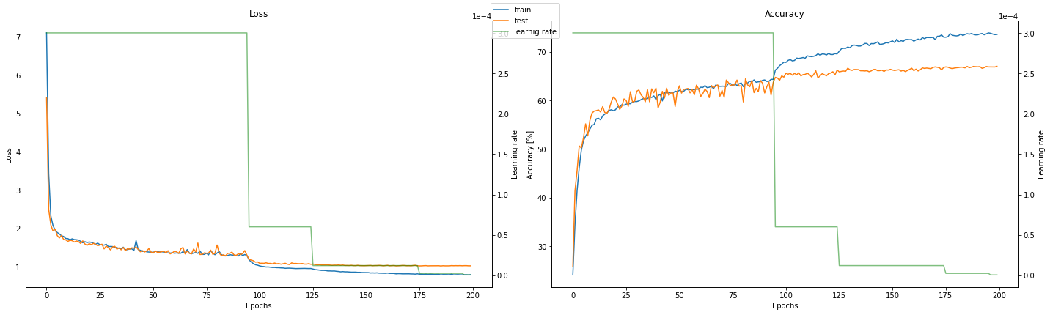
Results

Slide 10
Results
The model learns to classify images effectively within just a few initial epochs
At around epoch 125 we can notice that the test set no longer reports improvements and the model is clearly starting to overfit the dataset

Slide 11
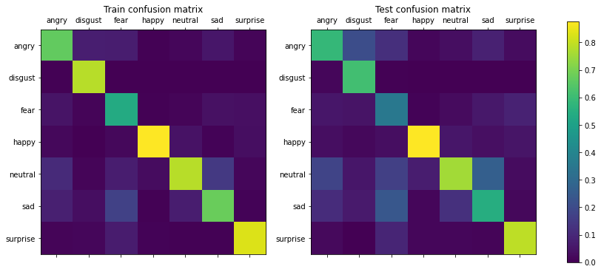
Results

Slide 12
Results
Happy is the most „obvious” emotion
It is hard to distinguish between sad and neutral
Model often classified fear as sadness

Slide 13
Thank you!

