Slide 1
New matching algorithms for Rust regexes
Robin Hänni / Marcin Wojnarowski

Slide 2
Regex engines
Linear
Backtracking
Linear-time matching guarantees
Support only a subset of features
Examples:
regex crate (Rust)
RE2 (C++)
regexp package (Golang)
RE2/J (Java)
V8Linear (ECMAScript)
Potential exponential blowup
Support all features
Examples:
PCRE2 (C)
Almost all regex engines in the standard library of programing languages

Slide 3
Missing linear-engine regex features
Lookarounds
/(?<!dogs) are better/
/[0-9]+(?=€)/
Backreference (NP-complete!)
/(.+) reversed is \1/

Slide 4
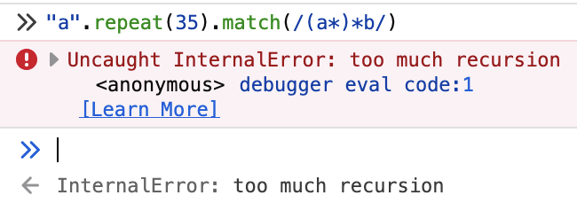
Backtracking problems
ReDoS
Slow even for linear-time-matching regexes
Unpredictable performance

Slide 5
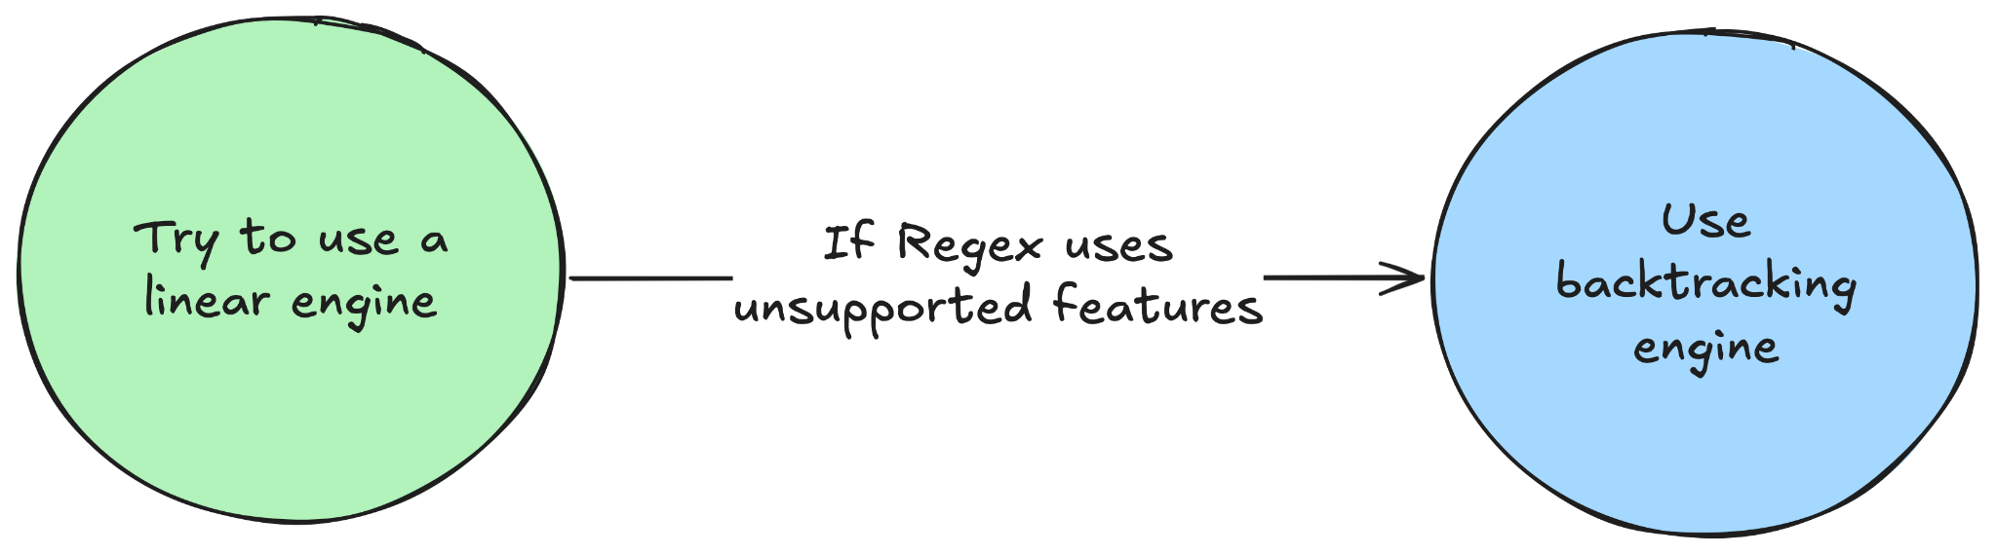
ripgrep / fancy-regex approach

Slide 6

Goal
Expansion of the subset of regexes accepted by linear engines in the Rust language ecosystem

Slide 7

Prior work
A lot of work at SystemF
Ideas implemented in RE2, V8

Slide 8
Aim
Implement algorithms in the regex crate
De facto standard for Rust
Highest impact: used by ripgrep, fancy-regex, VSCode, all Rust users
Adds new features rather than improving existing ones
If that fails, implement in fancy-regex
Used by less people
Already supports these features in the backtracking engine

Slide 9
Regex features
Capture-less look-behinds
Capture-less look-aheads (requires additional memory)
General look-arounds including capture groups (depends on semantics)
Investigation of compatibility of algorithms in various regex engines
API for choice of the data structure for capture group for space-time-complexity trade-offs
Exploring algorithms for intersections in NFA/PikeVM

Slide 10
Challenges
Open source politics
Identifying all benefits and drawbacks of various regex implementations

