Slide 1
Tendermint Lite Client

Slide 2
Tendermint full node VS lite node
Full Node
P2P网关：提供p2p网络中的网络发现服务
Memorypool: 处理交易，广播交易
Blockchain protocol：保存并验证所有区块
如果是validator节点，则还需参与区块共识过程
需要大量的存储和计算资源以及公网IP，一般来说只能运行在服务器端
Lite Node
转发用户请求到全节点
验证用户指定的交易，commit和区块
查询应用信息并且验证全节点所提供的证据链
需要很少的存储和计算资源，很适合运行在智能手机，平板电脑等存储和计算资源都受限的平台上

Slide 3
Tendermint Lite Node
Tendermint
Full Node
Lite Node
Certifier
wrapper
engine
Router
http Client

Slide 4
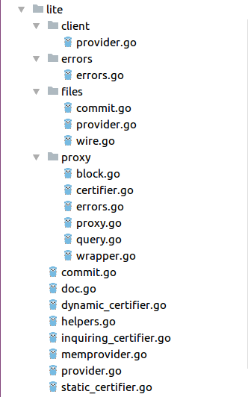
Router
func RPCRoutes(c rpcclient.Client) map[string]*rpc.RPCFunc {
return map[string]*rpc.RPCFunc{
// Subscribe/unsubscribe are reserved for websocket events.
// We can just use the core tendermint impl, which uses the
// EventSwitch we registered in NewWebsocketManager above
"subscribe": rpc.NewWSRPCFunc(core.Subscribe, "query"),
"unsubscribe": rpc.NewWSRPCFunc(core.Unsubscribe, "query"),
// info API
"status": rpc.NewRPCFunc(c.Status, ""),
"blockchain": rpc.NewRPCFunc(c.BlockchainInfo, "minHeight,maxHeight"),
"genesis": rpc.NewRPCFunc(c.Genesis, ""),
"block": rpc.NewRPCFunc(c.Block, "height"),
"commit": rpc.NewRPCFunc(c.Commit, "height"),
"tx": rpc.NewRPCFunc(c.Tx, "hash,prove"),
"validators": rpc.NewRPCFunc(c.Validators, ""),
// broadcast API
"broadcast_tx_commit": rpc.NewRPCFunc(c.BroadcastTxCommit, "tx"),
"broadcast_tx_sync": rpc.NewRPCFunc(c.BroadcastTxSync, "tx"),
"broadcast_tx_async": rpc.NewRPCFunc(c.BroadcastTxAsync, "tx"),
// abci API
"abci_query": rpc.NewRPCFunc(c.ABCIQuery, "path,data"),
"abci_info": rpc.NewRPCFunc(c.ABCIInfo, ""),
}
Redirect to full node

Slide 5
Certifier
// Certifier checks the votes to make sure the block really is signed properly.
// Certifier must know the current set of validitors by some other means.
type Certifier interface {
Certify(check Commit) error
ChainID() string
}
Inquiring certifier
dynamic certifier
static certifier

Slide 6
Static Certifier and Dynamic Certifier
static certifier
{
chainID string
vSet *types.ValidatorSet
vhash []byte
}
dynamic certifier
{
cert *StaticCertifier
lastHeight int64
}
Update

Slide 7
Inquiring certifier
map[string]
FullCommit
validators
Checkpoints
directory
file
provider
memory
provider
Full Node
Cache
provider
http
provider
dynamic certifier
NewInquiringCertifier
Certify
Update
ChainID
Validators
LastHeight
static certifier

Slide 8
Inquiring certifier
map[string]
FullCommit
validators
Checkpoints
directory
file
provider
memory
provider
Full Node
Cache
provider
http
provider
dynamic certifier
NewInquiringCertifier
Certify
Update
ChainID
Validators
LastHeight
static certifier

Slide 9
Wrapper engine
"commit" : rpc.NewRPCFunc(c.Commit, "height"),
"tx" : rpc.NewRPCFunc(c.Tx, "hash,prove"),
"blockchain" : rpc.NewRPCFunc(c.BlockchainInfo,"minHeight,maxHeight")
"block" : rpc.NewRPCFunc(c.Block, "height"),
"abci_query" : rpc.NewRPCFunc(c.ABCIQuery, "path,data"),

Slide 10
Commit
func (w Wrapper) Commit(height *int64) (*ctypes.ResultCommit, error) {
rpcclient.WaitForHeight(w.Client, *height, nil)
r, err := w.Client.Commit(height) //获取commit信息
// if we got it, then certify it
if err == nil {
check := certclient.CommitFromResult(r)
err = w.cert.Certify(check) //验证commit信息
}
return r, err
}

Slide 11
Inquiring certifier
func (ic *InquiringCertifier) Certify(commit Commit) error {
err := ic.useClosestTrust(commit.Height()) //get nearest commit from memory or file provider
if err != nil {
return err
}
err = ic.cert.Certify(commit)
if !liteErr.IsValidatorsChangedErr(err) {
return err
}
err = ic.updateToHash(commit.Header.ValidatorsHash)
if err != nil {
return err
}
err = ic.cert.Certify(commit)
if err != nil {
return err
}
// store the new checkpoint
return ic.trusted.StoreCommit(NewFullCommit(commit, ic.Validators()))
}

Slide 12
Certife Process
validator
changed
chainID
Update validator to target height
validatorset hash
Basic Validate
height
precommit
signature
checking
recalculate
head hash
Total voting power
> 2/3
precommit checking
type
height
round
PASS

Slide 13
Update validator set in inquiring certifier
old validator set
new validator set
Basic Validate
precommit
signature
checking
Total voting power
> 2/3
PASS

Slide 14
Update validator to target height
current height=100
height2=2575
height3=7525
target height=10000
height1=5050
Step1: Update to 10000, fail
Step2: Update to 5050, fail
Step3: Update to 2575, Success
Step4: Update to 5050, Success
Step5: Update to 10000,fail
Step6: Update to 7525, Success
Step7: Update to 10000, Success

Slide 15
Tx
func (w Wrapper) Tx(hash []byte, prove bool) (*ctypes.ResultTx, error) {
res, err := w.Client.Tx(hash, prove) //获取当前交易所在的区块信息
if !prove || err != nil {
return res, err
}
h := int64(res.Height)
check, err := GetCertifiedCommit(h, w.Client, w.cert) //获取并验证改区块的commit信息
if err != nil {
return res, err
}
err = res.Proof.Validate(check.Header.DataHash) //验证tx所在区块的Merkle树
return res, err
}

Slide 16
Tx Proof Validate
root
Header.DataHash
Habcd
Hefgh
Proof
Hab
Hcd
Hef
Hgh
Ha
Hb
Hc
Hd
He
Hf
Hg
Hh
Hcd=Hash(Hc+Hd)
Habcd=Hash(Hab+Hcd)
Root=Hash(Habcd+Hefgh)
if Root == Header.DataHash
valid
else
invalid
Target
Tx hash

Slide 17
abci_query
root
existence proof
Habcd
Hefgh
Sort
by
Key
Hab
Hcd
Hef
Hgh
Ha
Hb
Hc
Hd
He
Hf
Hg
Hh
Key
Value
Version
hash
TxHash

Slide 18
abci_query
absence proof
root
rightKey==nil
left most
leftKey==nil
rightmost
leftKey
targetKey
rightKey
<
<

Slide 19
abci_query
absence proof
root
rightmost
left most
leftKey
targetKey
rightKey
<
<

Slide 20
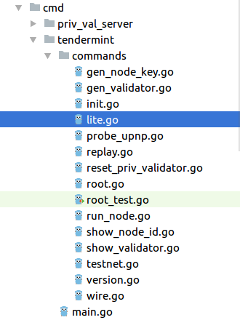
启动Lite node
tendermint lite \
--laddr tcp://localhost:8888 \
--home-dir chain/ \
--node tcp://111.231.70.168:46657 \
--chain-id test-chain-FQZuzW

Slide 21
Question & Answer

