Slide 1
Designing a Game Boy Cartridge
By emulating it with a RP2040
Sebastian Quilitz
Backspace Bamberg, 2024-01-27

Slide 2
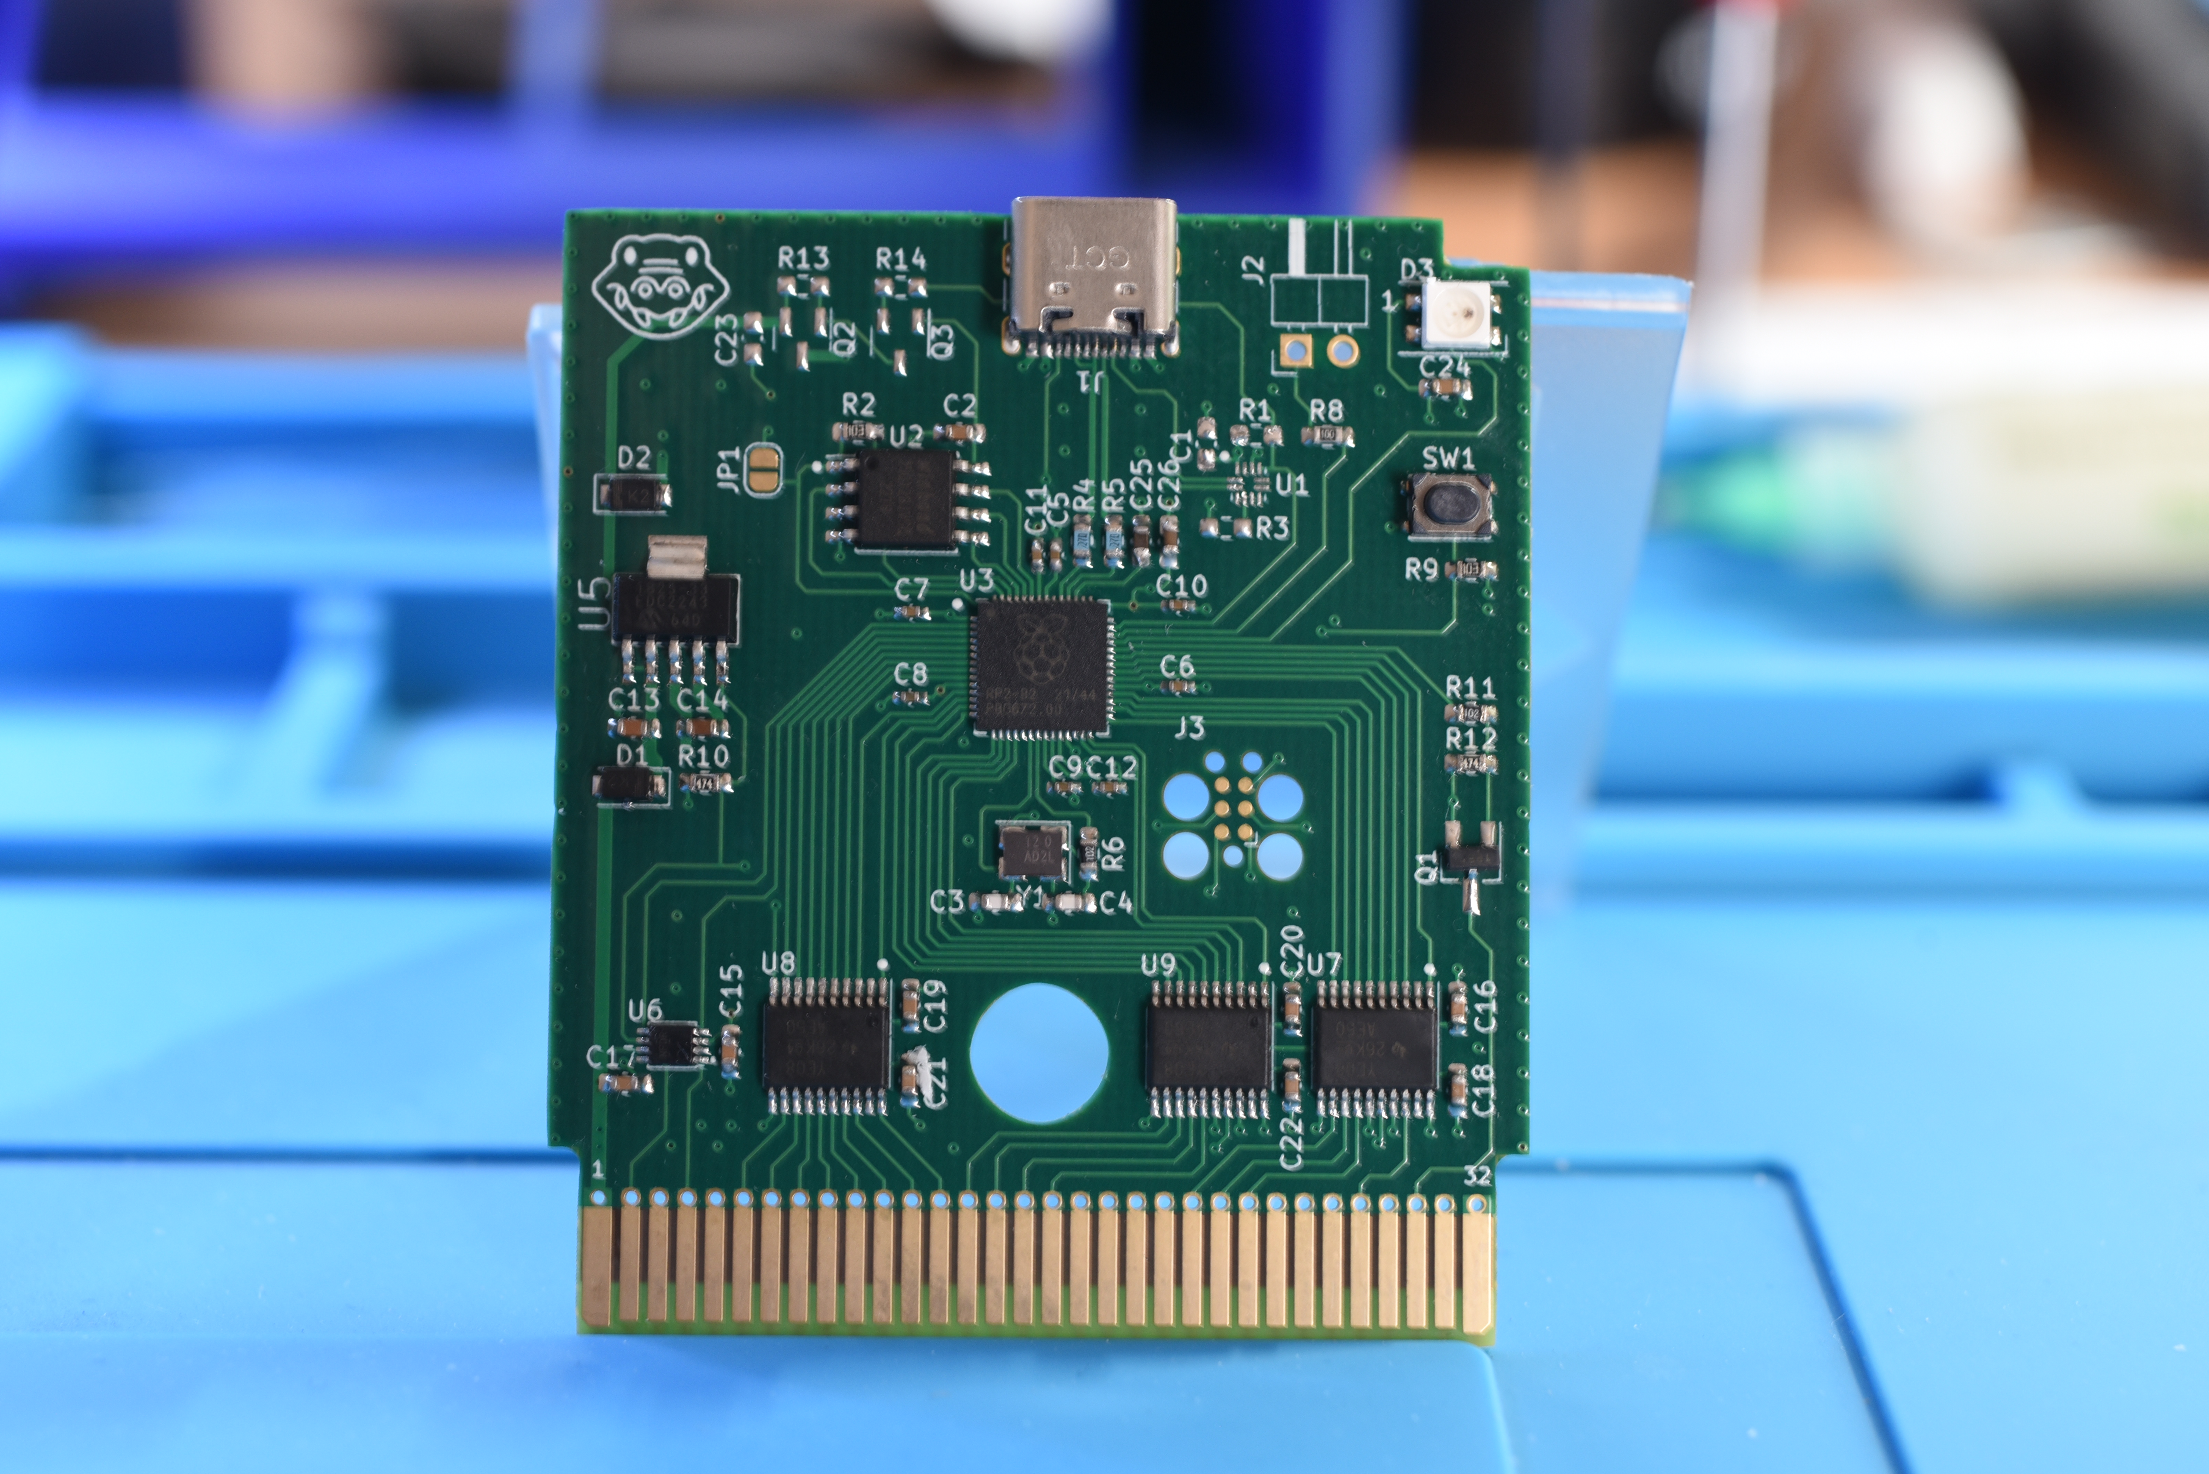
Chapters
Overview RP2040
PIO
Designing the hardware
Ordering the PCB
Manufacturing the hardware
Software Overview

Slide 3
Overview RP2040

Slide 4
What is the RP2040?
First microcontroller designed by Raspberry Pi Foundation
Introduced firstly in the Raspberry Pico in January 2021
Available as single chips in small numbers since June 2021 and broader availability in autumn/winter 2021
Designed to be low-cost: Raspberry Pico 4$, MCU 1$

Slide 5
RP2040 Hardware Spec
Dual Core ARM Cortex M0+
Rated for 133 MHz (overclockable)
264 KB internal SRAM
No internal Flash or EEPROM
QSPI interface for external flash which allows XIP
USB controller
SPI, I2C, UART
Programmable IO (PIO)

Slide 6

Why the name RP2040?
Source: RP2040 Datasheet

Slide 7
Programmable IO (PIO)

Slide 8
PIO Overview
Instruction set highly optimized for IO operations
RP2040 has 2 PIO blocks
Each PIO block has 32 instructions
Each PIO block has 4 state machines which share the instructions
Each state machine has 2 FIFOs for communication with ARM cores

Slide 9
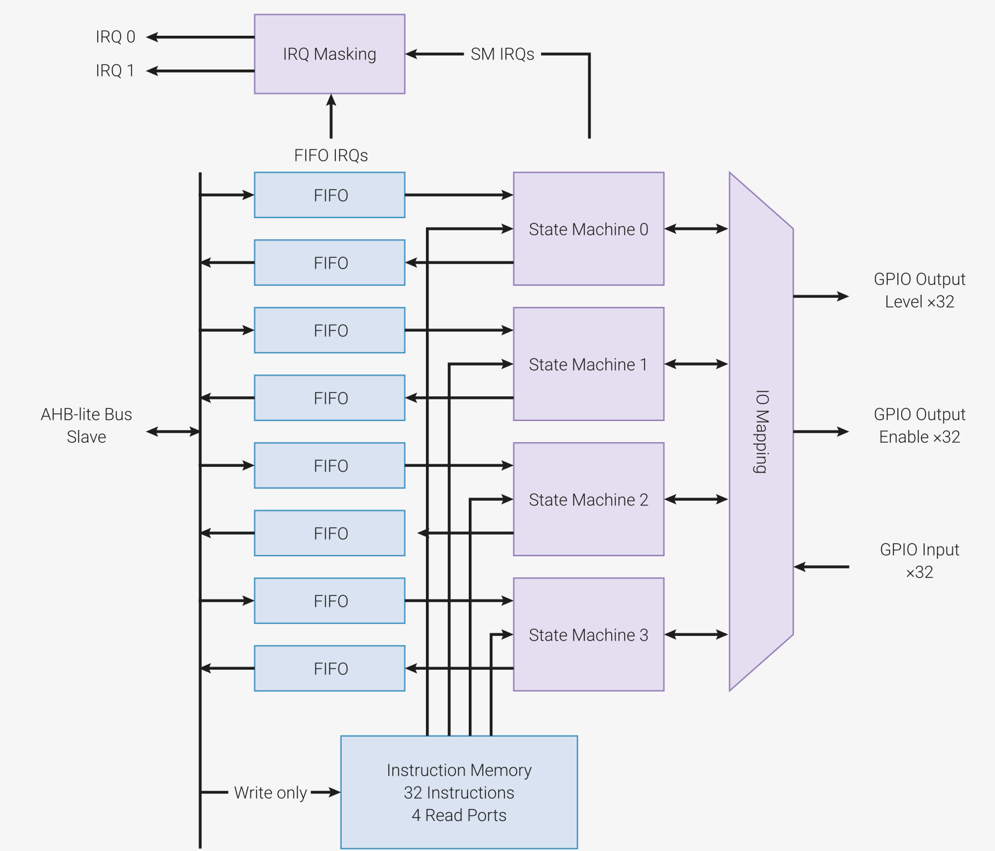
PIO Blockdiagram
Source: RP2040 Datasheet

Slide 10
Tightly packed PIO Assembler
For example one instruction can:
Read all pins at once
Sideset (output) pins
Delay a few cycles
Autopush to the FIFO
Wrap back to the beginning of instruction loop
in pins 8 side 1 [3]

Slide 11
But PIO is bad at
Compare operations
Conditional jumps
  Only one pin can act as jump
Mathematical operations

Slide 12
Game Boy

Slide 13
Game Boy Overview
EU Release: September 1990
Sharp LR35902 core @ 4.19 MHz
  Similar to Zilog Z80 and Intel 8080
Work RAM: 8KiB
Video RAM: 8KiB
Screen Resolution: 160x144

Slide 14
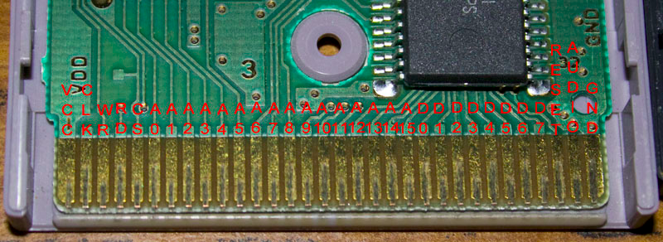
Game Boy Cartridge interface
Parallel bus with 16 address lines and 8 data lines @~1Mhz
Source: https://www.insidegadgets.com/2016/12/06/gbxcartread-part-1-design-and-testing-gameboy-carts/

Slide 15
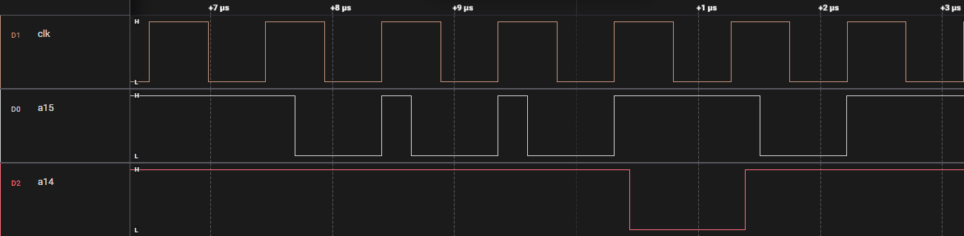
External memory interface
A15 and CS are special pins
CLK is not the CPU clock but a slower fetch clock @~1Mhz

Slide 16
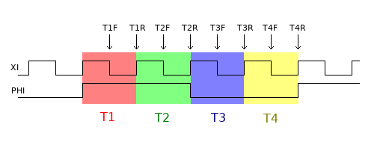
Bus timings
T1F:
  Only when CPU accesses External Bus, Internal Bus or Internal Video Bus:
    A0-A14 change to new address
  Only when CPU writes to External Bus:
    #read goes high
T1R:
  Only when CPU accesses External Bus:
    #cs or A15 goes low
Source: http://iceboy.a-singer.de/doc/mem_patterns.html

Slide 17
Bus timings
T2F:
  No changes
T2R:
  Only when CPU writes to External Bus:
    #write goes low
    D0-D7 get driven with the actual data
Source: http://iceboy.a-singer.de/doc/mem_patterns.html

Slide 18
Bus timings
T3F:
  No changes
T3R:
  D0-D7 get sampled during read
Source: http://iceboy.a-singer.de/doc/mem_patterns.html

Slide 19
Bus timings
T4F:
  Only when CPU writes to External Bus:
    #write goes high
T4R:
  Only when CPU accesses External Bus:
    #cs or A15 goes high
  Only when CPU writes to External Bus:
    D0-D7 stop being driven (pull-up resistors take over)
    #read goes low
Source: http://iceboy.a-singer.de/doc/mem_patterns.html

Slide 20
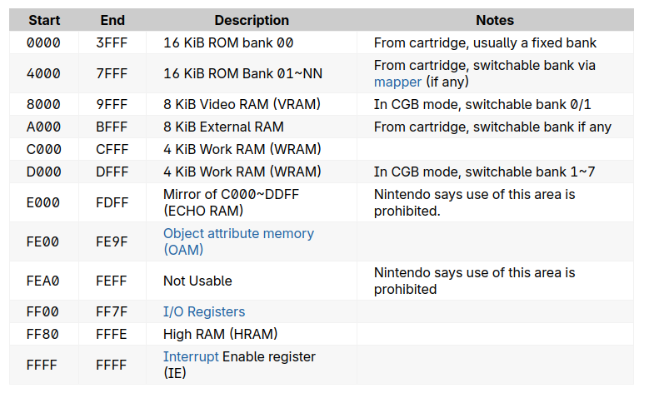
Gameboy Memory Map
Source: Pan Docs

Slide 21
Designing the hardware

Slide 22
Bus Translators
RP2040 runs at 3,3V
But Gameboy at 5 V
Texas Instrument TXB0108
  Bi-directional bus translator
  Auto direction
  15 kV ESD protection

Slide 23
RGB LED
WS2812b (Neopixel)
1-wire control of color & brightness

Slide 24
Design goals
As less components as possible
→ Mostly software defined

Slide 25

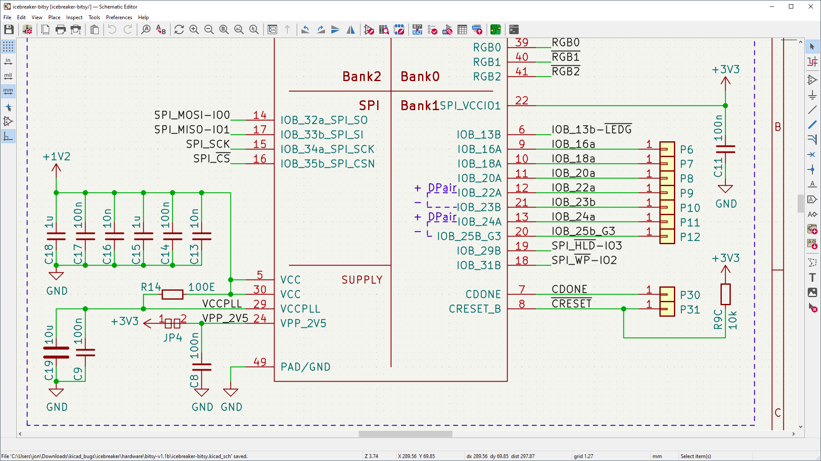
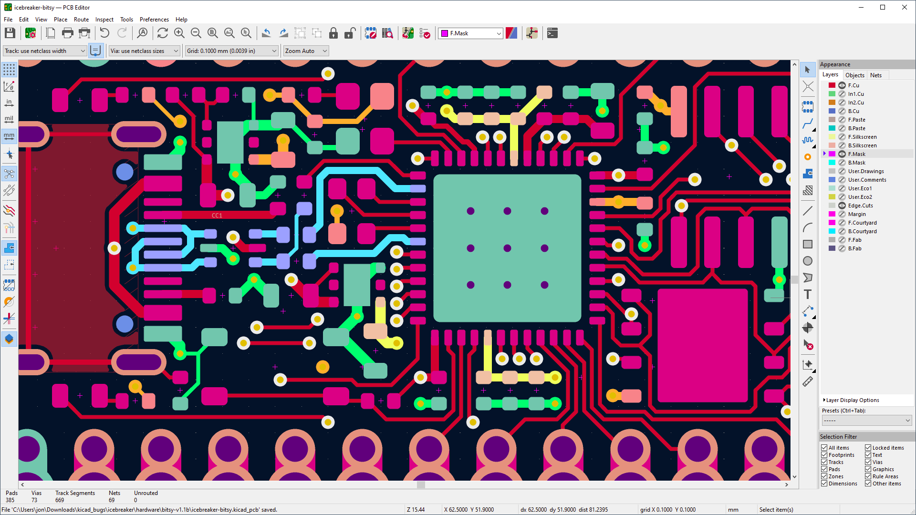
Design Tool
7
Open Source www.kicad.org

Slide 26
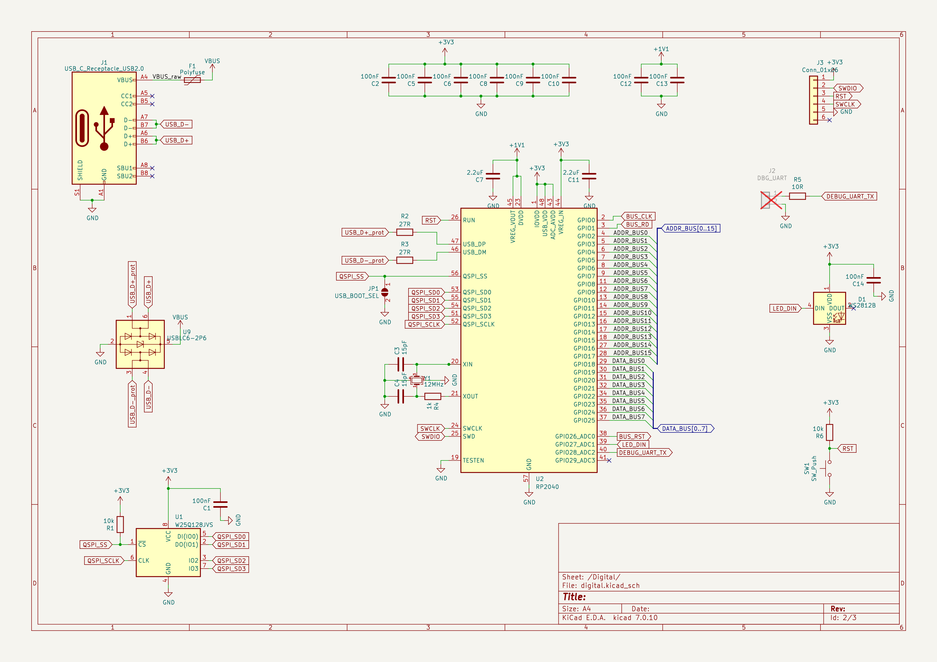
Schematic 1/2

Slide 27
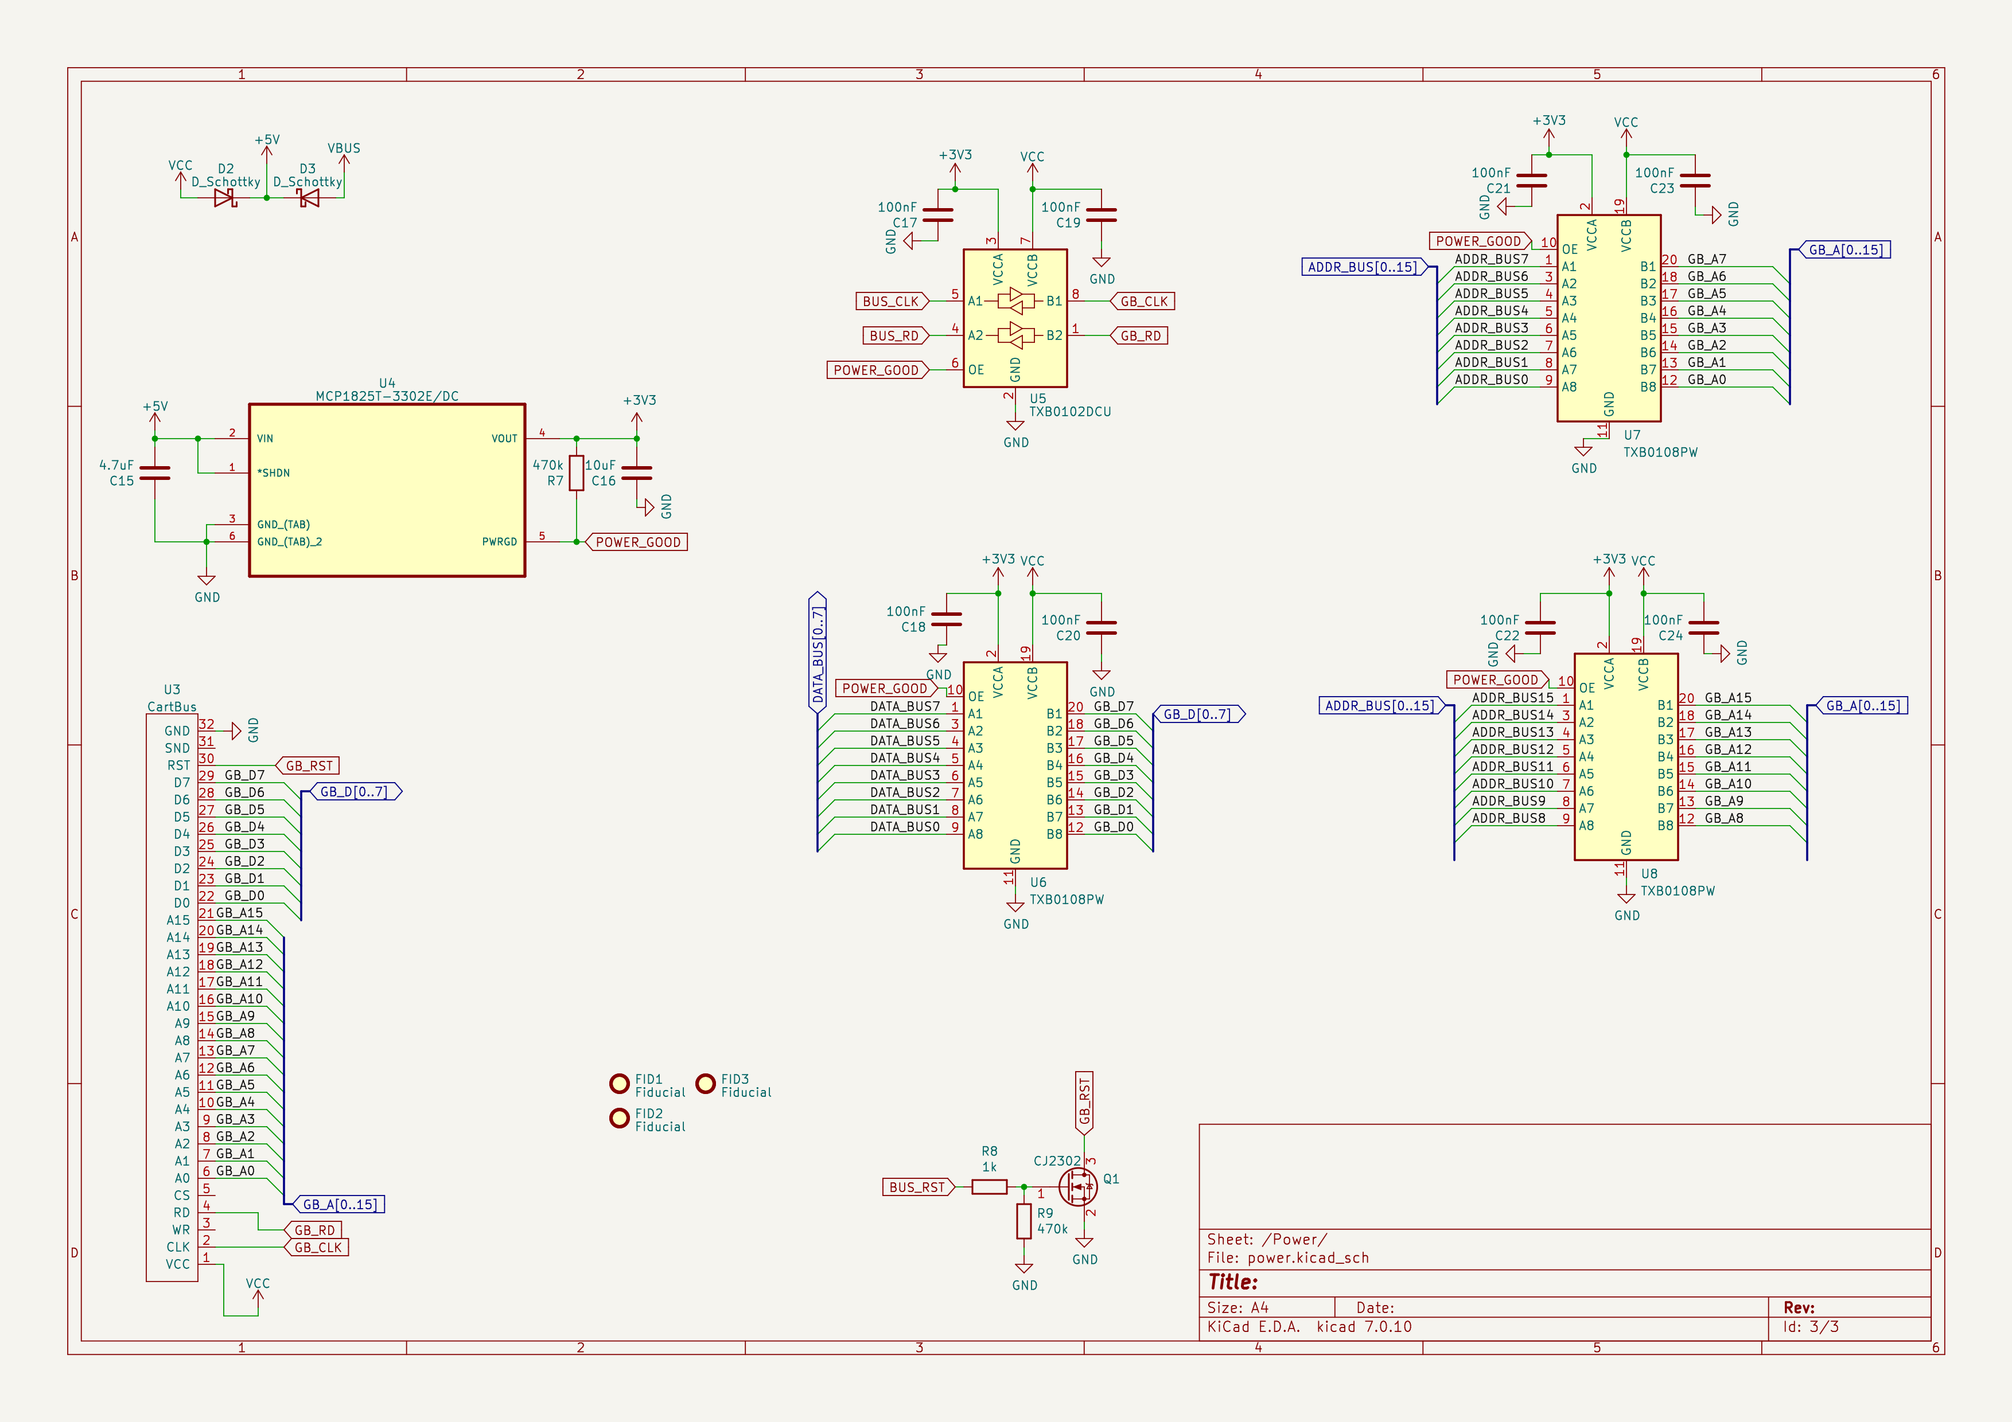
Schematic 2/2

Slide 28
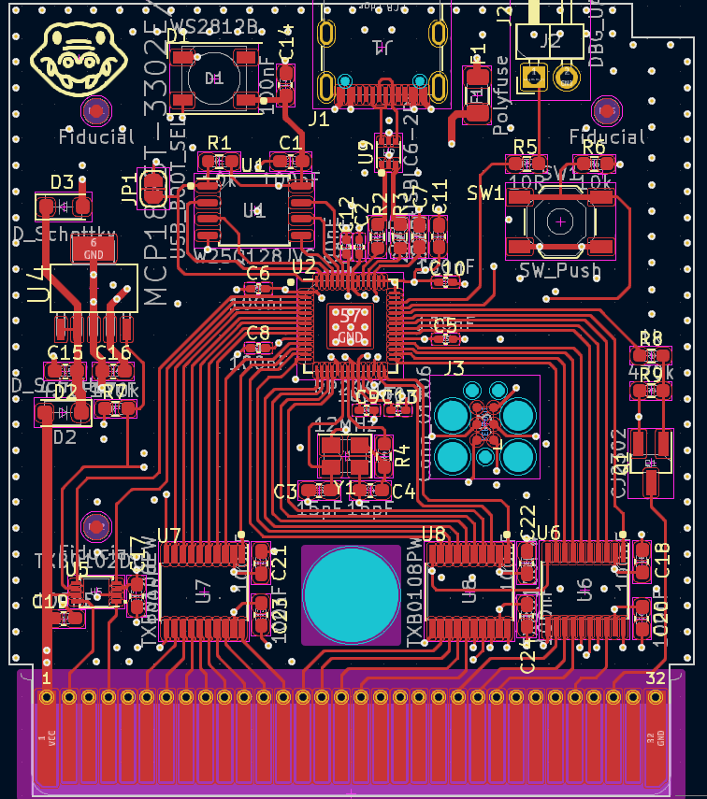
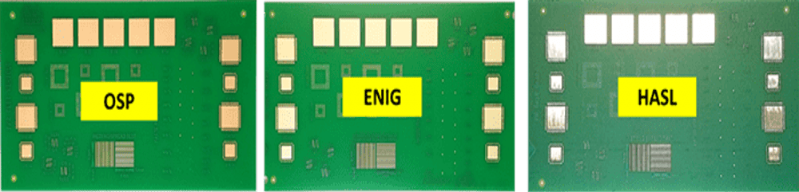
After Routing
4 layer PCB
  Reduces EMC and cross-talk between the signal lines as the distance from signal to power planes is shorter
  Is not that much more expensive than 2 layer
    18$ vs 23$ for 10 PCBs
    Expensive part is the ENIG plating and shipping
0.8 mm thick
Inner layers
  GND
  Power supply and signal
ENIG (Eloctroless nickel immersion gold) as surface finish to make the edge connector longer lasting
Source: https://hillmancurtis.com/10-differences-between-hasl-and-enig-plating-methods-a-concise-comparison/

Slide 29
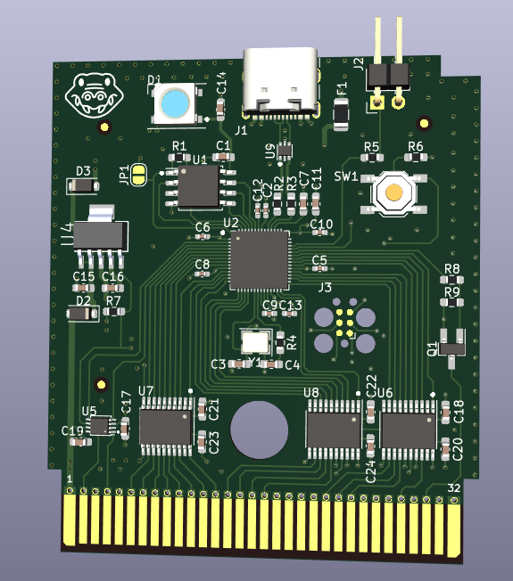
3D View

Slide 30
Ordering the PCB

Slide 31
PCB ordering
Several online manufacturers available
Examples:
  PCBWay (China)
  JLCPCB (China)
  Eurocircuits (Hungary and Germany)
  Aisler (Netherlands)

Slide 32
PCB assembly
Solder yourself
  Soldering iron
  Get Stencil with PCB and reflow
Order assembled
  Let the PCB manufacturer do the assembly
  Tip to save money:
    Only SMD parts
    Only one side

Slide 33
Manual assembly

Slide 34
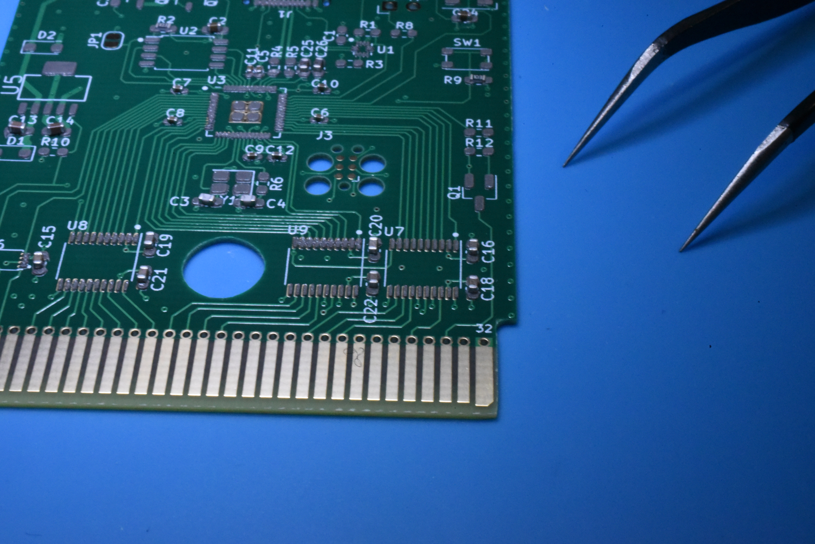
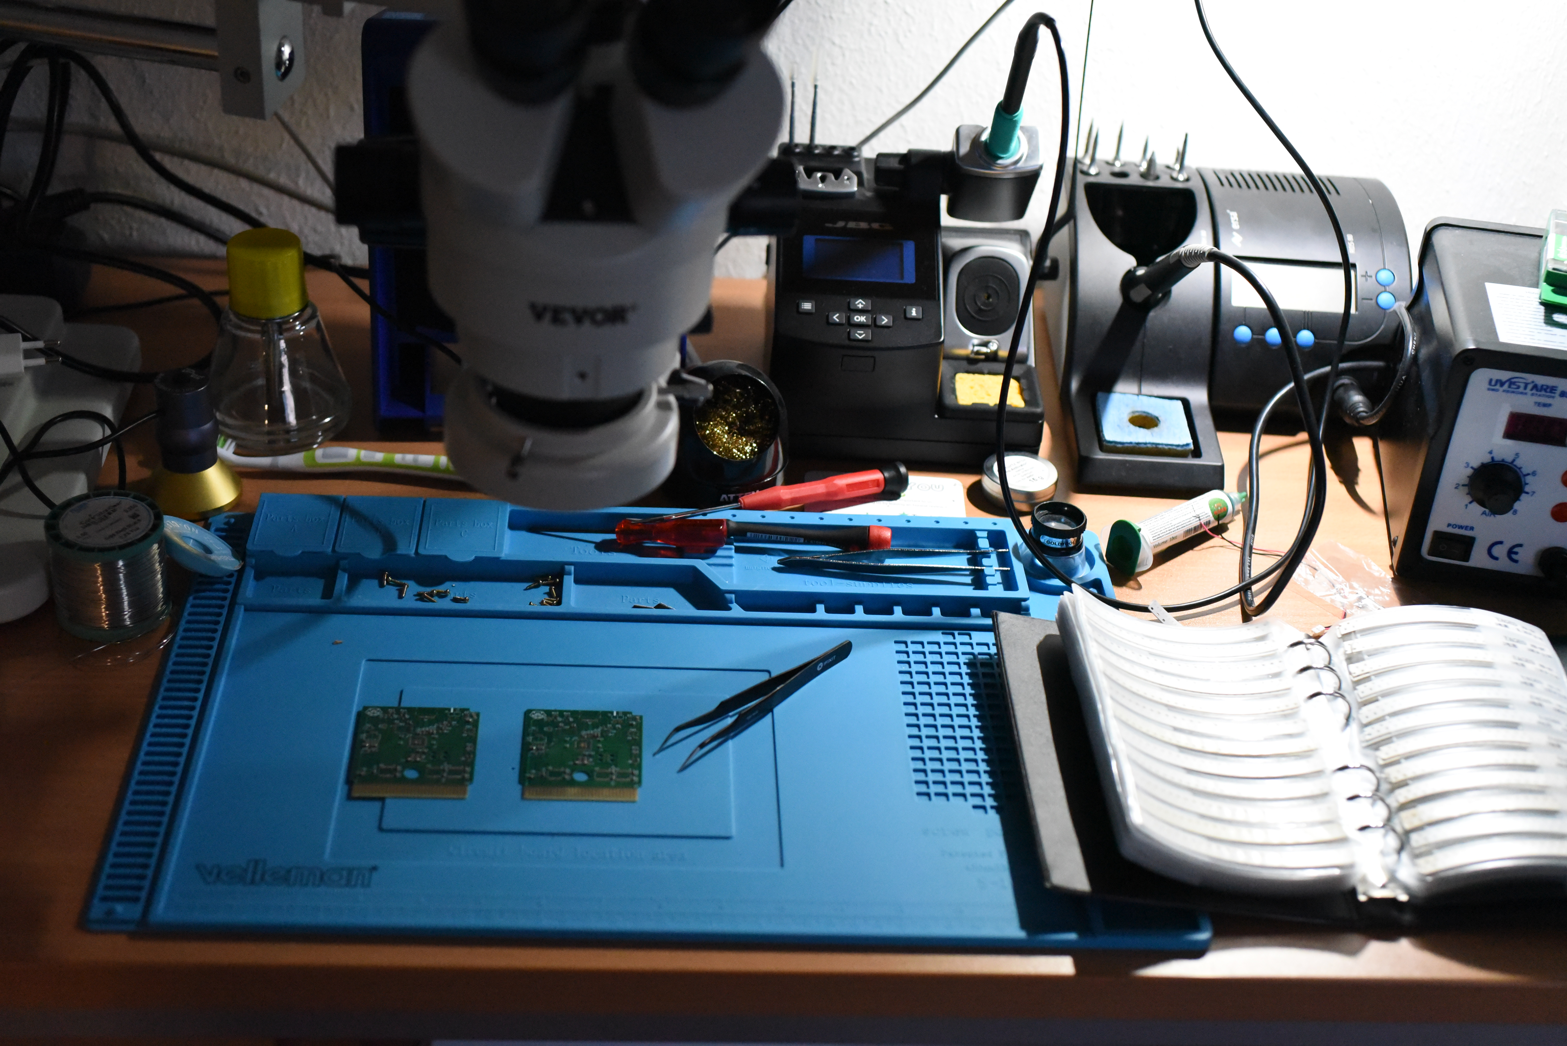
PCB assembly
Place solder paste with stencil
Place components with tweezers
  Microscope recommended

Slide 35
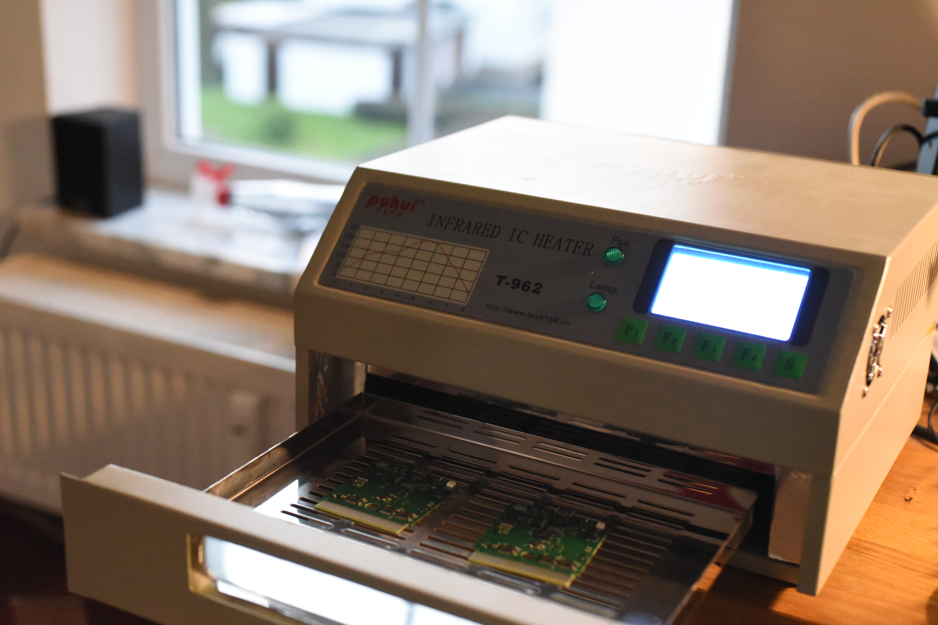
Bake it
Reflow
  IR oven
  Iron (for clothes)
  Pan
  Hot plates
  Pizza oven

Slide 36
Software

Slide 37
Software problems
Timing is tight
--→ Fast / less instructions as possible
--→ Use DMA as much as possible
--→ Conditional bus handling must happen on PIO side
    --→ PIO is not really designed for that
Not enough RAM to buffer full ROM in most cases
--→ Must be loaded from flash in time

Slide 38
PIO
Generally the following Statemachines are needed:
  reading lower ROM
  reading higher (bank-switched) ROM
  reading Savegame RAM
  writing Savegame RAM
  Writing data back to the bus
  “Master” statemachine to follow bus for bank switching
  (Statemachine to control RGB LED)

Slide 39
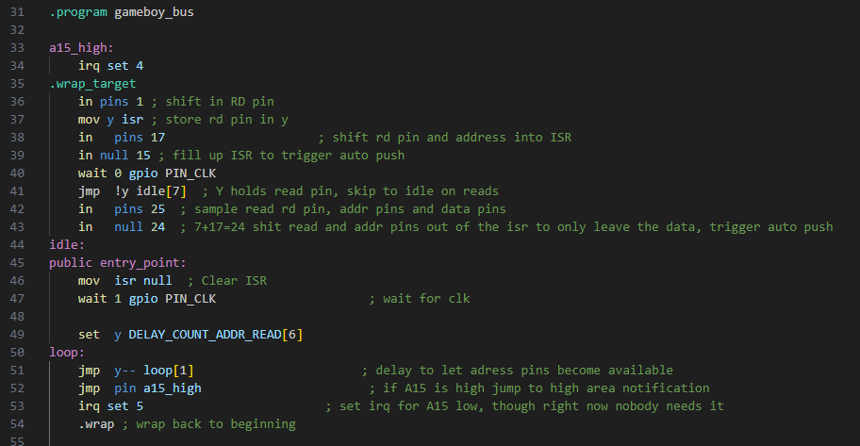
Master State Machine

Slide 40
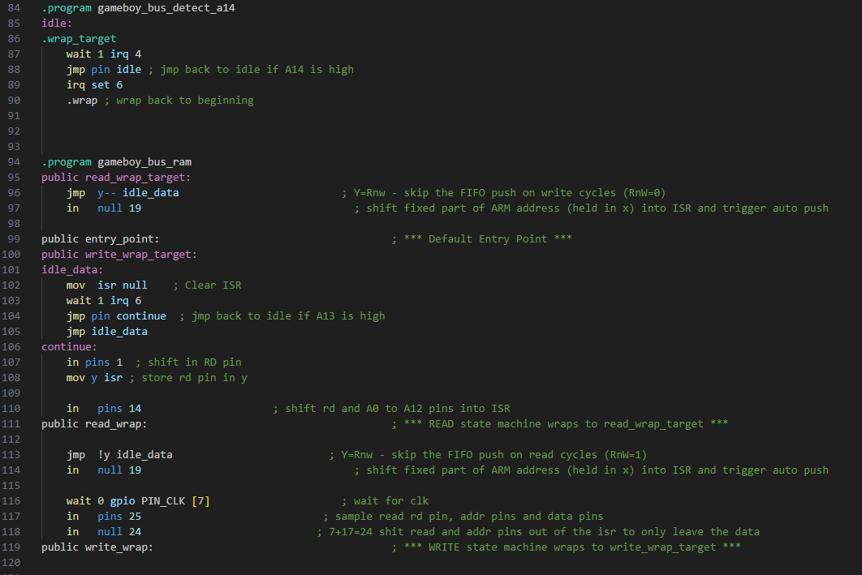
State Machines for savegame RAM

Slide 41
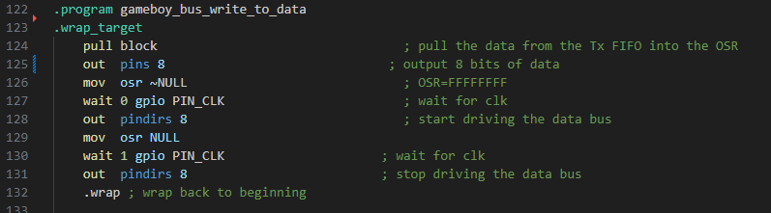
State Machine to push data to the GB

Slide 42
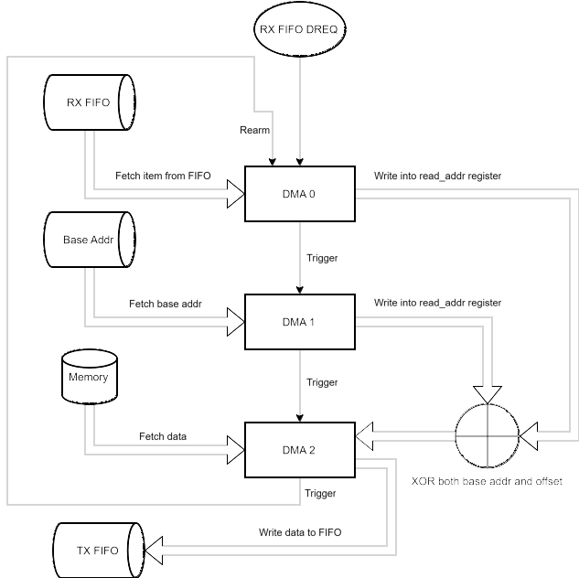
DMA loop for reading memory
Base addr points to either:
- address in RAM
- address in flash (XIP)
The CPU has shadow registers for peripherals which allows XOR operations

Slide 43
Game Boy bootloader
Small Game Boy “Game” which shows the list of games
  Communication with RP2040 through shared memory (savegame RAM)
Written in C with the toolchain from GBDK-2020

Slide 44
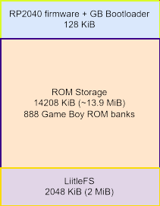
Flash layout
16 MiB total
Each bank in ROM storage is aligned
LittleFs holds savegames, config files, and ROM info

Slide 45
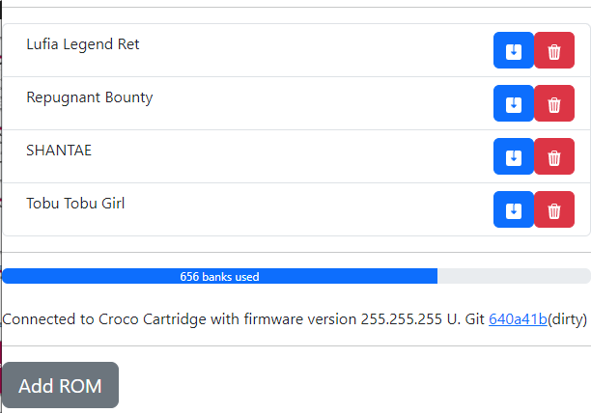
Management Software
Uses WebUSB for connection
  Chrome based browsers (also on Android)
Written in React JS

Slide 46
Debugging

Slide 47
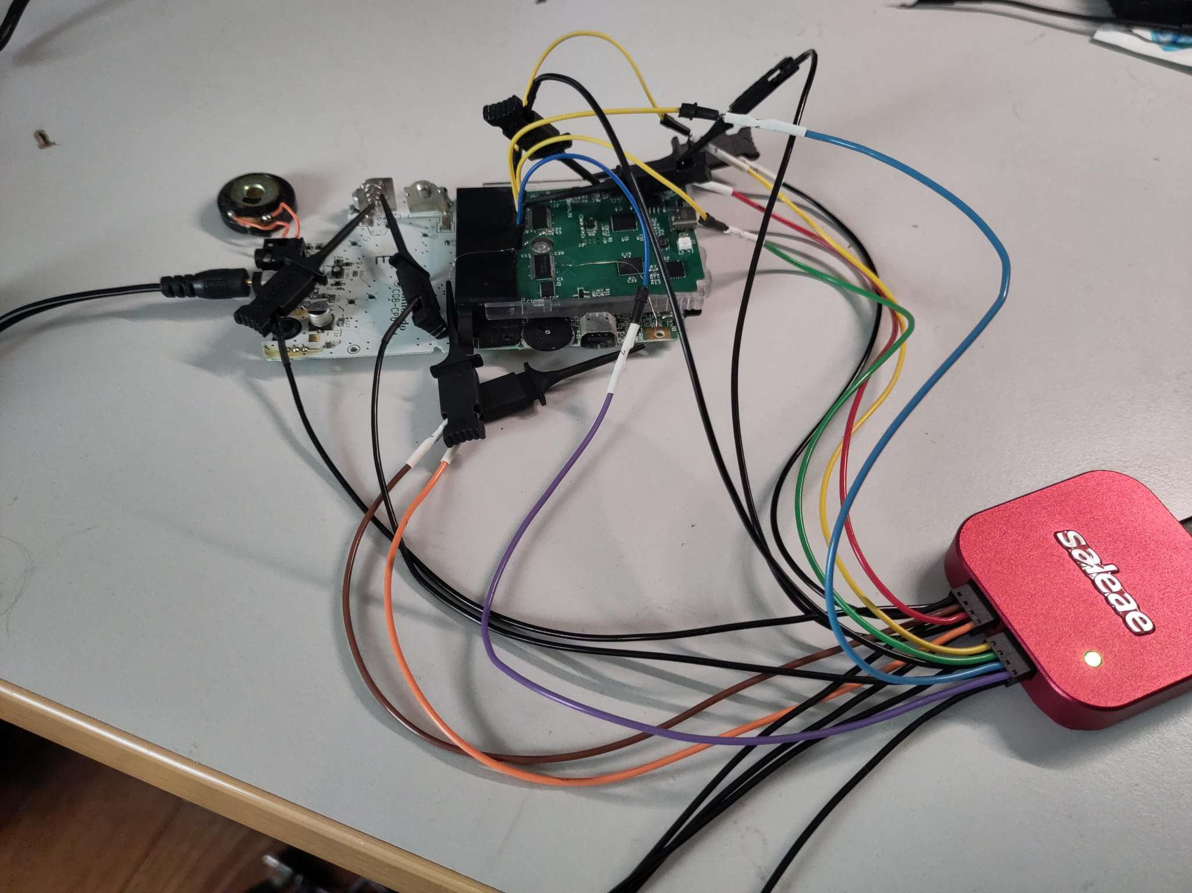
Debugging

Slide 48
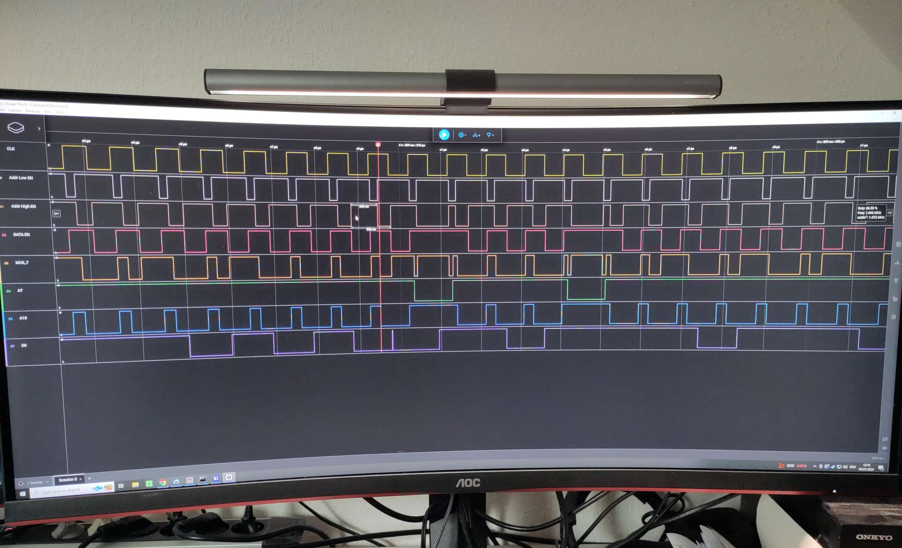
Debugging

Slide 49
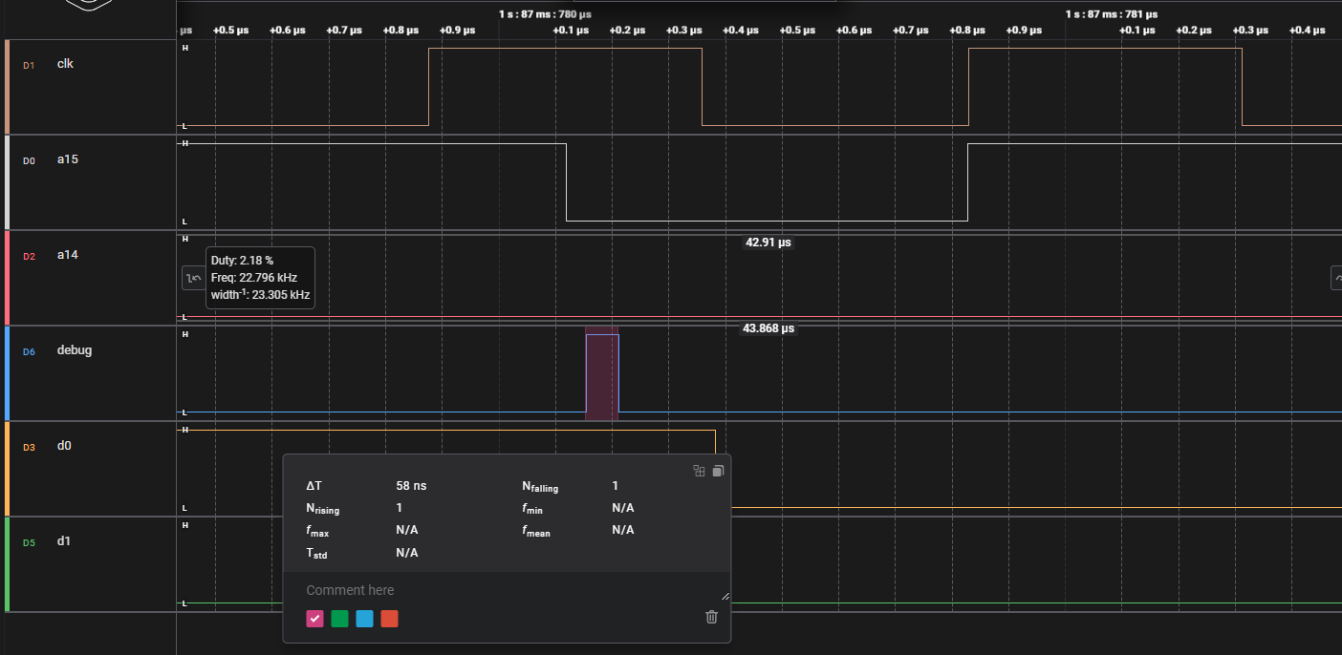
Data fetch from RAM

Slide 50
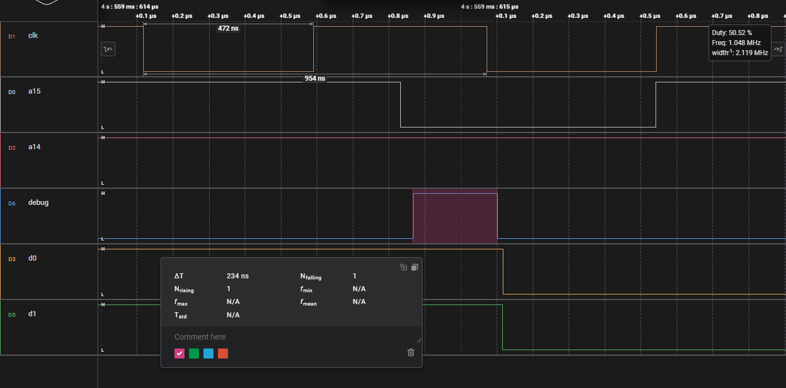
Data fetch from flash

Slide 51
Sources and helpful documents

Slide 52
Sources
Pandocs: https://gbdev.io/pandocs/
(unoffical) Game Boy CPU Manual: D. P.
Game Boy Technical Reference: gekkio.fi
Game-Boy-KiCad-Library: HDR (Martin Refseth)
PIO introduction: Youtube stacksmashing

Slide 53
Thank you!
This presentation is released under the CC BY-SA 4.0 license
See https://creativecommons.org/licenses/by-sa/4.0/ and read about your rights.

