Slide 2
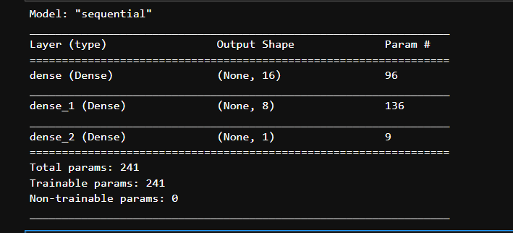
Arrival Time Prediction:
Model structure:
Input:
Output:
X coordinate
Y coordinate
Planning Delaytime
Entry port
Past time
Estimate arrival time(seconds)
Input data setting:
4 entry port(0: 40, 1:9, 2:15, 3:26)
Loss function: MSE

Slide 3
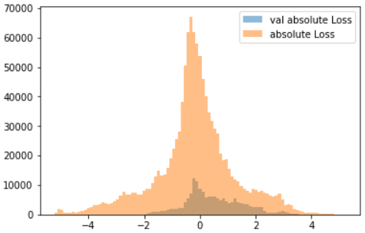
Overall performance evaluation:
We take 3 traj from each entry port for validation. For each traj we add holding time ranging from 0 – 10. Total 30
validation traj generated. Validation ratio: 12/90
We use absulote error as metrics to evaluate the result.
Total points
Training and validation loss distribution
As we could see from the figure shown left. The
distribution over the training set and validation set
Are almost same distribution.
Error/Second(s)

Slide 4
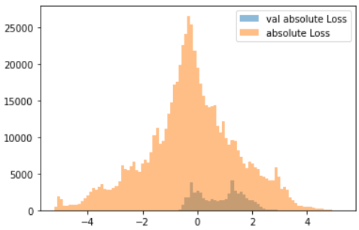
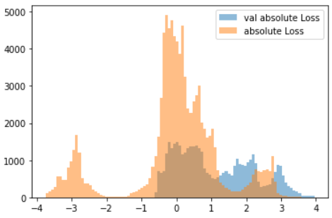
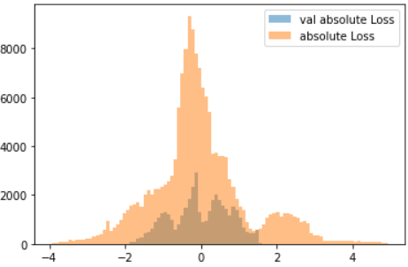
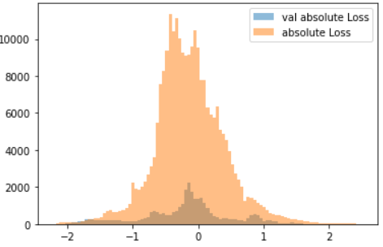
Flight come from Entry 0
Entry 1
Entry 1 is hard
To predict
The error is
relatively large
Entry 2
Entry 3

Slide 5
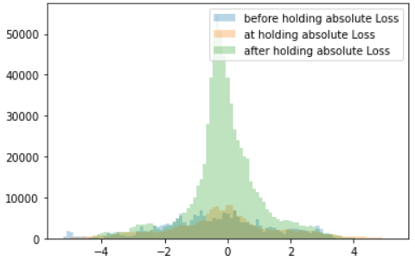
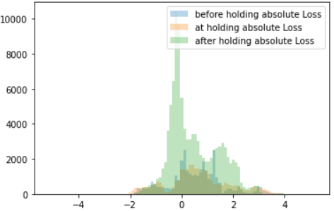
Training set: Before,at,after holding error distribution
Validation set: Before,at,after holding error distribution
At holding and before holding error is lager than after holding
Before holding and At holding processes have same error distribution

Slide 6
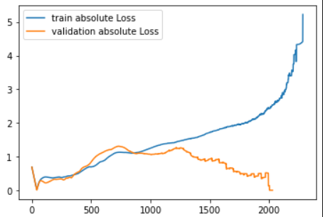
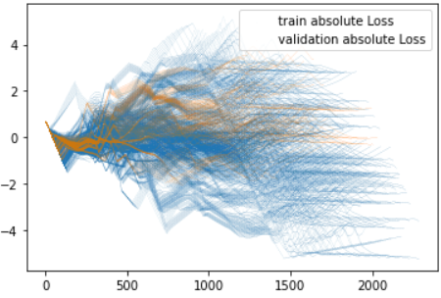
Prediction error
Second(s)
Prediction error
Second(s)
The tail has few sample,
thus not representative
Arrive airport
Frame/Second(s)
Line plot: Mean error across the time frames
Scatter plot: all points error across the time frames
Overall trend is as approaching to the airport, the error decrease. (x-axis value 0 is at airport, value 2000+ is far
away from airport) Overall Error could be bounded into 5 seconds.

Slide 7
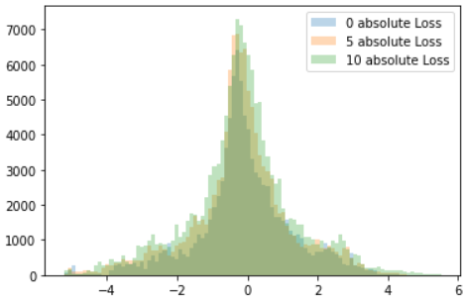
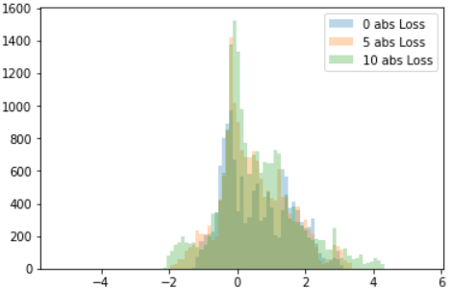
Training set error distribution on basis of [0,5,10] mins holding
Validation set error distribution
These two plot is that we vary the holding time from 0 mins to 5 mins to 10 mins. We could find the error distribution is
Not shifting too much. And the holding mins does not deeply affect the model performance.

